Slide 1



Fundamentally Understanding and Solving RowHammer
Onur Mutlu
omutlu@gmail.com
https://people.inf.ethz.ch/omutlu
29 March 2022
Microsoft Swiss Joint Research Center Kickoff Meeting: Confidential Computing

Slide 2
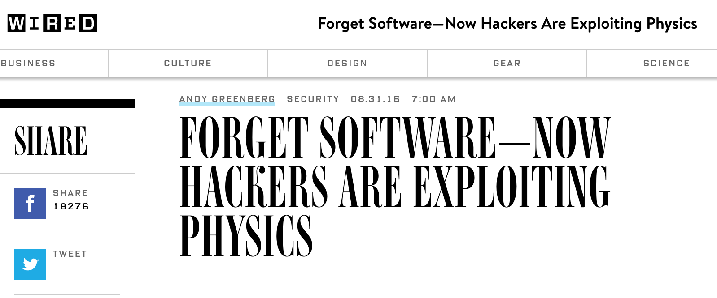
What Is RowHammer?
One can predictably induce bit flips in commodity DRAM chips
  >80% of the tested DRAM chips are vulnerable
First example of how a simple hardware failure mechanism can create a widespread system security vulnerability

Slide 3
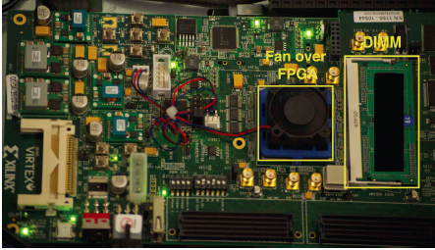
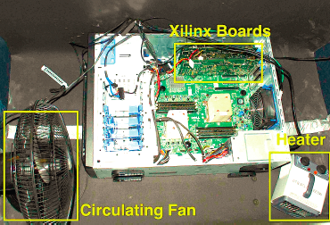
Infrastructures to Understand DRAM Reliability
  An Experimental Study of Data Retention Behavior in Modern DRAM Devices: Implications for Retention Time Profiling Mechanisms (Liu et al., ISCA 2013)
  The Efficacy of Error Mitigation Techniques for DRAM Retention Failures: A Comparative Experimental Study
  (Khan et al., SIGMETRICS 2014)
  Flipping Bits in Memory Without Accessing Them: An Experimental Study of DRAM Disturbance Errors (Kim et al., ISCA 2014)
  Adaptive-Latency DRAM: Optimizing DRAM Timing for the Common-Case (Lee et al., HPCA 2015)
  AVATAR: A Variable-Retention-Time (VRT) Aware Refresh for DRAM Systems (Qureshi et al., DSN 2015)

Slide 4
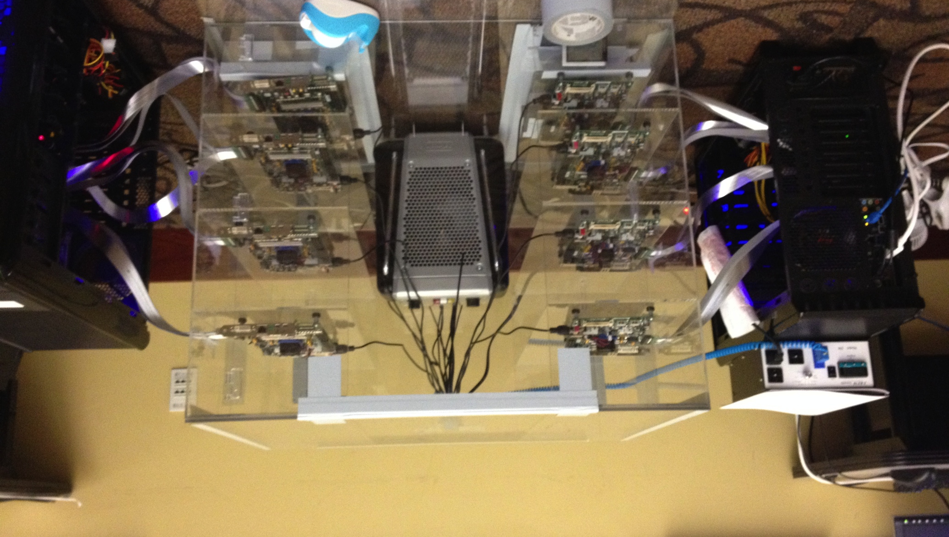
Infrastructures to Understand Such Issues
Temperature
Controller
FPGAs
Heater
FPGAs
PC
  Kim+, “Flipping Bits in Memory Without Accessing Them: An Experimental Study of DRAM Disturbance Errors,” ISCA 2014.

Slide 5
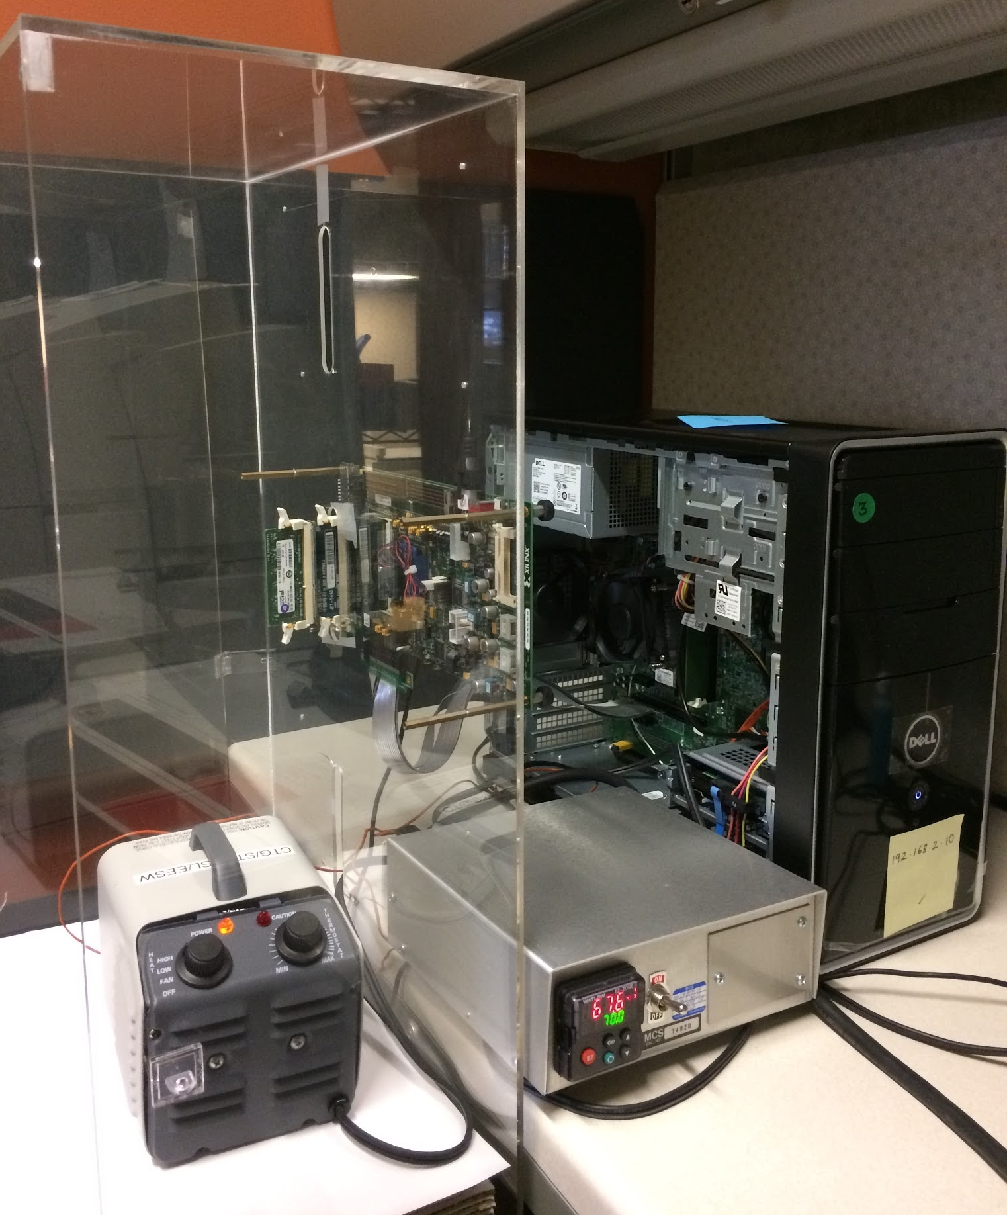
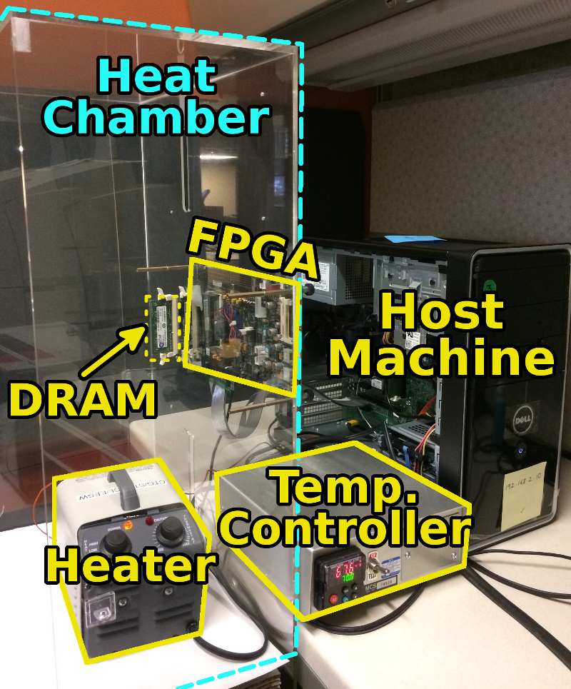
SoftMC: Open Source DRAM Infrastructure
Hasan Hassan et al., “SoftMC: A Flexible and Practical Open-Source Infrastructure for Enabling Experimental DRAM Studies,” HPCA 2017.
Flexible
Easy to Use (C++ API)
Open-source
github.com/CMU-SAFARI/SoftMC

Slide 6
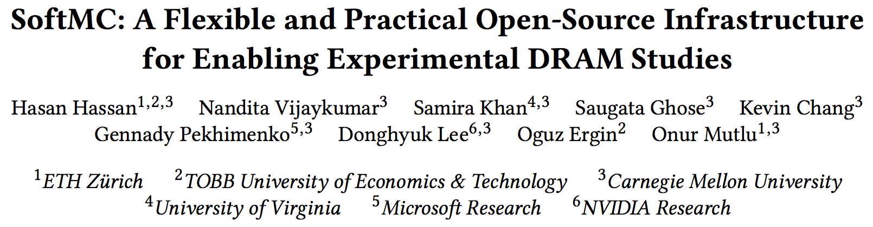
SoftMC: Open Source DRAM Infrastructure
https://github.com/CMU-SAFARI/SoftMC

Slide 7
A Curious Discovery [Kim et al., ISCA 2014]
One can
predictably induce errors
in most DRAM memory chips

Slide 8
DRAM RowHammer
A simple hardware failure mechanism
can create a widespread
system security vulnerability

Slide 9
Modern DRAM is Prone to Disturbance Errors
Row of Cells
Wordline
Row
Victim Row
Row
Hammered Row
V_{LOW}
Opened
V_{HIGH}
Closed
Row
Victim Row
Row
Repeatedly reading a row enough times (before memory gets refreshed) induces disturbance errors in adjacent rows in most real DRAM chips you can buy today
Flipping Bits in Memory Without Accessing Them: An Experimental Study of DRAM Disturbance Errors, (Kim et al., ISCA 2014)

Slide 10
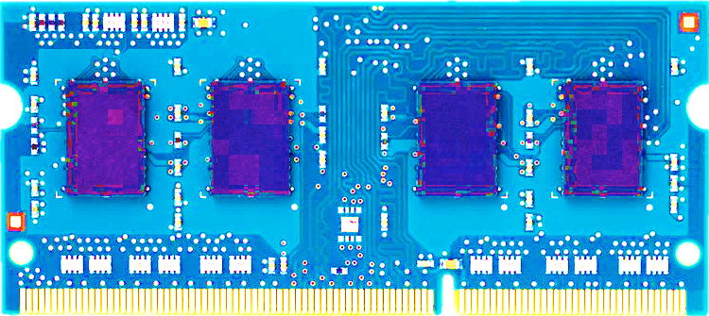
Most DRAM Modules Are Vulnerable
A company
B company
C company
86%
(37/43)
83%
(45/54)
88%
(28/32)
Up to
1.0×10⁷
errors
Up to
2.7×10⁶
errors
Up to
3.3×10⁵
errors
Flipping Bits in Memory Without Accessing Them: An Experimental Study of DRAM Disturbance Errors, (Kim et al., ISCA 2014)

Slide 11
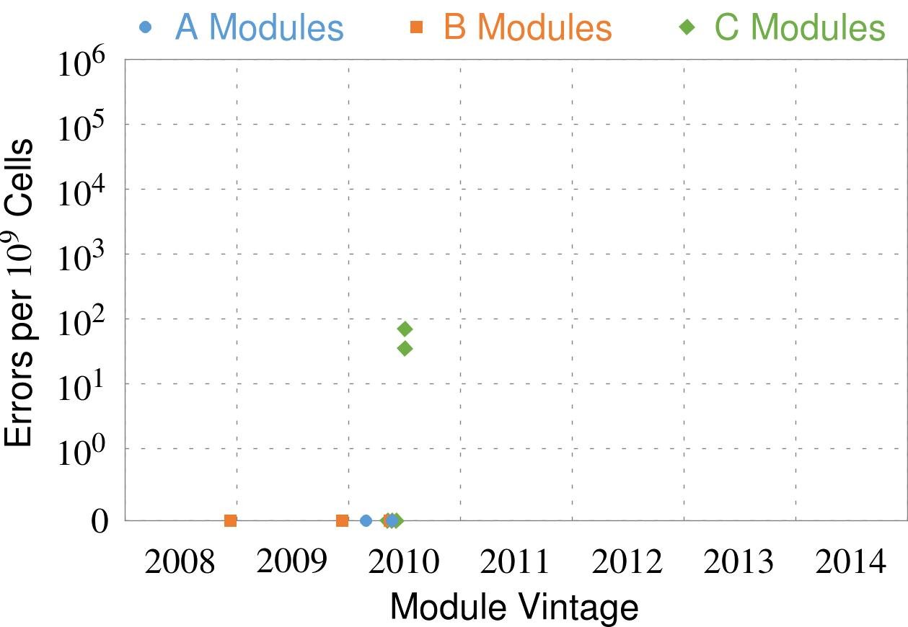
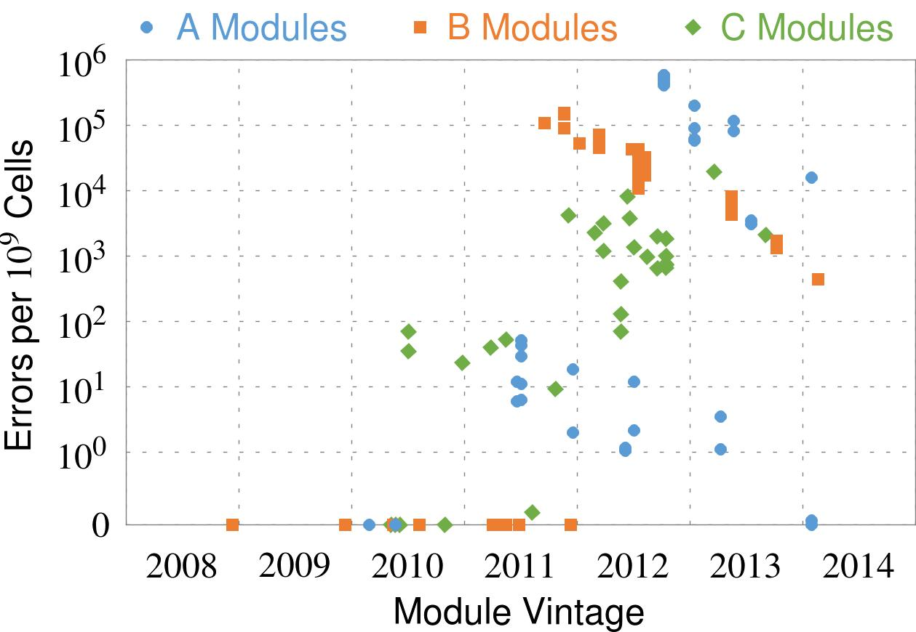
Recent DRAM Is More Vulnerable
Notes:
In this figure, the x-axis is the module manufacture date. And the y-axis is the number of errors in a module, normalized to one billion cells. In 2008 and 2009, there are no errors. But, in 2010, we first start to see errors in C modules. After 2010, the errors start to proliferate. For A and B modules, we first start to see errors in 2011. In particular, all modules from 2012 and 2013 are vulnerable.

Slide 12
Recent DRAM Is More Vulnerable
First
Appearance
Notes:
In this figure, the x-axis is the module manufacture date. And the y-axis is the number of errors in a module, normalized to one billion cells. In 2008 and 2009, there are no errors. But, in 2010, we first start to see errors in C modules. After 2010, the errors start to proliferate. For A and B modules, we first start to see errors in 2011. In particular, all modules from 2012 and 2013 are vulnerable.

Slide 13
Recent DRAM Is More Vulnerable
First
Appearance
All modules from 2012–2013 are vulnerable
Notes:
In this figure, the x-axis is the module manufacture date. And the y-axis is the number of errors in a module, normalized to one billion cells. In 2008 and 2009, there are no errors. But, in 2010, we first start to see errors in C modules. After 2010, the errors start to proliferate. For A and B modules, we first start to see errors in 2011. In particular, all modules from 2012 and 2013 are vulnerable.

Slide 14
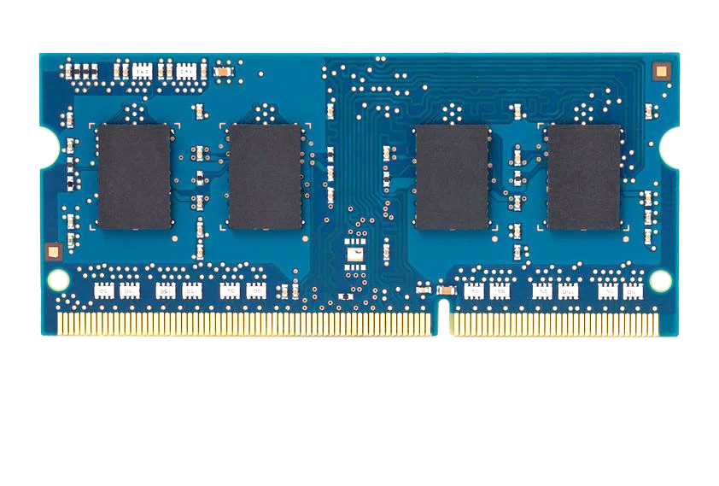
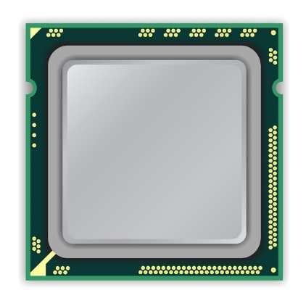
A Simple Program Can Induce Many Errors
CPU
DRAM Module
loop:
mov (X), %eax
mov (Y), %ebx
clflush (X)
clflush (Y)
mfence
jmp loop
X
Y
  Download from: https://github.com/CMU-SAFARI/rowhammer
Notes:
We demonstrate the errors on multiple x86 systems. Shown to the bottom-left is a “disturbance kernel”. When executed, it forces two rows to be opened and closed one after the other – over and over again. Consequently, it induces many errors in the module.

Slide 15
Observed Errors in Real Systems
A real reliability & security issue
CPU Architecture | Errors | Access-Rate
Intel Haswell (2013) | 22.9K | 12.3M/sec
Intel Ivy Bridge (2012) | 20.7K | 11.7M/sec
Intel Sandy Bridge (2011) | 16.1K | 11.6M/sec
AMD Piledriver (2012) | 59 | 6.1M/sec
Kim+, “Flipping Bits in Memory Without Accessing Them: An Experimental Study of DRAM Disturbance Errors,” ISCA 2014.
Notes:
When we executed the code on four different processors, all four of them yielded errors. Intel Haswell has the most errors, at 23 thousand, because it has the highest rate of accessing DRAM.
Later on, I’ll show that we can induce as many as ten million disturbance errors in a more controlled environment.
From this, we conclude that disturbance errors are a serious reliability issue.

Slide 16


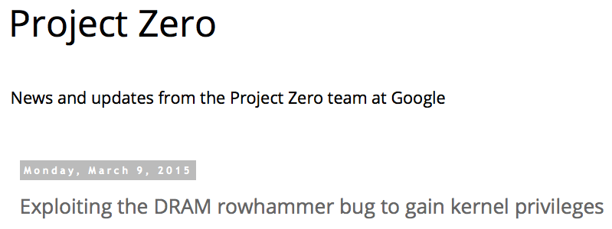
One Can Take Over an Otherwise-Secure System
Flipping Bits in Memory Without Accessing Them: An Experimental Study of DRAM Disturbance Errors (Kim et al., ISCA 2014)
Exploiting the DRAM rowhammer bug to gain kernel privileges (Seaborn, 2015)

Slide 17
RowHammer Security Attack Example
“Rowhammer” is a problem with some recent DRAM devices in which repeatedly accessing a row of memory can cause bit flips in adjacent rows (Kim et al., ISCA 2014).
  Flipping Bits in Memory Without Accessing Them: An Experimental Study of DRAM Disturbance Errors (Kim et al., ISCA 2014)
Tested a selection of laptops and found that a subset of them exhibited the problem.
Built privilege escalation exploits that use this effect.
  Exploiting the DRAM rowhammer bug to gain kernel privileges (Seaborn+, 2015)
When run on a machine vulnerable to the RowHammer problem, the process was able to induce bit flips in page table entries (PTEs).
It was able to use this to gain write access to its own page table, and hence gain read-write access to all of physical memory
Exploiting the DRAM rowhammer bug to gain kernel privileges (Seaborn & Dullien, 2015)

Slide 18
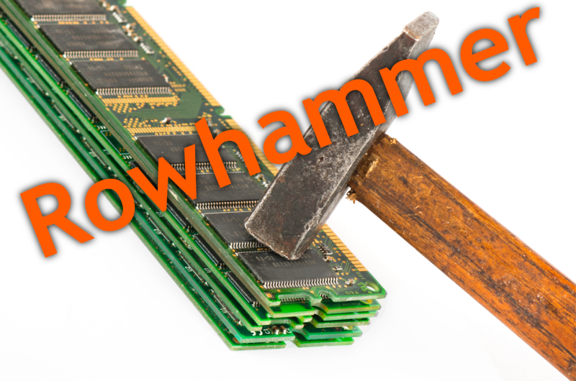
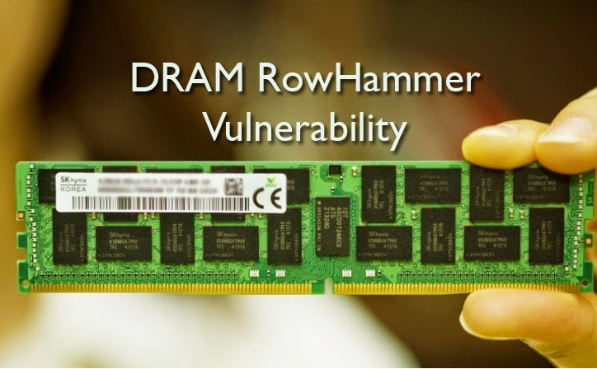
Security Implications
Notes:
Picture from the article:
http://thehackernews.com/2015/03/dram-rowhammer-vulnerability.html

Slide 19
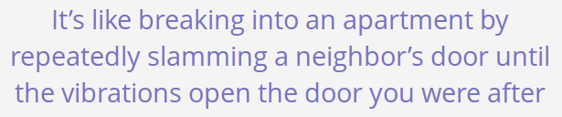
Security Implications
Notes:
Picture from the article:
http://thehackernews.com/2015/03/dram-rowhammer-vulnerability.html

Slide 20
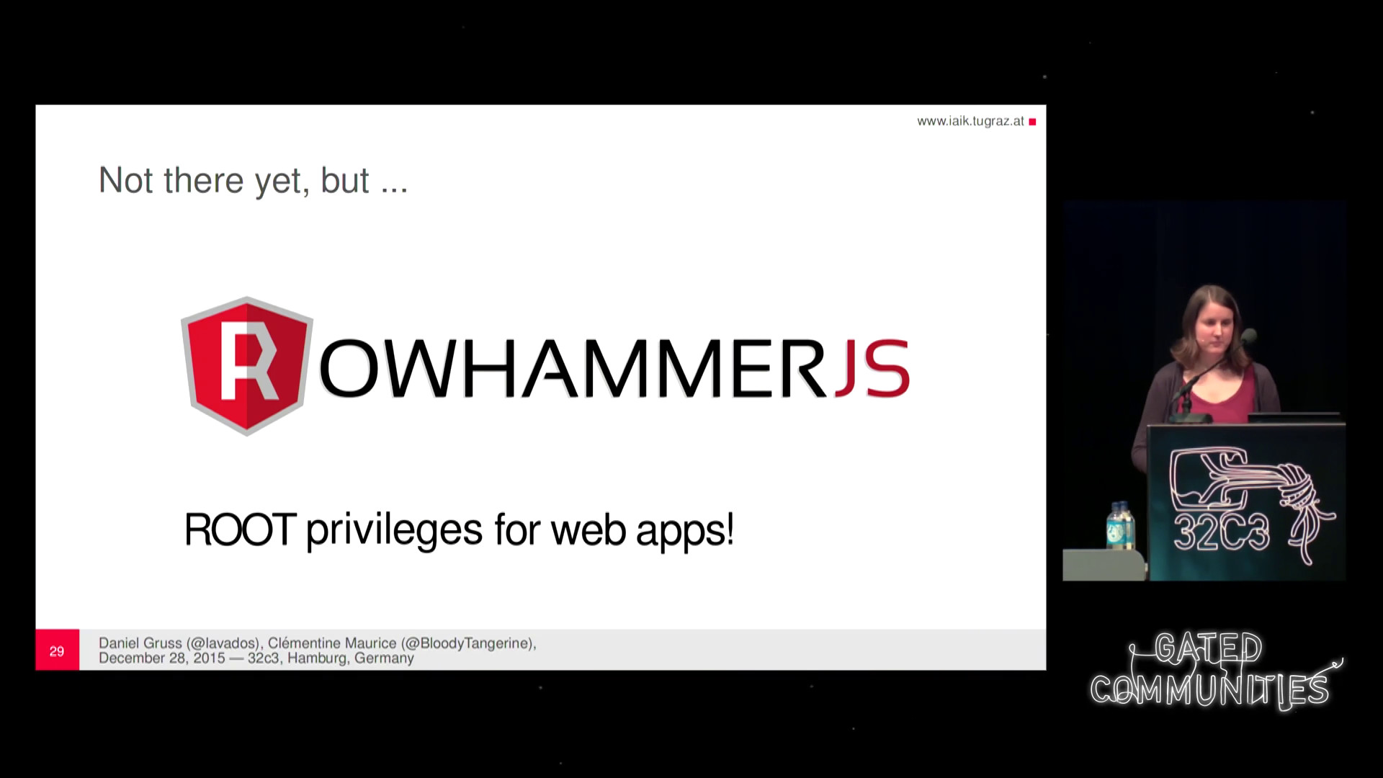
More Security Implications (I)
“We can gain unrestricted access to systems of website visitors.”
Rowhammer.js: A Remote Software-Induced Fault Attack in JavaScript (DIMVA’16)
Source: https://lab.dsst.io/32c3-slides/7197.html

Slide 21

More Security Implications (II)
  “Can gain control of a smart phone deterministically”
Drammer: Deterministic Rowhammer Attacks on Mobile Platforms, CCS’16
Source: https://fossbytes.com/drammer-rowhammer-attack-android-root-devices/

Slide 22
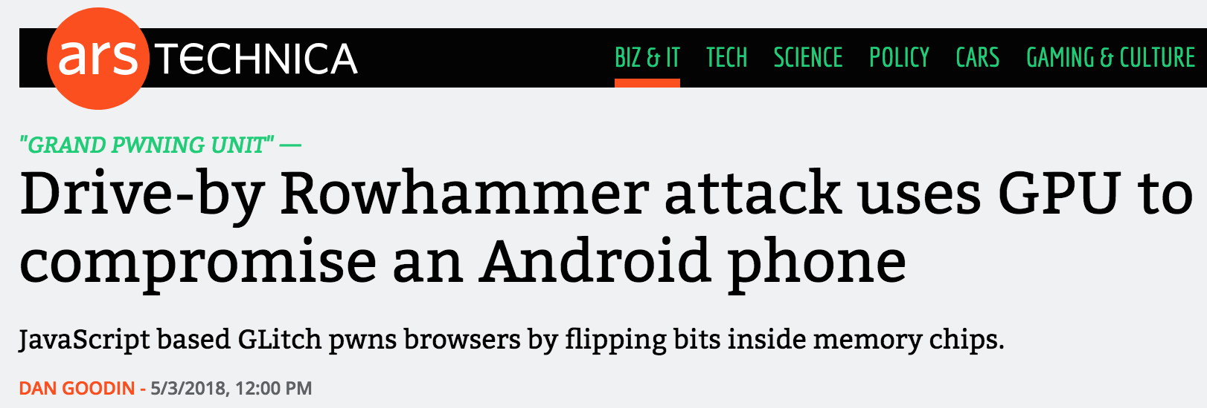

More Security Implications (III)
Using an integrated GPU in a mobile system to remotely escalate privilege via the WebGL interface. IEEE S&P 2018

Slide 23
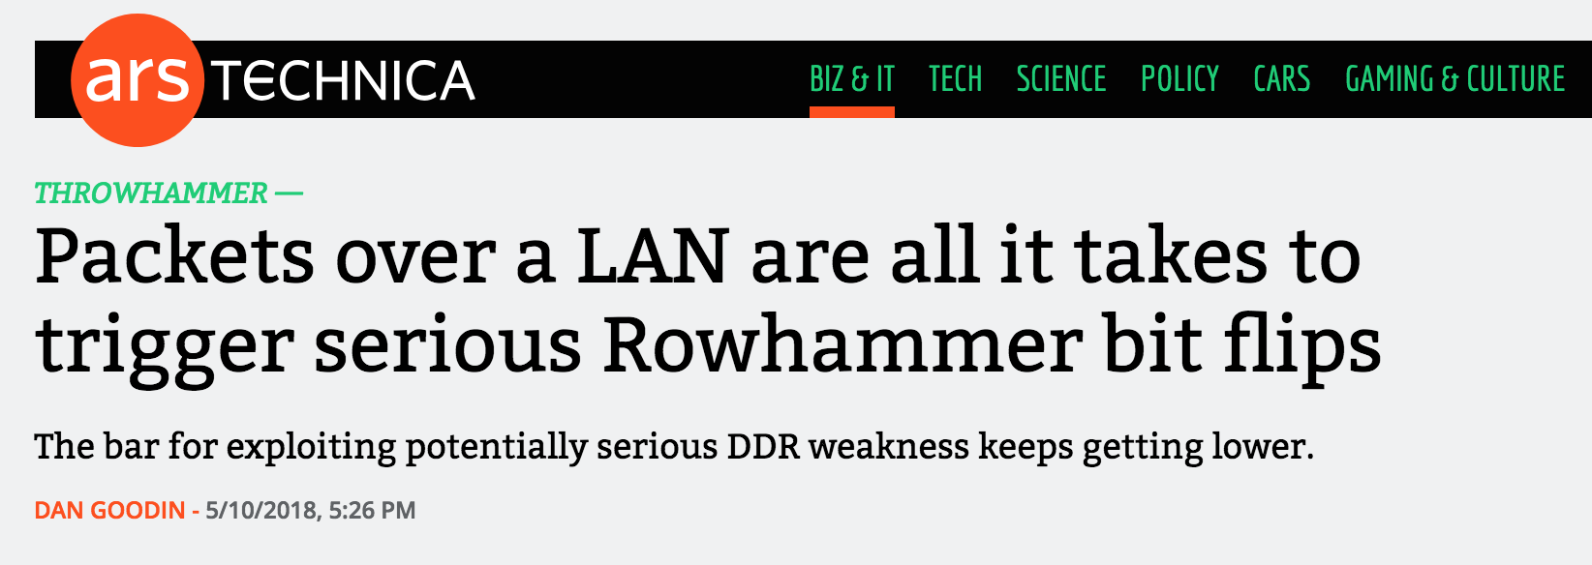
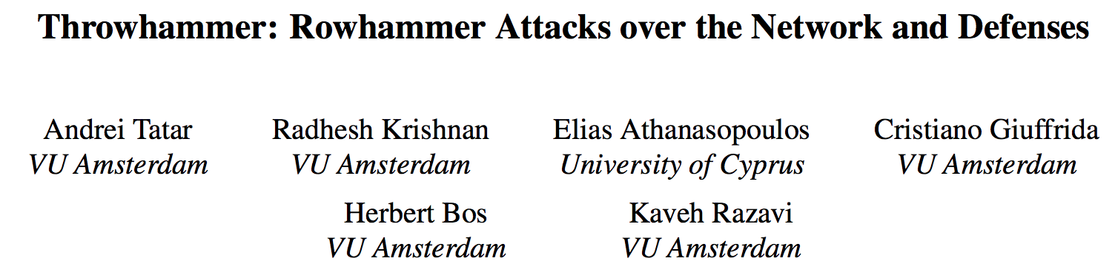
More Security Implications (IV)
Rowhammer over RDMA (I) USENIX ATC 2018

Slide 24
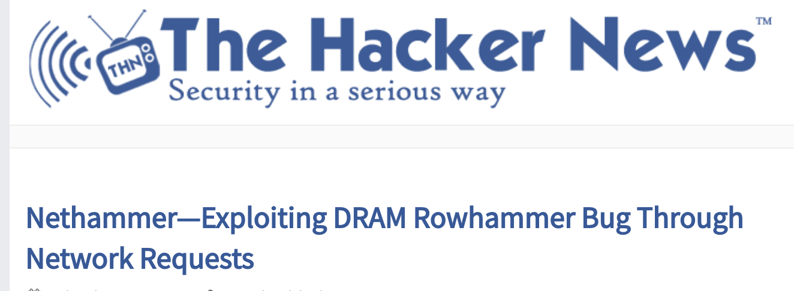

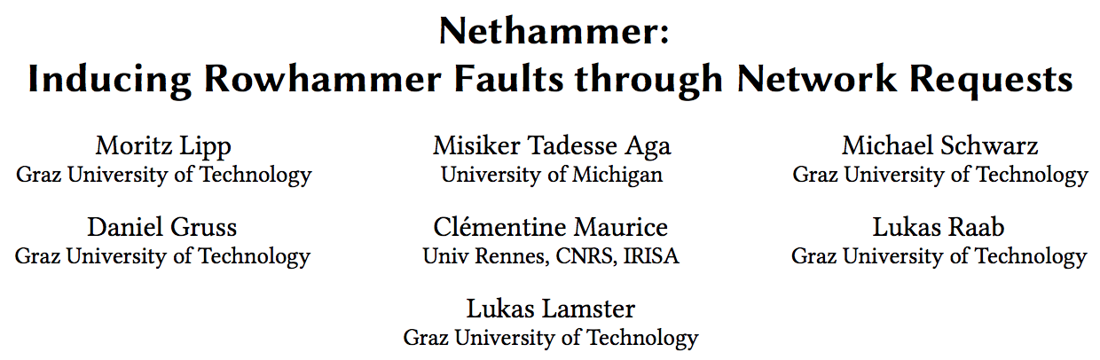
More Security Implications (V)
Rowhammer over RDMA (II)

Slide 25
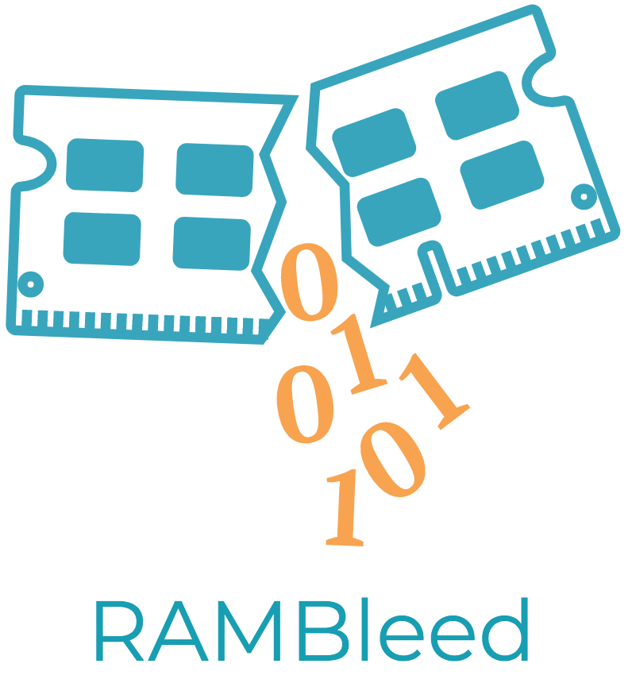
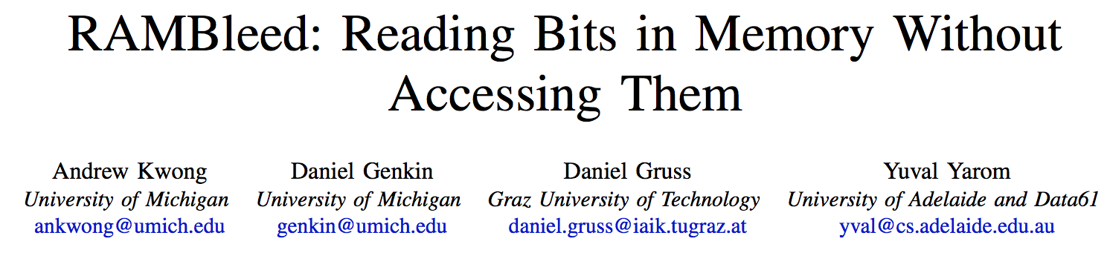
More Security Implications (VI)
IEEE S&P 2020

Slide 26
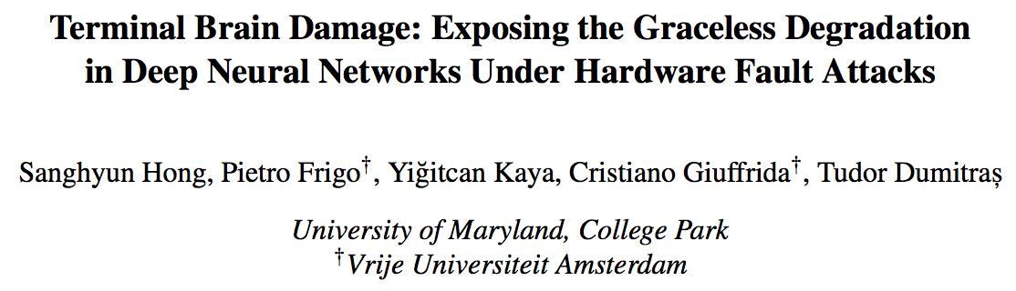
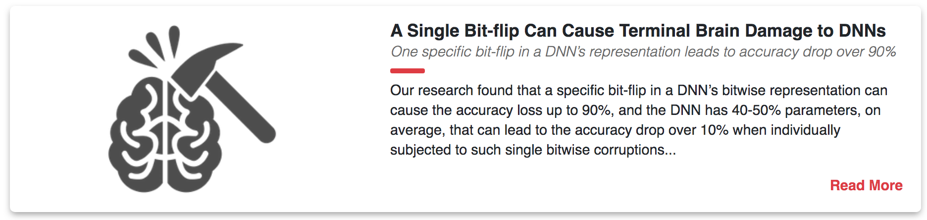
More Security Implications (VII)
USENIX Security 2019

Slide 27
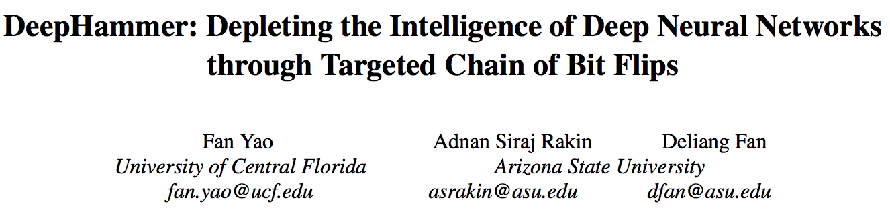
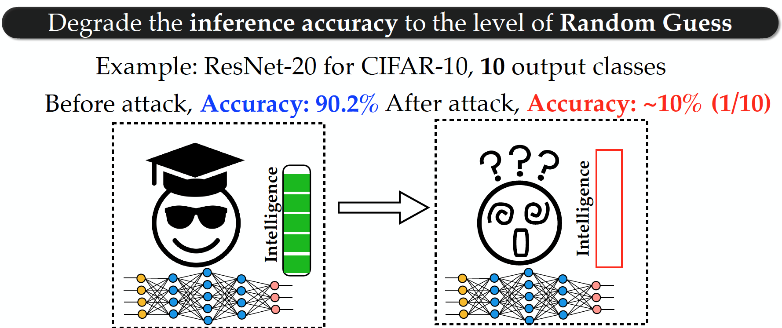
More Security Implications (VIII)
USENIX Security 2020

Slide 28

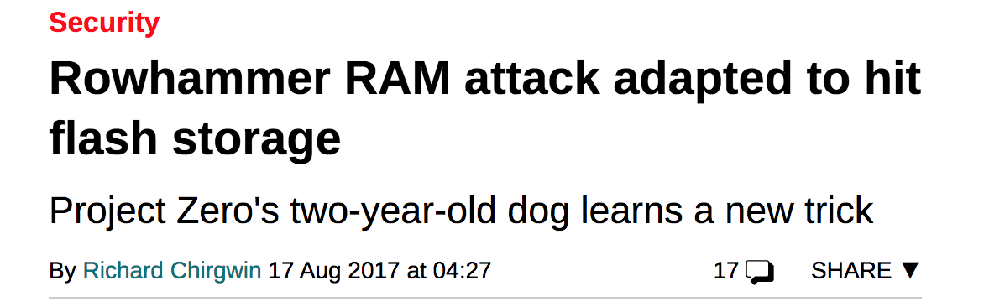
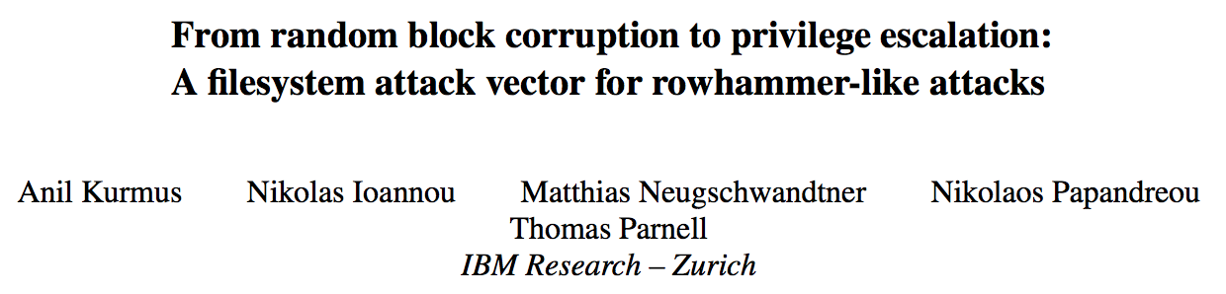
More Security Implications (IX)
Rowhammer on MLC NAND Flash (based on [Cai+, HPCA 2017])

Slide 29
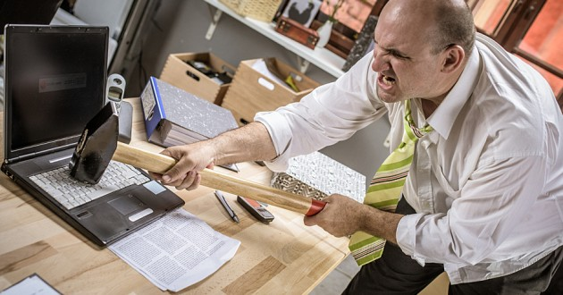
More Security Implications?

Slide 30
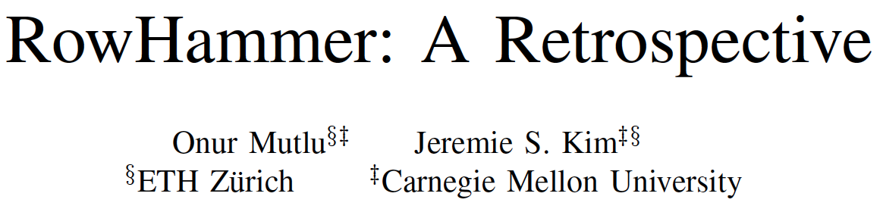
A RowHammer Survey Across the Stack
Onur Mutlu and Jeremie Kim,
"RowHammer: A Retrospective"
IEEE Transactions on Computer-Aided Design of Integrated Circuits and Systems (TCAD) Special Issue on Top Picks in Hardware and Embedded Security, 2019.
[Preliminary arXiv version]
[Slides from COSADE 2019 (pptx)]
[Slides from VLSI-SOC 2020 (pptx) (pdf)]
[Talk Video (1 hr 15 minutes, with Q&A)]

Slide 31
Understanding RowHammer

Slide 32
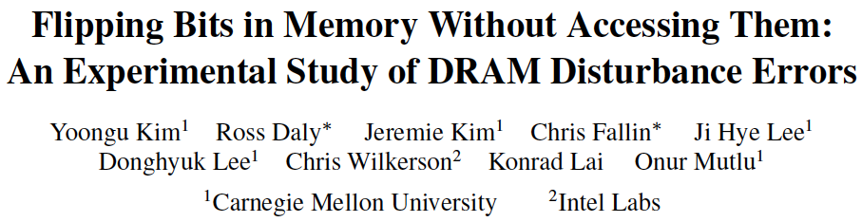
First RowHammer Analysis
Yoongu Kim, Ross Daly, Jeremie Kim, Chris Fallin, Ji Hye Lee, Donghyuk Lee, Chris Wilkerson, Konrad Lai, and Onur Mutlu,
"Flipping Bits in Memory Without Accessing Them: An Experimental Study of DRAM Disturbance Errors"
Proceedings of the 41st International Symposium on Computer Architecture (ISCA), Minneapolis, MN, June 2014.
[Slides (pptx) (pdf)] [Lightning Session Slides (pptx) (pdf)] [Source Code and Data] [Lecture Video (1 hr 49 mins), 25 September 2020]
One of the 7 papers of 2012-2017 selected as Top Picks in Hardware and Embedded Security for IEEE TCAD (link).

Slide 33
RowHammer Infrastructure (2012-2014)
Temperature
Controller
FPGAs
Heater
FPGAs
PC
  Kim+, “Flipping Bits in Memory Without Accessing Them: An Experimental Study of DRAM Disturbance Errors,” ISCA 2014.

Slide 34
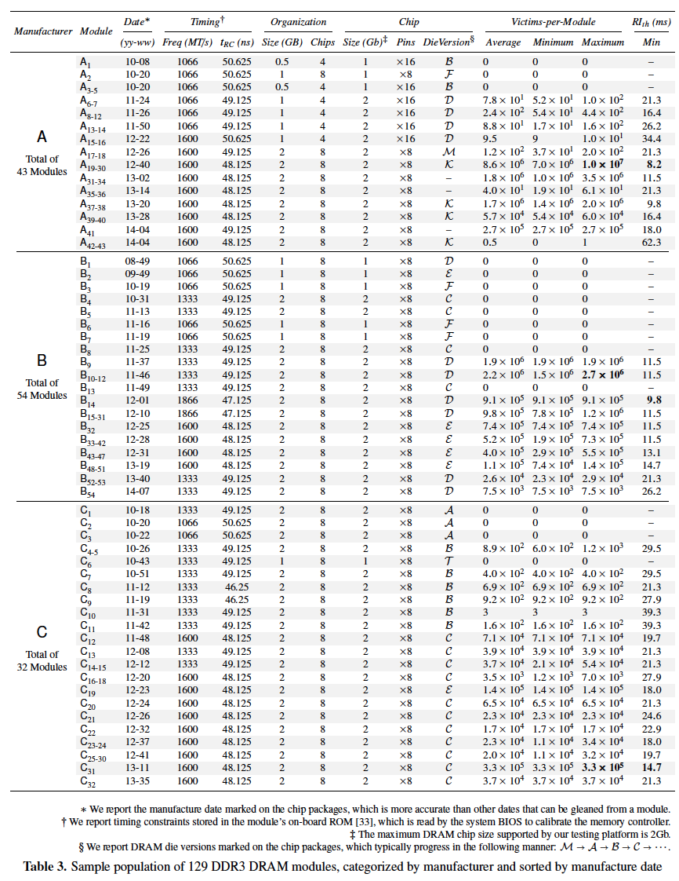
Tested
DRAM
Modules
from
2008-2014
(129 total)

Slide 35
RowHammer Characterization Results
Most Modules Are at Risk
Errors vs. Vintage
Error = Charge Loss
Adjacency: Aggressor & Victim
Sensitivity Studies
Other Results in Paper
Solution Space
Flipping Bits in Memory Without Accessing Them: An Experimental Study of DRAM Disturbance Errors, (Kim et al., ISCA 2014)
Notes:
Now I will present the characterization results, one-by-one.
First, I show that most modules are at risk. Second, I show the number of errors in a module as a function of the manufacture date. Third, I show that the errors are symptomatic of charge loss. Fourth, I show that an aggressor induces errors in adjacent rows. Fifth, I show several sensitivity studies. And, finally, I briefly describe other results in the paper.

Slide 36
Major RowHammer Characteristics (2014)
Yoongu Kim, Ross Daly, Jeremie Kim, Chris Fallin, Ji Hye Lee, Donghyuk Lee, Chris Wilkerson, Konrad Lai, and Onur Mutlu,
"Flipping Bits in Memory Without Accessing Them: An Experimental Study of DRAM Disturbance Errors"
Proceedings of the 41st International Symposium on Computer Architecture (ISCA), Minneapolis, MN, June 2014.
[Slides (pptx) (pdf)] [Lightning Session Slides (pptx) (pdf)] [Source Code and Data] [Lecture Video (1 hr 49 mins), 25 September 2020]
One of the 7 papers of 2012-2017 selected as Top Picks in Hardware and Embedded Security for IEEE TCAD (link).

Slide 37
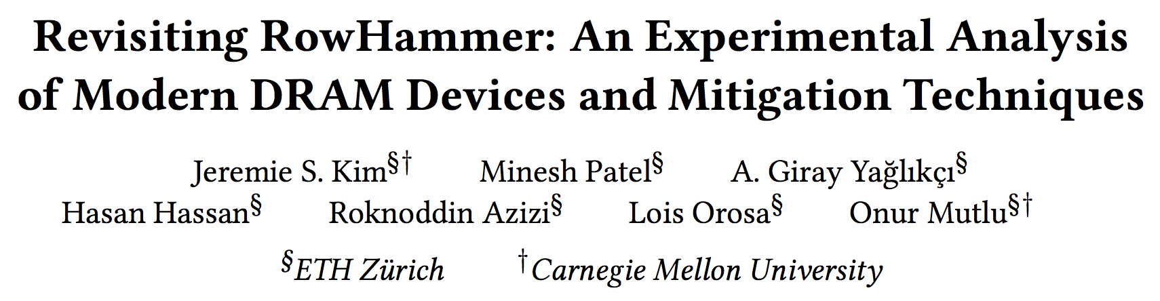
RowHammer is Getting Much Worse (2020)
Jeremie S. Kim, Minesh Patel, A. Giray Yaglikci, Hasan Hassan, Roknoddin Azizi, Lois Orosa, and Onur Mutlu,
"Revisiting RowHammer: An Experimental Analysis of Modern Devices and Mitigation Techniques"
Proceedings of the 47th International Symposium on Computer Architecture (ISCA), Valencia, Spain, June 2020.
[Slides (pptx) (pdf)]
[Lightning Talk Slides (pptx) (pdf)]
[Talk Video (20 minutes)]
[Lightning Talk Video (3 minutes)]

Slide 38
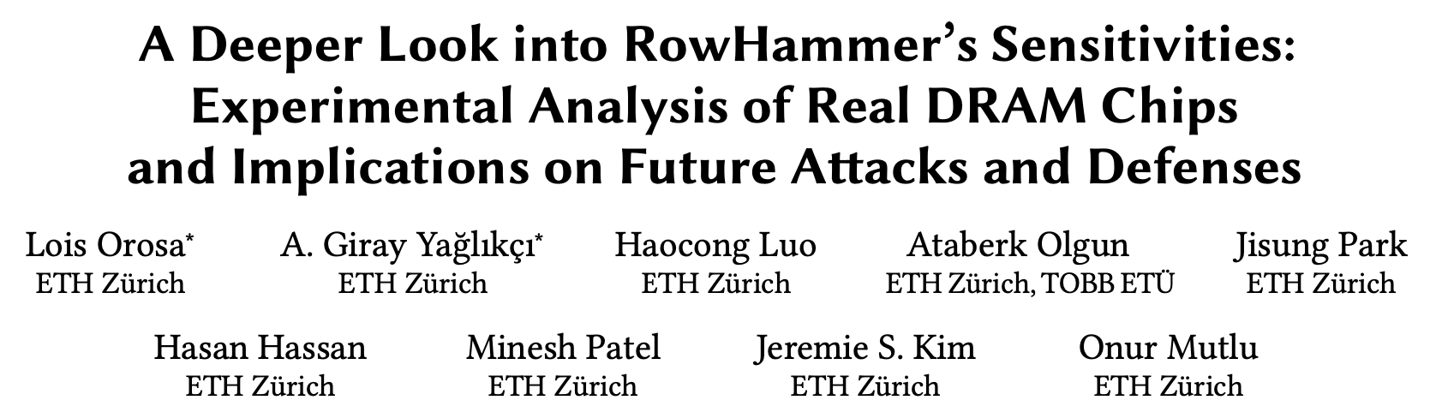
New RowHammer Dimensions (2021)
Lois Orosa, Abdullah Giray Yaglikci, Haocong Luo, Ataberk Olgun, Jisung Park, Hasan Hassan, Minesh Patel, Jeremie S. Kim, and Onur Mutlu,
"A Deeper Look into RowHammer’s Sensitivities: Experimental Analysis of Real DRAM Chips and Implications on Future Attacks and Defenses"
Proceedings of the 54th International Symposium on Microarchitecture (MICRO), Virtual, October 2021.
[Slides (pptx) (pdf)]
[Short Talk Slides (pptx) (pdf)]
[Lightning Talk Slides (pptx) (pdf)]
[Talk Video (21 minutes)]
[Lightning Talk Video (1.5 minutes)]
[arXiv version]

Slide 39
RowHammer Solutions

Slide 40
Two Types of RowHammer Solutions
Immediate
  To protect the vulnerable DRAM chips in the field
  Limited possibilities
Longer-term
  To protect future DRAM chips
  Wider range of protection mechanisms
Our ISCA 2014 paper proposes both types of solutions
  Seven solutions in total
  PARA proposed as best solution → already employed in the field

Slide 41
Some Potential Solutions (ISCA 2014)
Cost
Make better DRAM chips
Power, Performance
Refresh frequently
Cost, Power
Sophisticated ECC
Cost, Power, Complexity
Access counters
Notes:
Here is a list of four potential solutions to disturbance errors: making better DRAM chips, refreshing more frequently, employing sophisticated ECC schemes, and using hardware counters to track the number of accesses to different rows.
However, all of these solutions incur a large overhead in terms cost, power, performance, and/or complexity.

Slide 42
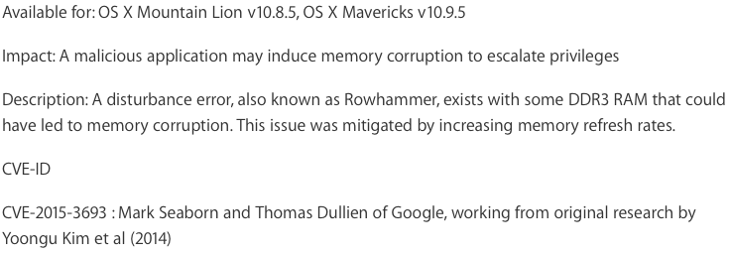
Apple’s Patch for RowHammer
https://support.apple.com/en-gb/HT204934
HP, Lenovo, and many other vendors released similar patches

Slide 43
Our Solution to RowHammer
PARA: Probabilistic Adjacent Row Activation
Key Idea
  After closing a row, we activate (i.e., refresh) one of its neighbors with a low probability: p = 0.005
Reliability Guarantee
  When p=0.005, errors in one year: 9.4×10⁻¹⁴
  By adjusting the value of p, we can vary the strength of protection against errors
Notes:
We provide a more efficient solution, called PARA, which stands for probabilistic adjacent row activation.
The key idea is thus: after closing a row, we activate (i.e., refresh) one of its neighbors with a low probability, for example, p equal to 0.005.
PARA provides a strong reliability guarantee even under the worst-case access patterns to DRAM. When we set p to 0.005, the expected number of errors in one year is 9.4 times 10 to the negative 14. This probability is much lower the failure rate of other hardware components, for example, the hard-disk drive.
And by adjusting the value of p, PARA can provide an arbitrarily strong-degree of protection against errors.

Slide 44
Advantages of PARA
PARA refreshes rows infrequently
  Low power
  Low performance-overhead
    Average slowdown: 0.20% (for 29 benchmarks)
    Maximum slowdown: 0.75%
PARA is stateless
  Low cost
  Low complexity
PARA is an effective and low-overhead solution to prevent disturbance errors
Notes:
PARA has many advantages. Since it refreshes row infrequently, it has low power and low performance-overhead. Simulated across 29 benchmarks, we saw an average of only 0.2% slowdown and a maximum of only 0.75% slowdown.
In addition, due to its stateless nature, PARA has low cost and complexity.
Therefore, PARA is an effective and low-overhead solution to prevent disturbance errors.

Slide 45
Requirements for PARA
If implemented in DRAM chip (done today)
  Enough slack in timing and refresh parameters
  Plenty of slack today:
    Lee et al., “Adaptive-Latency DRAM: Optimizing DRAM Timing for the Common Case,” HPCA 2015.
    Chang et al., “Understanding Latency Variation in Modern DRAM Chips,” SIGMETRICS 2016.
    Lee et al., “Design-Induced Latency Variation in Modern DRAM Chips,” SIGMETRICS 2017.
    Chang et al., “Understanding Reduced-Voltage Operation in Modern DRAM Devices,” SIGMETRICS 2017.
    Ghose et al., “What Your DRAM Power Models Are Not Telling You: Lessons from a Detailed Experimental Study,” SIGMETRICS 2018.
    Kim et al., “Solar-DRAM: Reducing DRAM Access Latency by Exploiting the Variation in Local Bitlines,” ICCD 2018.
If implemented in memory controller
  Better coordination between memory controller and DRAM
  Memory controller should know which rows are physically adjacent

Slide 46
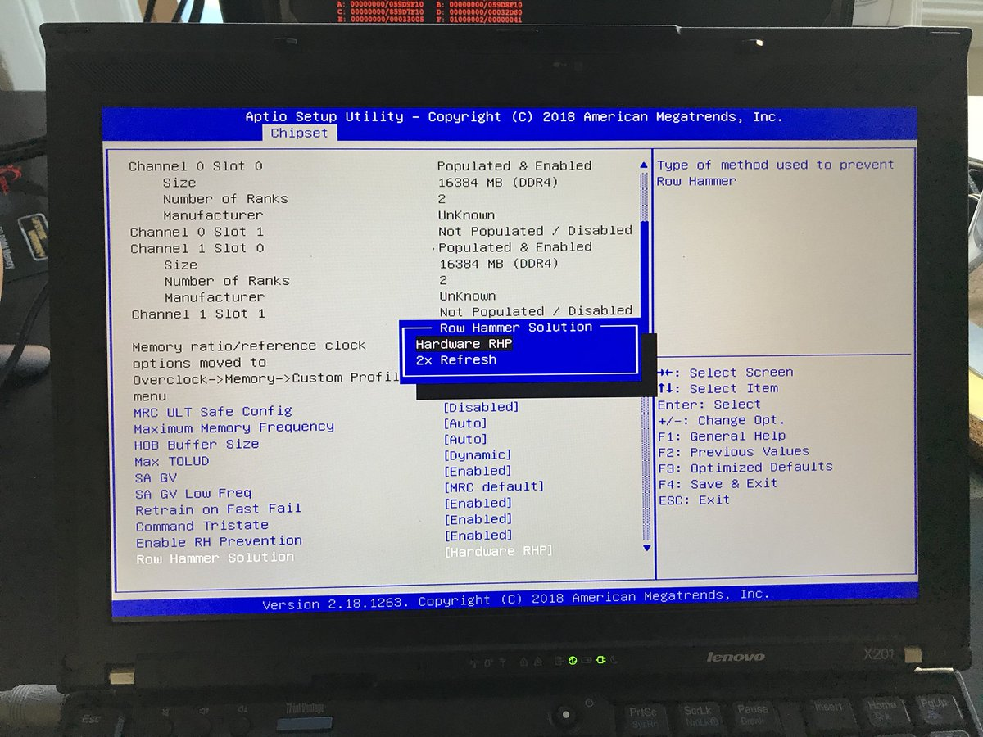
Probabilistic Activation in Real Life (I)
https://twitter.com/isislovecruft/status/1021939922754723841

Slide 47
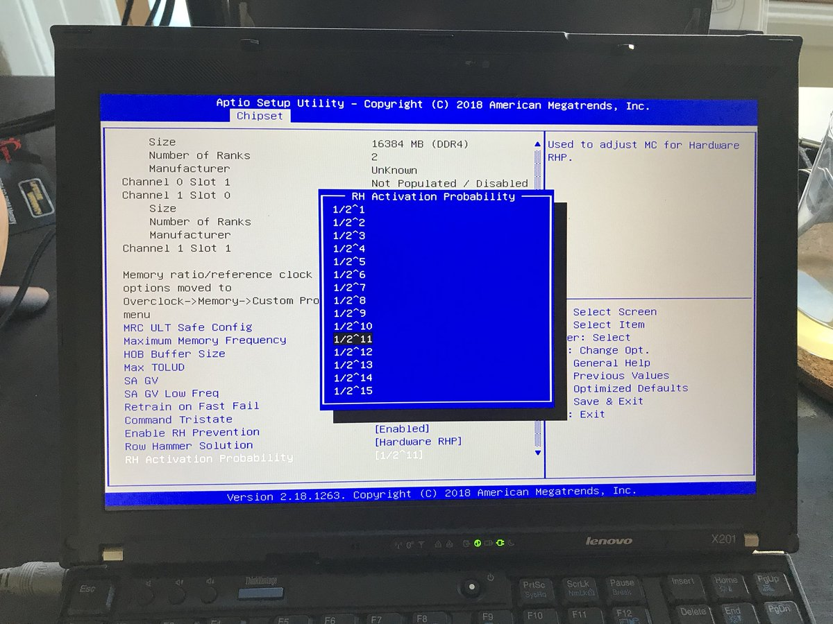
Probabilistic Activation in Real Life (II)
https://twitter.com/isislovecruft/status/1021939922754723841

Slide 48
Seven RowHammer Solutions Proposed
Yoongu Kim, Ross Daly, Jeremie Kim, Chris Fallin, Ji Hye Lee, Donghyuk Lee, Chris Wilkerson, Konrad Lai, and Onur Mutlu,
"Flipping Bits in Memory Without Accessing Them: An Experimental Study of DRAM Disturbance Errors"
Proceedings of the 41st International Symposium on Computer Architecture (ISCA), Minneapolis, MN, June 2014.
[Slides (pptx) (pdf)] [Lightning Session Slides (pptx) (pdf)] [Source Code and Data] [Lecture Video (1 hr 49 mins), 25 September 2020]
One of the 7 papers of 2012-2017 selected as Top Picks in Hardware and Embedded Security for IEEE TCAD (link).

Slide 49
A Takeaway
Main Memory Needs
Intelligent Controllers
for Security, Safety, Reliability, Scaling

Slide 50
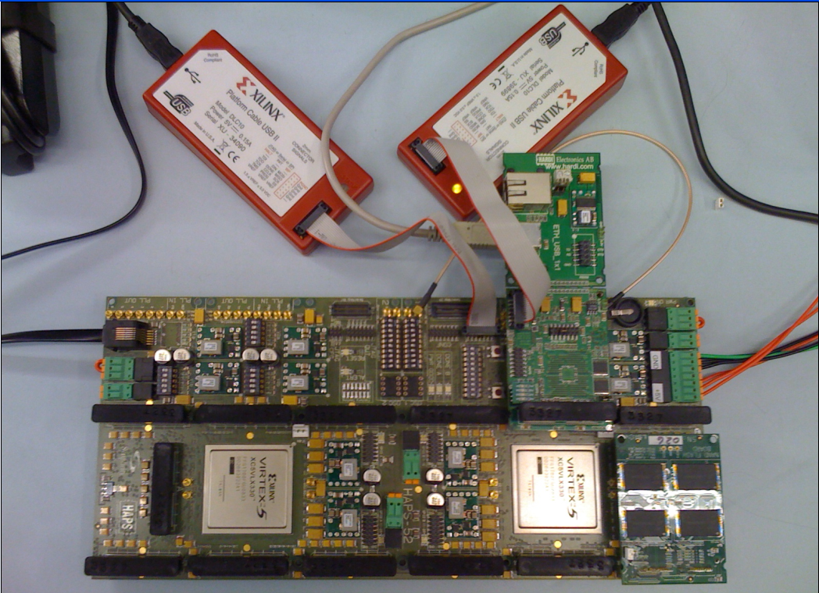
Aside: Intelligent Controller for NAND Flash
USB Daughter Board
USB Jack
HAPS-52 Mother Board
Virtex-II Pro
(USB controller)
1x-nm
NAND Flash
Virtex-V FPGA
(NAND Controller)
[DATE 2012, ICCD 2012, DATE 2013, ITJ 2013, ICCD 2013, SIGMETRICS 2014, HPCA 2015, DSN 2015, MSST 2015, JSAC 2016, HPCA 2017, DFRWS 2017,
PIEEE 2017, HPCA 2018, SIGMETRICS 2018]
NAND Daughter Board
Cai+, “Error Characterization, Mitigation, and Recovery in Flash Memory Based Solid State Drives,” Proc. IEEE 2017.

Slide 51
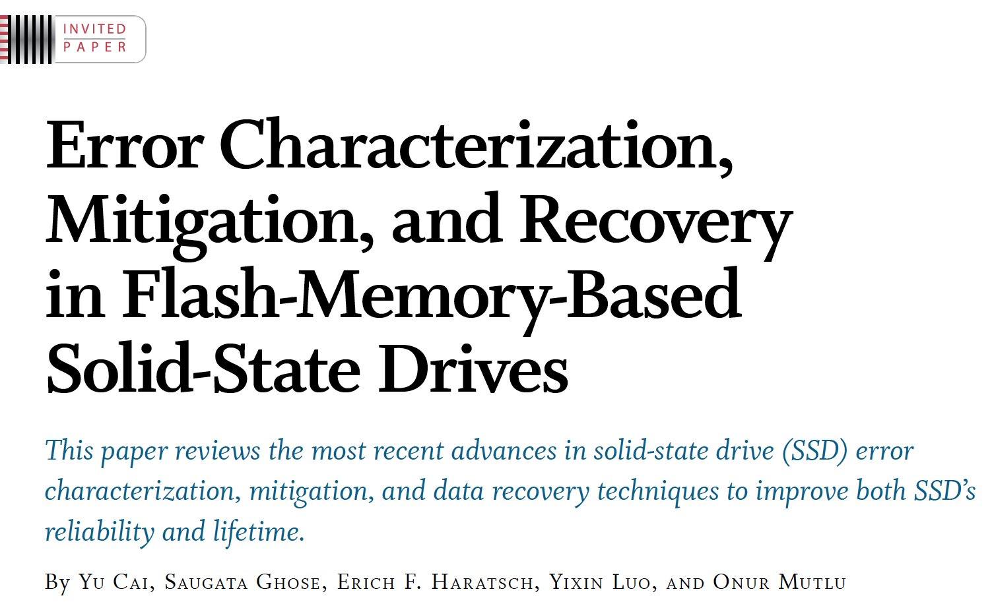

Intelligent Flash Controllers [PIEEE’17]
Proceedings of the IEEE, Sept. 2017
https://arxiv.org/pdf/1706.08642

Slide 52
Detailed Lectures on RowHammer
Computer Architecture, Fall 2021, Lecture 5
  RowHammer (ETH Zürich, Fall 2021)
  https://www.youtube.com/watch?v=7wVKnPj3NVw&list=PL5Q2soXY2Zi-Mnk1PxjEIG32HAGILkTOF&index=5
Computer Architecture, Fall 2021, Lecture 6
  RowHammer and Secure & Reliable Memory (ETH Zürich, Fall 2021)
  https://www.youtube.com/watch?v=HNd4skQrt6I&list=PL5Q2soXY2Zi-Mnk1PxjEIG32HAGILkTOF&index=6
https://www.youtube.com/onurmutlulectures

Slide 53
First RowHammer Analysis
Yoongu Kim, Ross Daly, Jeremie Kim, Chris Fallin, Ji Hye Lee, Donghyuk Lee, Chris Wilkerson, Konrad Lai, and Onur Mutlu,
"Flipping Bits in Memory Without Accessing Them: An Experimental Study of DRAM Disturbance Errors"
Proceedings of the 41st International Symposium on Computer Architecture (ISCA), Minneapolis, MN, June 2014.
[Slides (pptx) (pdf)] [Lightning Session Slides (pptx) (pdf)] [Source Code and Data] [Lecture Video (1 hr 49 mins), 25 September 2020]
One of the 7 papers of 2012-2017 selected as Top Picks in Hardware and Embedded Security for IEEE TCAD (link).

Slide 54
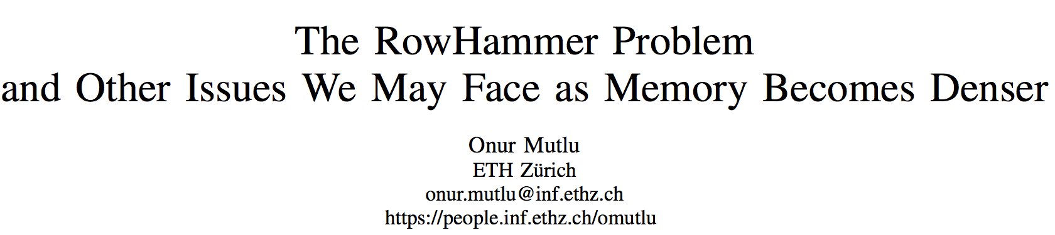
Retrospective on RowHammer & Future
Onur Mutlu,
"The RowHammer Problem and Other Issues We May Face as Memory Becomes Denser"
Invited Paper in Proceedings of the Design, Automation, and Test in Europe Conference (DATE), Lausanne, Switzerland, March 2017.
[Slides (pptx) (pdf)]
https://people.inf.ethz.ch/omutlu/pub/rowhammer-and-other-memory-issues_date17.pdf

Slide 55
A More Recent RowHammer Retrospective
Onur Mutlu and Jeremie Kim,
"RowHammer: A Retrospective"
IEEE Transactions on Computer-Aided Design of Integrated Circuits and Systems (TCAD) Special Issue on Top Picks in Hardware and Embedded Security, 2019.
[Preliminary arXiv version]
[Slides from COSADE 2019 (pptx)]
[Slides from VLSI-SOC 2020 (pptx) (pdf)]
[Talk Video (1 hr 15 minutes, with Q&A)]

Slide 56
RowHammer in 2020-2022

Slide 57
Revisiting RowHammer

Slide 58
RowHammer is Getting Much Worse
Jeremie S. Kim, Minesh Patel, A. Giray Yaglikci, Hasan Hassan, Roknoddin Azizi, Lois Orosa, and Onur Mutlu,
"Revisiting RowHammer: An Experimental Analysis of Modern Devices and Mitigation Techniques"
Proceedings of the 47th International Symposium on Computer Architecture (ISCA), Valencia, Spain, June 2020.
[Slides (pptx) (pdf)]
[Lightning Talk Slides (pptx) (pdf)]
[Talk Video (20 minutes)]
[Lightning Talk Video (3 minutes)]

Slide 59
Key Takeaways from 1580 Chips
Newer DRAM chips are much more vulnerable to RowHammer (more bit flips, happening earlier)
There are new chips whose weakest cells fail after only 4800 hammers
Chips of newer DRAM technology nodes can exhibit RowHammer bit flips 1) in more rows and 2) farther away from the victim row.
Existing mitigation mechanisms are NOT effective at future technology nodes
Notes:
To reiterate our three key takeaways from our experimental characterization, we find that
[CLICK] First, chips of newer DRAM technology nodes are more vulnerable to RowHammer
[CLICK] Second, there are chips today whose weakest cells fail after only 4800 hammers
[CLICK] Third, chips of newer DRAM technology nodes can exhibit RowHammer bit flips in more rows and farther away from the victim row
================

Slide 60
3. Hammer Count (HC) Effects
RowHammer bit flip rates increase
when going from old to new DDR4 technology node generations
RowHammer bit flip rates (i.e., RowHammer vulnerability)
increase with technology node generation
Notes:
We plot each of these curves across our DRAM type-node configurations per manufacturer
[CLICK] We find that newer DDR4 DRAM technology nodes show a clear trend of increasing RowHammer bit flip rates.
the same Hammer count value causes an increased RowHammer bit flip rate from DDR4-old to DDR4-new DRAM chips of all DRAM manufacturers
[CLICK] This indicates that RowHammer bit flip rates are increasing with newer technology node generations.
=======
spend more time.
Stronger second conclusion. Clear from this that rh bit flips increase with technology node generation. and we show DDR4 as an example.
rowhammer bit flip rates are increasing when going from old to new DDR4 technology nodes.

Slide 61
5. First RowHammer Bit Flips per Chip
Newer chips from each DRAM manufacturer
are more vulnerable to RowHammer
Notes:
We plot these distributions across each DRAM manufacturer.
[CLICK] We find that newer chips from a given DRAM manufacturer are more vulnerable to RowHammer, which is demonstrated by the clear reduction in HCfirst values from older to newer DRAM generations across most DRAM types
===============

Slide 62
RowHammer is Getting Much Worse
Jeremie S. Kim, Minesh Patel, A. Giray Yaglikci, Hasan Hassan, Roknoddin Azizi, Lois Orosa, and Onur Mutlu,
"Revisiting RowHammer: An Experimental Analysis of Modern Devices and Mitigation Techniques"
Proceedings of the 47th International Symposium on Computer Architecture (ISCA), Valencia, Spain, June 2020.
[Slides (pptx) (pdf)]
[Lightning Talk Slides (pptx) (pdf)]
[Talk Video (20 minutes)]
[Lightning Talk Video (3 minutes)]

Slide 63
Detailed Lecture on Revisiting RowHammer
Computer Architecture, Fall 2020, Lecture 5b
  RowHammer in 2020: Revisiting RowHammer (ETH Zürich, Fall 2020)
  https://www.youtube.com/watch?v=gR7XR-Eepcg&list=PL5Q2soXY2Zi9xidyIgBxUz7xRPS-wisBN&index=10
https://www.youtube.com/onurmutlulectures

Slide 64
TRRespass

Slide 65
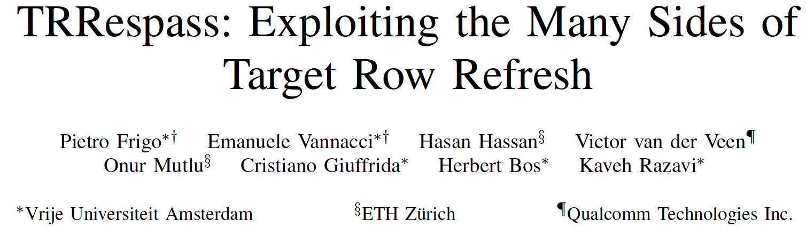
Industry-Adopted Solutions Do Not Work
Pietro Frigo, Emanuele Vannacci, Hasan Hassan, Victor van der Veen, Onur Mutlu, Cristiano Giuffrida, Herbert Bos, and Kaveh Razavi,
"TRRespass: Exploiting the Many Sides of Target Row Refresh"
Proceedings of the 41st IEEE Symposium on Security and Privacy (S&P), San Francisco, CA, USA, May 2020.
[Slides (pptx) (pdf)]
[Lecture Slides (pptx) (pdf)]
[Talk Video (17 minutes)]
[Lecture Video (59 minutes)]
[Source Code]
[Web Article]
Best paper award.
Pwnie Award 2020 for Most Innovative Research. Pwnie Awards 2020

Slide 66
TRRespass
First work to show that TRR-protected DRAM chips are vulnerable to RowHammer in the field
  Mitigations advertised as secure are not secure
Introduces the Many-sided RowHammer attack
  Idea: Hammer many rows to bypass TRR mitigations (e.g., by overflowing proprietary TRR tables that detect aggressor rows)
(Partially) reverse-engineers the TRR and pTRR mitigation mechanisms implemented in DRAM chips and memory controllers
Provides an automatic tool that can effectively create many-sided RowHammer attacks in DDR4 and LPDDR4(X) chips

Slide 67
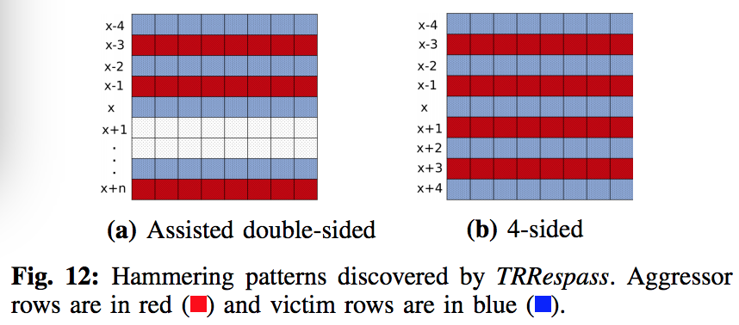
Example Many-Sided Hammering Patterns

Slide 68
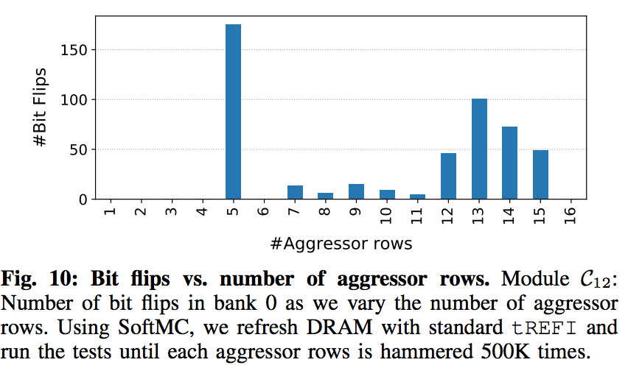
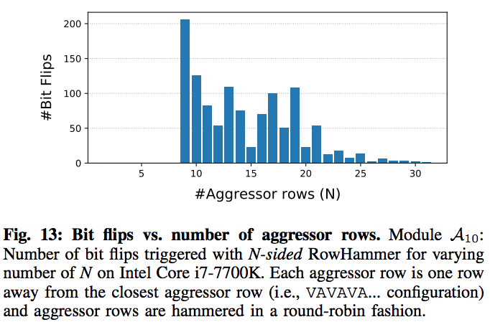
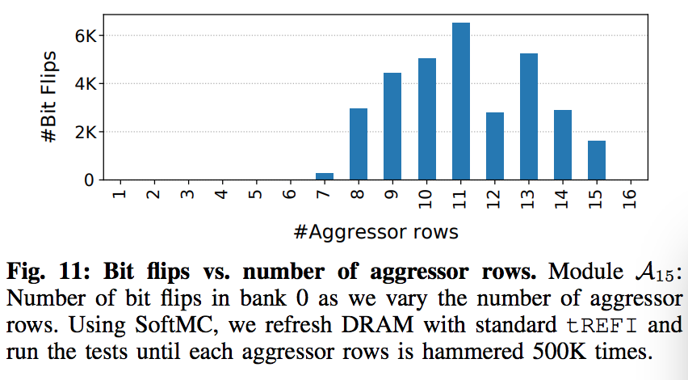
BitFlips vs. Number of Aggressor Rows

Slide 69
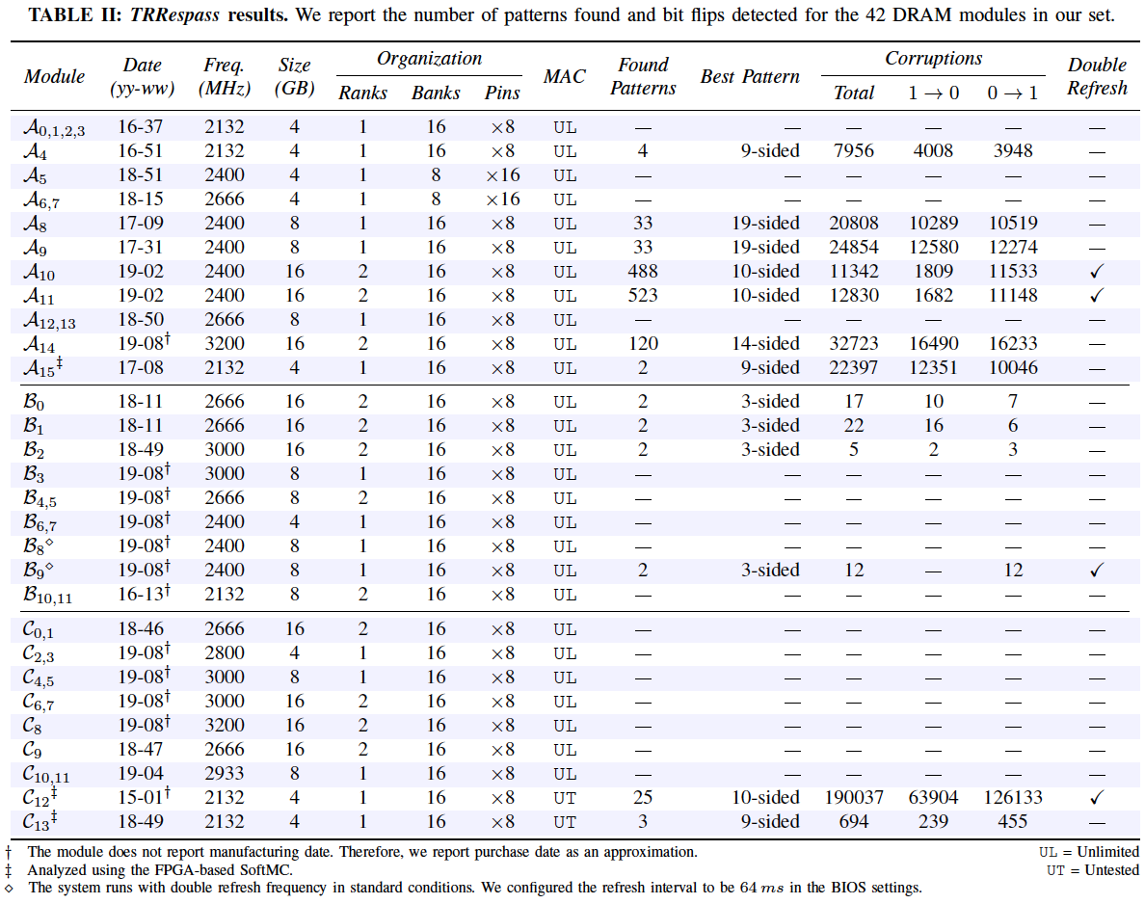
TRRespass Vulnerable DRAM Modules

Slide 70
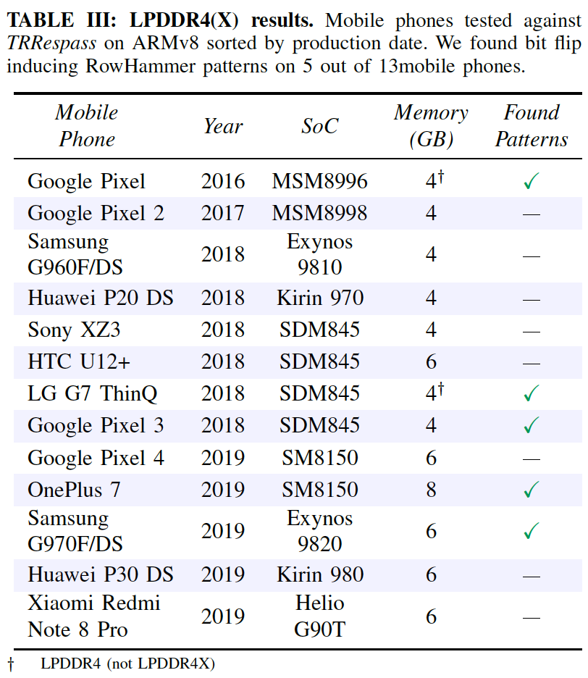
TRRespass Vulnerable Mobile Phones

Slide 71
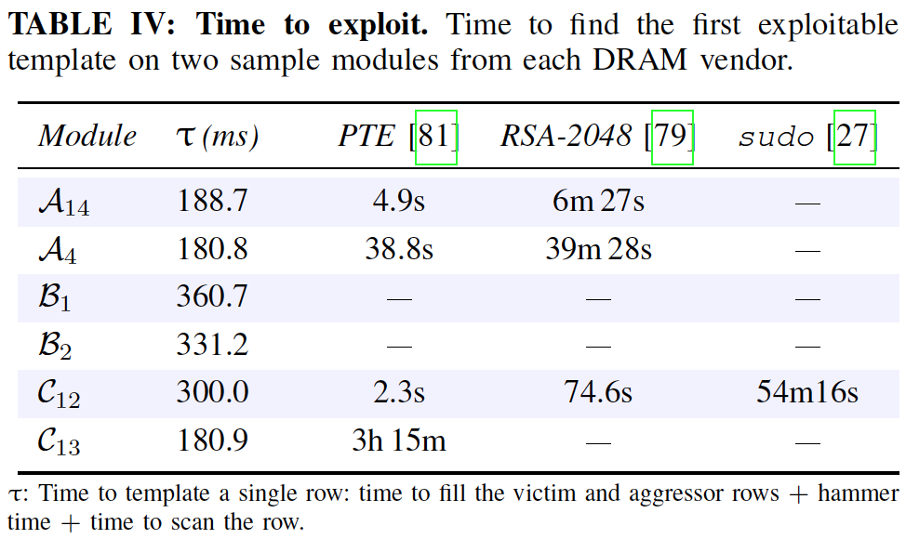
TRRespass Based RowHammer Attack

Slide 72
TRRespass Key Results
13 out of 42 tested DDR4 DRAM modules are vulnerable
  From all 3 major manufacturers
  3-, 9-, 10-, 14-, 19-sided hammer attacks needed
5 out of 13 mobile phones tested vulnerable
  From 4 major manufacturers
  With LPDDR4(X) DRAM chips
These results are scratching the surface
  TRRespass tool is not exhaustive
  There is a lot of room for uncovering more vulnerable chips and phones

Slide 73
TRRespass Key Takeaways
RowHammer is still
an open problem
Security by obscurity
is likely not a good solution

Slide 74
Detailed Lecture on TRRespass
Computer Architecture, Fall 2020, Lecture 5a
  RowHammer in 2020: TRRespass (ETH Zürich, Fall 2020)
  https://www.youtube.com/watch?v=pwRw7QqK_qA&list=PL5Q2soXY2Zi9xidyIgBxUz7xRPS-wisBN&index=9
https://www.youtube.com/onurmutlulectures

Slide 75
Industry-Adopted Solutions Do Not Work
Pietro Frigo, Emanuele Vannacci, Hasan Hassan, Victor van der Veen, Onur Mutlu, Cristiano Giuffrida, Herbert Bos, and Kaveh Razavi,
"TRRespass: Exploiting the Many Sides of Target Row Refresh"
Proceedings of the 41st IEEE Symposium on Security and Privacy (S&P), San Francisco, CA, USA, May 2020.
[Slides (pptx) (pdf)]
[Lecture Slides (pptx) (pdf)]
[Talk Video (17 minutes)]
[Lecture Video (59 minutes)]
[Source Code]
[Web Article]
Best paper award.
Pwnie Award 2020 for Most Innovative Research. Pwnie Awards 2020

Slide 76
How to Guarantee That a Chip is RowHammer-Free?

Slide 77

Hard to Guarantee RowHammer-Free Chips
Lucian Cojocar, Jeremie Kim, Minesh Patel, Lillian Tsai, Stefan Saroiu, Alec Wolman, and Onur Mutlu,
"Are We Susceptible to Rowhammer? An End-to-End Methodology for Cloud Providers"
Proceedings of the 41st IEEE Symposium on Security and Privacy (S&P), San Francisco, CA, USA, May 2020.
[Slides (pptx) (pdf)]
[Talk Video (17 minutes)]

Slide 78
Uncovering TRR
Almost Completely

Slide 79

Industry-Adopted Solutions Are Very Poor
Hasan Hassan, Yahya Can Tugrul, Jeremie S. Kim, Victor van der Veen, Kaveh Razavi, and Onur Mutlu,
"Uncovering In-DRAM RowHammer Protection Mechanisms: A New Methodology, Custom RowHammer Patterns, and Implications"
Proceedings of the 54th International Symposium on Microarchitecture (MICRO), Virtual, October 2021.
[Slides (pptx) (pdf)]
[Short Talk Slides (pptx) (pdf)]
[Lightning Talk Slides (pptx) (pdf)]
[Talk Video (25 minutes)]
[Lightning Talk Video (100 seconds)]
[arXiv version]

Slide 80





U-TRR Summary & Key Results
Target Row Refresh (TRR):
a set of obscure, undocumented, and proprietary RowHammer mitigation techniques
We cannot easily study the security properties of TRR
Is TRR fully secure? How can we validate its security guarantees?
U-TRR
A new methodology that leverages data retention failures to
uncover the inner workings of TRR and study its security
15x Vendor A
DDR4 modules
All 45 modules we test are vulnerable
15x Vendor B
DDR4 modules
99.9% of rows in a DRAM bank
experience at least one RowHammer bit flip
New RowHammer access patterns
15x Vendor C
DDR4 modules
U-TRR
Up to 7 RowHammer bit flips in
an 8-byte dataword, making ECC ineffective
TRR does not provide security against RowHammer
U-TRR can facilitate the development of new RowHammer attacks
and more secure RowHammer protection mechanisms
Notes:
[CLICK] The RowHammer vulnerability of modern DRAM is a critical reliability and security threat.
[CLICK] The security guarantees of TRR, which is the commonly used RowHammer protection mechanism, cannot be easily studied as TRR is obscure, undocumented, and proprietary.
[CLICK] In this work, our main goal is to answer the following questions. Is TRR fully secure? How can we validate the security guarantees of different TRR mechanisms?
[CLICK] To this end, we propose U-TRR, a new methodology that leverages data retention failures in DRAM to uncover the inner workings of TRR and study its security.
[CLICK] Using U-TRR, we analyze 15 DDR4 DRAM modules from each of the three major DRAM vendors.
[CLICK] Through these analyses, we make several observations regarding the TRR mechanisms implemented in these modules and craft new custom RowHammer access patterns that cause RowHammer bit flips in TRR-protected DRAM modules.
[CLICK] Our results show that: First, all 45 modules that we test across three vendors are vulnerable to our new RowHammer access patterns.
[CLICK] Second, our access pattern cause at least one bit flip in almost all DRAM rows in many modules. This makes system-level RowHammer attacks easier to mount as the attacker would have the ability to cause bit flips in almost any DRAM row
[CLICK] Third, we observe that our access patterns cause up to 7 RowHammer bit flips in an 8-byte dataword, making ECC ineffective and systems equipped with ECC also susceptible to RowHammer attacks
[CLICK] We conclude that TRR does not provide security against RowHammer and can be easily circumvented using the new understanding provided by U-TRR.
[CLICK] We believe and hope that U-TRR will facilitate future research by enabling rigorous and open analysis of RowHammer mitigation mechanisms, leading to the development of both new RowHammer attacks and more secure RowHammer protection mechanisms.

Slide 81
Overview of U-TRR
U-TRR: A new methodology to
uncover the inner workings of TRR
Key idea: Use data retention failures as a side channel
to detect when a row is refreshed by TRR
Notes:
To this end, we propose U-TRR, a new methodology to uncover the inner workings of TRR.
[CLICK] The key idea of U-TRR is to use data retention failures in DRAM as a side channel to detect when a certain row is refreshed by TRR

Slide 82

Analyzing TRR-Protected DDR4 Chips
* SoftMC [Hassan+, HPCA’17] enhanced for DDR4
Notes:
We implement U-TRR using SoftMC, an FPGA-based infrastructure with precise temperature control which we enhanced for DDR4

Slide 83
U-TRR Analysis Summary
15x Vendor A
DDR4 DRAM modules
15x Vendor B
DDR4 DRAM modules
15x Vendor C
DDR4 DRAM modules
U-TRR
new RowHammer access patterns
that circumvent TRR
Notes:
Using U-TRR, [CLICK] we analyze 45 DDR4 modules from three major DRAM vendors. [CLICK] Based on the understanding we develop from our analysis, we craft new RowHammer access patterns that circumvent the TRR mechanisms implemented today.

Slide 84

Key Takeaways
All 45 modules we test are vulnerable
99.9% of rows in a DRAM bank
experience at least one RowHammer bit flip
ECC is ineffective: up to 7 RowHammer bit flips
in an 8-byte dataword
Notes:
In summary, we find that all 45 modules we test are vulnerable to our new RowHammer access patterns
[CLICK] almost all rows in a DRAM bank experience at least one RowHammer bit flip
[CLICK] a single 8-byte dataword experiences up to 7 Rowhammer bit flips, making ECC ineffective against our RowHammer access patterns.
[CLICK] Our paper has detailed descriptions and analyses of each of the 45 modules and we encourage you to read it and attend our full talk

Slide 85

Effect on Individual Rows
All 45 modules we tested are vulnerable
to our new RowHammer access patterns
Our RowHammer access patterns
cause bit flips in more than 99.9% of the rows
Notes:
[CLICK] We find that all 45 modules we tested are vulnerable to our new RowHammer access patterns
[CLICK] Further, in 20 of the modules, our RowHammer access patterns cause bit flips in almost all of the rows

Slide 86

Bypassing ECC with New RowHammer Patterns
Vendor A
Vendor B
Vendor C
Modules from all three vendors have many 8-byte data chunks with 3 and more (up to 7) RowHammer bit flips
Conventional DRAM ECC cannot protect
against our new RowHammer access patterns
Notes:
The new RowHammer access patterns cause a lot of RowHammer bit flips. But can conventional DRAM ECC protect against those bit flips?
When we look at how RowHammer bit flips are distributed across 8-byte data chunks, we find that [CLICK] our RowHammer access patterns can cause at least 3 bit flips in modules of all three vendors. Further, [CLICK] we see up to 7 bit flips in many datawords, which the conventional SECDED ECC cannot correct or detect
[CLICK] We conclude that conventional DRAM ECC cannot protect against our new RowHammer patterns

Slide 87

Many Observations & Results in the Paper
More observations on the TRRs of the three vendors
Detailed description of the crafted access patterns
Hammers per aggressor row sensitivity analysis
Observations and results for individual modules
…
Notes:
For many other observations and results, we invite you to read our paper.

Slide 88
Uncovering TRR Can Help Future Solutions
Hasan Hassan, Yahya Can Tugrul, Jeremie S. Kim, Victor van der Veen, Kaveh Razavi, and Onur Mutlu,
"Uncovering In-DRAM RowHammer Protection Mechanisms: A New Methodology, Custom RowHammer Patterns, and Implications"
Proceedings of the 54th International Symposium on Microarchitecture (MICRO), Virtual, October 2021.
[Slides (pptx) (pdf)]
[Short Talk Slides (pptx) (pdf)]
[Lightning Talk Slides (pptx) (pdf)]
[Talk Video (25 minutes)]
[Lightning Talk Video (100 seconds)]
[arXiv version]

Slide 89
New RowHammer Characteristics

Slide 90
RowHammer Has Many Dimensions
Lois Orosa, Abdullah Giray Yaglikci, Haocong Luo, Ataberk Olgun, Jisung Park, Hasan Hassan, Minesh Patel, Jeremie S. Kim, and Onur Mutlu,
"A Deeper Look into RowHammer’s Sensitivities: Experimental Analysis of Real DRAM Chips and Implications on Future Attacks and Defenses"
Proceedings of the 54th International Symposium on Microarchitecture (MICRO), Virtual, October 2021.
[Slides (pptx) (pdf)]
[Short Talk Slides (pptx) (pdf)]
[Lightning Talk Slides (pptx) (pdf)]
[Talk Video (21 minutes)]
[Lightning Talk Video (1.5 minutes)]
[arXiv version]

Slide 91



A Deeper Look Into RowHammer [MICRO’21]
We provide insights into three fundamental properties
To find effective and efficient attacks and defenses
"A Deeper Look into RowHammer’s Sensitivities: Experimental Analysis of Real DRAM Chips and Implications on Future Attacks and Defenses"
Notes:
Our goal in this work is to Provide insights into three fundamental properties of RowHammer:
Temperature [CLICK]
Aggressor row active time [CLICK]
Victim DRAM cell's physical location [CLICK]
By doing so we aim enabling research to find effective and efficient attacks and defenses [CLICK]

Slide 92

DRAM Testing Infrastructures
Two separate testing infrastructures
  DDR3: FPGA-based SoftMC (Xilinx ML605)
  DDR4: FPGA-based SoftMC (Xilinx Virtex UltraScale+ XCU200)
FPGA (w/SoftMC)
Host Machine
(via PCI-e)
Temperature
Controller
DRAM Module
and Heater
DDR4 DRAM Testing Infrastructure
Fine-grained control over DRAM commands,
timing parameters and temperature (±0.1°C )
Notes:
We use two FPGA-based experimental setups for DDR3 and DDR4 DRAM modules, both programmed with a modified version of SoftMC [CLICK]
We control the chip temperature using a pair of heaters [CLICK] connected to a temperature controller [CLICK]
These infrastructures provide fine-grained control over DRAM commands, timing parameters, and temperature [CLICK]
=======

Slide 93

DRAM Chips Tested
Two DRAM standards
Mfr. | DDR4 DIMMs | DDR3 SODIMMs | # Chips | Density | Die | Org.
A (Micron) | 9 | 1 | 144 (8) | 8Gb (4Gb) | B (P) | x4 (x8)
B (Samsung) | 4 | 1 | 32 (8) | 4Gb (4Gb) | F (Q) | x8 (x8)
C (SK Hynix) | 5 | 1 | 40 (8) | 4Gb (4Gb) | B (B) | x8 (x8)
D (Nanya) | 4 | - | 32 (-) | 8Gb (-) | C (-) | x8 (-)
4 Major Manufacturers
272 DRAM Chips in total
Notes:
In our characterization, [CLICK]
we test 272 real DRAM chips [CLICK]
from four major manufacturers, [CLICK]
that implement DDR3 and DDR4 DRAM standards [CLICK]
and with different densities, die revisions, and chip organizations[CLICK]

Slide 94
Summary of The Study & Key Results
272 DRAM chips from four major manufacturers
6 major takeaways from 16 novel observations
A RowHammer bit flip is more likely to occur
  in a bounded range of temperature
  if the aggressor row is active for longer time
  in certain physical regions of the DRAM module under attack
Our novel observations can inspire and aid future work
  Craft more effective attacks
  Design more effective and efficient defenses
Notes:
Denser DRAM chips are more vulnerable to RowHammer [CLICK]
And Understanding RowHammer is critical to find effective and efficient solutions. However, no rigorous study demonstrates how this vulnerability varies under different conditions [CLICK]
In this work, our goal is to provide insights into three fundamental properties of RowHammer that can be leveraged to design more effective and efficient attacks and defenses These three properties are [CLICK]
DRAM chip temperature, [CLICK]
The time that an aggressor row stays active [CLICK]
and victim DRAM cell’s physical location [CLICK]
In this study, we test 272 real DRAM chips of DDR3 and DDR4 modules from four major manufacturers [CLICK]
Based on our analyses, we draw 6 key takeaway lessons from 16 novel observations. Among these, we highlight that [CLICK]
A RowHammer bit flip is more likely to occur [CLICK]
in a bounded range of temperature [CLICK]
if the aggressor row is active for longer time [CLICK]
And in certain physical regions of the DRAM module under attack [CLICK]
Based on our findings, we propose several improvements. We believe and hope that our novel observations will inspire and aid future work on crafting more effective attacks and designing more effective and efficient defense mechanisms [END]

Slide 95
Example Attack Improvement 3:
Bypassing Defenses with Aggressor Row Active Time
Activating aggressor rows as frequently as possible:
Row A is active
Row B is active
Row A is active
Time
Keeping aggressor rows active for a longer time:
Row A is active
Row B is active
Time
36% reduction
in HC_{first}
Reduces the minimum activation count to induce a bit flip by 36%
Bypasses defenses that do not account for this reduction
Notes:
In the third example, an attacker can leverage the effect of aggressor row active time [CLICK]
In this scenario, instead of activating aggressor rows as frequently as possible, [CLICK]
the attacker can keep the aggressor rows active for longer time [CLICK]
Based on our analyses, HCfirst reduces by 36% on average with the proposed access pattern
With this reduction, an attacker can bypass RowHammer defenses that do not account for this reduction [CLICK]

Slide 96

Example Defense Improvements
Example 1: Leveraging variation across DRAM rows
Example 2: Leveraging variation with temperature
  A DRAM cell experiences bit flips within a bounded temperature range
  A row can be disabled within the row’s vulnerable temperature range
90%
HC_{first}
10%
Aggressiveness can be reduced:
33% area reduction
for BlockHammer [Yağlıkçı+, HPCA'21]
$2×$HC_{first}
80% area reduction
for Graphene [Park+, MICRO'20]
Breakdown
of DRAM Rows
no bit flips
Vulnerable Temperature Range
no bit flips
Temperature
Disable RowA
Disable RowB
Temperature
Notes:
I will also explain two improvements for defense mechanisms in this slide, but you can find more in the paper [CLICK]
The first improvement leverages the variation across rows [CLICK]
We observe that 90% of the rows do not experience bit flips until the activation count reaches the double Hcfirst of the 10% of the rows.[CLICK]
Therefore, we can reduce the aggressiveness of defense mechanisms for 90% of the rows, which can reduce the area overheads of state-of-the-art defense mechanisms: [CLICK] BlockHammer and [CLICK] Graphene, by 33 and 80%, respectively [CLICK]
The second example leverages the variation in RowHammer vulnerability with temperature [CLICK]
We show that DRAM cells experience bit flips in bounded temperature ranges [CLICK]
To avoid bit flips, A DRAM row can be disabled when its cells are vulnerable to RowHammer at the current operating temperature [CLICK]

Slide 97
Many More Analyses In The Paper
Lois Orosa, Abdullah Giray Yaglikci, Haocong Luo, Ataberk Olgun, Jisung Park, Hasan Hassan, Minesh Patel, Jeremie S. Kim, and Onur Mutlu,
"A Deeper Look into RowHammer’s Sensitivities: Experimental Analysis of Real DRAM Chips and Implications on Future Attacks and Defenses"
Proceedings of the 54th International Symposium on Microarchitecture (MICRO), Virtual, October 2021.
[Slides (pptx) (pdf)]
[Short Talk Slides (pptx) (pdf)]
[Lightning Talk Slides (pptx) (pdf)]
[Talk Video (21 minutes)]
[Lightning Talk Video (1.5 minutes)]
[arXiv version]

Slide 98
New RowHammer Solutions

Slide 99




RowHammer Solution Approaches
More robust DRAM chips and/or error-correcting codes
Increased refresh rate
Physical isolation
Reactive refresh
Proactive throttling
Fewer activations possible
in a refresh interval
DRAM Bank
Aggressor Row
Isolation Rows
Large-enough distance
Cost, Power, Performance, Complexity
Victim Rows
DRAM Bank
Victim Rows
Refresh
Aggressor Row
Rapidly activated (hammered)
Victim rows
Refresh
Fewer activations allowed for aggressive applications
Notes:
There are four high-level RowHammer mitigation approaches.
[CLICK] The first approach is to increase refresh rate
[CLICK] which reduces the refresh window,
[CLICK] and thus the activation count that an attacker can reach in a refresh window.
[CLICK] The second approach is to physically isolate
[CLICK] potential victim rows with sensitive data
[CLICK] from aggressor rows that a potential attacker can hammer
[CLICK] by allocating isolation rows in between
such that the attacker cannot disturb sensitive data by performing RowHammer attack.
[CLICK] The third approach is reactive refresh.
[CLICK] In this approach, when an aggressor row is hammered
[CLICK] potential victim rows are refreshed to avoid bit-flips.
[CLICK] Finally the fourth approach suggests
[CLICK] throttling or slowing down memory accesses proactively such that no row’s activation rate can reach RowHammer threshold.

Slide 100
BlockHammer Solution in 2021
A. Giray Yaglikci, Minesh Patel, Jeremie S. Kim, Roknoddin Azizi, Ataberk Olgun, Lois Orosa, Hasan Hassan, Jisung Park, Konstantinos Kanellopoulos, Taha Shahroodi, Saugata Ghose, and Onur Mutlu,
"BlockHammer: Preventing RowHammer at Low Cost by Blacklisting Rapidly-Accessed DRAM Rows"
Proceedings of the 27th International Symposium on High-Performance Computer Architecture (HPCA), Virtual, February-March 2021.
[Slides (pptx) (pdf)]
[Short Talk Slides (pptx) (pdf)]
[Talk Video (22 minutes)]
[Short Talk Video (7 minutes)]

Slide 101
Two Key Challenges
Scalability
with worsening RowHammer vulnerability
1
Compatibility
with commodity DRAM chips
Compatibility
with commodity DRAM chips
2
Compatibility
with commodity DRAM chips
2
2
Notes:
Unfortunately, existing mechanisms face two key challenges.
[CLICK] Let's begin with the scalability challenge.

Slide 102
Our Goal
To prevent RowHammer efficiently and scalably
without knowledge of or modifications to DRAM internals
Notes:
To address these two challenges,
OUR GOAL in this paper is to prevent RowHammer efficiently and scalably without knowledge of or modification to DRAM internals.

Slide 103
BlockHammer
Key Idea
Selectively throttle memory accesses
that may cause RowHammer bit-flips
Notes:
BlockHammer's key idea is to selectively throttle memory accesses
that may cause RowHammer bit-flips.

Slide 104
BlockHammer
Overview of Approach
RowBlocker
Tracks row activation rates using area-efficient Bloom filters
Blacklists rows that are activated at a high rate
Throttles activations targeting a blacklisted row
AttackThrottler
Identifies threads that perform a RowHammer attack
Reduces memory bandwidth usage of identified threads
No row can be activated at a high enough rate to induce bit-flips
Greatly reduces the performance degradation
and energy wastage a RowHammer attack inflicts on a system
Notes:
BlockHammer consists of two mechanisms [CLICK] RowBlocker [CLICK] and AttackThrottler.
RowBlocker [CLICK] tracks ROW ACTIVATION RATES using area-efficient Bloom filters
[CLICK] BLACKLISTS rows that are activated at a high rate
[CLICK] THROTTLES (or enforces a certain delay between) activations targeting a blacklisted row.
[CLICK] By doing so, RowBlocker ensures that NO ROW can be activated at a high enough rate to induce RowHammer bit-flips.
[CLICK] AttackThrottler IDENTIFIES threads that try activating blacklisted rows.
[CLICK] and reduces their memory bandwidth consumption by throttling their memory requests.
[CLICK] By doing so, AttackThrottler greatly reduces the performance degradation and energy wastage a RowHammer attack inflicts on a system.

Slide 105

Key Results: BlockHammer
Competitive with state-of-the-art mechanisms when there is no attack
Superior performance and DRAM energy when RowHammer attack present
Better hardware area scaling with RowHammer vulnerability
Security Proof
Addresses Many-Sided Attacks
Evaluation of 14 mechanisms representing four mitigation approaches
  Comprehensive Protection
  Compatibility with Commodity DRAM Chips
  Scalability with RowHammer Vulnerability
  Deterministic Protection
Notes:
We provide more analyses and implementation details available in the full paper.
[CLICK] First, the paper shares a security proof where we mathematically represent ALL POSSIBLE access patterns and show that NO ROW can be activated at a high-enough rate to induce bit-flips when BlockHammer is configured correctly.
[CLICK] Second, the paper explains how BlockHammer addresses many-sided attacks by tuning its thresholds.
[CLICK] Third, we evaluate all four high-level RowHammer mitigation approaches through analyzing 14 mechanisms from four aspects
[CLICK] comprehensive protection
[CLICK] compatibiltiy with commodity DRAM chips
[CLICK] scalability with worsening RowHammer vulnerability
[CLICK] and deterministic protection.
[CLICK] We show that BlockHammer is the only mechanism that satisfies all of them.
[END]

Slide 106
A Takeaway
Main Memory Needs
Intelligent Controllers
for Security, Safety, Reliability, Scaling

Slide 107
More RowHammer in 2020-2022

Slide 108

RowHammer in 2020 (I)

Slide 109

RowHammer in 2020 (II)

Slide 110

RowHammer in 2020 (III)

Slide 111
RowHammer in 2021 (I)

Slide 112

RowHammer in 2021 (II)

Slide 113


RowHammer in 2021 (III)

Slide 114



RowHammer in 2022 (I)

Slide 115

RowHammer in 2022 (II)

Slide 116



RowHammer in 2022 (III)

Slide 117
More to Come…

Slide 118
Future Memory Reliability/Security Challenges

Slide 119
Future of Main Memory Security
DRAM is becoming less reliable → more vulnerable
Due to difficulties in DRAM scaling, other problems may also appear (or they may be going unnoticed)
Some errors may already be slipping into the field
  Read disturb errors (Rowhammer)
  Retention errors
  Read errors, write errors
  …
These errors can also pose security vulnerabilities

Slide 120
Future of Main Memory Security
DRAM
Flash memory
Emerging Technologies
  Phase Change Memory
  STT-MRAM
  RRAM, memristors
  …

Slide 121
A Takeaway
Main Memory Needs
Intelligent Controllers
for Security, Safety, Reliability, Scaling

Slide 122
The Takeaway
Intelligent
Memory Controllers
Can Avoid Many Failures
& Enable Better Scaling

Slide 123
Final Thoughts on RowHammer

Slide 124



Before RowHammer (I)
IEEE S&P 2003
https://www.cs.princeton.edu/~appel/papers/memerr.pdf

Slide 125

Before RowHammer (II)
IEEE S&P 2003
https://www.cs.princeton.edu/~appel/papers/memerr.pdf

Slide 126
After RowHammer
A simple memory error
can be induced by software

Slide 127
RowHammer: Retrospective
New mindset that has enabled a renewed interest in HW security attack research:
  Real (memory) chips are vulnerable, in a simple and widespread manner → this causes real security problems
  Hardware reliability → security connection is now mainstream discourse
Many new RowHammer attacks…
  Tens of papers in top security & architecture venues
  More to come as RowHammer is getting worse (DDR4 & beyond)
Many new RowHammer solutions…
  Apple security release; Memtest86 updated
  Many solution proposals in top venues (latest in ASPLOS 2022)
  Principled system-DRAM co-design (in original RowHammer paper)
  More to come…

Slide 128
Perhaps Most Importantly…
RowHammer enabled a shift of mindset in mainstream security researchers
  General-purpose hardware is fallible, in a widespread manner
  Its problems are exploitable
This mindset has enabled many systems security researchers to examine hardware in more depth
  And understand HW’s inner workings and vulnerabilities
It is no coincidence that two of the groups that discovered Meltdown and Spectre heavily worked on RowHammer attacks before
  More to come…

Slide 129
Research Thrusts
Fundamentally Understanding RowHammer

Slide 130
Thrust 1. Experimental Characterization
RowHammer’s sensitivities to environmental conditions
(e.g., temperature and power supply)
Worst- and best-case conditions for RowHammer
The most effective access patterns under different conditions
The effect of DRAM design on RowHammer
How to efficiently evaluate a given DRAM module’s RowHammer vulnerability

Slide 131
Thrust 2. Experimental Characterization
Are the RowHammer mitigation mechanisms used in existing real DRAM chips fully secure?
How to automatically reverse engineer an undocumented RowHammer defense (e.g., TRR)?
How to easily evaluate the security properties
of a RowHammer defense at low cost?
What are the fundamental reasons for the weaknesses of existing RowHammer defenses?

Slide 132
Research Thrusts
Fundamentally Solving RowHammer

Slide 133
Thrust 3: New RowHammer Access Patterns
Exploiting the weaknesses of existing RowHammer defenses
Finding the RowHammer access patterns that evade the RowHammer defenses yet induce most RowHammer bit flips
How to automatically find effective RowHammer access patterns for a given RowHammer mitigation mechanism?
Finding the challenges and solutions for using
new RowHammer access patterns in real systems

Slide 134
Thrust 4: New RowHammer Solutions
How can we completely solve RowHammer
in a cost-efficient and practical way?
How can we minimize the overheads of a RowHammer mitigation mechanism?
How can we make new RowHammer defenses scale well with worsening RowHammer vulnerability?

Slide 135
Timeline
We project a two-year-long period
First year (2022)
  Thrust 1: Analyze the unexplored aspects of RowHammer
  Thrust 2: Understand the operation of existing RowHammer mitigation mechanisms to evaluate their security properties
Second year (2023)
  Thrust 3: Crafting more effective RowHammer access patterns
  Thrust 4: Designing secure, efficient, and low-cost RowHammer defenses

Slide 136

Sneak Peak: RowHammer vs. Voltage
Voltage swing on a DRAM row’s wordline causes RowHammer
No prior study on the impact of voltage on RowHammer
RowHammer vulnerability can be reduced via voltage scaling

Slide 137

Sneak Peak: RowHammer vs Voltage
Voltage swing on a DRAM row’s wordline causes RowHammer
No prior study on the impact of voltage on RowHammer
Stay tuned for DSN 2022
RowHammer vulnerability can be reduced via voltage scaling

Slide 138











Our RowHammer Experts
Actively Working
Affiliated Researchers

Slide 139
Conclusion

Slide 140
Summary: RowHammer
Memory reliability is reducing
Reliability issues open up security vulnerabilities
  Very hard to defend against
Rowhammer is a prime example
  First example of how a simple hardware failure mechanism can create a widespread system security vulnerability
  Its implications on system security research are tremendous & exciting
Bad news: RowHammer is getting worse
Good news: We have a lot more to do
  We are now fully aware hardware is easily fallible
  We are developing both attacks and solutions
  We are developing principled models, methodologies, solutions

Slide 141
A RowHammer Survey Across the Stack
Onur Mutlu and Jeremie Kim,
"RowHammer: A Retrospective"
IEEE Transactions on Computer-Aided Design of Integrated Circuits and Systems (TCAD) Special Issue on Top Picks in Hardware and Embedded Security, 2019.
[Preliminary arXiv version]
[Slides from COSADE 2019 (pptx)]
[Slides from VLSI-SOC 2020 (pptx) (pdf)]
[Talk Video (1 hr 15 minutes, with Q&A)]

Slide 142
Detailed Lectures on RowHammer
Computer Architecture, Fall 2021, Lecture 5
  RowHammer (ETH Zürich, Fall 2021)
  https://www.youtube.com/watch?v=7wVKnPj3NVw&list=PL5Q2soXY2Zi-Mnk1PxjEIG32HAGILkTOF&index=5
Computer Architecture, Fall 2021, Lecture 6
  RowHammer and Secure & Reliable Memory (ETH Zürich, Fall 2021)
  https://www.youtube.com/watch?v=HNd4skQrt6I&list=PL5Q2soXY2Zi-Mnk1PxjEIG32HAGILkTOF&index=6
https://www.youtube.com/onurmutlulectures

Slide 143
Notes:
Picture from the article:
http://thehackernews.com/2015/03/dram-rowhammer-vulnerability.html

Slide 144
Funding Acknowledgments
Alibaba, AMD, ASML, Google, Facebook, Hi-Silicon, HP Labs, Huawei, IBM, Intel, Microsoft, Nvidia, Oracle, Qualcomm, Rambus, Samsung, Seagate, Vmware, Xilinx
NSF
NIH
GSRC
SRC
CyLab
Thank you!

Slide 145

Acknowledgments
Think BIG, Aim HIGH!
https://safari.ethz.ch

Slide 146

SAFARI Research Group
https://safari.ethz.ch/safari-newsletter-december-2021/

Slide 147
Fundamentally Understanding and Solving RowHammer
Onur Mutlu
omutlu@gmail.com
https://people.inf.ethz.ch/omutlu
29 March 2022
Microsoft Swiss Joint Research Center Kickoff Meeting: Confidential Computing

Slide 149
Backup Slides for Further Info

Slide 150

How Reliable/Secure/Safe is This Bridge?
Source: http://www.technologystudent.com/struct1/tacom1.png

Slide 151

Collapse of the “Galloping Gertie”
Source: AP
http://www.wsdot.wa.gov/tnbhistory/connections/connections3.htm

Slide 152

How Secure Are These People?
Security is about preventing unforeseen consequences
Source: https://s-media-cache-ak0.pinimg.com/originals/48/09/54/4809543a9c7700246a0cf8acdae27abf.jpg

Slide 153
Why Is This Happening?
DRAM cells are too close to each other!
  They are not electrically isolated from each other
Access to one cell affects the value in nearby cells
  due to electrical interference between
    the cells
    wires used for accessing the cells
  Also called cell-to-cell coupling/interference
Example: When we activate (apply high voltage) to a row, an adjacent row gets slightly activated as well
  Vulnerable cells in that slightly-activated row lose a little bit of charge
  If row hammer happens enough times, charge in such cells gets drained

Slide 154
Higher-Level Implications
This simple circuit level failure mechanism has enormous implications on upper layers of the transformation hierarchy
Problem
Problem
Algorithm
Algorithm
Program/Language
User
Program/Language
Runtime System
(VM, OS, MM)
Runtime System
(VM, OS, MM)
ISA (Architecture)
ISA
Microarchitecture
Microarchitecture
Logic
Logic
Devices
Devices
Electrons
Electrons

Slide 155
Understanding RowHammer

Slide 156
Root Causes of Disturbance Errors
Cause 1: Electromagnetic coupling
  Toggling the wordline voltage briefly increases the voltage of adjacent wordlines
  Slightly opens adjacent rows → Charge leakage
Cause 2: Conductive bridges
Cause 3: Hot-carrier injection
Confirmed by at least one manufacturer
Notes:
Why do the errors occur? We see three possible causes.
First, there could electromagnetic coupling between adjacent wordlines. When the voltage of one is toggled, it could briefly increase the voltage of the other and facilitate the leakage of charge.
Two other possibilities are conductive bridges and hot-carrier injection.
At least one manufacturer confirmed that these three could play a role in the disturbance errors we see them today.

Slide 157
Experimental DRAM Testing Infrastructure
  An Experimental Study of Data Retention Behavior in Modern DRAM Devices: Implications for Retention Time Profiling Mechanisms (Liu et al., ISCA 2013)
  The Efficacy of Error Mitigation Techniques for DRAM Retention Failures: A Comparative Experimental Study
  (Khan et al., SIGMETRICS 2014)
  Flipping Bits in Memory Without Accessing Them: An Experimental Study of DRAM Disturbance Errors (Kim et al., ISCA 2014)
  Adaptive-Latency DRAM: Optimizing DRAM Timing for the Common-Case (Lee et al., HPCA 2015)
  AVATAR: A Variable-Retention-Time (VRT) Aware Refresh for DRAM Systems (Qureshi et al., DSN 2015)

Slide 158


4. Adjacency: Aggressor & Victim
Adjacent
Adjacent
Adjacent
Non-Adjacent
Non-Adjacent
Note: For three modules with the most errors (only first bank)
Most aggressors & victims are adjacent
Notes:
In this figure, the x-axis is the row-address difference between an aggressor and its victims. And the y-axis is the number of victim-aggressor pairs that correspond to the row-address difference. For all three modules, we see strong peaks at plus/minus 1. This implies that aggressors and victims have consecutive row-addresses, in other words, they are adjacent.
However, the figure also shows some victims that are not adjacent to the aggressor. We believe this could be caused by two reasons. First, depending on the mapping, two rows that are physically adjacent within the DRAM chip may not have consecutive row-addresses. Second, fault rows are often re-mapped to spare rows that may reside on a different portion of the DRAM chip.
Nevertheless, we conclude that the vast majority of aggressors & victims are adjacent.

Slide 159


❶ Access Interval (Aggressor)
Not Allowed
500ns
55ns
Note: For three modules with the most errors (only first bank)
Less frequent accesses → Fewer errors
Notes:
In this figure, the x-axis is the interval at which we access the aggressor. And the y-axis is the number of errors. To comply with the DRAM standard, we employ a default value of 55ns in our experiments. However, as we increase the access-interval, we see that the number of errors decreases. In particular, at 500ns, there are no errors for all three modules.
From this, we conclude that less frequent accesses induce fewer errors.

Slide 160


❷ Refresh Interval
~7x frequent
64ms
Note: Using three modules with the most errors (only first bank)
More frequent refreshes → Fewer errors
Notes:
In this figure, the x-axis is the refresh-interval. And the y-axis is the number of errors. To comply with the DRAM standard, we employ a default value of 64ms in our experiments. However, as we decrease the refresh-interval, we see that the number of errors decreases. In particular, when the refresh is shortened by 7x, there are no errors for all three modules.
From this, we conclude that more frequent accesses induce fewer errors.

Slide 161
❸ Data Pattern
Solid
RowStripe
111111
111111
111111
000000
111111
111111
10x Errors
111111
000000
~Solid
~RowStripe
000000
000000
000000
111111
000000
000000
000000
111111
Errors affected by data stored in other cells
Notes:
We tested the modules with four different data-patterns: Solid, inverse Solid, RowStripe, and inverse RowStripe. Solid and inverse Solid give us full coverage since each cell is tested with both 1s and 0s. And the same applies to RowStripe and its inverse.
However, we found that the rowstripe pattern had 10 times as more errors than the solid pattern. We also tested many other data-patterns, including random, but found RowStripe to induce the most errors.
Therefore, we conclude that errors are affected by data stored in other cells due to differences in coupling effects between the cells.

Slide 162
6. Other Results (in Paper)
Victim Cells ≠ Weak Cells (i.e., leaky cells)
  Almost no overlap between them
Errors not strongly affected by temperature
  Default temperature: 50°C
  At 30°C and 70°C, number of errors changes <15%
Errors are repeatable
  Across ten iterations of testing, >70% of victim cells had errors in every iteration
Notes:
First, we show that victim cells are not weak cells, which are cells that are inherently leaky. According to our experiments, we saw almost no overlap between them.
Second, we show that errors are not strongly affected by temperature. In all of the tests so far, we set the temperature to 50 degrees Celsius. But even when we changed the temperature by 20 degrees, the number of errors changed by less than 15 percent.
Third, we show that errors are repeatable. Across ten iterations of testing, more than 70% of victim cells had errors in every iteration.

Slide 163
6. Other Results (in Paper) cont’d
As many as 4 errors per cache-line
  Simple ECC (e.g., SECDED) cannot prevent all errors
Number of cells & rows affected by aggressor
  Victims cells per aggressor: ≤110
  Victims rows per aggressor: ≤9
Cells affected by two aggressors on either side
  Very small fraction of victim cells (<100) have an error when either one of the aggressors is toggled
Notes:
Fourth, we show that there are as many as four errors per cacheline. From this, we conclude that simple ECC schemes (for example, SECDED) cannot prevent all errors.
Fifth, we show that the number of cells & rows affected by an aggressor can be as high as 110 or 9, respectively.
Lastly, we show that a very small fraction of victim cells experience an error when either one of the aggressors is toggled.

Slide 164
First RowHammer Analysis
Yoongu Kim, Ross Daly, Jeremie Kim, Chris Fallin, Ji Hye Lee, Donghyuk Lee, Chris Wilkerson, Konrad Lai, and Onur Mutlu,
"Flipping Bits in Memory Without Accessing Them: An Experimental Study of DRAM Disturbance Errors"
Proceedings of the 41st International Symposium on Computer Architecture (ISCA), Minneapolis, MN, June 2014.
[Slides (pptx) (pdf)] [Lightning Session Slides (pptx) (pdf)] [Source Code and Data]

Slide 165
RowHammer Solutions

Slide 166
Naive Solutions
❶ Throttle accesses to same row
  Limit access-interval: ≥500ns
  Limit number of accesses: ≤128K (=64ms/500ns)
❷ Refresh more frequently
  Shorten refresh-interval by ~7x
Both naive solutions introduce significant overhead in performance and power
Notes:
Based on what we learned from the sensitivity studies, there are two naive solutions that immediately present themselves.
First, we can throttle accesses to the same row. If the access-interval is greater than 500ns, I showed how errors are not induced. We can achieve the same effect by limiting the maximum number of accesses to the same row to be less than 128K, within a refresh interval.
Second, we can refresh the module more frequently. If the refresh-interval is shortened by 7x, I showed how errors can be prevented.
However, both naive solutions introduce significant overhead in both performance and power. Later on, I will propose a much more efficient solution.

Slide 167

Industry Is Writing Papers About It, Too

Slide 168

Industry Is Writing Papers About It, Too

Slide 169
Revisiting RowHammer

Slide 170



Revisiting RowHammer
An Experimental Analysis of Modern Devices and Mitigation Techniques
Jeremie S. Kim Minesh Patel
A. Giray Yağlıkçı Hasan Hassan
Roknoddin Azizi Lois Orosa Onur Mutlu
Notes:
Hello, my name is Jeremie Kim and I will be presenting our work revisiting rowhammer: an experimental analysis of modern devices and mitigation techniques

Slide 171
Key Conclusions
We characterized 1580 DRAM chips of different DRAM types, technology nodes, and manufacturers.
We studied five state-of-the-art RowHammer mitigation mechanisms and an ideal refresh-based mechanism
We made two key observations
  RowHammer is getting much worse. It takes much fewer hammers to induce RowHammer bit flips in newer chips
    e.g., DDR3: 69.2k to 22.4k, DDR4: 17.5k to 10k, LPDDR4: 16.8k to 4.8k
  Existing mitigation mechanisms do not scale to DRAM chips that are more vulnerable to RowHammer
    e.g., 80% performance loss when the hammer count to induce the first bit flip is 128
We conclude that it is critical to do more research on RowHammer and develop scalable mitigation mechanisms to prevent RowHammer in future systems
Notes:
We characterized over 1500 DRAM chips of different DRAM types, technology nodes and manufacturers
[CLICK] we studied five state-of-the-art RowHammer mitigation mechanisms and an ideal refresh-based mechanism
[CLICK] and we made two key observations.
[CLICK] First, RowHAmmer is getting much worse. It takes much fewer hammers to induce RowHAmmer bit flips in newer chips
[CLICK] Second, existing mitigation mechanisms do not scale to DRAM chips that are more vulnerable to RowHammer
[CLICK] we conclude that it is critical to do more research on RowHammer and develop scalable mitigation mechanisms to prevent RowHammer in future systems
=====

Slide 172

DRAM Testing Infrastructures
Three separate testing infrastructures
  DDR3: FPGA-based SoftMC [Hassan+, HPCA’17]
    (Xilinx ML605)
  DDR4: FPGA-based SoftMC [Hassan+, HPCA’17]
    (Xilinx Virtex UltraScale 95)
  LPDDR4: In-house testing hardware for LPDDR4 chips
All provide fine-grained control over DRAM commands, timing parameters and temperature
DDR4 DRAM testing infrastructure
Notes:
We use three separate testing infrastructures for each DRAM standard or type that we characterize in this work.
We use one FPGA-based SoftMC infrastructure for DDR3 chips and another for DDR4 chips.
We also use an in-house testing hardware infrastructure to examine LPDDR4 chips
Across our infrastructures, we have fine-grained control over DRAM commands, timing parameters, and temperatures
Below is an example of our FPGA-based DDR4 testing infrastructure.
=======

Slide 173
DRAM Chips Tested
1580 total DRAM chips tested from 300 DRAM modules
Three major DRAM manufacturers {A, B, C}
Three DRAM types or standards {DDR3, DDR4, LPDDR4}
  LPDDR4 chips we test implement on-die ECC
Two technology nodes per DRAM type {old/new, 1x/1y}
  Categorized based on manufacturing date, datasheet publication date, purchase date, and characterization results
Type-node: configuration describing a chip’s type and technology node generation: DDR3-old/new, DDR4-old/new, LPDDR4-1x/1y
Notes:
Here we show a table that lists all the DRAM chips that we test
[CLICK] We characterize over 1500 DRAM chips from 300 DRAM modules
[CLICK] spanning the three major DRAM manufacturers which we anonymize as A, B, and C
[CLICK] of three DRAM types or standards DDR3, DDR4, and LPDDR4. We note that LPDDR4 chips that we test implement on-die ECC.
[CLICK] We identify two technology nodes per DRAM type (old/new, 1x and 1y) , which we categorize based on manufacturing date, datasheet publication date, purchase date, and characterization results
[CLICK] we define the term type-node which refers to the configuration describing a chip’s type and technology node generation. Across the chips we characterize, we identify the 6 DRAM type-node configurations listed

Slide 174
3. Hammer Count (HC) Effects
RowHammer bit flip rates increase
when going from old to new DDR4 technology node generations
RowHammer bit flip rates (i.e., RowHammer vulnerability)
increase with technology node generation
Notes:
We plot each of these curves across our DRAM type-node configurations per manufacturer
[CLICK] We find that newer DDR4 DRAM technology nodes show a clear trend of increasing RowHammer bit flip rates.
the same Hammer count value causes an increased RowHammer bit flip rate from DDR4-old to DDR4-new DRAM chips of all DRAM manufacturers
[CLICK] This indicates that RowHammer bit flip rates are increasing with newer technology node generations.
=======
spend more time.
Stronger second conclusion. Clear from this that rh bit flips increase with technology node generation. and we show DDR4 as an example.
rowhammer bit flip rates are increasing when going from old to new DDR4 technology nodes.

Slide 175
5. First RowHammer Bit Flips per Chip
What is the minimum Hammer Count required to cause bit flips (HC_{first})?
We note the different DRAM types on the x-axis: DDR3, DDR4, LPDDR4.
We focus on trends across chips of the same DRAM type to draw conclusions
Notes:
We note the different DRAM types on the x-axis: DDR3, DDR4, and LPDDR4, and subdivide the plots with vertical lines.
We focus on trends across chips of the same DRAM type but different technology node generations to draw conclusions.

Slide 176
5. First RowHammer Bit Flips per Chip
Newer chips from a given DRAM manufacturer
more vulnerable to RowHammer
Notes:
We plot these distributions across each DRAM manufacturer.
[CLICK] We find that newer chips from a given DRAM manufacturer are more vulnerable to RowHammer, which is demonstrated by the clear reduction in HCfirst values from older to newer DRAM generations across most DRAM types
===============

Slide 177
5. First RowHammer Bit Flips per Chip
In a DRAM type, HC_{first} reduces significantly from old to new chips, i.e., DDR3: 69.2k to 22.4k,
DDR4: 17.5k to 10k, LPDDR4: 16.8k to 4.8k
There are chips whose weakest cells fail
after only 4800 hammers
Newer chips from a given DRAM manufacturer
more vulnerable to RowHammer
Notes:
We plot these distributions across each DRAM manufacturer.
[CLICK] We find that newer chips from a given DRAM manufacturer are more vulnerable to RowHammer, which is demonstrated by the clear reduction in HCfirst values from older to newer DRAM generations across most DRAM types
===============

Slide 178
Key Takeaways from 1580 Chips
Chips of newer DRAM technology nodes are more vulnerable to RowHammer
There are chips today whose weakest cells fail after only 4800 hammers
Chips of newer DRAM technology nodes can exhibit RowHammer bit flips 1) in more rows and 2) farther away from the victim row.
Notes:
To reiterate our three key takeaways from our experimental characterization, we find that
[CLICK] First, chips of newer DRAM technology nodes are more vulnerable to RowHammer
[CLICK] Second, there are chips today whose weakest cells fail after only 4800 hammers
[CLICK] Third, chips of newer DRAM technology nodes can exhibit RowHammer bit flips in more rows and farther away from the victim row
================

Slide 179
Mitigation Mechanism Evaluation
10⁵
10⁴
10³
10²
Ideal
TWiCe-ideal
PARA
LPDDR4-1x
LPDDR4-1y
DDR3-old
DDR3-new
DDR4-new
DDR4-old
10⁵
10⁴
10³
10²
HC_{first} (number of hammers required to induce first RowHammer bit flip)
PARA, ProHIT, and MRLoc mitigate RowHammer bit flips
in worst chips today with reasonable system performance (92%, 100%, 100%)
Notes:
[CLICK] We next overlay the lowest HCfirst values observed across all chips of a given DRAM type-node configuration, to show exactly how each mechanism would affect a system's performance when used on a system using a particular DRAM type-node configuration
[CLICK] We find that PARA, ProHIT and MRLoc are viable options for mitigating RowHammer bit flips in the worst chips that we tested today with reasonable system performance

Slide 180
Mitigation Mechanism Evaluation
10⁵
10⁴
10³
10²
Ideal
TWiCe-ideal
PARA
LPDDR4-1x
LPDDR4-1y
DDR3-old
DDR3-new
DDR4-new
DDR4-old
10⁵
10⁴
10³
10²
HC_{first} (number of hammers required to induce first RowHammer bit flip)
Only PARA’s design scales to low HC_{first} values
but has very low normalized system performance
Notes:
However, only PARA’s design scales to low HCfirst values that we are likely to see in future DRAM chips but has very low normalized system performance

Slide 181
Mitigation Mechanism Evaluation
10⁵
10⁴
10³
10²
Ideal
TWiCe-ideal
PARA
LPDDR4-1x
LPDDR4-1y
DDR3-old
DDR3-new
DDR4-new
DDR4-old
10⁵
10⁴
10³
10²
HC_{first} (number of hammers required to induce first RowHammer bit flip)
Ideal mechanism is significantly better
than any existing mechanism for HC_{first} < 1024
Significant opportunity for developing a RowHammer solution
with low performance overhead that supports low HC_{first}
Notes:
We find that the ideal refresh-based mitigation mechanism is significantly better than any existing mechanism as HCFirst reduces below 1024 .
[CLICK] And this indicates significant opportunity for developing a RowHammer solution with low performance overhead that also scales to low HCFirst values

Slide 182
Key Takeaways from Mitigation Mechanisms
Existing RowHammer mitigation mechanisms can prevent RowHammer attacks with reasonable system performance overhead in DRAM chips today
Existing RowHammer mitigation mechanisms do not scale well to DRAM chips more vulnerable to RowHammer
There is still significant opportunity for developing a mechanism that is scalable with low overhead
Notes:
From our evaluation of mitigation mechanisms
[CLICK] we find that existing RowHammer mitigation mechanisms can prevent RowHammer attacks with reasonable system performance overhead in DRAM chips today
[CLICK] However, existing mitigation mechanisms do not scale well to DRAM chips that are more vulnerable to RowHammer
[CLICK] and there is still significant opportunity for developing a mechanism that is scalable with low overhead
===========

Slide 183
RowHammer Solutions Going Forward
Two promising directions for new RowHammer solutions:
DRAM-system cooperation
  We believe the DRAM and system should cooperate more to provide a holistic solution can prevent RowHammer at low cost
Profile-guided
  Accurate profile of RowHammer-susceptible cells in DRAM provides a powerful substrate for building targeted RowHammer solutions, e.g.:
    Only increase the refresh rate for rows containing RowHammer-susceptible cells
  A fast and accurate profiling mechanism is a key research challenge for developing low-overhead and scalable RowHammer solutions
Notes:
We identify two promising directions for new RowHammer solutions
[CLICK] First, we believe that the [CLICK] DRAM and system should cooperate more to provide a holistic approach that can prevent RowHammer at low cost
[CLICK] Second, we believe that a profile-guided approach can provide significant benefits.
[CLICK] Accurately profiling RowHammer-susceptible cells in DRAM provides a powerful substrate for building target RowHammer solutions. For Example:
[CLICK] in the Increasing refresh rate mechanism, the DRAM bandwidth overhead could be reduced by only increasing the refresh rate for rows containing RowHammer-susceptible cells
[CLICK] We believe that a fast and accurate profiling mechanism is a key research challenge for developing low-overhead and scalable RowHammer solutions
=============
[CLICK] In mechanisms that use DRAM access counters, we could lower the area overhead by only counting accesses to rows containing RowHammer-susceptible cells.
beautify. Maybe reduce and save time. DRAM system should cooperate more. Details in the paper

Slide 184
Revisiting RowHammer
An Experimental Analysis of Modern Devices and Mitigation Techniques
Jeremie S. Kim Minesh Patel
A. Giray Yağlıkçı Hasan Hassan
Roknoddin Azizi Lois Orosa Onur Mutlu
Notes:
This concludes my talk . Thank you for your time and attention. For many more details, I invite you to read our ISCA 2020 paper.

Slide 185
Detailed Lecture on Revisiting RowHammer
Computer Architecture, Fall 2020, Lecture 5b
  RowHammer in 2020: Revisiting RowHammer (ETH Zürich, Fall 2020)
  https://www.youtube.com/watch?v=gR7XR-Eepcg&list=PL5Q2soXY2Zi9xidyIgBxUz7xRPS-wisBN&index=10
https://www.youtube.com/onurmutlulectures

Slide 186
Revisiting RowHammer in 2020 (I)
Jeremie S. Kim, Minesh Patel, A. Giray Yaglikci, Hasan Hassan, Roknoddin Azizi, Lois Orosa, and Onur Mutlu,
"Revisiting RowHammer: An Experimental Analysis of Modern Devices and Mitigation Techniques"
Proceedings of the 47th International Symposium on Computer Architecture (ISCA), Valencia, Spain, June 2020.
[Slides (pptx) (pdf)]
[Lightning Talk Slides (pptx) (pdf)]
[Talk Video (20 minutes)]
[Lightning Talk Video (3 minutes)]

Slide 187
Executive Summary
Motivation: Denser DRAM chips are more vulnerable to RowHammer but no characterization-based study demonstrates how vulnerability scales
Problem: Unclear if existing mitigation mechanisms will remain viable for future DRAM chips that are likely to be more vulnerable to RowHammer
Goal:
  Experimentally demonstrate how vulnerable modern DRAM chips are to RowHammer and study how this vulnerability will scale going forward
  Study viability of existing mitigation mechanisms on more vulnerable chips
Experimental Study: First rigorous RowHammer characterization study across a broad range of DRAM chips
  1580 chips of different DRAM {types, technology node generations, manufacturers}
  We find that RowHammer vulnerability worsens in newer chips
RowHammer Mitigation Mechanism Study: How five state-of-the-art mechanisms are affected by worsening RowHammer vulnerability
  Reasonable performance loss (8% on average) on modern DRAM chips
  Scale poorly to more vulnerable DRAM chips (e.g., 80% performance loss)
Conclusion: it is critical to research more effective solutions to RowHammer for future DRAM chips that will likely be even more vulnerable to RowHammer
Notes:
I will first begin with an executive summary
[CLICK] Denser DRAM chips are more vulnerable to RowHammer but there is no characterization-based study that demonstrates how exactly the vulnerability scales
[CLICK] The problem is that it is unclear whether current mitigation mechanisms will remain viable for future DRAM chips that are likely to be more vulnerable to RowHammer
[CLICK] The goal of this work is to [CLICK] first experimentally demonstrate how vulnerable modern DRAM chips are to RowHammer and study how this vulnerability will scale going forward
[CLICK] Secondly, we want to study the viability of current mitigation mechanisms on more vulnerable chips
[CLICK] We are the first experimental study to present a rigorous RowHammer failure characterization study across a broad range of DRAM chips
[CLICK] We characterize 1580 DRAM chips across different DRAM types and technology node generations, across the three major DRAM manufacturers
[CLICK] And we demonstrate that the RowHammer vulnerability worsens in newer chips
[CLICK] We also study RowHammer mitigation mechanisms in simulation and show how 5 state-of-the-art mechanisms are affected by a worsening RowHammer vulnerability
[CLICK] We find that these mitigation mechanisms have reasonable performance loss on modern DRAM chips, but [CLICK] scale poorly to more vulnerable DRAM chips
[CLICK] We conclude that it is critical to research more effective solutions to RowHammer for future DRAM chips that will likely be even more vulnerable to RowHammer
=============
reduce text on this slide.

Slide 188
Motivation
  Denser DRAM chips are more vulnerable to RowHammer
  Three prior works [Kim+, ISCA’14], [Park+, MR’16], [Park+, MR’16], over the last six years provide RowHammer characterization data on real DRAM
  However, there is no comprehensive experimental study that demonstrates how vulnerability scales across DRAM types and technology node generations
  It is unclear whether current mitigation mechanisms will remain viable for future DRAM chips that are likely to be more vulnerable to RowHammer
Notes:
The motivation for this study is that
[CLICK] denser DRAM chips are more vulnerable to RowHammer
[CLICK] Three prior works provide RowHammer characterization data on real DRAM chips.
[CLICK] However, there is no comprehensive experimental study that demonstrates how the RowHammer vulnerability scales across DRAM types and technology node generations and as DRAM chips become more dense
[CLICK] Therefore it is hard to identify whether current mitigation mechanisms will remain viable for future DRAM chips that are likely to be more vulnerable to RowHammer

Slide 189
Goal
  Experimentally demonstrate how vulnerable modern DRAM chips are to RowHammer and predict how this vulnerability will scale going forward
  Examine the viability of current mitigation mechanisms on more vulnerable chips
Notes:
The goal of this work is to
[CLICK] First, experimentally demonstrate how vulnerable modern DRAM chips are to RowHammer and predict how this vulnerability will scale going forward and
[CLICK] Second, we want to study the viability of current mitigation mechanisms on more vulnerable chips.

Slide 190
Effective RowHammer Characterization
To characterize our DRAM chips at worst-case conditions, we:
Prevent sources of interference during core test loop
  We disable:
    DRAM refresh: to avoid refreshing victim row
    DRAM calibration events: to minimize variation in test timing
    RowHammer mitigation mechanisms: to observe circuit-level effects
  Test for less than refresh window (32ms) to avoid retention failures
Worst-case access sequence
- We use worst-case access sequence based on prior works’ observations
- For each row, repeatedly access the two directly physically-adjacent rows as fast as possible
[More details in the paper]
Notes:
[CLICK] To characterize our DRAM chips at worst-case conditions we take two measures:
[CLICK] First, we prevent external sources of interference such that the core loop of testing (or the code sequence that repeatedly activates rows) can run consistently as desired and without interruptions
[CLICK] During the core loop of testing, we disable
[CLICK] DRAM refresh so the victim rows are not refreshed during a RowHammer test,
[CLICK] DRAM calibration events to minimize variation in test timings
[CLICK] and RowHammer mitigation mechanisms to ensure that we can directly observe circuit-level bit flips such that we can make conclusions about DRAM vulnerability to RowHammer at the circuit technology level rather than the system level.
[CLICK] we also ensure that the core loop of our test runs for shorter than the refresh window to prevent retention failures from interfering with our results
[CLICK] Second, we try to issue the worst-case access sequence for inducing RowHammer bit flips
[CLICK] we construct the worst-case access sequence based on observations from prior work
[CLICK] Using these observations, we test each row’s worst-case vulnerability to RowHammer by repeatedly accessing the two directly physically-adjacent rows as fast as possible
[CLICK] We refer to our paper for more details on the worst-case access sequence
=========

Slide 191
Testing Methodology
Row 0
Row 0
Aggressor Row
Row
REFRESH
Row 1
Row 1
Row
Victim Row
Victim Row
Row 2
Row 2
Aggressor Row
Aggressor Row
Row
Row 3
Row 3
Row
Row 4
Row 4
Row
Row 5
Row
Row
Disable refresh to prevent interruptions in the core loop of our test from refresh operations
Induce RowHammer bit flips on a fully charged row
Notes:
We describe our RowHammer characterization test using a DRAM diagram and a snippet of pseudocode.
To test each row in DRAM, we run the following sequence
[CLICK] first we set that row as the victim row in which we will induce RowHammer bit flips
[CLICK] we then select the two physically-adjacent rows as aggressor rows which we will repeatedly access
[CLICK] we then disable refresh to prevent interruptions in the core loop of our test from refresh operations
[CLICK] We then refresh the victim row so that we are inducing RowHammer bit flips on a fully charged row and minimizing interference from charge variation in the cells
[CLICK]
=======
HC defined more clearly somewhere

Slide 192
Testing Methodology
open
closed
Row 0
Row 0
Row 0
Aggressor Row
Aggressor Row
Row
Row 1
Row 1
Row 1
Aggressor Row
Row
Victim Row
Victim Row
open
closed
Row 2
Row 2
Row 2
Row 2
Row 2
Row 2
Aggressor Row
Aggressor Row
Aggressor Row
Row
Aggressor Row
Row
Victim Row
Row 3
Row 3
Row 3
Row 3
Row 3
Aggressor Row
Aggressor Row
Row
Victim Row
Row 4
Row 4
Row 4
Row 4
Aggressor Row
Row
Victim Row
Row 5
Row 5
Aggressor Row
Row
Row
Disable refresh to prevent interruptions in the core loop of our test from refresh operations
Induce RowHammer bit flips on a fully charged row
Core test loop where we alternate accesses to adjacent rows
1 Hammer (HC) = two accesses
Prevent further retention failures
Record bit flips for analysis
Notes:
We [FORTH&BACK] then induce RowHammer bit flips in our core test loop by alternating accesses to the aggressor rows
[CLICK] note that 1 hammer, which we call HC, refers to two accesses. One to each of the aggressors
[CLICK] After hammering a prescribed number of times. We then enable DRAM refresh to prevent further retention failures
[CLICK] and record the resulting RowHammer bit flips for analysis
[CLICK] Finally, we restore the bit flips to their original values
[CLICK]
[CLICK] We repeat this sequence for all rows in the DRAM chip
[CLICK]

Slide 193
1. RowHammer Vulnerability
Q. Can we induce RowHammer bit flips in all of our DRAM chips?
All chips are vulnerable, except many DDR3 chips
A total of 1320 out of all 1580 chips (84%) are vulnerable
Within DDR3-old chips, only 12% of chips (24/204) are vulnerable
Within DDR3-new chips, 65% of chips (148/228) are vulnerable
Newer DRAM chips are more vulnerable to RowHammer
27%
0%
0%
11%
85%
92%
Notes:
The first question we want to answer is "Can we induce RowHammer bit flips in all of our DRAM chips?"
[CLICK] We find that we are able to induce RowHammer bit flips in all chips we test except many DDR3 DRAM chips
[CLICK] We find that of the total set of chips, 84% are vulnerable. The remaining 16% are of DDR3 DRAM types.
[CLICK] Wtihin DDR3-old chips, we find only 12% of chips to be vulnerable
[CLICK] Within DDR3-new chips, we find 65% of chips to be vulnerable
[CLICK] we conclude that Newer DRAM chips are more vulnerable to RowHammer based on the increasing percentage from DDR3-old to DDR3-new, the fact that all other newer chips are vulnerable, and also as we will show later.
In the remaining characterization results, we only show results for chips that we can induce enough RowHammer bit flips in
====================
Potentially describe the outlier mfr a.

Slide 194
2. Data Pattern Dependence
Q. Are some data patterns more effective in inducing RowHammer bit flips?
We test several data patterns typically examined in prior work to identify the worst-case data pattern
The worst-case data pattern is consistent across chips of the same manufacturer and DRAM type-node configuration
We use the worst-case data pattern per DRAM chip to characterize each chip at worst-case conditions and minimize the extensive testing time
[More detail and figures in paper]
Notes:
The second question we want to answer is "Are some data patterns more effective in inducing RowHammer bit flips than others?"
[CLICK] We test several data patterns that are typically examined in prior work to identify the worst-case data pattern for inducing RowHammer bit flips
[CLICK] We find that the worst-case data pattern is consistent across chips of the same manufacturer and DRAM type-node configuration
[CLICK] and we use the worst-case data pattern per DRAM chip to characterize each chip at worst-case conditions and minimize the extensive testing time
[CLICK] We refer to our paper for more detail

Slide 195
3. Hammer Count (HC) Effects
Q. How does the Hammer Count affect the number of bit flips induced?
Mfr. A DDR4-new
Hammer Count = 2 Accesses,
one to each adjacent row of victim
Notes:
The third question we want to answer is "How does the Hammer Count affect the number of bit flips induced?"
[CLICK] We plot the RowHammer bit flip rate (or the number of observed RowHammer bit flips to the total number of bits in the tested DRAM rows) on the y-axis as a function of the hammer count on the x-axis for DDR4-new chips of Mfr A as an example.
[CLICK] Remember that Hammer Count is defined as two accesses. One access to each of the two adjacent rows.

Slide 196
4. Spatial Effects: Row Distance
Q. Where do RowHammer bit flips occur relative to aggressor rows?
Mfr. A DDR4-old
Aggressor Row
Aggressor Row
The number of RowHammer bit flips that occur in a given row decreases as the distance from the victim row (row 0) increases.
Notes:
The next question we want to answer is "Where do RowHammer bit flips occur relative to aggressor rows?"
[CLICK] We plot the fraction of RowHammer bit flips that occur in a given row offset from the victim row out of all observed RowHammer bit flips for DDR4-old chips of Mfr A as an example.
[CLICK] The aggressor rows at offsets 1 and -1 are marked and the error bars show the standard deviation of the distribution across our tested chips.
[CLICK] We find that the number of RowHammer bit flips that occur in a given row decreases as the distance from the victim row (or row 0) increases. This is because row 0 is being hammered from both sides with a double-sided hammer, while rows 2 and -2 are only being "hammered" from a single side each.

Slide 197
4. Spatial Effects: Row Distance
We normalize data by inducing a bit flip rate of 10⁻⁶ in each chip
Chips of newer DRAM technology nodes can exhibit RowHammer
bit flips 1) in more rows and 2) farther away from the victim row.
Notes:
We first normalize the data we get across our different chips by inducing a RowHammer bit flip rate of 10-6 in each chip and studying the resulting bit flips
[CLICK] And plot representative distributions for different DRAM type-node configurations ordered from top to bottom
[CLICK] we find that DRAM chips of newer DRAM technology nodes can exhibit RowHammer bit flips in more rows and also farther away from the victim rows.

Slide 198
4. Spatial Effects: Row Distance
We plot this data for each DRAM type-node configuration per manufacturer
[More analysis in the paper]
Notes:
We plot results for each group of chips from each DRAM type-node configuration per manufacturer in the paper
And we provide more analysis on these results in the paper
====

Slide 199
4. Spatial Distribution of Bit Flips
Q. How are RowHammer bit flips spatially distributed across a chip?
We normalize data by inducing a bit flip rate of 10⁻⁶ in each chip
Representative of DDR3/DDR4 chip
Representative of LPDDR4 chip
The distribution of RowHammer bit flip density per word
changes significantly in LPDDR4 chips from other DRAM types
At a bit flip rate of 10⁻⁶, a 64-bit word can contain up to 4 bit flips.
Even at this very low bit flip rate, a very strong ECC is required
Notes:
The next question we want to answer is ”How are RowHammer bit flips spatially distributed across a chip?"
[CLICK] we first normalize the data we get across our different chips by inducing a RowHammer bit flip rate of 10-6 in each chip and studying the resulting bit flips
[CLICK] We plot the distribution of 64-bit words containing x RowHammer bit flips across our tested DRAM chips. We find the proportion of 64-bit words containing x RowHammer bit flips out of all 64-bit words in each chip containing any RowHammer bit flip and plot the distribution as a bar chart with error bars for each x value
[CLICK] we find that this plot is representative of the results from our DDR3 and DDR4 chips.
[CLICK] we next plot data that is representative of our LPDDR4 chips.
[CLICK] We find that the distribution of RowHammer bit flip density per word changes significantly in LPDDR4 chips compared to other DRAM types.
We believe this is due to the interaction of RowHammer bit flips and the on-die ECC that is implemented in the LPDDR4 chips we test.
[CLICK] We find that at a bit flip rate of 10^-6, a 64-bit word can contain up to 4 bit flips. This indicates that even at this relatively low bit flip rate, a DRAM chip can only be protected from RowHammer bit flips with a very strong ECC code
======

Slide 200
4. Spatial Distribution of Bit Flips
We plot this data for each DRAM type-node configuration per manufacturer
[More analysis in the paper]
Notes:
We show the results for each DRAM type-node configuration per manufacturer as is in the paper.
And we provide more analysis on these plots in the paper

Slide 201
5. First RowHammer Bit Flips per Chip
What is the minimum Hammer Count required to cause bit flips (HC_{first})?
Whisker
Q3: 75% point
Median: 50%
Q1: 25% point
Whisker
Notes:
We next want to answer the question "What is the minimum hammer count required to cause RowHammer bit flips in a chip?" We refer to this value as HC first
[CLICK] For each DRAM chip we find the lowest number of hammers required to induce a RowHammer bit flip in that chip, and we plot the distribution of those values across each chip in a given DRAM type-node configuration (on the x-axis). We use results from Manufacturer C as an example.
We plot these distribution as box-and-whisker plots, where
[CLICK] the center line indicates the median,
[CLICK] the box edges represent the Q1 and Q3 points,
[CLICK] the whiskers extend 1.5 times the difference between Q3 and Q1 beyond Q3 and Q1 and
[CLICK] Any point outside of the whiskers are outliers and are shown with plus signs.
=======

Slide 202
Evaluation Methodology
Cycle-level simulator: Ramulator [Kim+, CAL’15]
https://github.com/CMU-SAFARI/ramulator
  4GHz, 4-wide, 128 entry instruction window
  48 8-core workload mixes randomly drawn from SPEC CPU2006 (10 < MPKI < 740)
Metrics to evaluate mitigation mechanisms
  DRAM Bandwidth Overhead: fraction of total system DRAM bandwidth consumption from mitigation mechanism
  Normalized System Performance: normalized weighted speedup to a 100% baseline
Notes:
[CLICK] We use ramulator, a cycle-level DRAM simulator with a simple core model to examine 48 8-core workload mixes drawn from SPEC CPU2006 with last level cache misses per kilo-instruction or MPKI values ranging between 10 and 740. We note that there could be other workloads with which mitigation mechanisms exhibit higher performance overheads, but we did not try to maximize the overhead experienced by workloads by biasing the workload construction in any way.
[CLICK] We use two metrics to evaluate our mechanisms
[CLICK] First, we use DRAM Bandwidth overhead, which is the fraction of the total system DRAM bandwidth consumption coming from the RowHammer mitigation mechanism
[CLICK] Second, we use Normalized System Performance, which is the weighted speedup metric normalized to the baseline value, which we denote as 100%. We find that when using RowHammer mitigation mechanisms, most values appear below the baseline. Therefore, for clarity, we refer to normalized weighted speedup as normalized system performance in our evaluations
[CLICK] While we present the results of both metrics in the paper, we focus on our Normalized system performance results in this talk as they are highly correlated
==================

Slide 203
Evaluation Methodology
We evaluate five state-of-the-art mitigation mechanisms:
  Increased Refresh Rate [Kim+, ISCA’14]
  PARA [Kim+, ISCA’14]
  ProHIT [Son+, DAC’17]
  MRLoc [You+, DAC’19]
  TWiCe [Lee+, ISCA’19]
and one ideal refresh-based mitigation mechanism:
  Ideal
More detailed descriptions in the paper on:
  Descriptions of mechanisms in our paper and the original publications
  How we scale each mechanism to more vulnerable DRAM chips (lower HC_{first})
Notes:
[CLICK] We evaluate five state-of-the-art mitigation mechanisms
[CLICK] and one ideal refresh-based mitigation mechanism
[CLICK] Please refer to our paper and the respective original publications for more detailed descriptions of each mechanism, and how we scale each mechanism to DRAM chips that are more vulnerable to RowHammer or that require a lower hammer count to induce the first RowHammer bit flip in the chip. As a reminder, we refer to this value as HCfirst
===========

Slide 204
Mitigation Mech. Eval. (Increased Refresh)
10⁵
10⁴
10³
10²
Increased Refresh Rate
10⁵
10⁴
10³
10²
HC_{first} (number of hammers required to induce first RowHammer bit flip)
Substantial overhead for high HC_{first} values.
This mechanism does not support HC_{first} < 32k
due to the prohibitively high refresh rates required
Notes:
We plot normalized system performance as a function of HCfirst, or the number of hammers required to induce the first RowHammer bit flip in a chip. A Lower y value corresponds to worse system performance and we sweep HCfirst between 200k and 64.
[CLICK] We first plot the results for the increased refresh rate mechanism.
[CLICK] we note that there is substantial overhead even at high HCfirst values and that it does not scale under HCfirst values of 32k due to prohibitively high refresh rates required for mitigating RowHammer bit flips.
========
Title mention the mechanism evaluated

Slide 205
Mitigation Mechanism Evaluation (PARA)
10⁵
10⁴
10³
10²
80% performance loss
PARA
Low Performance Overhead
High Performance Overhead
10⁵
10⁴
10³
10²
HC_{first} (number of hammers required to induce first RowHammer bit flip)
Notes:
We next plot the results for PARA and find that it [CLICK] results in reasonable normalized system performance until around the point where HCfirst is 4000, at which point the system performance quickly reduces.
[CLICK] When HCfirst is 128, the system suffers 80% performance loss

Slide 206
Mitigation Mechanism Evaluation (ProHIT)
10⁵
10⁴
10³
10²
ProHIT
PARA
10⁵
10⁴
10³
10²
HC_{first} (number of hammers required to induce first RowHammer bit flip)
Notes:
We next plot ProHIT

Slide 207
Mitigation Mechanism Evaluation (MRLoc)
10⁵
10⁴
10³
10²
MRLoc
PARA
Supported
Not supported
10⁵
10⁴
10³
10²
HC_{first} (number of hammers required to induce first RowHammer bit flip)
Models for scaling ProHIT and MRLoc for HC_{first} < 2k
are not provided and how to do so is not intuitive
Notes:
and MRLoc for a single data point of HCfirst = 2000.[CLICK] We only plot a single data point, since both of these works do not provide models for scaling their mechanisms to lower HCfirst values and how to do so is not intuitive.

Slide 208
Mitigation Mechanism Evaluation (TWiCe)
10⁵
10⁴
10³
10²
TWiCe
TWiCe-ideal
PARA
Supported
Not supported
10⁵
10⁴
10³
10²
HC_{first} (number of hammers required to induce first RowHammer bit flip)
TWiCe does not support HC_{first} < 32k.
We evaluate an ideal scalable version (TWiCe-ideal)
assuming it solves two critical design issues
Notes:
We next plot the results for TWiCe with a solid line, which has high normalized system performance for HCfirst values that it supports.
[CLICK] In its current form, TWiCe does not support HCfirst values under 32k, but we evaluate an ideal version that we refer to as TWiCe-ideal assuming that it solves two critical design issues in scaling. TWiCe-ideal is drawn with a dashed line. We note that TWiCe-ideal has the potential to provide a higher normalized system performance compared to PARA for all HCfirst values, but only if it is able to overcome the critical design issues. We discuss these issues in more detail in the paper
==========

Slide 209
Mitigation Mechanism Evaluation (Ideal)
10⁵
10⁴
10³
10²
Ideal
TWiCe-ideal
PARA
6% performance loss
10⁵
10⁴
10³
10²
HC_{first} (number of hammers required to induce first RowHammer bit flip)
Ideal mechanism issues a refresh command
to a row only right before the row
can potentially experience a RowHammer bit flip
Notes:
We next plot the ideal refresh-based mitigation mechanism in green.
[CLICK] The ideal mechanism works by tracking every single activation and issuing a refresh command to a row only right before it can potentially experience a RowHammer bit flip.
We find that the ideal mechanism provides reasonably high normalized system performance across all tested HCfirst values. However, there is still opportunity for exceeding the scalability of the ideal refresh-based mechanism, which [CLICK] results in 6% performance loss when HCfirst is 128.
====

Slide 210
Additional Details in the Paper
Single-cell RowHammer bit flip probability
More details on our data pattern dependence study
Analysis of Error Correcting Codes (ECC) in mitigating RowHammer bit flips
Additional observations on our data
Methodology details for characterizing DRAM
Further discussion on comparing data across different infrastructures
Discussion on scaling each mitigation mechanism
Notes:
There are additional details in the paper including:
[CLICK] a study on the single-cell RowHammer bit flip probability
[CLICK] more details on our data pattern dependence study
[CLICK] an analysis of Error Correcting Codes (ECC) in mitigating RowHammer bit flips
[CLICK] additional observations on our data
[CLICK] methodology details for characterizing DRAM
[CLICK] further discussion on comparing data across different infrastructures and a
[CLICK] discussion on scaling each mitigation mechanism
=======

Slide 211
RowHammer Reviews

Slide 212


Initial RowHammer Reviews

Slide 213



Missing the Point
Reviews from Micro 2013

Slide 214


More …
Reviews from ISCA 2014

Slide 215


Final RowHammer Reviews

Slide 216
Some More History

Slide 217
Some More Historical Perspective
RowHammer is the first example of a circuit-level failure mechanism causing a widespread system security vulnerability
It led to a large body of work in security attacks, mitigations, architectural solutions, …
Work building on RowHammer still continues
  See HPCA 2021, MICRO 2020, ISCA 2020, S&P 2020, SEC 2020
Initially, RowHammer was dismissed by some reviewers
  Rejected from MICRO 2013 conference

Slide 218

Initial RowHammer Reviews (MICRO 2013)

Slide 219


Reviewer A

Slide 220


Reviewer A -- Security is Not “Realistic”

Slide 221

Rebuttal to Reviewer A

Slide 222


Reviewer A -- Demands

Slide 223

Reviewer C

Slide 224


Reviewer C -- Leave It to DRAM Vendors

Slide 225



Reviewer D -- Nothing New in RowHammer

Slide 226

ISCA 2014 Submission

Slide 227


Reviewer D

Slide 228


Slide 229

Reviewer D Continued…

Slide 230



Rebuttal to Reviewer D

Slide 231

Reviewer E

Slide 232


Slide 233




Rebuttal to Reviewer E

Slide 234

Top Pick Reviews

Slide 235


Another Top Pick Review

Slide 236


Slide 237
Suggestions to Reviewers
Be fair; you do not know it all
Be open-minded; you do not know it all
Be accepting of diverse research methods: there is no single way of doing research
Be constructive, not destructive
Do not have double standards…
Do not block or delay scientific progress for non-reasons

Slide 238
An Interview on Research and Education
Computing Research and Education (@ ISCA 2019)
  https://www.youtube.com/watch?v=8ffSEKZhmvo&list=PL5Q2soXY2Zi_4oP9LdL3cc8G6NIjD2Ydz
Maurice Wilkes Award Speech (10 minutes)
  https://www.youtube.com/watch?v=tcQ3zZ3JpuA&list=PL5Q2soXY2Zi8D_5MGV6EnXEJHnV2YFBJl&index=15

Slide 239
More Thoughts and Suggestions
Onur Mutlu,
"Some Reflections (on DRAM)"
Award Speech for ACM SIGARCH Maurice Wilkes Award, at the ISCA Awards Ceremony, Phoenix, AZ, USA, 25 June 2019.
[Slides (pptx) (pdf)]
[Video of Award Acceptance Speech (Youtube; 10 minutes) (Youku; 13 minutes)]
[Video of Interview after Award Acceptance (Youtube; 1 hour 6 minutes) (Youku; 1 hour 6 minutes)]
[News Article on "ACM SIGARCH Maurice Wilkes Award goes to Prof. Onur Mutlu"]
Onur Mutlu,
"How to Build an Impactful Research Group"
57th Design Automation Conference Early Career Workshop (DAC), Virtual, 19 July 2020.
[Slides (pptx) (pdf)]

Slide 240
Aside: A Recommended Book
Raj Jain, “The Art of
Computer Systems
Performance Analysis,”
Wiley, 1991.

Slide 241

Raj Jain, “The Art of
Computer Systems
Performance Analysis,”
Wiley, 1991.

Slide 242

Raj Jain, “The Art of
Computer Systems
Performance Analysis,”
Wiley, 1991.

Slide 243

A Fun Reading: Food for Thought
https://www.livemint.com/science/news/could-einstein-get-published-today-11601014633853.html

Slide 244
Byzantine Failures

Slide 245
After RowHammer: Byzantine Failures
This class of failures is known as Byzantine failures
Characterized by
  Undetected erroneous computation
  Opposite of “fail fast (with an error or no result)”
“erroneous” can be “malicious” (intent is the only distinction)
Very difficult to detect and confine Byzantine failures
Do all you can to avoid them
Lamport et al., “The Byzantine Generals Problem,” ACM TOPLAS 1982.
Slide credit: Mahadev Satyanarayanan, CMU, 15-440, Spring 2015

Slide 246

Aside: Byzantine Generals Problem
https://dl.acm.org/citation.cfm?id=357176

Slide 247
Some Selected Readings

Slide 248
Selected Readings on RowHammer (I)
Our first detailed study: Rowhammer analysis and solutions (June 2014)
  Yoongu Kim, Ross Daly, Jeremie Kim, Chris Fallin, Ji Hye Lee, Donghyuk Lee, Chris Wilkerson, Konrad Lai, and Onur Mutlu,
  "Flipping Bits in Memory Without Accessing Them: An Experimental Study of DRAM Disturbance Errors"
  Proceedings of the 41st International Symposium on Computer Architecture (ISCA), Minneapolis, MN, June 2014. [Slides (pptx) (pdf)] [Lightning Session Slides (pptx) (pdf)] [Source Code and Data]
Our Source Code to Induce Errors in Modern DRAM Chips (June 2014)
  https://github.com/CMU-SAFARI/rowhammer
Google Project Zero’s Attack to Take Over a System (March 2015)
  Exploiting the DRAM rowhammer bug to gain kernel privileges (Seaborn+, 2015)
  https://github.com/google/rowhammer-test
  Double-sided Rowhammer

Slide 249
Selected Readings on RowHammer (II)
Remote RowHammer Attacks via JavaScript (July 2015)
  http://arxiv.org/abs/1507.06955
  https://github.com/IAIK/rowhammerjs
  Gruss et al., DIMVA 2016.
  CLFLUSH-free Rowhammer
  “A fully automated attack that requires nothing but a website with JavaScript to trigger faults on remote hardware.”
  “We can gain unrestricted access to systems of website visitors.”
ANVIL: Software-Based Protection Against Next-Generation Rowhammer Attacks (March 2016)
  http://dl.acm.org/citation.cfm?doid=2872362.2872390
  Aweke et al., ASPLOS 2016
  CLFLUSH-free Rowhammer
  Software based monitoring for rowhammer detection

Slide 250
Selected Readings on RowHammer (III)
Dedup Est Machina: Memory Deduplication as an Advanced Exploitation Vector (May 2016)
  https://www.ieee-security.org/TC/SP2016/papers/0824a987.pdf
  Bosman et al., IEEE S&P 2016.
  Exploits Rowhammer and Memory Deduplication to overtake a browser
  “We report on the first reliable remote exploit for the Rowhammer vulnerability running entirely in Microsoft Edge.”
  “[an attacker] … can reliably “own” a system with all defenses up, even if the software is entirely free of bugs.”
CAn’t Touch This: Software-only Mitigation against Rowhammer Attacks targeting Kernel Memory (August 2017)
  https://www.usenix.org/system/files/conference/usenixsecurity17/sec17-brasser.pdf
  Brasser et al., USENIX Security 2017.
  Partitions physical memory into security domains, user vs. kernel; limits rowhammer-induced bit flips to the user domain.

Slide 251
Selected Readings on RowHammer (IV)
A New Approach for Rowhammer Attacks (May 2016)
  https://ieeexplore.ieee.org/document/7495576
  Qiao et al., HOST 2016
  CLFLUSH-free RowHammer
  “Libc functions memset and memcpy are found capable of rowhammer.”
  Triggers RowHammer with malicious inputs but benign code
One Bit Flips, One Cloud Flops: Cross-VM Row Hammer Attacks and Privilege Escalation (August 2016)
  https://www.usenix.org/system/files/conference/usenixsecurity16/sec16_paper_xiao.pdf
  Xiao et al., USENIX Security 2016.
  “Technique that allows a malicious guest VM to have read and write accesses to arbitrary physical pages on a shared machine.”
  Graph-based algorithm to reverse engineer mapping of physical addresses in DRAM

Slide 252
Selected Readings on RowHammer (V)
Curious Case of RowHammer: Flipping Secret Exponent Bits using Timing Analysis (August 2016)
  https://link.springer.com/content/pdf/10.1007%2F978-3-662-53140-2_29.pdf
  Bhattacharya et al., CHES 2016
  Combines timing analysis to perform rowhammer on cryptographic keys stored in memory
DRAMA: Exploiting DRAM Addressing for Cross-CPU Attacks (August 2016)
  https://www.usenix.org/system/files/conference/usenixsecurity16/sec16_paper_pessl.pdf
  Pessl et al., USENIX Security 2016
  Shows RowHammer failures on DDR4 devices despite TRR solution
  Reverse engineers address mapping functions to improve existing RowHammer attacks

Slide 253
Selected Readings on RowHammer (VI)
Flip Feng Shui: Hammering a Needle in the Software Stack (August 2016)
  https://www.usenix.org/system/files/conference/usenixsecurity16/sec16_paper_razavi.pdf
  Razavi et al., USENIX Security 2016.
  Combines memory deduplication and RowHammer
  “A malicious VM can gain unauthorized access to a co-hosted VM running OpenSSH.”
  Breaks OpenSSH public key authentication
Drammer: Deterministic Rowhammer Attacks on Mobile Platforms (October 2016)
  http://dl.acm.org/citation.cfm?id=2976749.2978406
  Van Der Veen et al., ACM CCS 2016
  Can take over an ARM-based Android system deterministically
  Exploits predictable physical memory allocator behavior
    Can deterministically place security-sensitive data (e.g., page table) in an attacker-chosen, vulnerable location in memory

Slide 254
Selected Readings on RowHammer (VII)
When Good Protections go Bad: Exploiting anti-DoS Measures to Accelerate Rowhammer Attacks (May 2017)
  https://web.eecs.umich.edu/~misiker/resources/HOST-2017-Misiker.pdf
  Aga et al., HOST 2017
  “A virtual-memory based cache-flush free attack that is sufficiently fast to rowhammer with double rate refresh.”
  Enabled by Cache Allocation Technology
SGX-Bomb: Locking Down the Processor via Rowhammer Attack (October 2017)
  https://dl.acm.org/citation.cfm?id=3152709
  Jang et al., SysTEX 2017
  “Launches the Rowhammer attack against enclave memory to trigger the processor lockdown.”
  Running unknown enclave programs on the cloud can shut down servers shared with other clients.

Slide 255
Selected Readings on RowHammer (VIII)
Another Flip in the Wall of Rowhammer Defenses (May 2018)
  https://arxiv.org/pdf/1710.00551.pdf
  Gruss et al., IEEE S&P 2018
  A new type of Rowhammer attack which only hammers one single address, which can be done without knowledge of physical addresses and DRAM mappings
  Defeats static analysis and performance counter analysis defenses by running inside an SGX enclave
GuardION: Practical Mitigation of DMA-Based Rowhammer Attacks on ARM (June 2018)
  https://link.springer.com/chapter/10.1007/978-3-319-93411-2_5
  Van Der Veen et al., DIMVA 2018
  Presents RAMPAGE, a DMA-based RowHammer attack against the latest Android OS

Slide 256
Selected Readings on RowHammer (IX)
Grand Pwning Unit: Accelerating Microarchitectural Attacks with the GPU (May 2018)
  https://www.vusec.net/wp-content/uploads/2018/05/glitch.pdf
  Frigo et al., IEEE S&P 2018.
  The first end-to-end remote Rowhammer exploit on mobile platforms that use our GPU-based primitives in orchestration to compromise browsers on mobile devices in under two minutes.
Throwhammer: Rowhammer Attacks over the Network and Defenses (July 2018)
  https://www.cs.vu.nl/~herbertb/download/papers/throwhammer_atc18.pdf
  Tatar et al., USENIX ATC 2018.
  “[We] show that an attacker can trigger and exploit Rowhammer bit flips directly from a remote machine by only sending network packets.”

Slide 257
Selected Readings on RowHammer (X)
Nethammer: Inducing Rowhammer Faults through Network Requests (July 2018)
  https://arxiv.org/pdf/1805.04956.pdf
  Lipp et al., arxiv.org 2018.
  “Nethammer is the first truly remote Rowhammer attack, without a single attacker-controlled line of code on the targeted system.”
ZebRAM: Comprehensive and Compatible Software Protection Against Rowhammer Attacks (October 2018)
  https://www.usenix.org/system/files/osdi18-konoth.pdf
  Konoth et al., OSDI 2018
  A new pure-software protection mechanism against RowHammer.

Slide 258



Selected Readings on RowHammer (XI.A)
PassMark Software, memtest86, since 2014
  https://www.memtest86.com/troubleshooting.htm#hammer

Slide 259


Selected Readings on RowHammer (XI.B)
PassMark Software, memtest86, since 2014
  https://www.memtest86.com/troubleshooting.htm#hammer

Slide 260
Security Implications (ISCA 2014)
Breach of memory protection
  OS page (4KB) fits inside DRAM row (8KB)
  Adjacent DRAM row → Different OS page
Vulnerability: disturbance attack
  By accessing its own page, a program could
  corrupt pages belonging to another program
We constructed a proof-of-concept
  Using only user-level instructions
Notes:
In addition, they have serious implications for security
When disturbance errors occur, they could breach memory protection. This is because an OS page fits inside a DRAM row. So an error in a different DRAM row means an error in a different OS page.
This opens up a vulnerability to disturbance attacks. Just by accessing its own page, a malicious program could corrupt pages belonging to another program.
And, as shown previously, we constructed a proof-of-concept using only user-level instructions.

Slide 261
Keeping Future Memory Secure

Slide 262
How Do We Keep Memory Secure?
DRAM
Flash memory
Emerging Technologies
  Phase Change Memory
  STT-MRAM
  RRAM, memristors
  …

Slide 263
Solution Direction: Principled Designs
Design fundamentally secure
computing architectures
Predict and prevent
such safety issues

Slide 264
Architecting Future Memory for Security
Understand: Methods for vulnerability modeling & discovery
  Modeling and prediction based on real (device) data and analysis
  Understanding vulnerabilities
  Developing reliable metrics
Architect: Principled architectures with security as key concern
  Good partitioning of duties across the stack
  Cannot give up performance and efficiency
  Patch-ability in the field
Design & Test: Principled design, automation, (online) testing
  Design for security
  High coverage and good interaction with system reliability methods

Slide 265
Understand and Model with Experiments (DRAM)
Temperature
Controller
FPGAs
Heater
FPGAs
PC
  Kim+, “Flipping Bits in Memory Without Accessing Them: An Experimental Study of DRAM Disturbance Errors,” ISCA 2014.

Slide 266
Understand and Model with Experiments (Flash)
USB Daughter Board
USB Jack
HAPS-52 Mother Board
Virtex-II Pro
(USB controller)
1x-nm
NAND Flash
Virtex-V FPGA
(NAND Controller)
[DATE 2012, ICCD 2012, DATE 2013, ITJ 2013, ICCD 2013, SIGMETRICS 2014, HPCA 2015, DSN 2015, MSST 2015, JSAC 2016, HPCA 2017, DFRWS 2017,
PIEEE 2017, HPCA 2018, SIGMETRICS 2018]
NAND Daughter Board
Cai+, “Error Characterization, Mitigation, and Recovery in Flash Memory Based Solid State Drives,” Proc. IEEE 2017.

Slide 267
Collapse of the “Galloping Gertie” (1940)
Source: AP
http://www.wsdot.wa.gov/tnbhistory/connections/connections3.htm

Slide 268

Another Example (1994)
Source: By 최광모 - Own work, CC BY-SA 4.0, https://commons.wikimedia.org/w/index.php?curid=35197984

Slide 269

Yet Another Example (2007)
Source: Morry Gash/AP,
https://www.npr.org/2017/08/01/540669701/10-years-after-bridge-collapse-america-is-still-crumbling?t=1535427165809

Slide 270

A More Recent Example (2018)
Source: AFP / Valery HACHE, https://www.capitalfm.co.ke/news/2018/08/genoa-bridge-collapse-what-we-know/

