Slide 1
Parallel Programming Exercise Session 1
Spring 2024

Slide 2
Outline
General Introduction
Setting up your Work environment

Slide 3
General Introduction

Slide 4
About me
Name: Gamal Hassan
If you have any questions, reach out to me:
E-Mail: ghassan@student.ethz.ch
Discord: @ggnh
Exercise Session Resources:
Webpage: https://n.ethz.ch/~ghassan/

Slide 5
About Exercise Sessions
Course website available at: spcl.inf.ethz.ch/Teaching/2024-pp/
Moodle available at: https://moodle-app2.let.ethz.ch/course/view.php?id=22281
Lecture slides Exercises & slides Forum

Slide 6
About Exercise Sessions
This session is for you!
Ask if something is unclear, does not work
If you have a problem with your code spend some time to solve it
If it still does not work after you tried for more than 1-2 hours, ask!
Ask if you would like me to talk about something in more detail in the next class
Feedback on request to exercises
Look at solution
Ask me if something is unclear
Use Moodle for general question Send me a mail if you have specific questions to an exercise

Slide 7
Exercise Submission (1)
You will have to hand in several deliverables for each exercise using GIT (no printouts, e-mails, etc.)
Follow the instructions on the exercise sheet carefully
What you need to submit
How you have to name your submissions
Where to submit it
Exercise available: Wednesday (Moodle)
Exercise deadline: Monday|Wednesday (marked on the exercise sheet)

Slide 8
Exercise Submission (2)
Hand-in your solution and not that of your colleague!
Don’t copy & paste code from other sources!
If you have questions or something does not work as expected, contact me.

Slide 9
Exam
2h written exam (pen & paper)
No programming on a PC
Doing exercises helps!

Slide 10
Schedule (Part I)

Slide 11
Setting up your machine

Slide 12
We need several tools
Java: We need the Java Development Kit with the Java compiler
Eclipse: An open-source development environment
GIT: A version control system
every student has a GIT repository at:
https://gitlab.inf.ethz.ch/COURSE-PPROG24/pprog-nethz
e.g. https://gitlab.inf.ethz.ch/COURSE-PPROG24/pprog-pwitzig

Slide 13
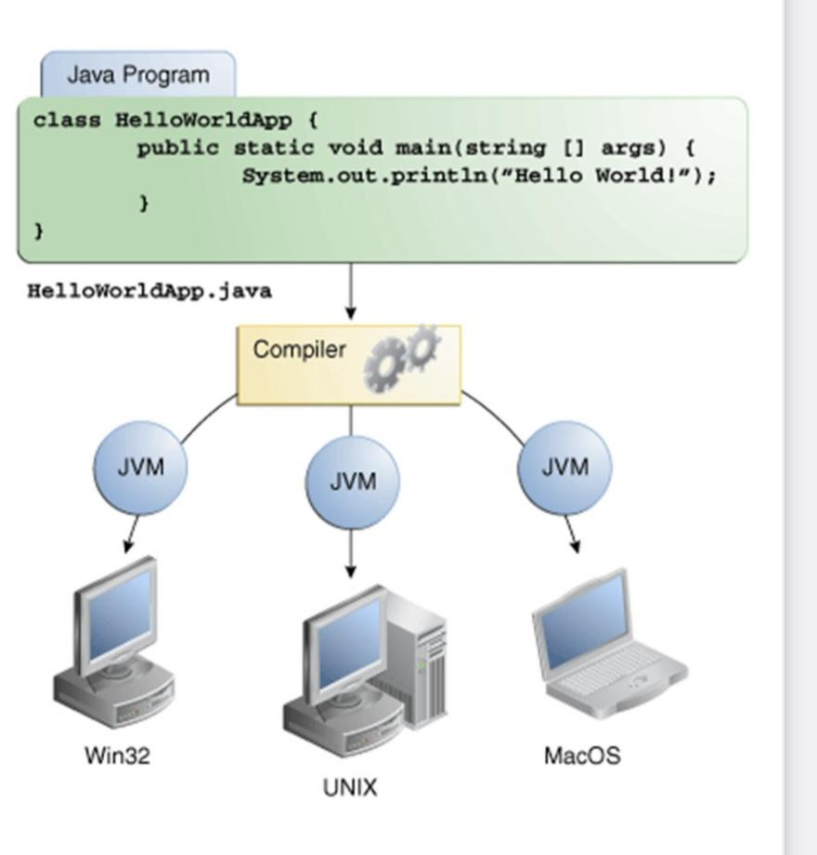
How Java works

