Slide 1
Parallel Programming Exercise Session 10

Slide 2
Lecture Recap

Slide 3
Semaphores
and Barriers

Slide 4
Semaphores
Locks provide means to enforce atomicity via mutual exclusion
They lack the means for threads to communicate about changes
We need something stronger to coordinate threads (e.g. to implement rendezvous)

Slide 5
Semaphores
S = new Semaphore(n) - create a new semaphore with n permits

Slide 6
Building a lock with Semaphores

Slide 7
Semaphores aren’t Locks!
We can build Locks with Semaphores
Some key differences:
More than one Thread can be in critical section!
How many depends on the number of permits
Threads can release() a Semaphore without accquiring before!
The is no notion of “holding” a Semaphore as we have with ”holding” Locks

Slide 8
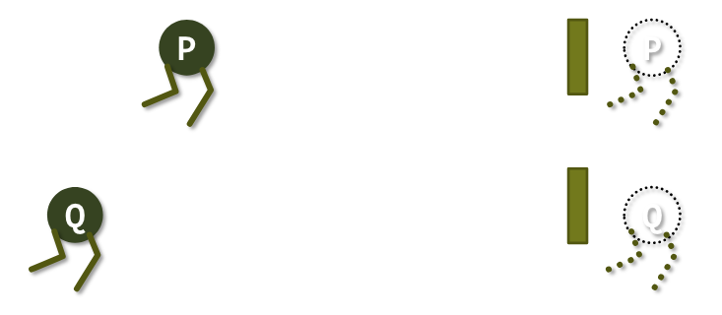
Rendezvous with Semaphores
Two processes P and Q execute code
Rendezvouz: locations in code, where P and Q wait for the other to arrive. Synchronize P and Q.

Slide 9
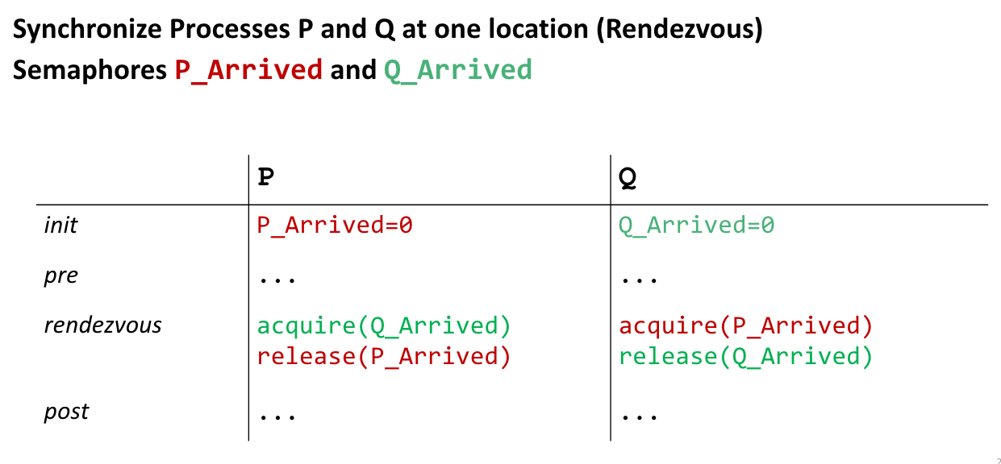
First attempt, whats wrong?

Slide 10
Deadlock :(
We are never able to release! Both P and Q wait endlessly for each other ☹

Slide 11
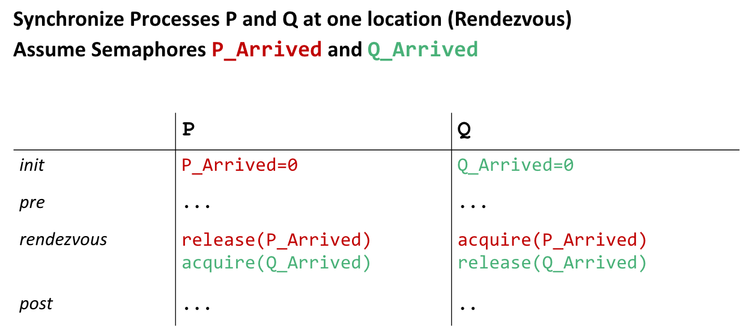
Attempt two, better?

Slide 12
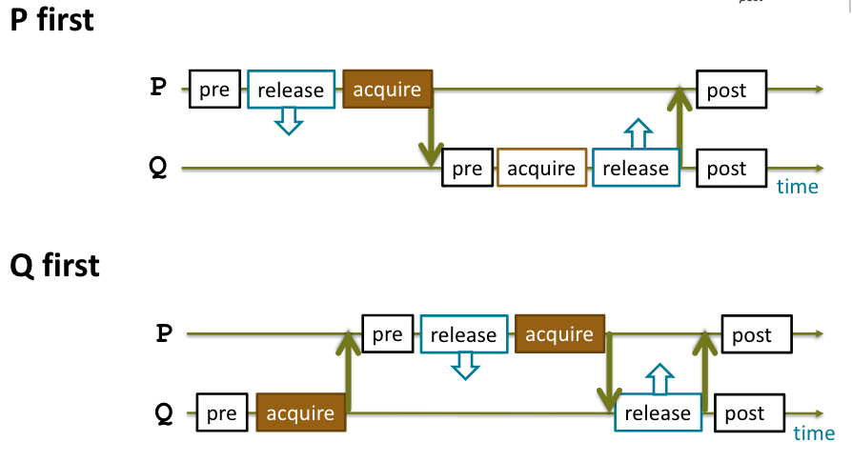
Yes, that works!

Slide 13
Yes, that works!
Many context switches

Slide 14
Lets do better!

Slide 15
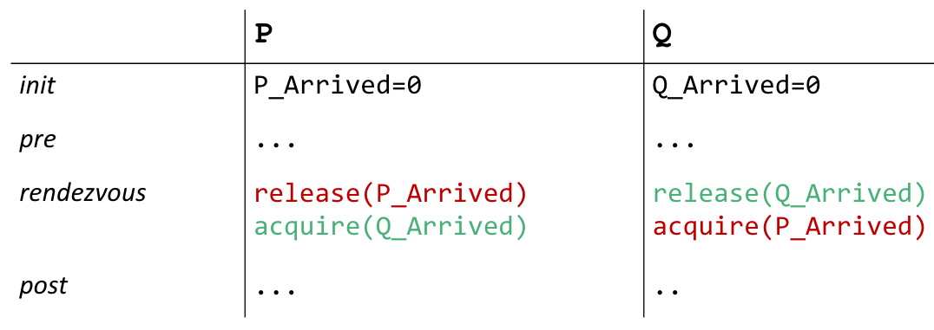
Order does no longer matter

Slide 16
How about more than two threads? Barriers!

Slide 17
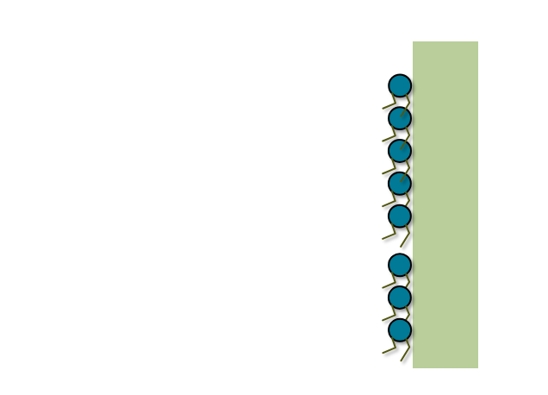
How about more than two threads? Barriers!

Slide 18
First attempt

Slide 19
Wrong

Slide 20
How about this?
Notes:
Works, but not resuable

Slide 21
Reusable Barrier

Slide 22
Reusable Barrier

Slide 23
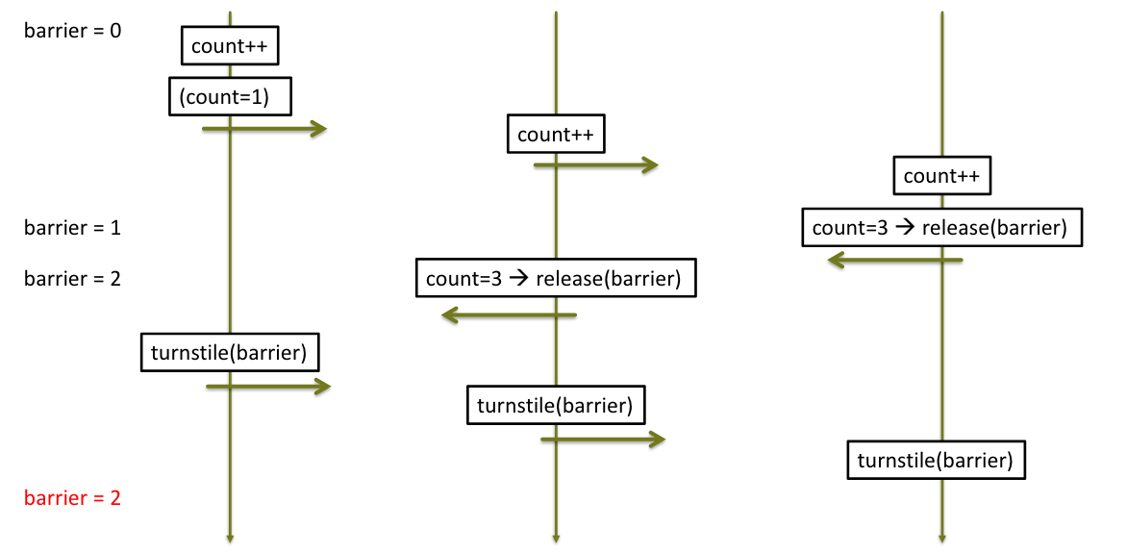
Scheduling Scenario

Slide 24
Reusable Barrier 2nd try

Slide 25
Doesn’t quite work yet

Slide 26
Solution: Two-Phase Barrier

Slide 27
Monitors

Slide 28
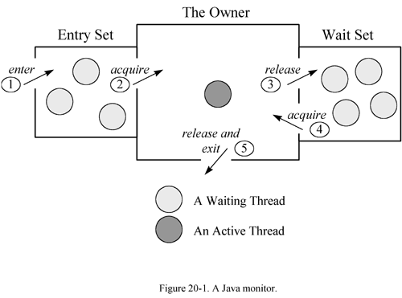
Monitors
Monitors provide two kinds of thread synchronization: mutual exclusion and cooperation using a lock
higher level mechanism than semaphores and more powerful
instance of a class that can be used safely by several threads
all methods of a monitor are executed with mutual exclusion

Slide 29
Monitors
Monitors provide two kinds of thread synchronization: mutual exclusion and cooperation using a lock
the possibility to make a thread waiting for a condition
signal one or more threads that a condition has been met

Slide 30
Monitors
Uses intrinsic lock (synchronized) of an object
wait() – the current thread waits until it is signaled
notify() – wakes up one waiting thread
notifyAll() – wakes up all waiting threads

Slide 31
Monitors
More abstractly there are 4 options:
Signal & Continue (SC) : The process who signal keep the mutual exclusion and the signaled will be awaken but need to acquire the mutual exclusion before going. (Java’s option)
Signal & Wait (SW) : The signaler is blocked and must wait for mutual exclusion to continue and the signaled thread is directly awaken and can start continue its operations.
Signal & Urgent Wait (SU) : Like SW but the signaler thread has the guarantee than it would go just after the signaled thread
Signal & Exit (SX) : The signaler exits from the method directly after the signal and the signaled thread can start directly.
signalling process continues running
signalling process moves signalled process to entry queue
31

Slide 32
Producer-Consumer Problem

Slide 33
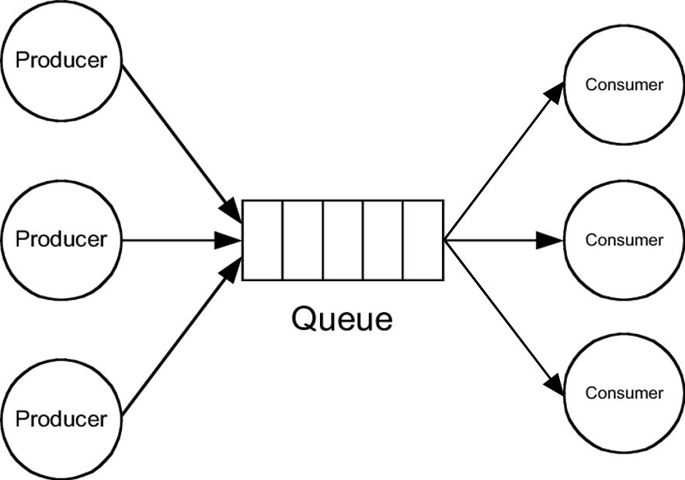
Producer-Consumer Problem
Generating Data
Processing Data
Buffer
Notes:
Sneak Peek for next week

Slide 34
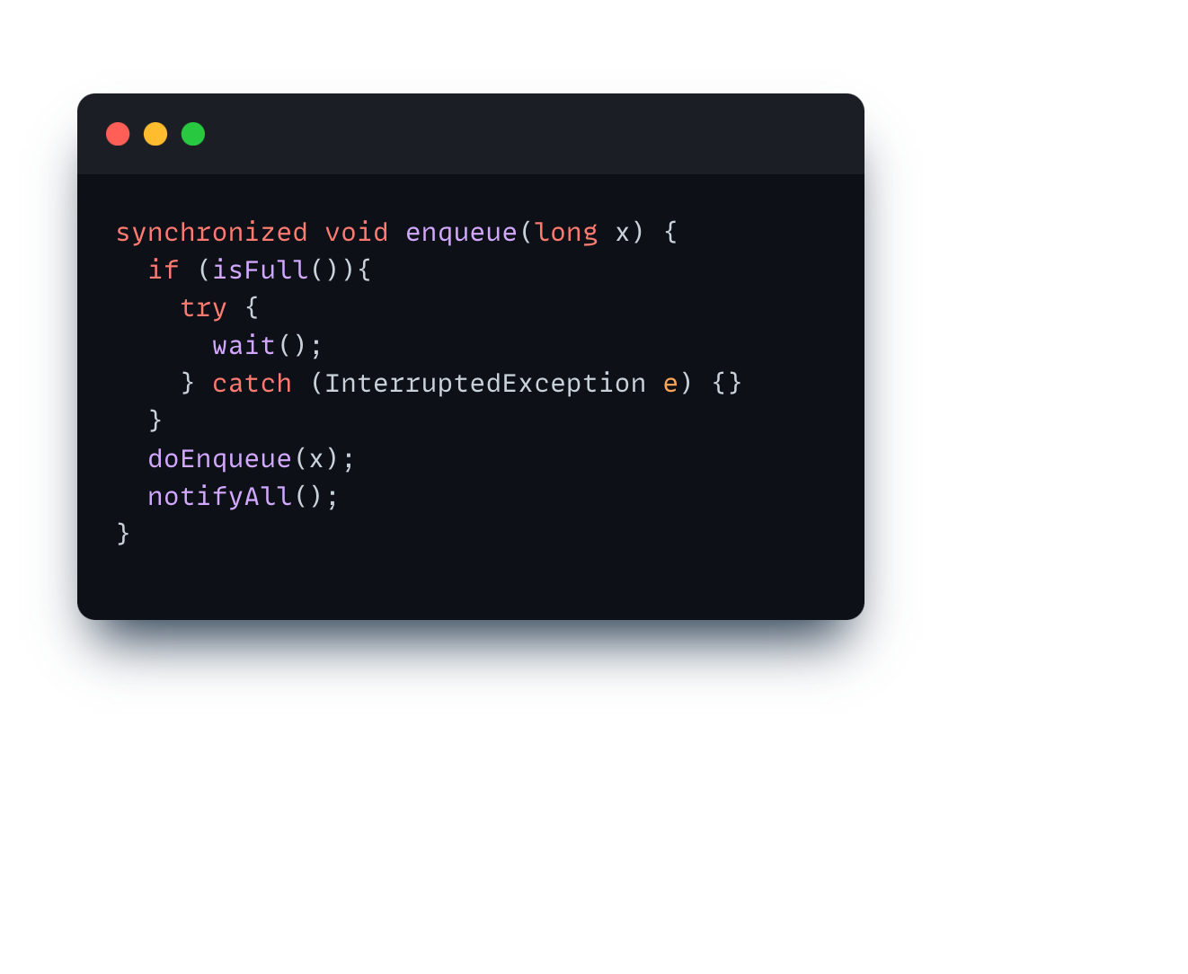
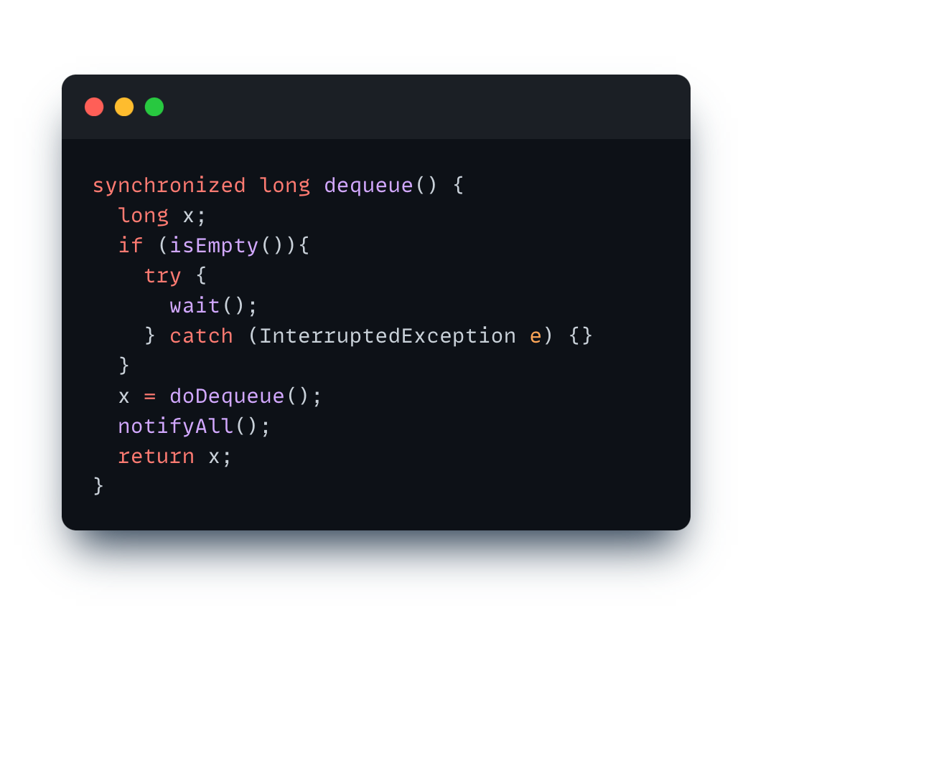
A simple implementation, correct?

Slide 35
A simple implementation, correct?
Queue is full
Process Q enters enqueue(), sees isFull(), and goes to the waiting list.
Process P enters dequeue()
In this moment process R wants to enter enqueue() and blocks
P signals Q and thus moves it into the ready queue, P then exits dequeue()
R enters the monitor before Q and sees !isFull(), fills the queue, and exits the monitor
Q resumes execution assuming isFull() is false
=> Inconsistency!

Slide 36
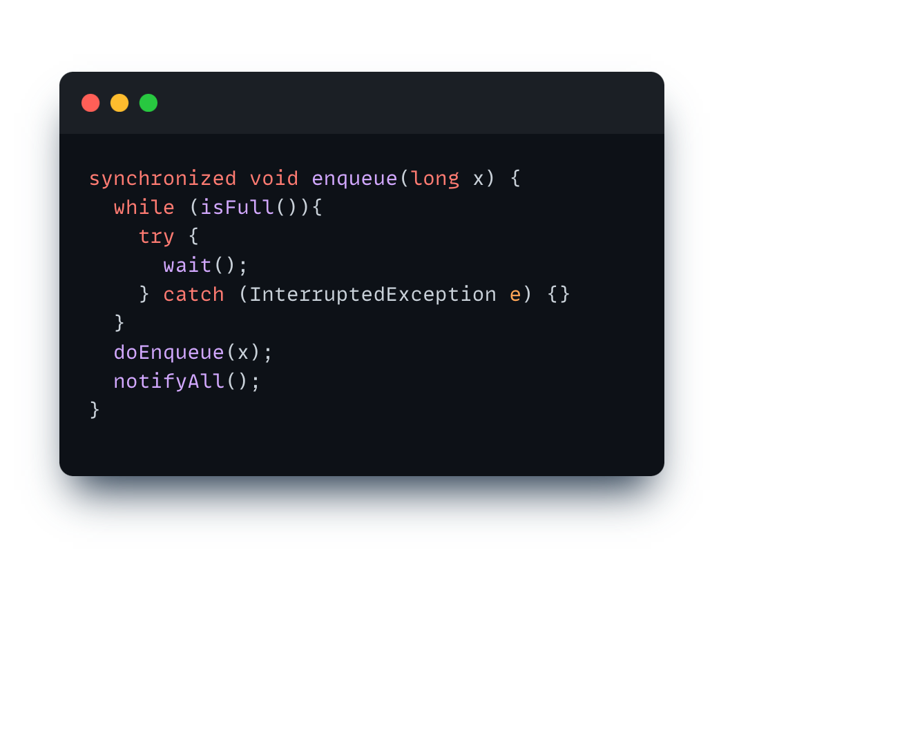
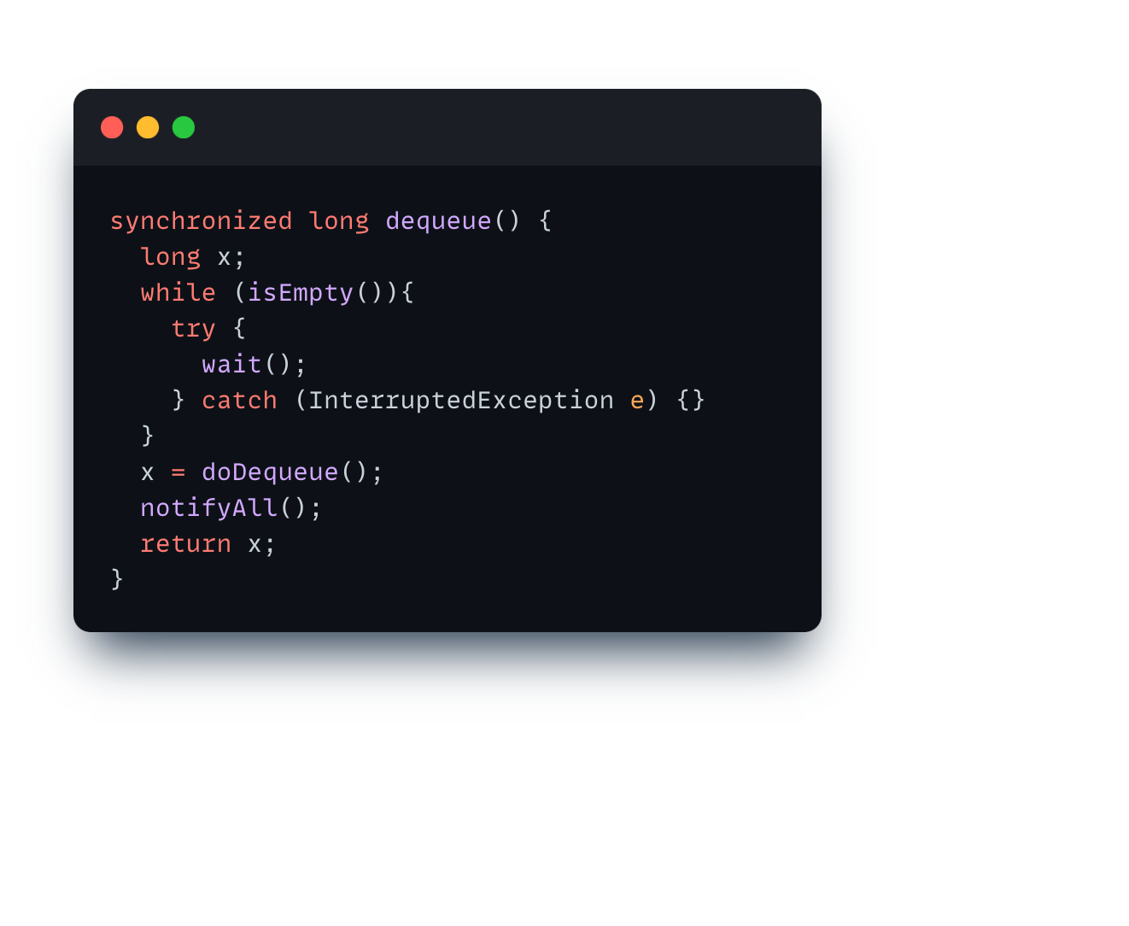
A simple implementation, correct?

Slide 37
Whats the problem here?
Producers and Consumers are in the same “wait” queue
We must use notifyAll() because we can not target only producer (or conusmer)

Slide 38
Lets try Locks
The Lock interface:
lock(): Acquires the lock, blocks until it is acquired
tryLock(): Acquire lock only if its lock is free when function is called
unlock(): Release the lock
How do we wait/notify?

Slide 39
Use conditions!
Can be used to implement monitors!
Java Locks provide conditions that can be instantiated Condition
notFull = lock.newCondition();
Java conditions offer
.await() – the current thread waits until condition is signaled
.signal() – wakes up one thread waiting on this condition
.signalAll() – wakes up all threads waiting on this condition

Slide 40
Monitors vs Lock Conditions
Condition 1
Await
Condition 2
Condition 3

Slide 41
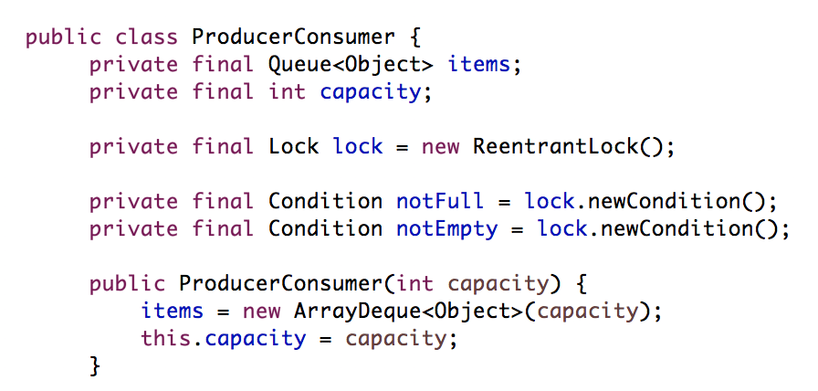
P/C Queue with Conditions

Slide 42
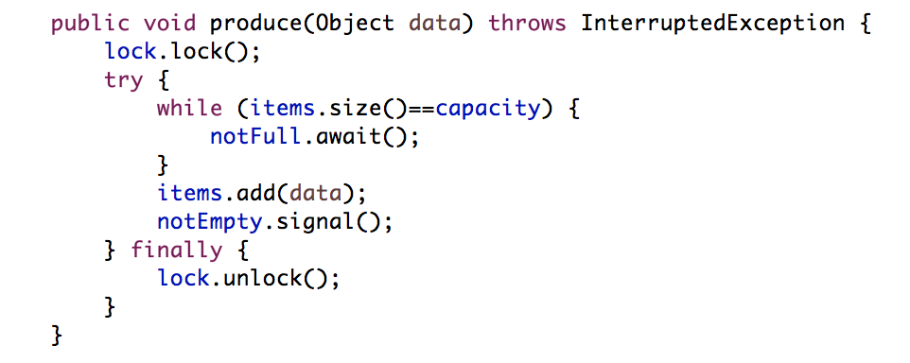
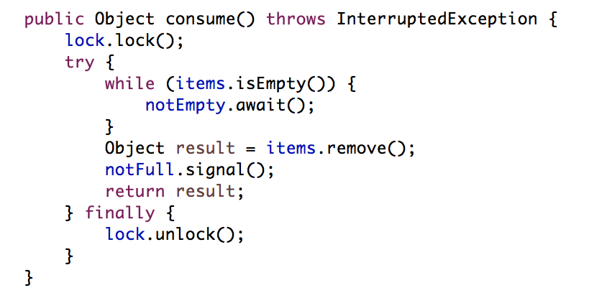
P/C Queue with Conditions

Slide 43
Why do we need the lock?

Slide 44
What is still not perfect?
notFull and notEmpty signal will be sent in any case, even when no threads are waiting.
This is expensive!
A simple solution: Sleeping Barber
Sleeping barber requires additional counters for checking if processes are waiting:
𝑚 ≤ 0 ⇔ buffer full & -𝑚 producers (clients) are waiting
𝑛 ≤ 0 ⇔ buffer empty & -𝑛 consumers (barbers) are waiting

Slide 45
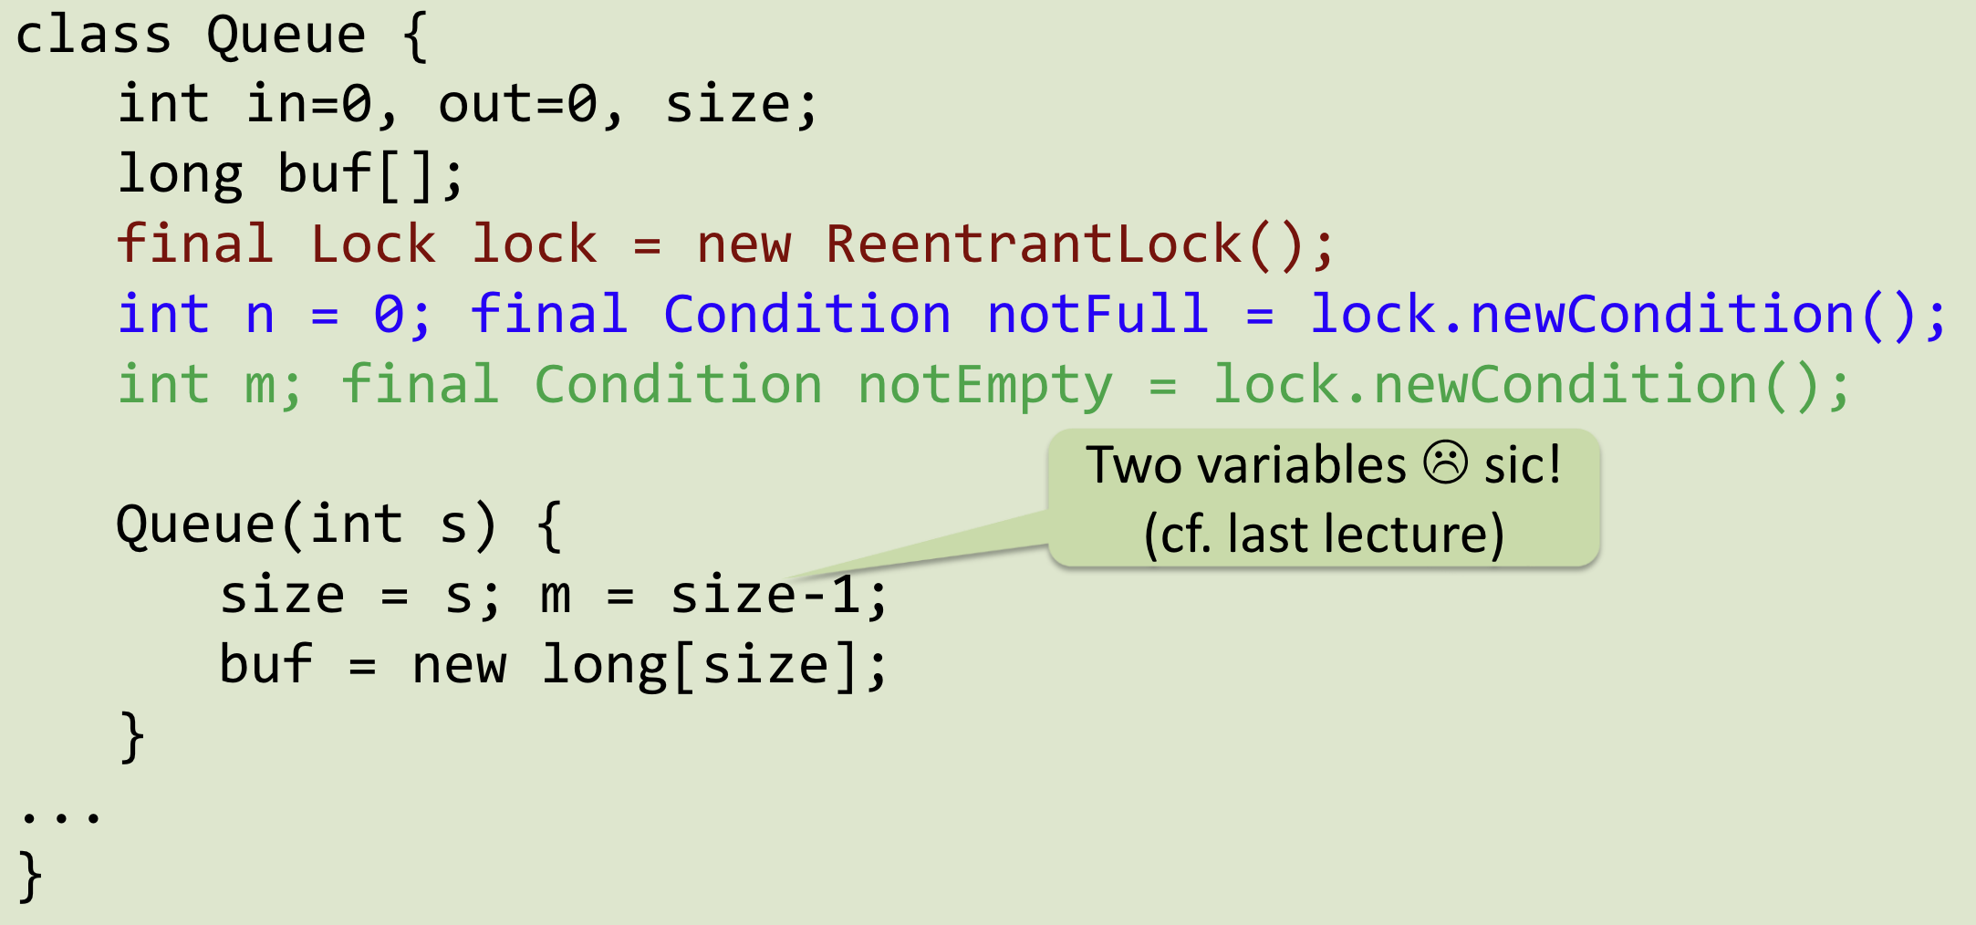
P/C, Sleeping Barber Variant

Slide 46
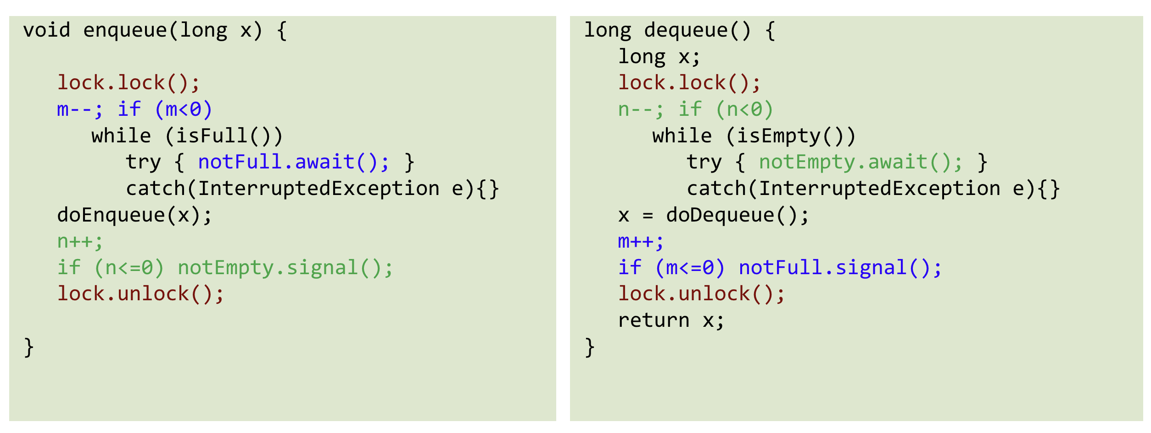
P/C, Sleeping Barber Variant

Slide 47
Guidelines to using condition waits
Always have a condition predicate
Always test the condition predicate:
before calling wait
after returning from wait
Always call wait in a loop
Ensure state is protected by lock associated with condition
What could go wrong if you don’t? (e.g. in sleeping barber variant)

Slide 48
Assignment 9
48
Notes:
48

Slide 49
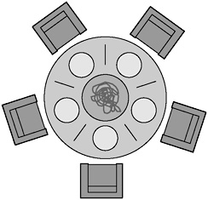
Task 1 - Dining Philosophers
Originally proposed by E. W. Dijkstra
Imagine five philosophers who spend their lives thinking and eating.
They sit around a circular table with five chairs with a big plate of spaghetti.
However, there are only five chopsticks available.
49

Slide 50
Task 1 - Dining Philosophers
Each philosopher thinks and when he gets hungry picks up the two chopsticks closest to him.
• If a philosopher can pick up BOTH chopsticks, he eats for a while.
• After a philosopher finishes eating, he puts down the chopsticks and starts to think again.
50

Slide 51
Find a solution that…
• Makes deadlocks impossible
• Has no starvation
• More than one parallel eating philosopher is possible
51

Slide 52
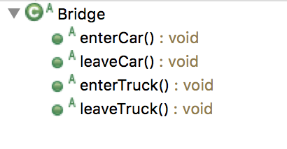
Task 2 – Monitors, Conditions and Bridges
Only either 3 cars or one truck may be on the bridge at each moment.
Implement Classes BridgeMonitor and BridgeCondition
How to Test my Implementation?
Implement method invariant() to check if the state is valid: at the end of a method there are never too many cars or trucks on the bridge
52

Slide 53
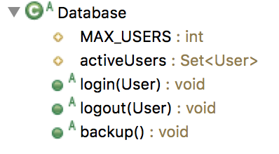
Task 3 – Semaphores and Databases
Use semaphores to implement login and logout database functionality that supports up to 10 concurrent users
Use barrier to implement 2-phase backup functionality.
53

Slide 54
Task 3 – Semaphores and Databases
Implement Classes MySemaphore and MyBarrier
Use monitors for both to avoid busy loop
Put processes to sleep, when there is no entry into semaphore
Wake up a waiting process when releasing a semaphore
acquire(S) {
wait until S > 0
dec(S)
}
release(S) {
inc(S)
}
Try to understand the existing DatabaseJava implementation before implementing your own semaphore and barrier.
54

