Slide 1
Parallel Programming Exercise Session 11

Slide 2
Assignment 11

Slide 3
Assignment 11
Implement SortedList with different lock strategies
Exercise about effective use of locks
Coarse grained vs. fine grained locks
Tricks to avoid locking altogether for certain operations
Measure the performance impact of your implementation choice
3

Slide 4
SortedListInterface
Essential
Add, Remove and Find unique elements in a sorted linked list.
add(c)
a
b
d
e

Slide 5
SortedListInterface
Essential
Add, Remove and Find unique elements in a sorted linked list.
add(c)
find b and d
b.next=c
c.next=d
a
b
d
e
c

Slide 6
SortedListInterface
Essential
Add, Remove and Find unique elements in a sorted linked list.
remove(c)
a
b
c
d

Slide 7
SortedListInterface
Essential
Add, Remove and Find unique elements in a sorted linked list.
remove(c)
find b and c
b.next=c.next
a
b
c
d

Slide 8
List and Node
public interface SortedListInterface<T extends Comparable<T>> {
public boolean add (T item);
public boolean remove (T item);
public boolean contains (T item);
}
Make sure we can sort the entries in the list!
Implement those methods in a thread-safe way

Slide 9
Implementation tipps
Keep an abstract Node to store list element:
private class Node {
public Node next ;
public T item;
}
Code is simpler if we always have two sentinel nodes in the list:
public SequentialList() {
first = new Node(Integer.MIN_VALUE);
first.next = new Node(Integer.MAX_VALUE);
}

Slide 10
Coarse Grained Locking
Essential
public synchronized boolean add(T x) {...};
public synchronized boolean remove(T x) {...};
public synchronized boolean contains(T x) {...};
add(c)
a
b
d
e

Slide 11
Coarse Grained Locking
Essential
public synchronized boolean add(T x) {...};
public synchronized boolean remove(T x) {...};
public synchronized boolean contains(T x) {...};
a
b
d
e

Slide 12
Coarse Grained Locking
Essential
public synchronized boolean add(T x) {...};
public synchronized boolean remove(T x) {...};
public synchronized boolean contains(T x) {...};
Simple, but a bottleneck for many threads, why?
a
b
d
e
c

Slide 13
Fine grained Locking
Essential
Often more intricate than visible at a first sight
requires careful consideration of special cases
Idea: split object into pieces with separate locks
no mutual exclusion for algorithms on disjoint pieces

Slide 14
Let's try this
Essential
remove(c)
a
b
c
d

Slide 15
Let's try this
Essential
remove(c)
Locking the predecessor is ok?
a
b
c
d

Slide 16
Let's try this
Essential
A: remove(c)
B: remove(b)
c not deleted!
B
A
a
b
c
d

Slide 17
Let's try this
Essential
A: remove(c)
B: remove(b)
c not deleted!
When removing, lock the successor defensively.
Waiting
B
B
A
A
a
b
c
d

Slide 18
Let's try this
Essential
A: remove(c)
B: remove(b)
c not deleted!
When removing, lock the successor defensively.
B
B
a
b
c
d

Slide 19
What's the problem?
Essential
When deleting, the next field of next is read, i.e. next also has to be protected.
find a and b
a.next=b.next
B
B
a
b
d
e

Slide 20
What about add?
Essential
add(b’)
a
b
c
d
b’

Slide 21
What about add?
Essential
A: add(b’)
B: remove(b)
b’ not added!
B
A
a
b
c
d
b’

Slide 22
What about add?
Essential
A: add(b’)
B: remove(b)
b’ not added!
Also when adding lock the successor defensively.
Waiting
B
B
A
A
a
b
c
d
b’

Slide 23
What about add?
Essential
A: add(b’)
B: remove(b)
b’ not added!
Also when adding lock the successor defensively.
B
B
a
b
c
d
b’

Slide 24
Hand-over-hand locking (remove d)
Essential
a
b
d
e
pred=-∞,curr=a
check(a<d)
a
b
d
e
pred=a,curr=b
check(b<d)
a
b
d
e
pred=b,curr=d
check(d<d)
if(d==d)
remove(d)

Slide 25
Hand-over-hand locking (remove d)
Essential
a
b
d
e
pred=-∞,curr=a
check(a<d)
a
b
d
e
What about add(c)
and contains(e)?
pred=a,curr=b
check(b<d)
a
b
d
e
pred=b,curr=d
check(d<d)
if(d==d)
remove(d)

Slide 26
Hand-over-hand locking
Essential
Benefits:
Multiple readers and writers can be actively doing work in the same list.
Readers and writers that are traversing the list in the same order will not pass each other.
The locks taken on parts of the list won't deadlock with each other, because multiple locks are acquired in the same order.

Slide 27
Hand-over-hand locking
Essential
But what’s bad?
We can have “traffic jam”, Threads can’t overtake each other
O(n) locks acquired/released => Big Overhead!

Slide 28
Optimistic Synchronization

Slide 29
Idea
Essential
Algorithm:
find nodes without locking,
then lock the two nodes and
check that everything is ok (validation)
if so perform the operation (add, remove or contains) and return true
if not return false
finally release the two locks
e.g. add(c)

Slide 30
Essential
Finding without locking
a
b
d
e
add(c)
Aha!
Notes:
30

Slide 31
Essential
Locking
a
b
d
e
add(c)
Notes:
31

Slide 32
Essential
Validation
a
b
d
e
add(c)
Notes:
32

Slide 33
Essential
Validation
a
b
d
e
add(c)
Yes. b is still reachable from head.
Notes:
33

Slide 34
Essential
Validation
a
b
d
e
add(c)
Yes. b still points to d.
Notes:
34

Slide 35
Essential
a
b
d
e
c
add(c)
Notes:
35

Slide 36
Essential
a
b
d
e
c
add(c)
Notes:
36

Slide 37
Validation: what can go wrong?
Essential
Why do we even need validation?

Slide 38
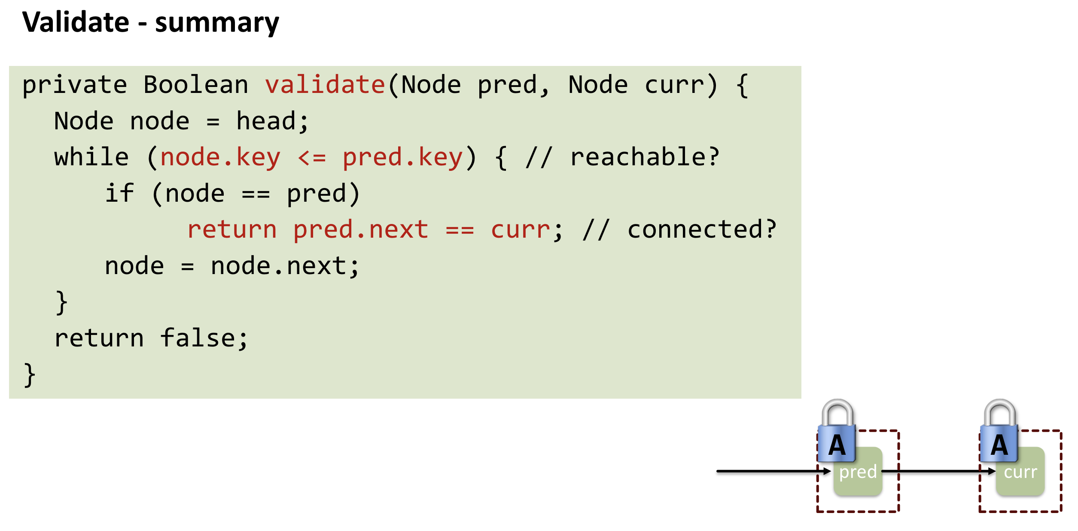

Slide 39
Validation: what can go wrong?
Essential
A: add(c)
A: find insertion point
B: remove(b)
A: lock
A: validate: rescan
A: b not reachable
→return false
a
b
d
e
B
B
a
b
d
e
A
A
a
b
d
e
Notes:
Found but not yet locked => Other thread comes in between

Slide 40
Validation: what can go wrong?
Essential
A: add(c)
A: find insertion point
B: insert(b')
A: lock
A: validate: rescan
A: d != succ(b)
→return false
a
b
d
e
B
B
a
b
d
e
b'
A
A
a
b
d
e
b'

Slide 41
Correctness (remove c)
Essential
If
nodes b and c both locked
node b still accessible
node c still successor to b
then
neither will be deleted
ok to delete and return true
If
nodes b and d both locked
node b still accessible
node d still successor to b
then
neither will be deleted
no thread can add between b and d
ok to return false

Slide 42
Optimistic List
Essential
Good:
No contention on traversals.
Traversals are wait-free.
Less lock acquisitions.
Bad:
Need to traverse list twice (find + validate)
contains() method needs to acquire locks

Slide 43
Lazy Synchronisation

Slide 44
Lazy List
Like optimistic list but
scan only once
contains() never locks
How?
Removing nodes causes trouble
do it "lazily”
add a special ”removed?” flag to the nodes

Slide 45
New Validate
Given two locked nodes
Pred is not marked
Curr is not marked
Pred points to Curr
b
c
?
?
?

Slide 46
Lazy List: Remove
Find nodes to remove (as before)
Lock predecessor and current (as before)
Validate (new validation)
Logical delete: (atomically) mark current node as removed
Physical delete: redirect predecessor's next
e.g. remove(c)
a
b
c
d

Slide 47
Lazy List: Remove
Find nodes to remove (as before)
Lock predecessor and current (as before)
Validate (new validation)
Logical delete: (atomically) mark current node as removed
Physical delete: redirect predecessor's next
e.g. remove(c)
Why atomically?
a
b
c
d
Notes:
Ask if it needs to be volatile

Slide 48
Invariant
If a node is not marked then
it is reachable from head
and reachable from its predecessor
Only check if nodes are adjacent. Why?
A: remove(c)
lock
check if b or c are marked
not marked? ok to delete:
mark c
delete c
a
b
c
d

Slide 49
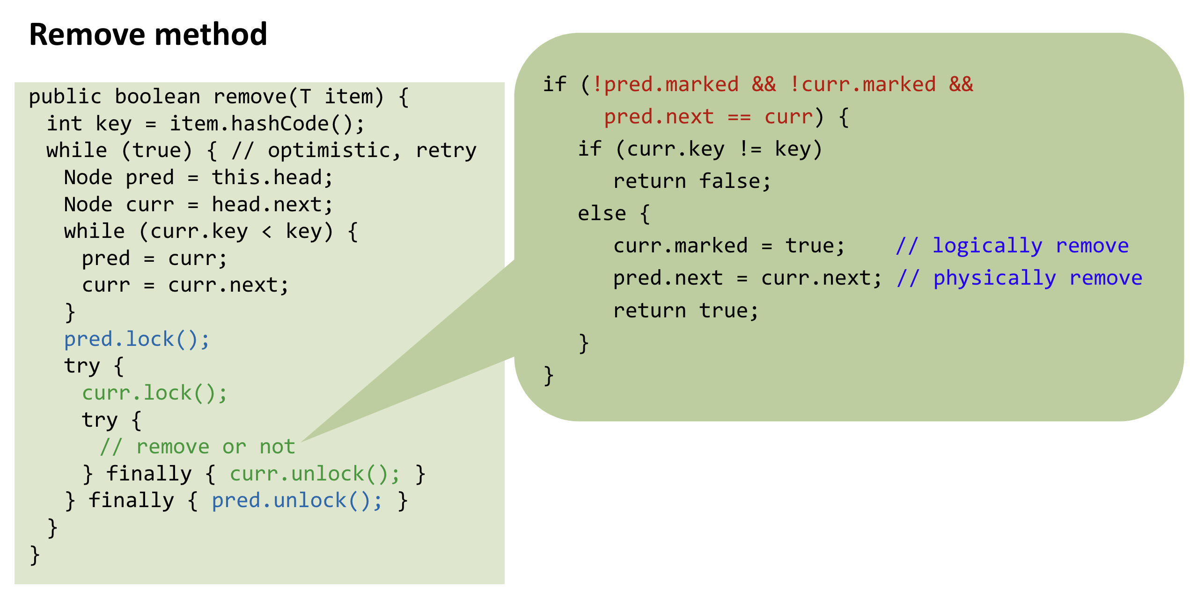
What is validate() now?

Slide 51
Lazy List: Add
Find nodes to where to add (as before)
Lock predecessor and current (as before)
Validate (new validation)
Physical add: change predecessor's next
e.g. add(b’)
a
b
c
d
b’

Slide 52
Lazy List: Contains
Find nodes to return without locking
Return true if node is not marked
e.g. contains(b)
a
b
c
d
?

Slide 53
New Validation: What can go wrong?
A: add(c)
A: find insertion point
B: remove(b)
A: lock
A: validate: marks + pred --> curr
A: b marked
→return false
a
b
d
e
B
B
a
b
d
e
A
A
a
b
d
e

Slide 54
New Validation: What can go wrong?
A: add(c)
A: find insertion point
B: insert(b')
A: lock
A: validate: marks + pred --> curr
A: pred –x-> curr
→return false
a
b
d
e
B
B
a
b
d
e
b'
A
A
a
b
d
e
b'

Slide 57
Lock-free Datastructures

Slide 58
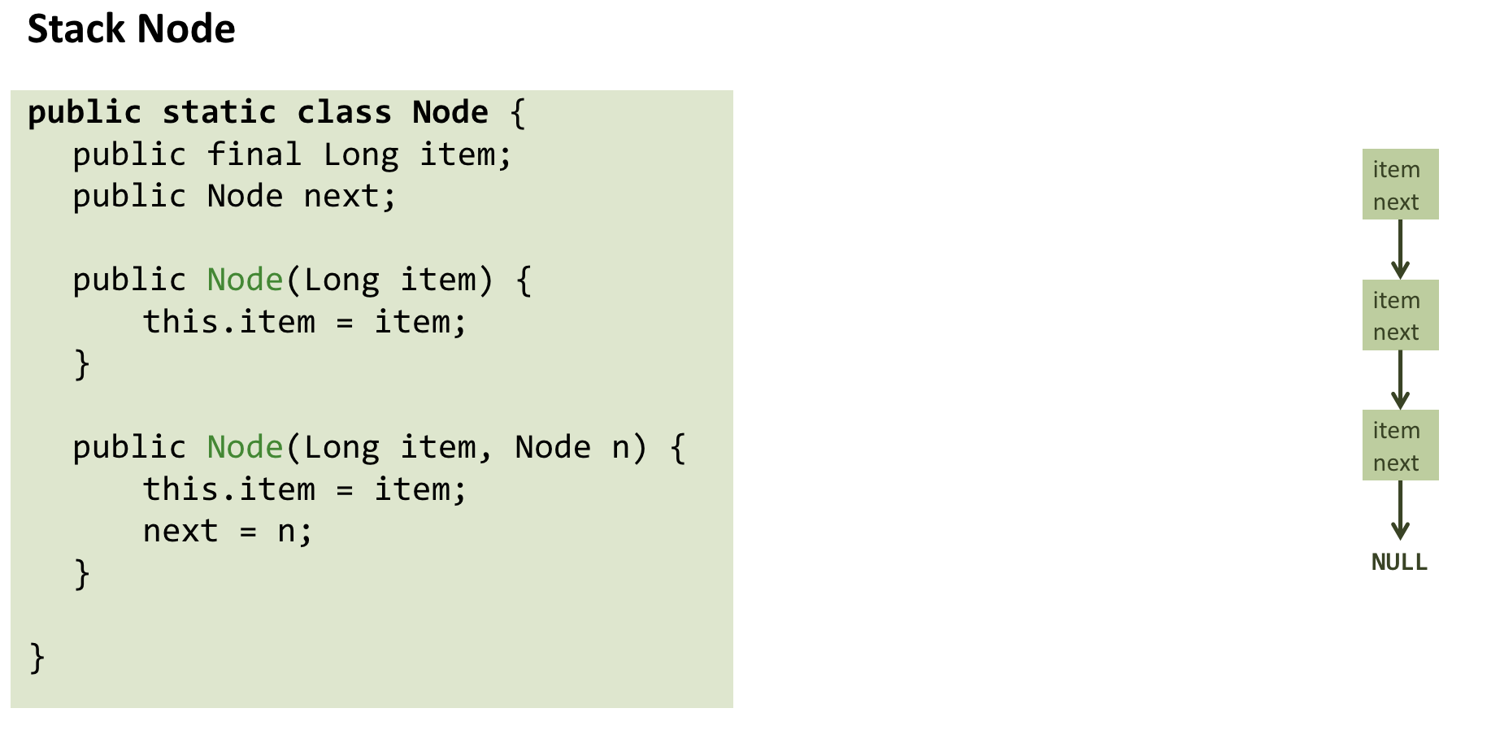

Slide 59
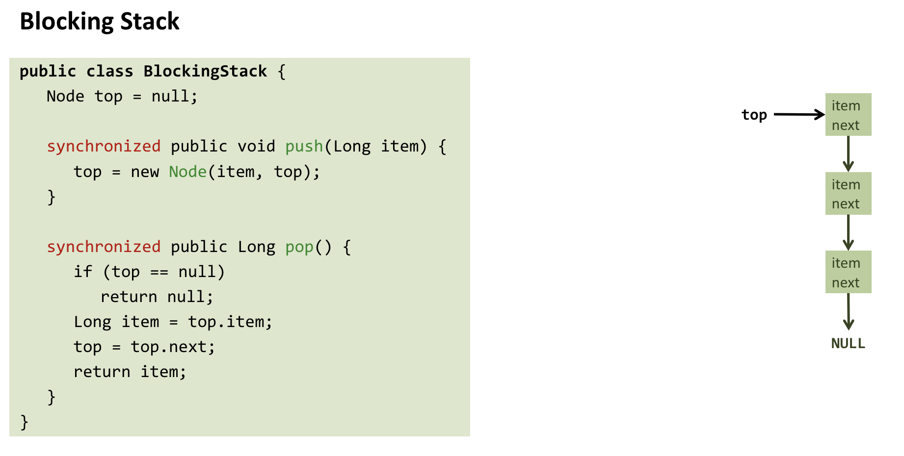

Slide 60
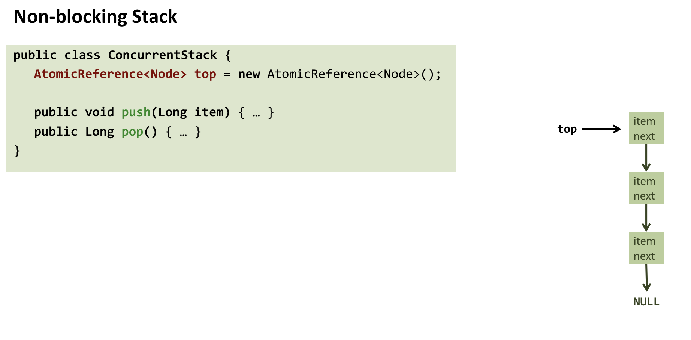

Slide 61
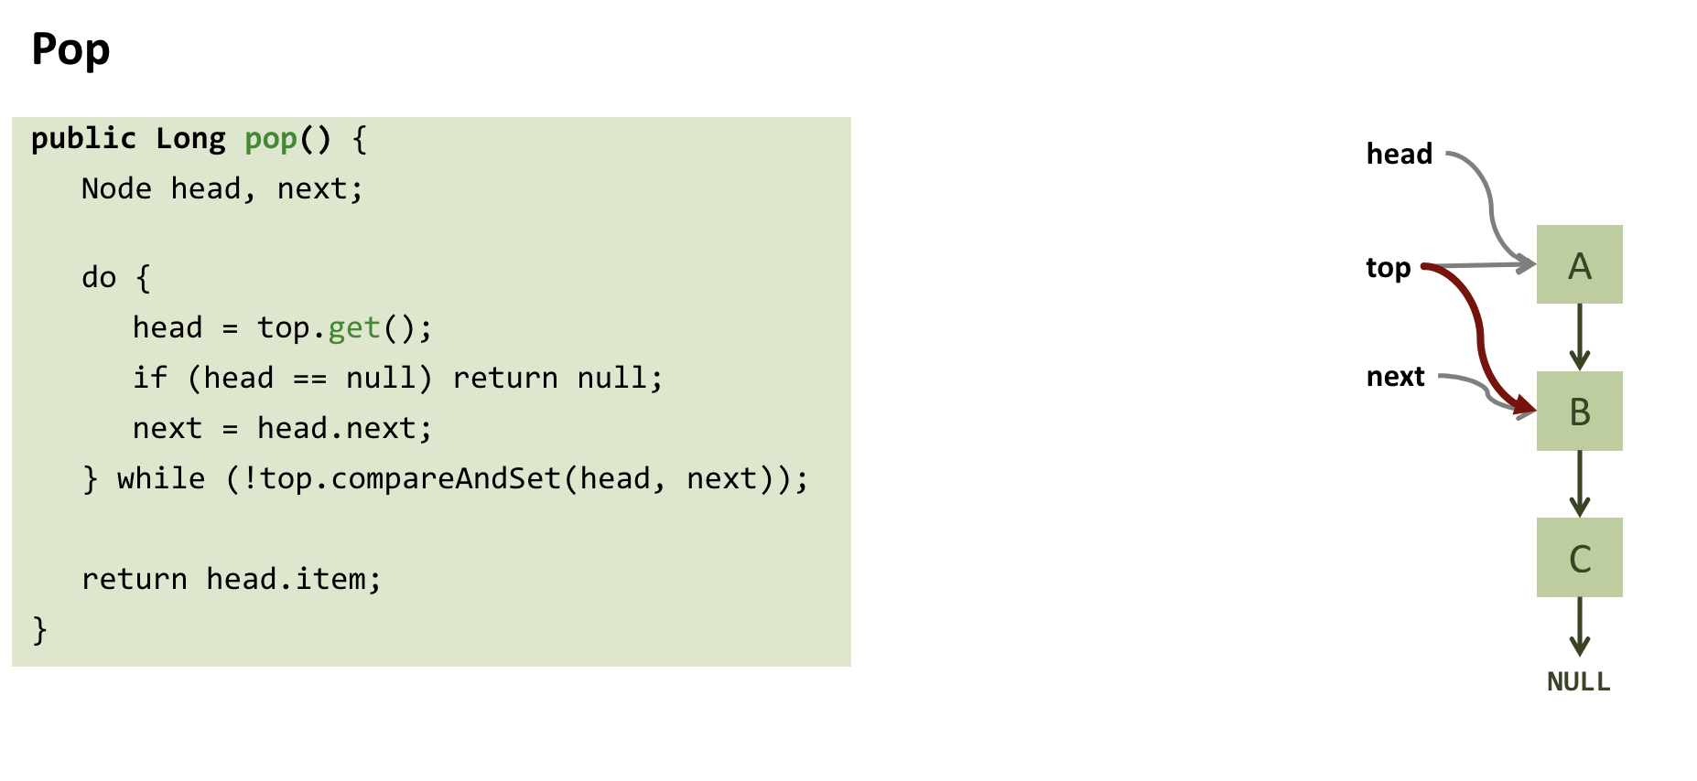

Slide 62
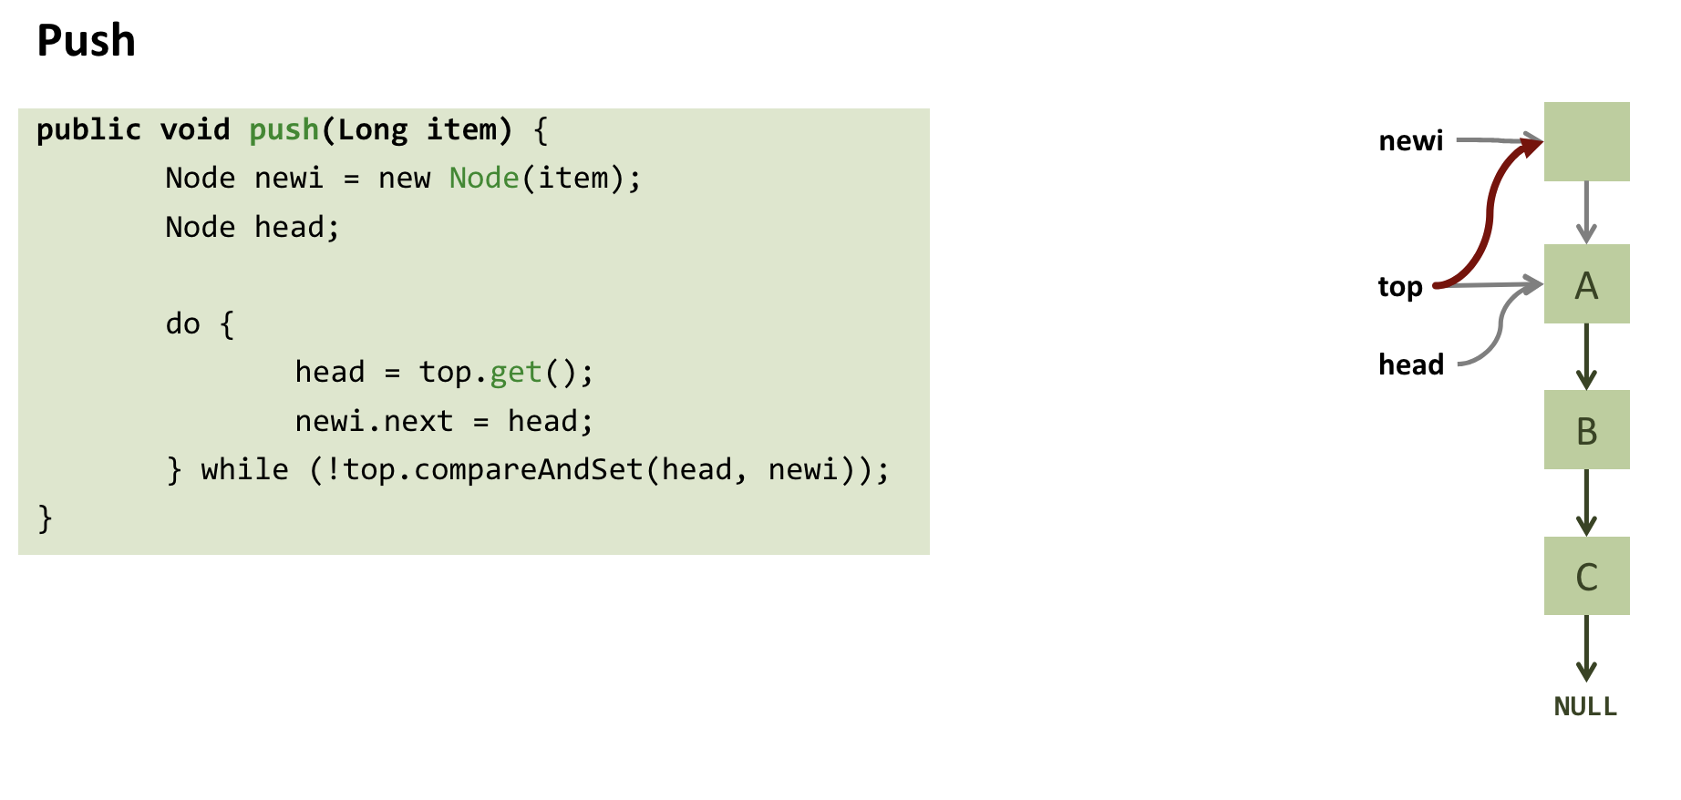

Slide 65
