Slide 1
Parallel Programming Exercise Session 2
Spring 2024

Slide 2
About me
Name: Gamal Hassan
If you have any questions, reach out to me:
E-Mail: ghassan@student.ethz.ch
Discord: @ggnh
Exercise Session Resources:
Webpage: https://n.ethz.ch/~ghassan/

Slide 3
Schedule
Motivation
Preparation assignment 2
Coding Remarks
Theory Recap
Break
Quiz
Pre-Discussion assignment 2 & Demo

Slide 4
Motivation: Why do we need Parallel Programming?
custom

Slide 5
My first encounter with parallelism
custom
User sends command (e.g. !help, !news)
Bot responds
Bot processes the command
How a Discord Bot works (roughly):

Slide 6
My first encounter with parallelism
custom
During testing the Bot had very low latency
But once I released the Bot, it became very very slow. Why?
My program used only one thread

Slide 7
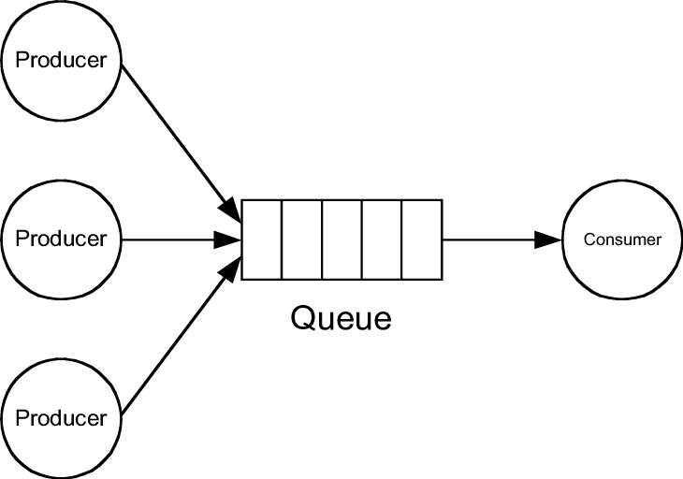
Producer-Consumer Problem
custom
Sending Commands
Processing Commands
Command Queue

Slide 8
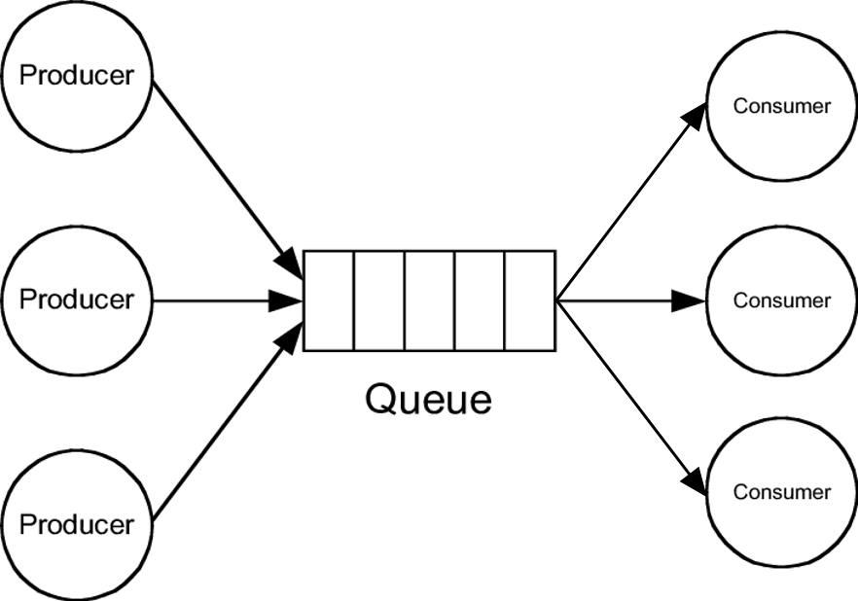
Solution? More Threads!
custom
Sending Commands
Processing Commands
Command Queue
Ideally empty!

Slide 9
Where are we?
Lecture
Feb 19 | Introduction & Course Overview
Feb 20 | Java Recap and JVM Overview
Feb 26 | Introduction to Threads and Synchronization (Part I)
Feb 27 | Introduction to Threads and Synchronization (Part II)
Mar 4 | Introduction to Threads and Synchronization (Part II)
Mar 5 | Parallel Architectures: Parallelism on the Hardware Level
Mar 11 | Basic Concepts in Parallelism
Mar 12 | Divide & Conquer and Executor Service
Mar 18 | ForkJoin Framework
Mar 29 | DAG and Parallel Algorithms (Part I)
Mar 25 | DAG and Parallel Algorithms (Part II)
Mar 26 | Virtual Threads
EASTER BREAK
Apr 08 | Shared Memory Concurrency, Locks and Data Races
Apr 09 | Fast Forward

Slide 10
Preparation Exercise 2

Slide 11
Preparations
Import assignment2.zip in Eclipse
Run the projects unit-tests in Eclipse
Understand output of unit-tests
Did the test fail or succeed?
Why did the test fail?
4. Start coding and keep checking if tests pass

Slide 12
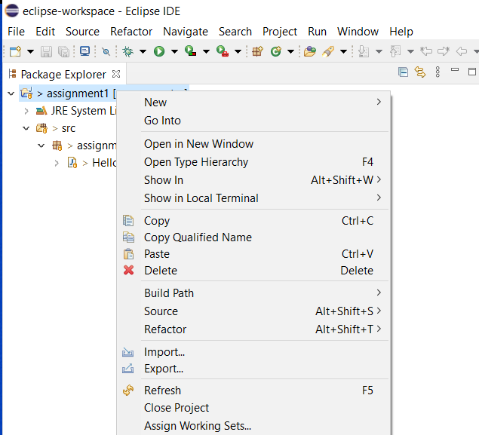
Eclipse: import project

Slide 13
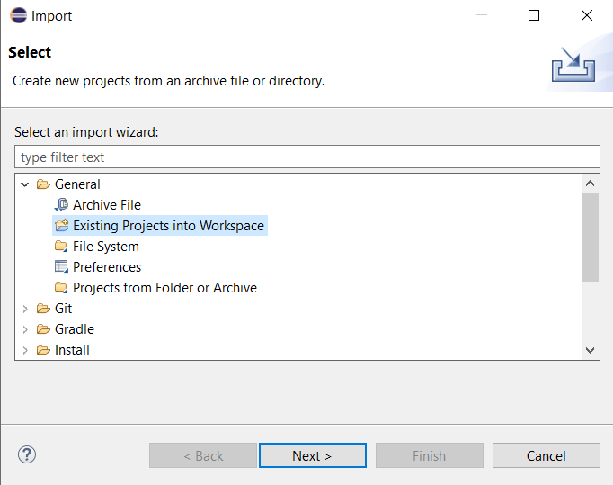
Eclipse: import project

Slide 14
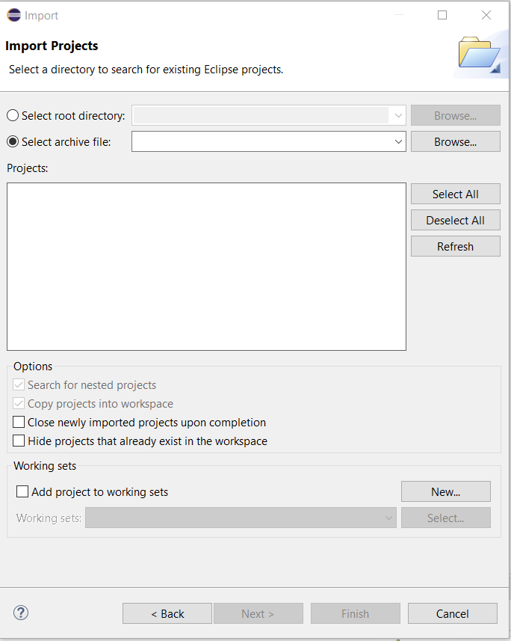
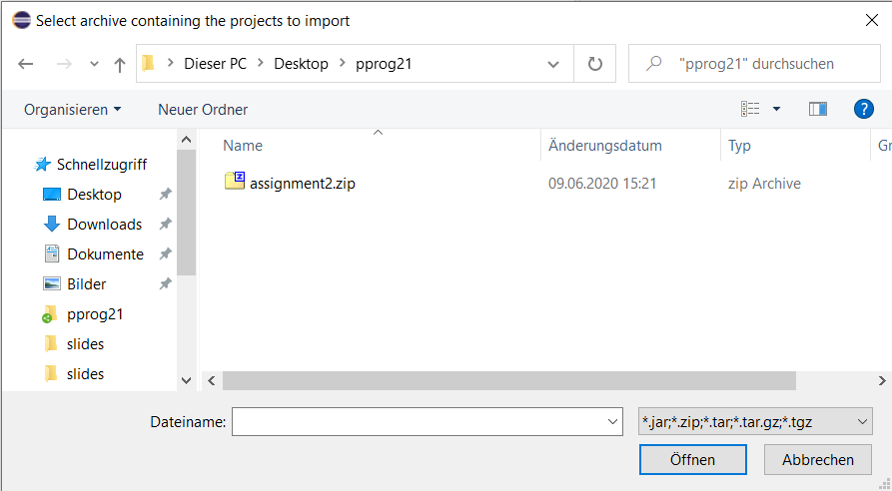
Eclipse: import project

Slide 15
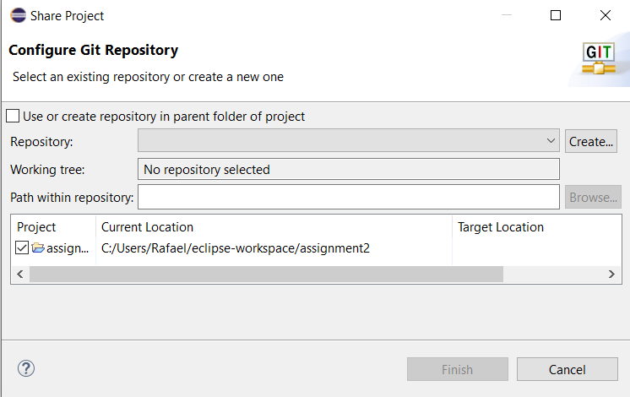
Eclipse: add to git
Team -> Share Project ...

Slide 16
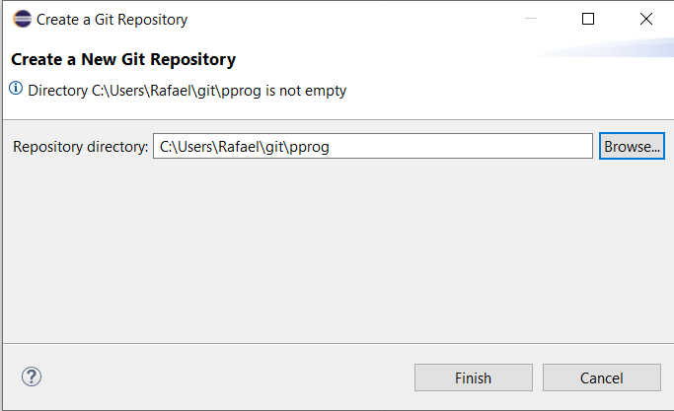
Eclipse: add to git
Important: Select same directory as for assignment 1 If you don’t have a repo yet, contact your TA

Slide 17
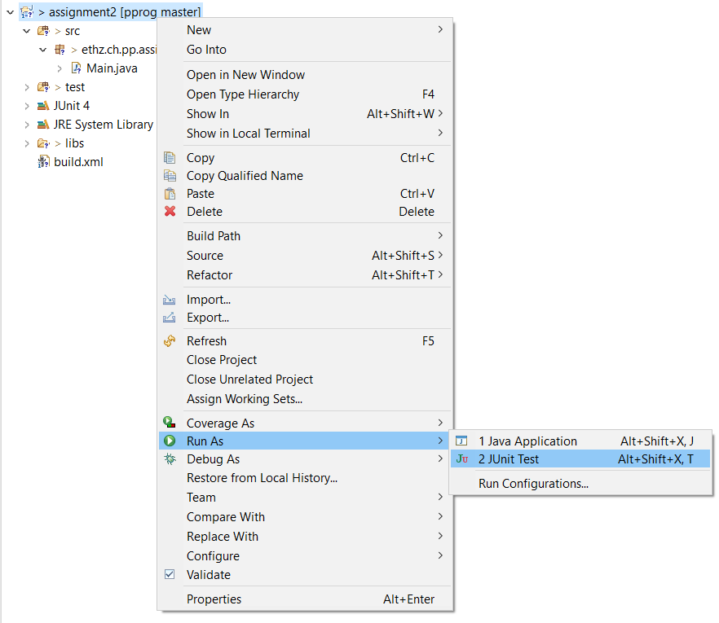
Eclipse: running JUnit tests (1)

Slide 18
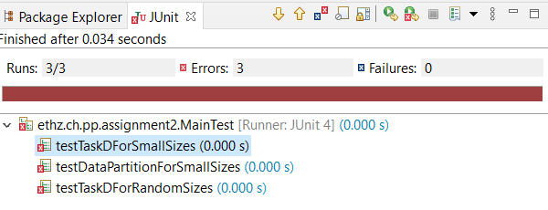
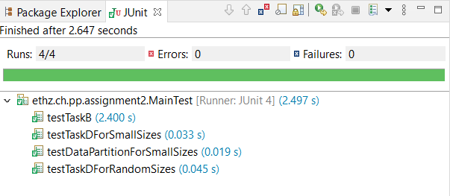
Eclipse: running JUnit tests (2)
Template
Your solution (ideally)

Slide 19
Coding Remarks

Slide 20
Code Style
essentials
Try to make your code as readable as possible
Include high-level comments that explain why you are doing something (much better than a line-by-line commentary of your code)

Slide 21
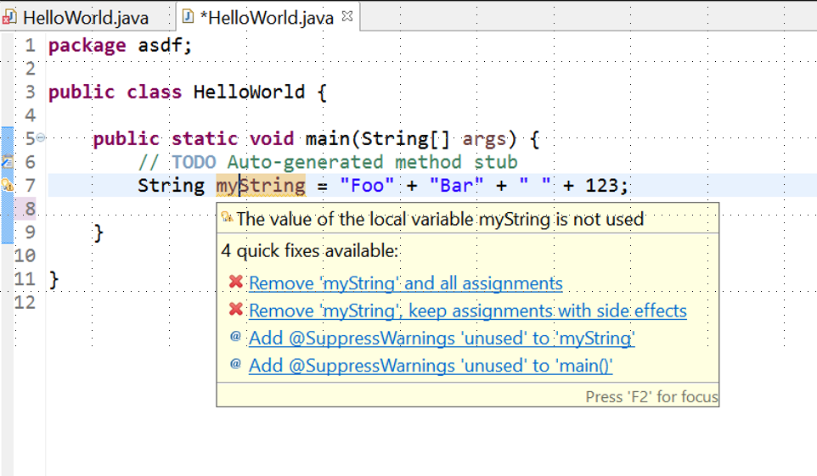
Code Style / Errors
essentials
Keep attention what Eclipse reports:

Slide 22
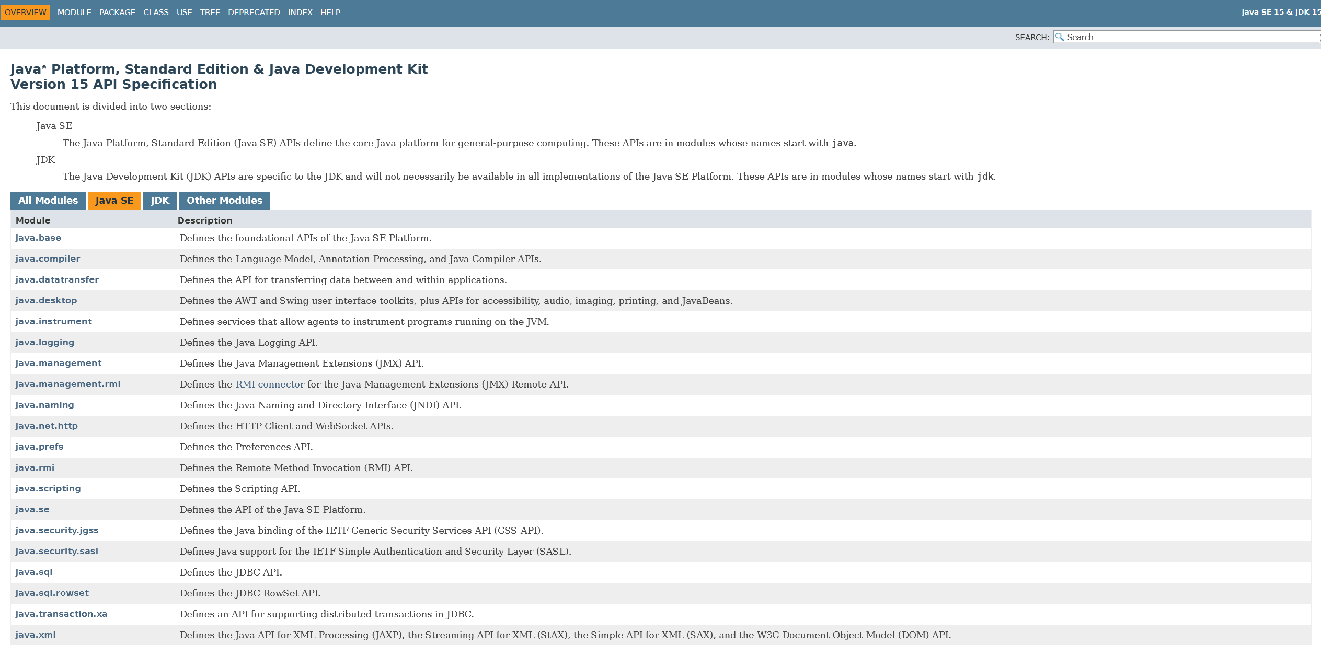
Java Doc (https://docs.oracle.com/en/java/javase/17/docs/api/index.html)
We will use Java SE
Modules

Slide 23
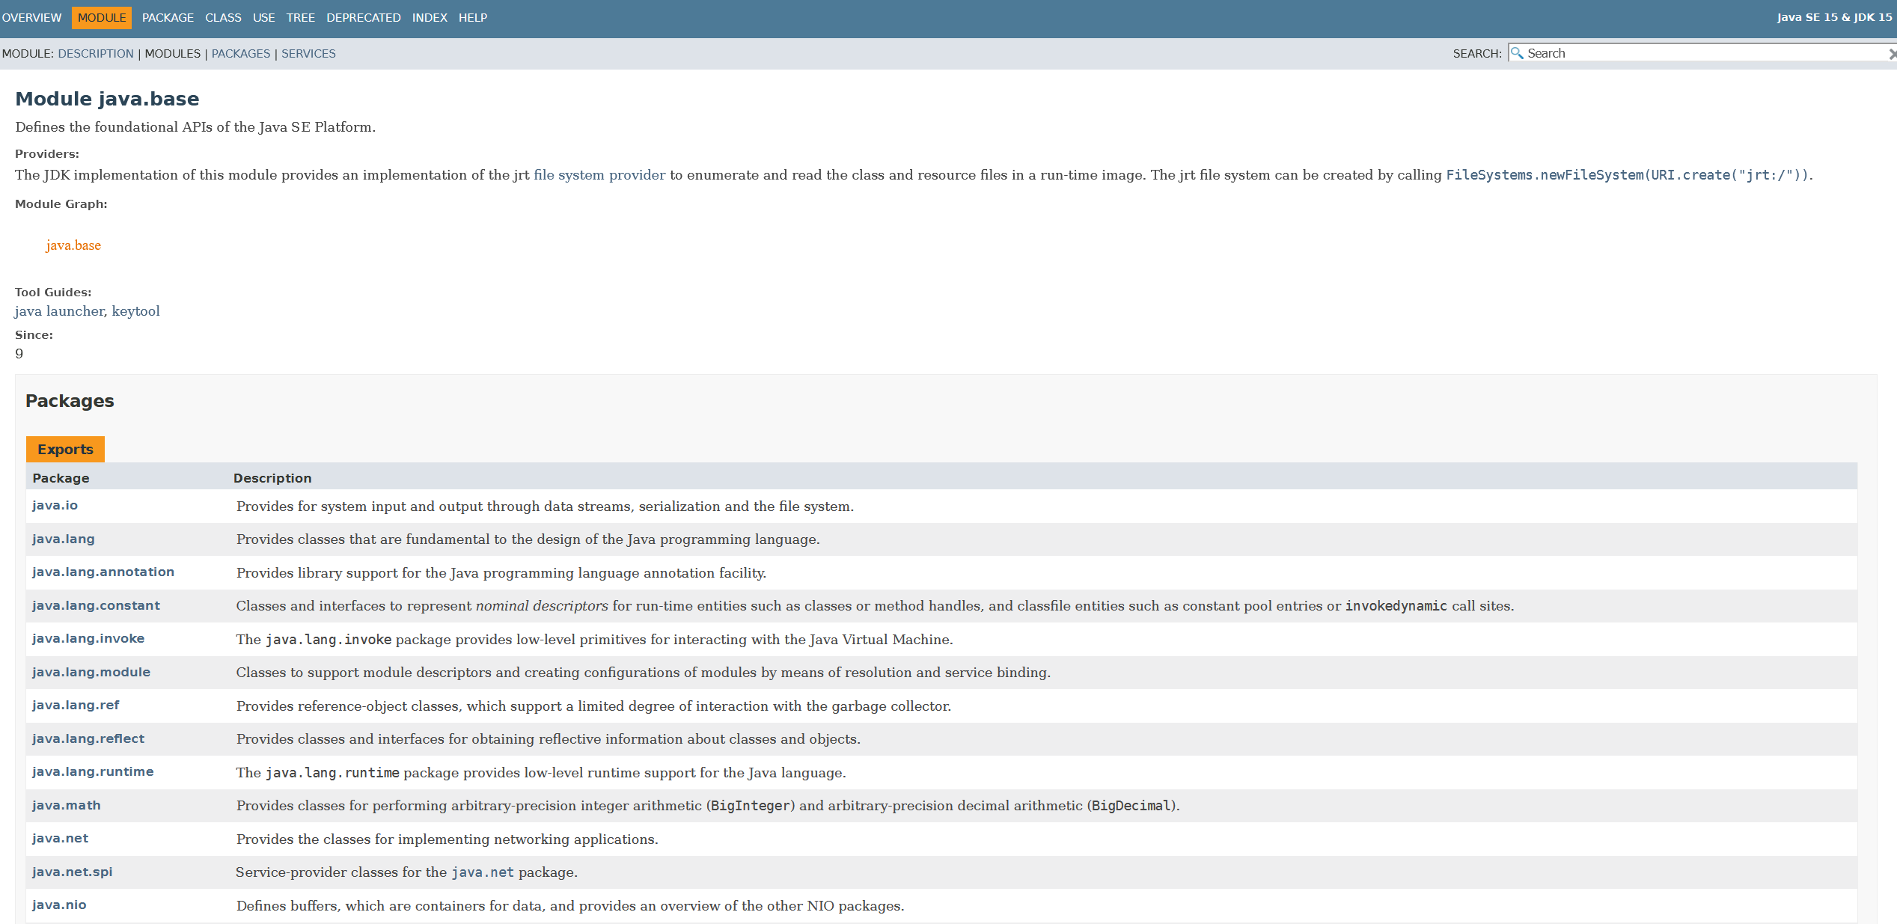
Java Doc (https://docs.oracle.com/en/java/javase/17/docs/api/index.html)
Packages

Slide 24
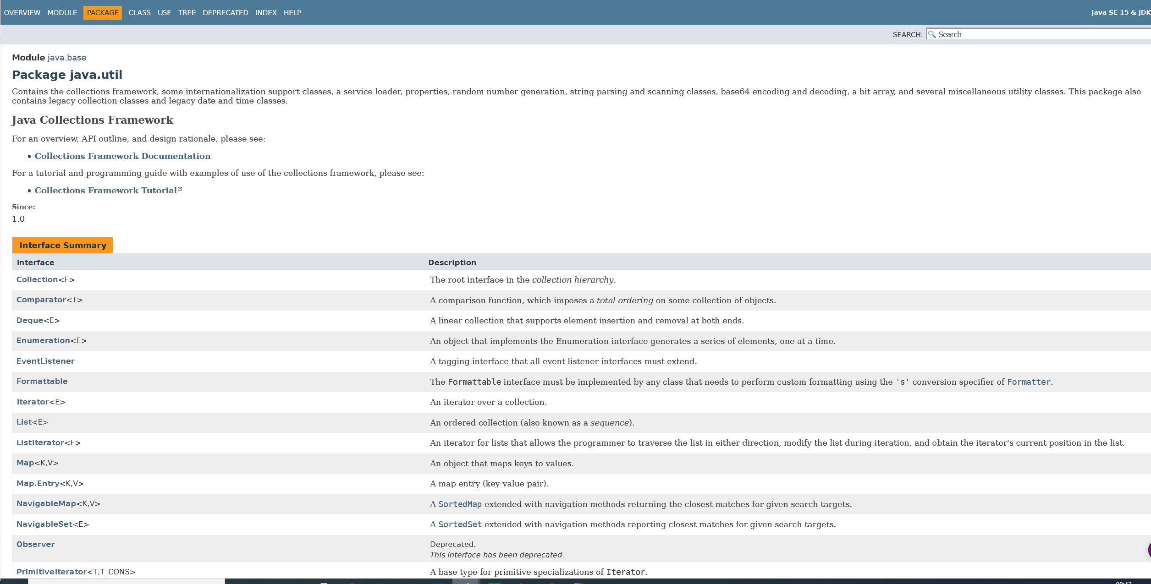
Java Doc (https://docs.oracle.com/en/java/javase/17/docs/api/index.html)
Classes

Slide 25
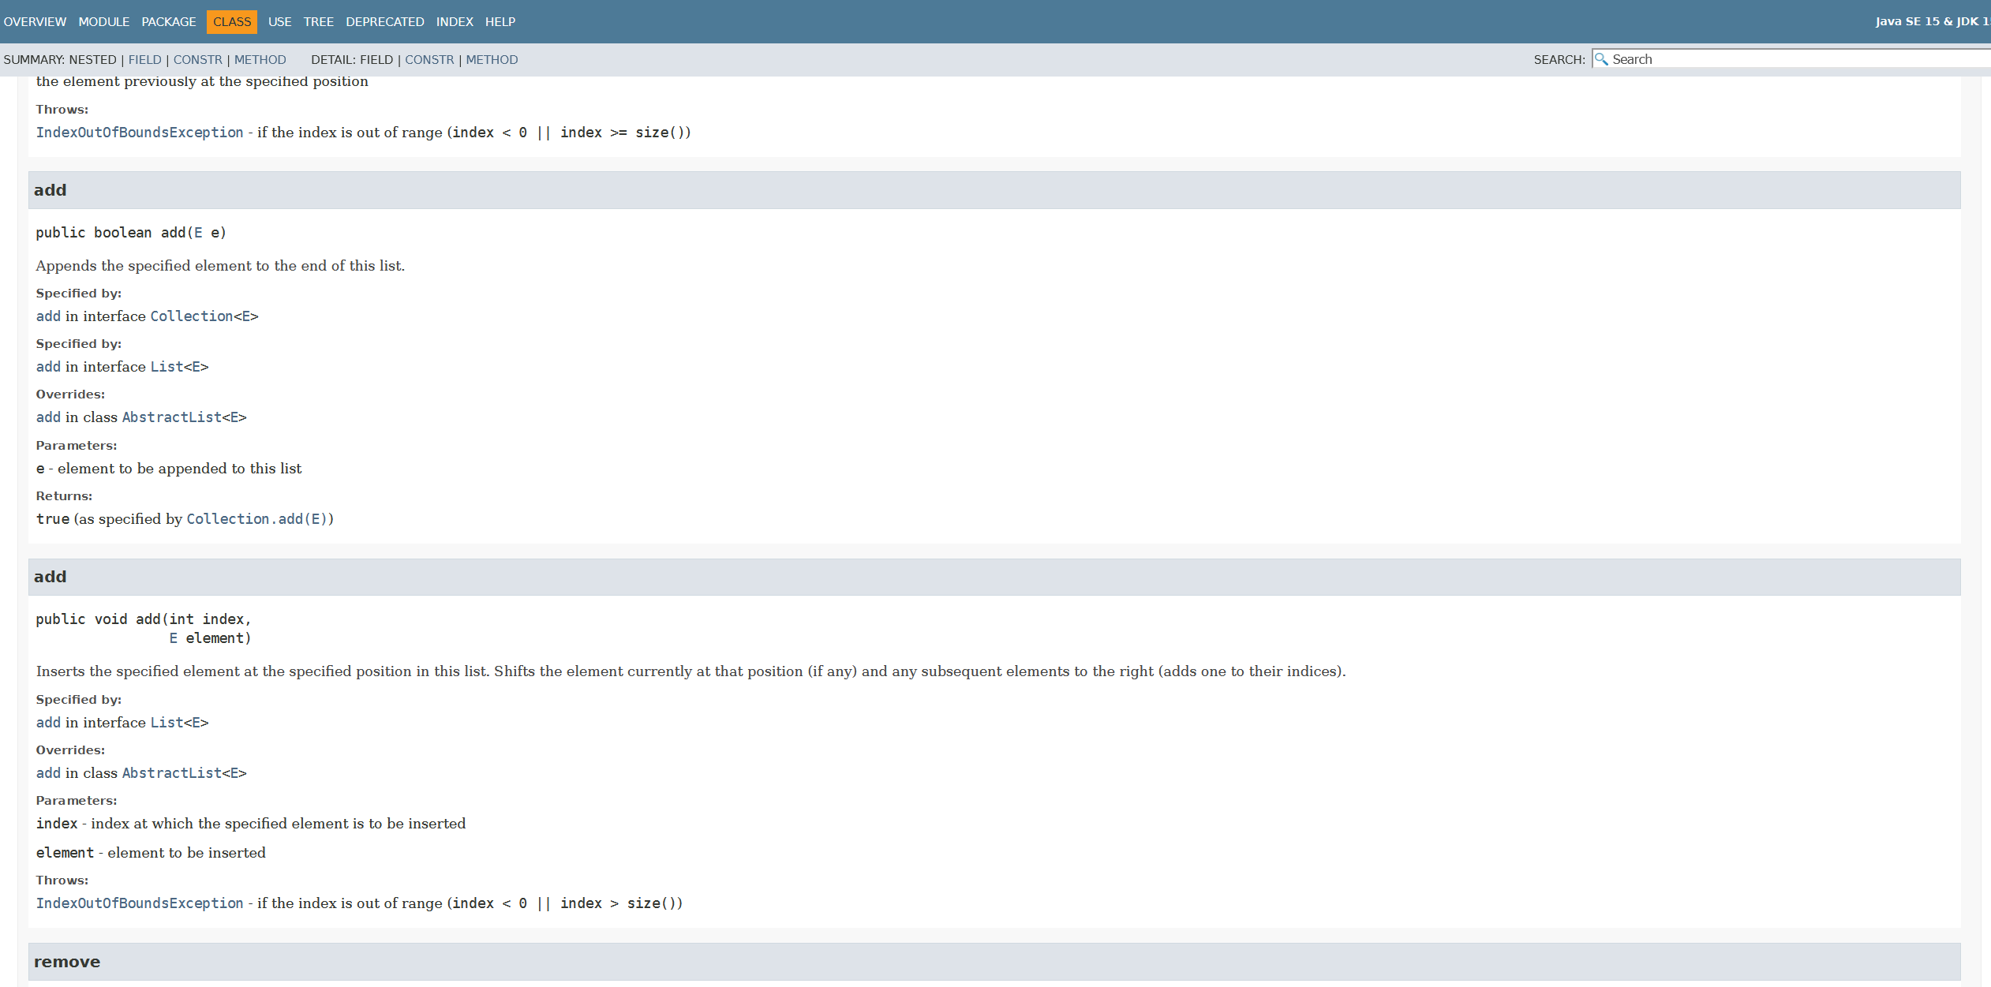
Java Doc (https://docs.oracle.com/en/java/javase/17/docs/api/index.html)
Method Signature
Semantic description what the method does
Parameter description
Possible occurring errors

Slide 26
Theory Recap

Slide 27
Terminology
Overview: https://cgl.ethz.ch/teaching/parallelprog24/pages/terminology.html

Slide 28
Thread Definition
essentials
An independent (i.e., capable of running in parallel) unit of computation that executes code.
Each thread is like a running sequential program,
but a thread can create other threads
that are then part of the same program.
Those threads can create more threads etc.

Slide 29
Thread Definition Advanced
essentials
Concept of threads exists on various levels:
Hardware (CPU)
Operating systems
Programming languages
Java: Thread class

Slide 30
Thread Properties (in our course)
essentials
Threads can create other threads
Shared memory (changes to variables by threads are visible to other Threads)
Threads (from same class) execute same program but with different arguments
Communication between threads: Writing fields of shared objects

Slide 31
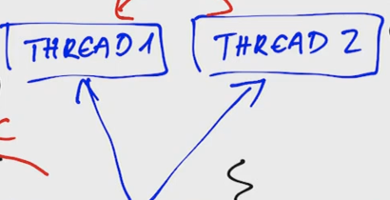
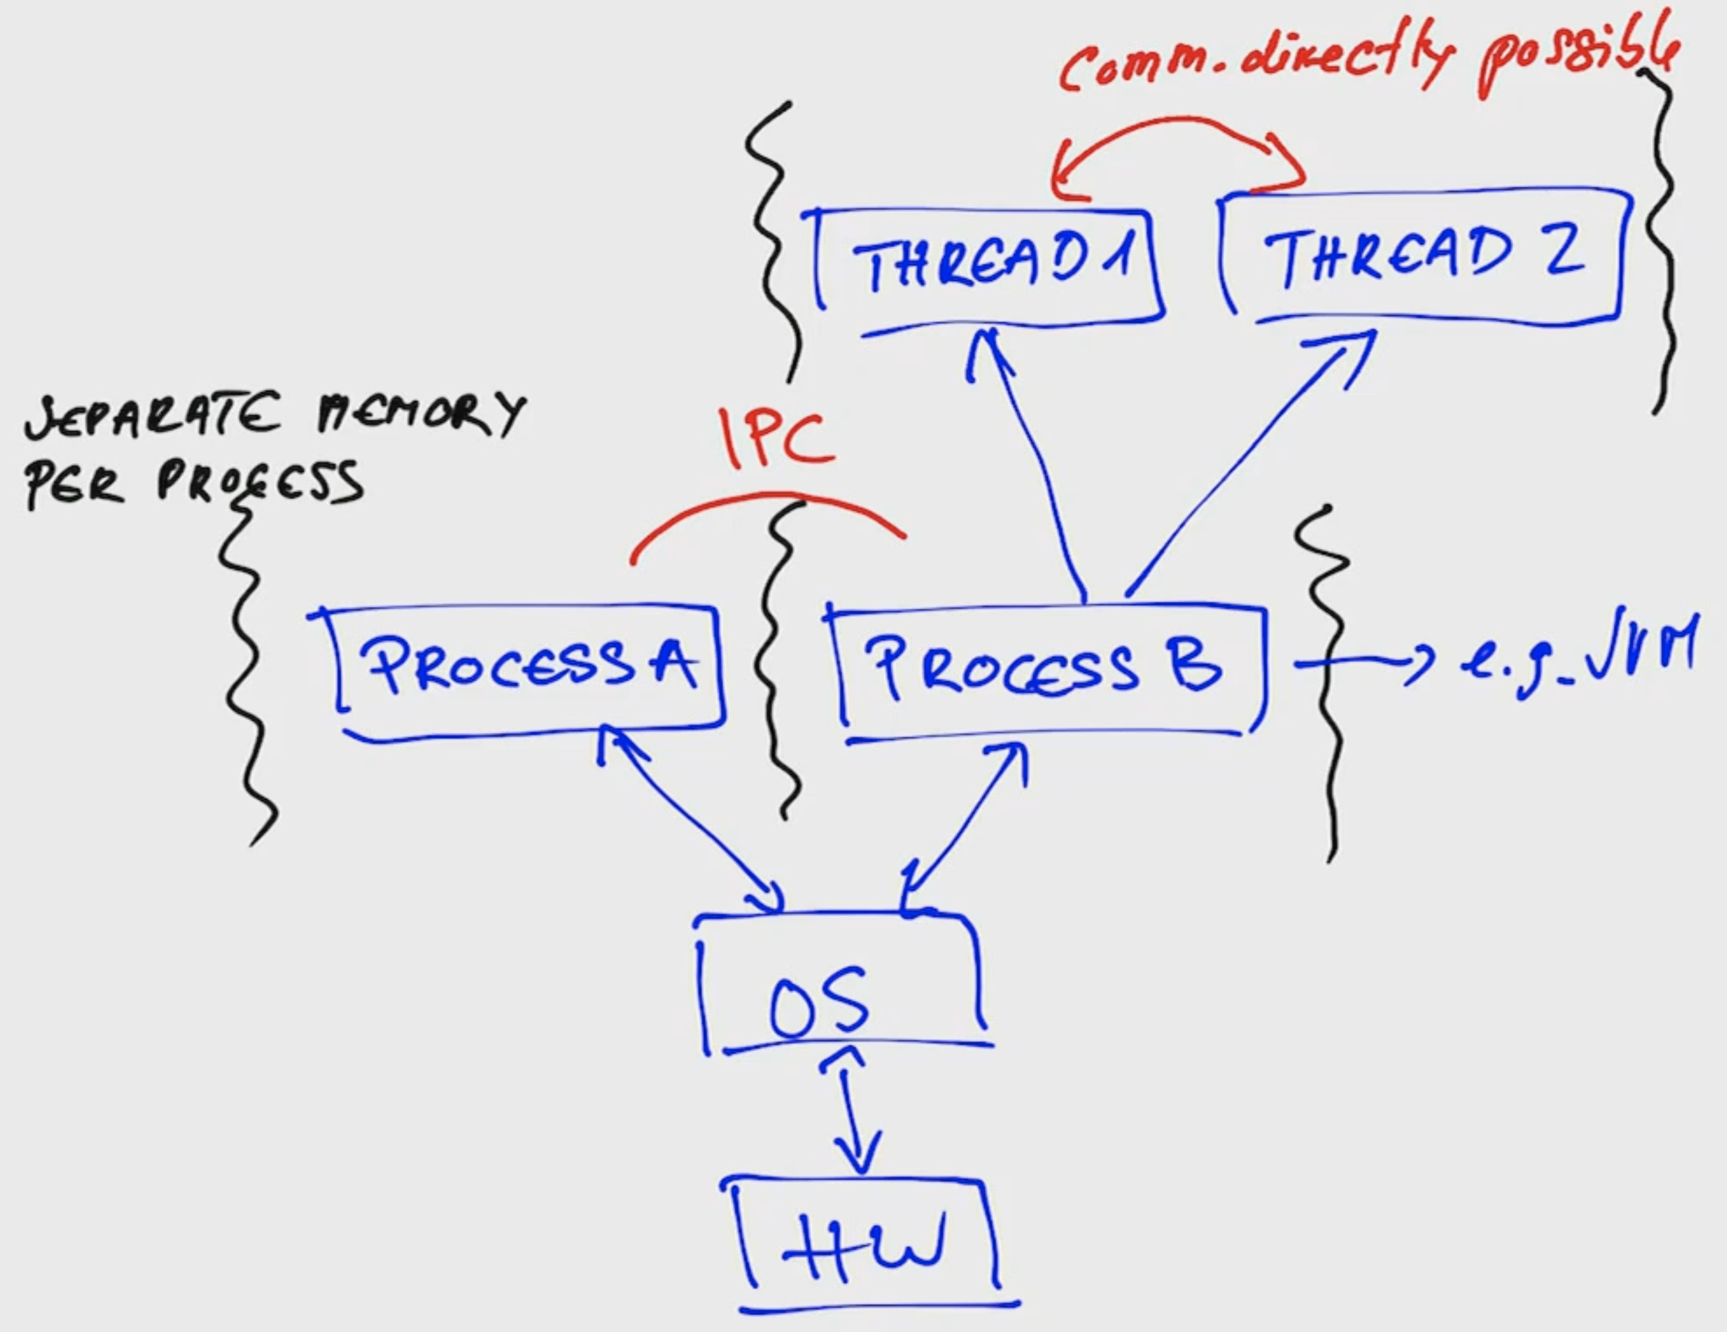

Slide 32
custom

Slide 33
custom

Slide 34
custom

Slide 35
Thread State Model
essentials
source: https://www3.ntu.edu.sg/home/ehchua/programming/java/j5e_multithreading.html

Slide 36
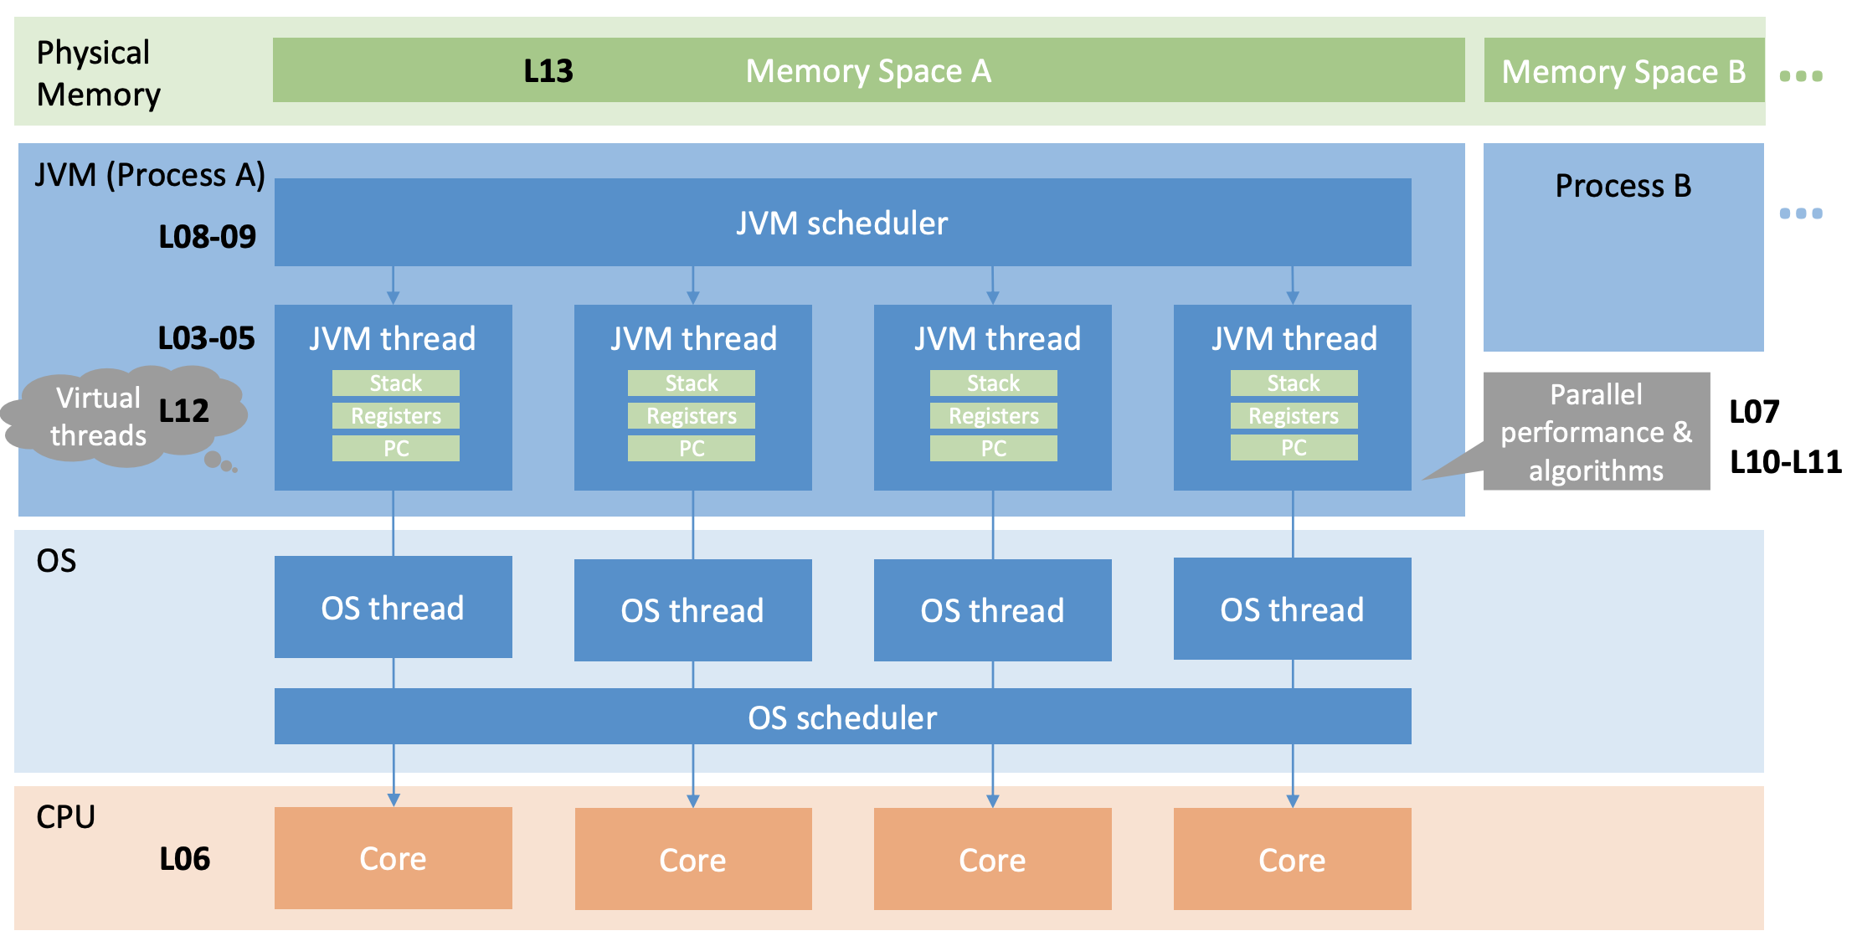
Big Picture
custom

Slide 37
(Bad) Interleavings, what can go wrong?
custom
Assume we have two threads executing increment() n-times
concurrently.
public class Counter {
int count = 0;
public void increment() {
count++;
}
}

Slide 38
(Bad) Interleavings, what can go wrong?
custom
Assume we have two threads executing increment() n-times
concurrently.
public class Counter {
int count = 0;
public void increment() {
count = count + 1;
}
}

Slide 39
Pre-Discussion Exercise 2

Slide 40
Task A
essentials
To start with, print to the console "Hello Thread!" from a new thread. How do you check that the statement was indeed printed from a thread that is different to the main thread of your application? Furthermore, ensure that your program (i.e., the execution of main thread) finishes only after the thread execution finishes.

Slide 41
Task A: How to create and start a new thread?
essentials
option 1: Extend class Thread
option 2: Implement Runnable

Slide 42
Demo

Slide 43
Task B
essentials

Slide 44
Task B
essentials
Run the method computePrimeFactors in a single thread other than the main thread. Measure the execution time of sequential execution (on the main thread) and execution using a single thread. Is there any noticeable difference?

Slide 45
Task C
essentials
Design and run an experiment that would measure the overhead of creating and executing a thread.

Slide 46
Task C
essentials
option 1: Measures real time elapsed including time when the thread is not running.
option 2: Measures thread cpu time excluding time when the thread is not running.

Slide 47
Task C
essentials
Measured execution time not always the same
Average over multiple runs (the more the better)
Calculate variance

Slide 48
Task D
essentials
Before you parallelize the loop in Task E, design how the work should be split between the threads by implementing method PartitionData. Each thread should process roughly equal amount of elements. Briefly describe you solution and discuss alternative ways to split the work.

Slide 49
Task D: Split the work between the threads
essentials
PartitionData(int length, int numPartitions) { … }
length (20)
Input
a) PartitionData(20,1)
?
b) PartitionData(20,2)
?
c) PartitionData(20,3)
?

Slide 50
Task D: Split the work between the threads
essentials
PartitionData(int length, int numPartitions) { … }
length (20)
Input
a) PartitionData(20,1)
b) PartitionData(20,2)
c) PartitionData(20,3)
d) PartitionData(20,3)
NOTE: both c) and d) are correct, why?

Slide 51
Task D
details
Several ways with different performance depending on task and data
If input is random: Splitting the input into half works well
If input is sorted: 1. half finishes faster than 2. half → maybe split on odd/even indices

Slide 52
Task D
essentials
What about (length>0 and numPartitions>0) and length<numPartitions?
??
??
And (length<=0 or numPartitions<=0)?
??
??
PartitionData(int length, int numPartitions) { … }

Slide 53
Task D
essentials
What about (length>0 and numPartitions>0) and length<numPartitions?
Throw an exception?
Return m = min(m,n) splits?
And (length<=0 or numPartitions<=0)?
Throw an exception?
Create a default return value (e.g. new ArraySplit[0])?
In any case, write your assumptions in JavaDoc
PartitionData(int length, int numPartitions) { … }

Slide 54
Task E
essentials
Parallelize the loop execution in computePrimeFactors using a configurable number of threads.

Slide 55
Task F
essentials
Think of how would a plot that shows the execution speed-up of your implementation, for n = 1, 2, 4, 8, 16, 32, 64, 128 threads and the input array size of 100, 1000, 10000, 100000 look like.

Slide 56
Task G
essentials
Measure the execution time of your parallel implementation for n = 1, 2, 4, 8, 16, 32, 64, 128 threads and the input array size of input.length = 100, 1000, 10000, 100000. Discuss the differences in the two plots from task F and G.

Slide 57
Speedup
essentials
Sub-linear: usually
Super-linear: not possible in theory, but
Modern hardware properties (local/remote memory)
Bug (this course assumes this)

Slide 58
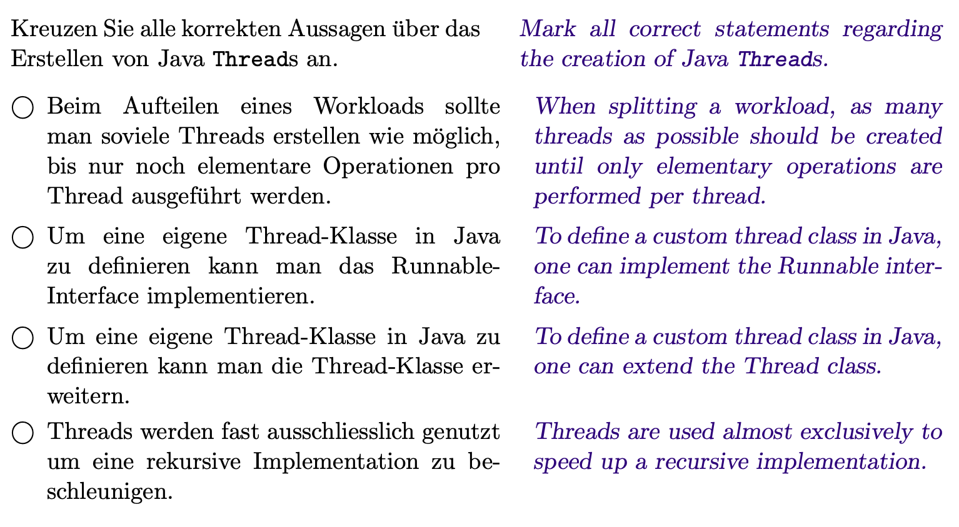
Past Exam Task
essentials

