Slide 1
Parallel Programming Exercise Session 3
Spring 2024

Slide 2
Today
Post-Discussion Exercise 2
Theory Recap
(Demo)
Break
Quiz
Pre-Discussion Exercise 3

Slide 3
Post-Discussion Exercise 2

Slide 4
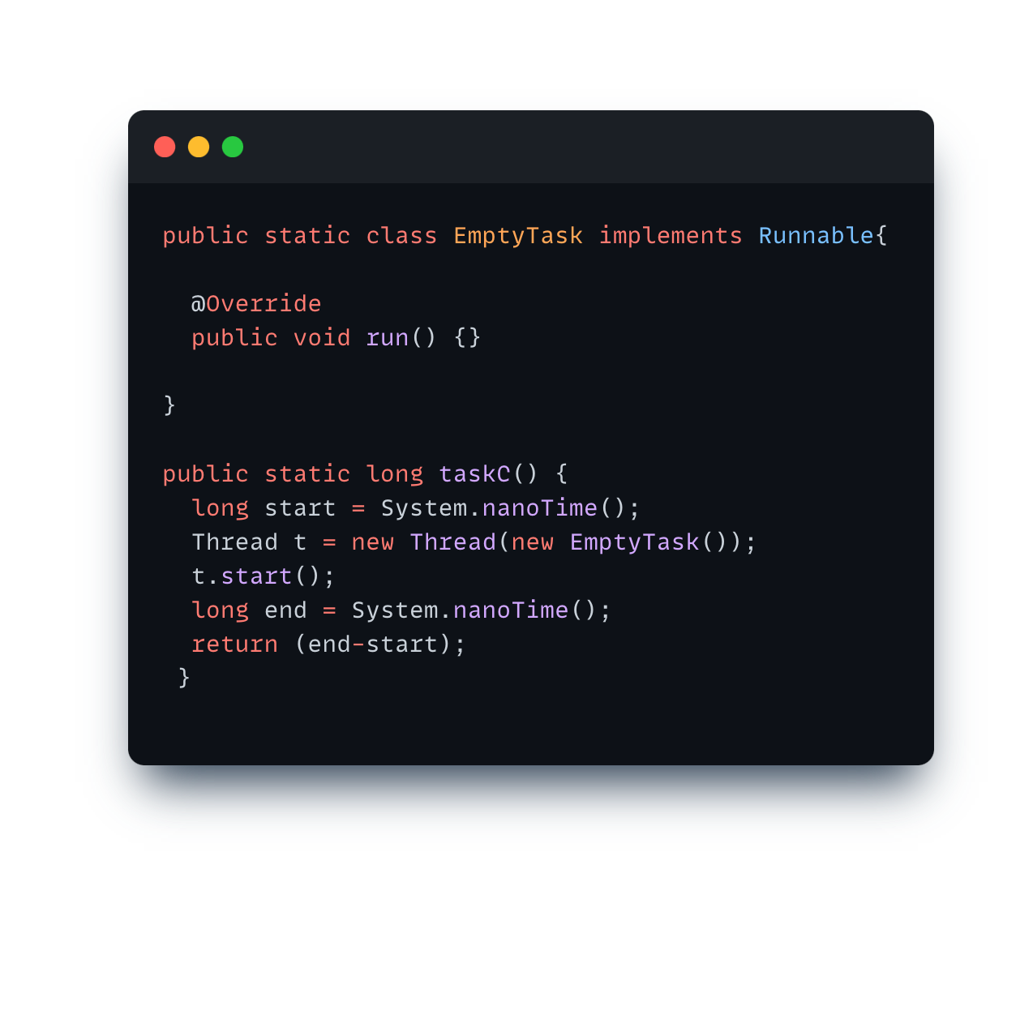
Task C: Thread with no Task

Slide 5
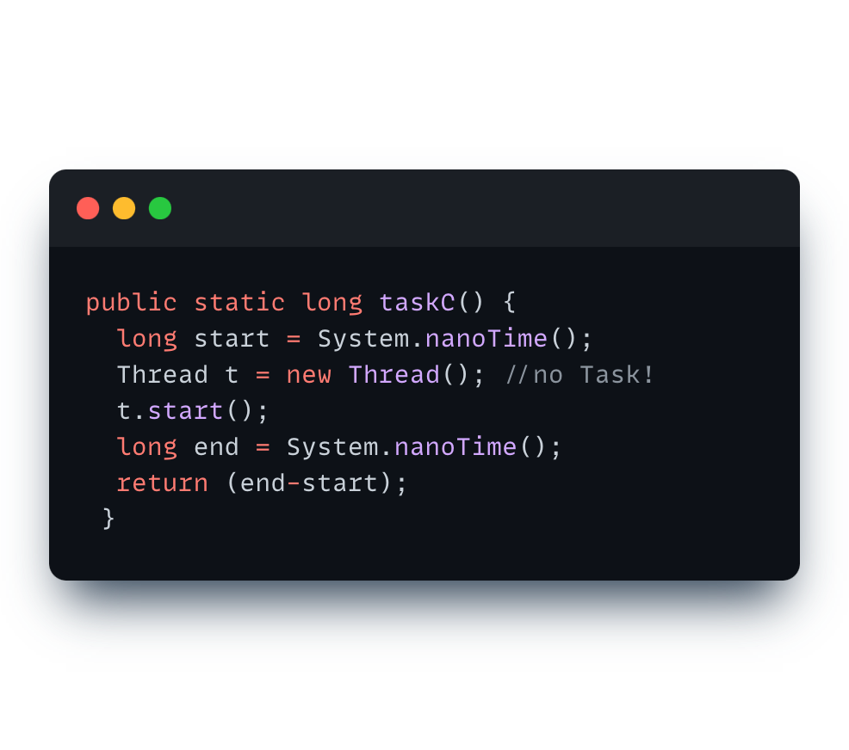
Task C: Thread with no Task

Slide 6
Task D: PartitionData
Static partitioning vs. other: dynamic, guided, etc.
In real world: use existing libraries. well tested, concise, fast (e.g. parallel streams for Java)
Think about edge cases: What if more Threads than values?

Slide 7
Exercise 2
Which task(s) do you want to discuss?

Slide 8
Theory Recap

Slide 9
Counter
Let’s count the number of times a given event occurs
public interface Counter { public void increment(); public int value(); }

Slide 10
Counter
Let’s count the number of times a given event occurs
// background threads for (int i = 0; i < numIterations; i++) { // perform some work counter.increment(); } // progress thread while (isWorking) { System.out.println(counter.value()); }
public interface Counter { public void increment(); public int value(); }

Slide 11
10 iterations each
Thread 1
0
Counter
Thread 2
0
0
Thread 3
0
value of the shared Counter
number of times increment() is called

Slide 12
Thread 1
0
Counter
Thread 2
0
0
Thread 3
0
value of the shared Counter
number of times increment() is called

Slide 13
Thread 1
1
Counter
Thread 2
0
0
Thread 3
0
value of the shared Counter
number of times increment() is called

Slide 14
Thread 1
1
increment()
Counter
Thread 2
1
0
Thread 3
0
value of the shared Counter
number of times increment() is called

Slide 15
Thread 1
10
increment()
Counter
Thread 2
10
0
Thread 3
0
value of the shared Counter
number of times increment() is called

Slide 16
Thread 1
10
Counter
Thread 2
15
0
increment()
Thread 3
5
value of the shared Counter
number of times increment() is called

Slide 17
Thread 1
10
Counter
Thread 2
25
increment()
10
Thread 3
5
value of the shared Counter
number of times increment() is called

Slide 18
Thread 1
10
Counter
Thread 2
30
10
increment()
Thread 3
10
value of the shared Counter
number of times increment() is called

Slide 19
Thread 1
10
Counter
Thread 2
30
10
Main
Thread 3
value()
Print 30
10
read the Counter value
value of the shared Counter
number of times increment() is called

Slide 20
Counter
essentials
Why will what we just saw probably not work?

Slide 21
Remember: (Bad) Interleavings
custom
Assume we have two threads executing increment() n-times
concurrently.
public class Counter {
int count = 0;
public void increment() {
count++;
}
}

Slide 22
Synchronization
essentials
Every reference type contains a lock inherited from the Object class
Primitive fields can be locked only via their enclosing objects
Locking arrays does not lock their elements
A lock is automatically acquired when entering and released when exiting a synchronized block
Locks will be covered in more detail later in the course

Slide 23
Synchronization
essentials
Synchronized method locks the object owning the method
Synchronized keyword obtains a lock on the parameter object
A thread can obtain multiple locks (by nesting the synchronized blocks)
foo.xMethod() //lock on foo
synchronized (bar) { … } //lock on bar

Slide 24
Using `synchronized`
custom
Now only one thread at a time can enter the increment() method ☺
public class Counter {
int count = 0;
public synchronized void increment() {
count++;
}
}

Slide 25
What exactly is a lock/monitor?
custom
Thread 1
Counter C
Counter C = new Counter()
attributes
Thread 2
int count = 0;
methods
synchronized increment() {
count++;
}
Thread 3
Counter C

Slide 26
What exactly is a lock/monitor?
custom
Thread 1
Counter C
increment()
Counter C = new Counter()
attributes
Thread 2
int count = 0;
methods
synchronized increment() {
count++;
}
Thread 3
Counter C

Slide 27
What exactly is a lock/monitor?
custom
Thread 1
Counter C
count++
Counter C = new Counter()
attributes
Thread 2
int count = 0;
methods
synchronized increment() {
count++;
}
Thread 3
Counter C

Slide 28
What exactly is a lock/monitor?
custom
Thread 1
Counter C
count++
Counter C = new Counter()
attributes
Thread 2
int count = 0;
increment()
methods
synchronized increment() {
count++;
}
Thread 3
Counter C

Slide 29
What exactly is a lock/monitor?
custom
Thread 1
Counter C
count++
Counter C = new Counter()
attributes
Thread 2
int count = 0;
WAITING
methods
synchronized increment() {
count++;
}
Thread 3
Counter C

Slide 30
Remember? Thread State Model
details

Slide 31
What exactly is a lock/monitor?
custom
Thread 1
Counter C
count++
Counter C = new Counter()
attributes
Thread 2
int count = 0;
WAITING
methods
increment()
synchronized increment() {
count++;
}
Thread 3
Counter C

Slide 32
What exactly is a lock/monitor?
custom
Thread 1
Counter C
count++
Counter C = new Counter()
attributes
Thread 2
int count = 0;
WAITING
methods
synchronized increment() {
count++;
}
Thread 3
WAITING
Counter C

Slide 33
What exactly is a lock/monitor?
custom
Thread 1
Counter C
DONE!
Counter C = new Counter()
attributes
Thread 2
int count = 0;
WAITING
methods
synchronized increment() {
count++;
}
Thread 3
WAITING
Counter C

Slide 34
What exactly is a lock/monitor?
custom
Thread 1
Counter C
DONE!
Counter C = new Counter()
attributes
Thread 2
int count = 0;
WAITING
methods
synchronized increment() {
count++;
}
Thread 3
WAITING
Counter C

Slide 35
What exactly is a lock/monitor?
custom
THIS LOCK IS SPECIFIC TO THE OBJECT!
Thread 1
Counter C
DONE!
Counter C = new Counter()
attributes
Thread 2
int count = 0;
WAITING
methods
synchronized increment() {
count++;
}
Thread 3
count++
Counter C
Notes:
MENTION REENTRANT

Slide 36
Locks are specific to Object/Class
custom
Thread 1
Counter C
Counter D
Counter C = new Counter()
Counter D = new Counter()
attributes
attributes
int count = 0;
int count = 0;
Thread 2
methods
methods
synchronized increment() {
count++;
}
synchronized increment() {
count++;
}
Counter C
Counter D
Thread 3
Counter CLASS
class Counter {}
static attributes
static methods
static int var = X;
static void func()…
Counter CLASS

Slide 37
Locks are specific to Object/Class
custom
Thread 1
Counter C
Counter D
Counter C = new Counter()
Counter D = new Counter()
attributes
attributes
int count = 0;
int count = 0;
Thread 2
methods
methods
void incrementD() {
synchronize (D) {
...
}
}
void incrementC() {
synchronize (C) {
...
}
}
Thread 3
Counter C
Counter D

Slide 38
Locks are specific to Object/Class
custom
Thread 1
Counter C
Counter D
Counter C = new Counter()
Counter D = new Counter()
incrementC()
attributes
attributes
int count = 0;
int count = 0;
Thread 2
methods
methods
void incrementD() {
synchronize (D) {
...
}
}
void incrementC() {
synchronize (C) {
...
}
}
Thread 3
Counter C
Counter D

Slide 39
Locks are specific to Object/Class
custom
Thread 1
Counter C
Counter D
Counter C = new Counter()
Counter D = new Counter()
count++
attributes
attributes
int count = 0;
int count = 0;
Thread 2
methods
methods
void incrementD() {
synchronize (D) {
...
}
}
void incrementC() {
synchronize (C) {
...
}
}
Thread 3
Counter C
Counter D

Slide 40
Bad Practices With Synchronization
custom
Do NOT synchronize on:
Literals
Boxed Primitives
On the `this` instance (for now it’s okay, see Demo)

Slide 41
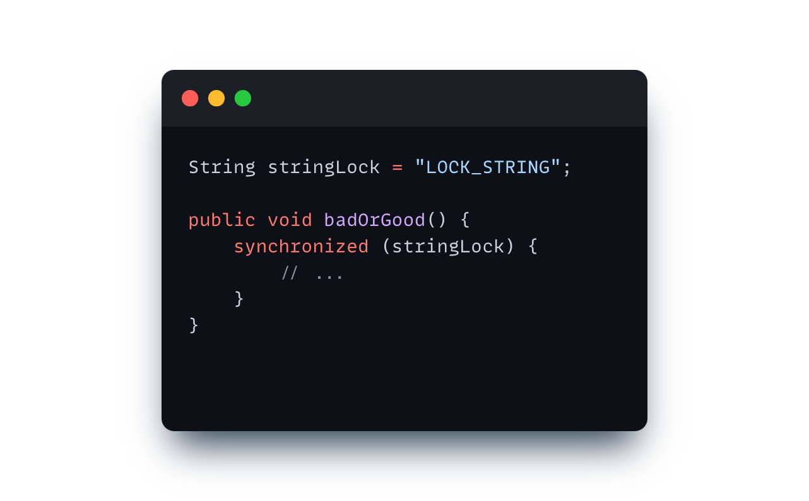
Good or not good?
custom
❌

Slide 42
Java String Pool
custom
Java Heap
String Pool
String a = “PPROG24”
“PPROG24”
String b = “PPROG24”
“pprog24”
String c = “pprog24”
String d = new String(“PPROG24”)
“PPROG24”
String e = new String(“PPROG24”)
“PPROG24”

Slide 43
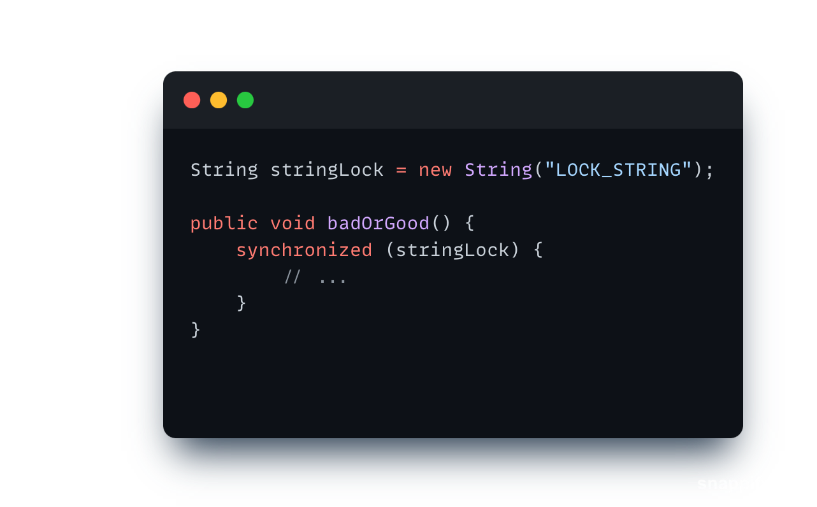
Good or not good?
custom
⚠️

Slide 44
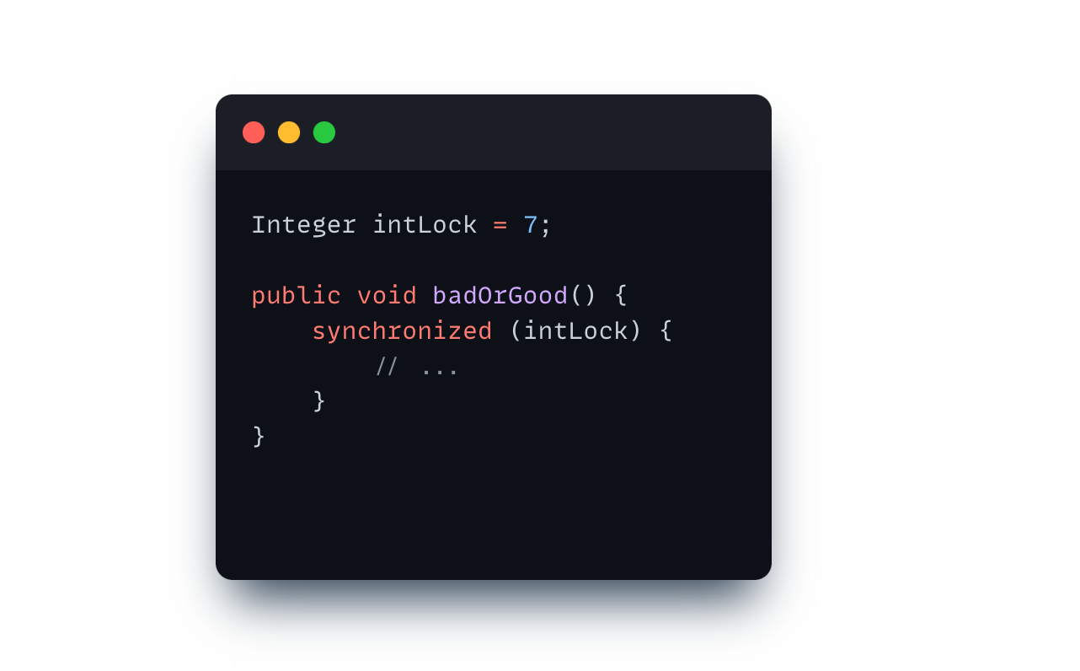
Good or not good?
custom
❌

Slide 45
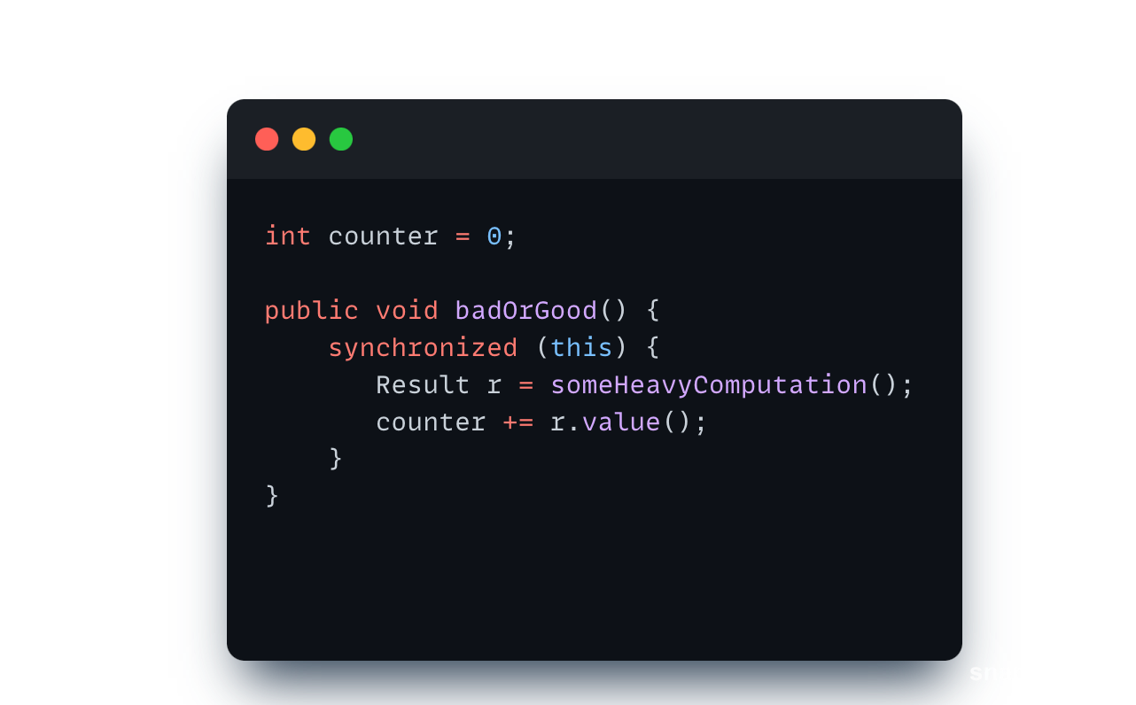
Good or not good?
custom
Assume this computation
takes *a lot* of time
❌

Slide 46
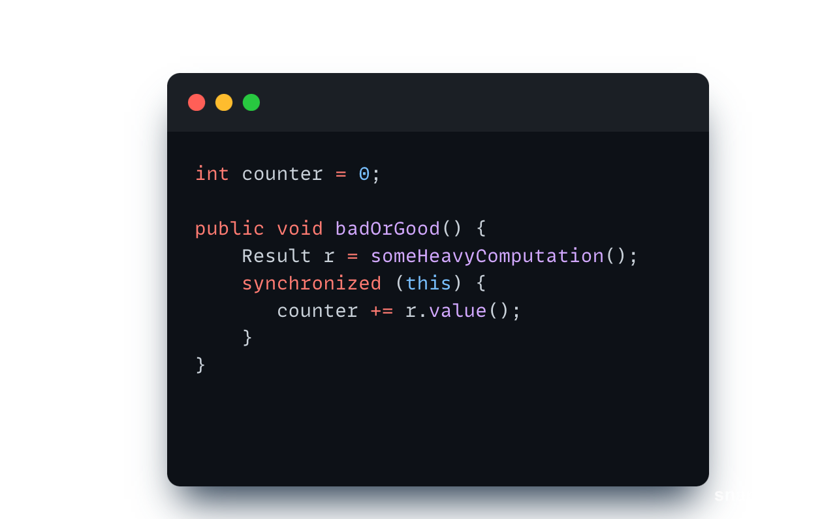
Good or not good?
custom
Try keeping your critical section as small as possible!
✅

Slide 47
Wait and Notify Recap
essentials
Object (lock) provides wait and notify methods
(any object is a lock)
wait: Thread must own object’s lock to call wait thread releases lock and is added to “waiting list” for that object thread waits until notify is called on the object
notify: Thread must own object’s lock to call notify
notify: Wake one (arbitrary) thread from object’s “waiting list”
notifyAll: Wake all threads

Slide 48
But… why?

Slide 49
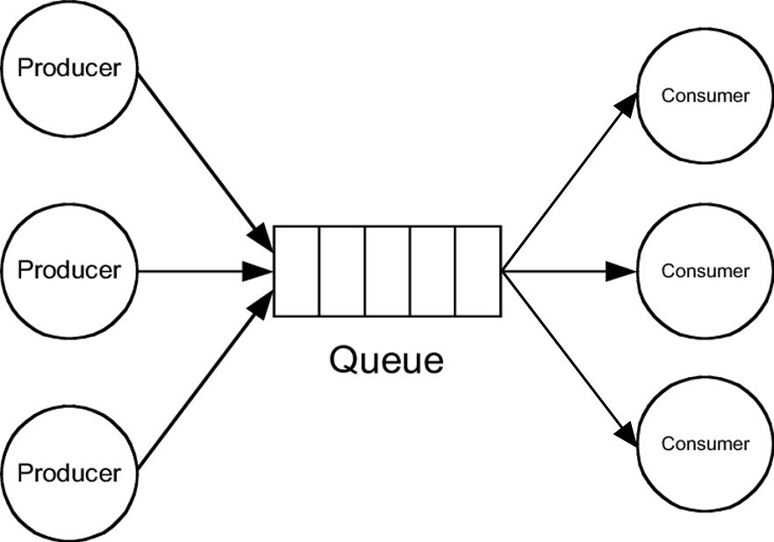
Producer-Consumer Problem
custom
Generating Data
Processing Data
Buffer

Slide 50
The Buffer

Slide 51
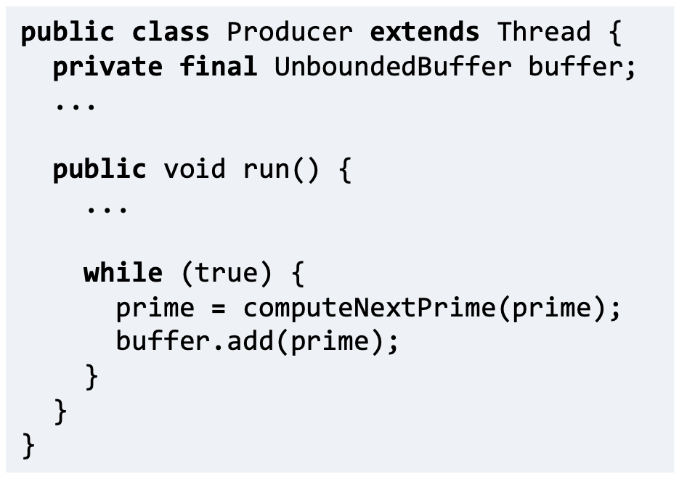
The Producer

Slide 52
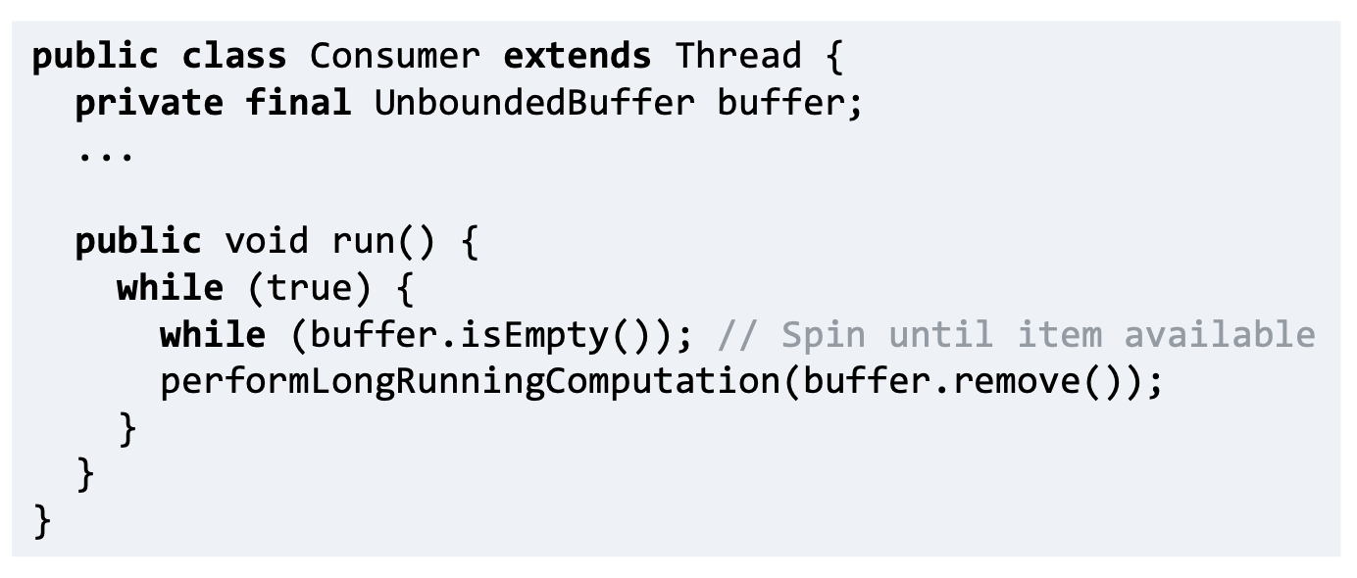
The Consumer
Where is the problem?

Slide 53
The Consumer
Bad Interleaving!

Slide 54
How about now?

Slide 55
How about now?

Slide 56
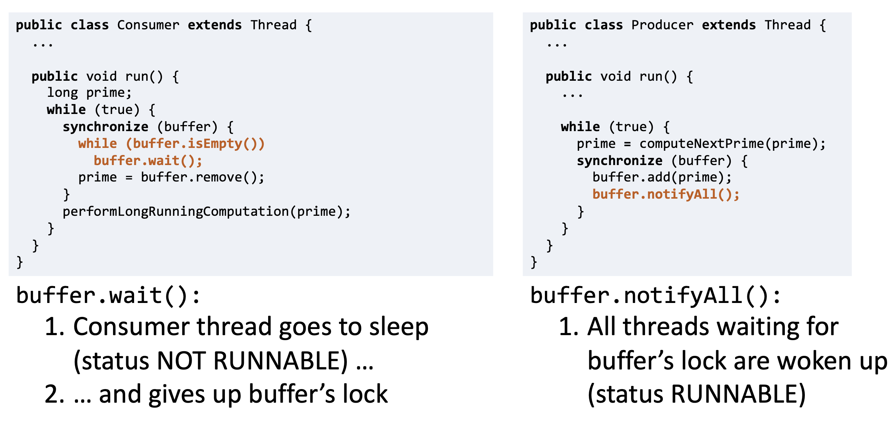
Solution? Use wait/notify!

Slide 57
Wait and Notify Recap
essentials
What is the difference? Issues?

Slide 58
Wait and Notify Recap
essentials
Spurious wake-ups and notifyAll() → wait has to be in a while loop

Slide 59
Wait and Notify Recap

Slide 60
Reentrant
details
Java locks are reentrant
A thread can hold a lock more than once
Also have to release multiple times

Slide 61
Concurrency vs Parallelism
details
Concurrency
Dealing with multiple things at the same time
Reasoning about and managing shared resources. Often used interchangeably with parallelism.
Parallelism
Doing multiple things at the same time
Performing computations simultaneously; either actually, if sufficient computations units (CPUs, cores, ...) are available, or virtually, via some form of alternation. Often used interchangeably with concurrency. Parallelism can be specified explicitly by manually assigning tasks to threads or implicitly by using a framework that takes care of distributing tasks to threads.
Source: https://cgl.ethz.ch/teaching/parallelprog23/pages/terminology.html

Slide 62
Concurrency vs Parallelism
essentials
Concurrent, not parallel
Thread A
Thread B
Thread C
Time
Concurrent, parallel
Thread A
Thread B
Thread C
Not concurrent, not parallel
Thread A

Slide 63
Concurrency vs Parallelism
essentials
Concurrency
No parallelism
McDonalds
McDonalds
Concurrency
Parallelism
Burger King

Slide 64
Demo

Slide 65
Pre-Discussion Exercise 3

Slide 66
Counter
There are many threads accessing the counter at the same time.
How should we implement it such that there are no conflicts?
You will try different solutions including:
Task A: SequentialCounter
Task B: SynchronizedCounter
Task E (optional): AtomicCounter

Slide 67
Task A – Sequential counter
Implement a sequential version of the Counter in SequentialCounter class that does not use any synchronization.
In taskASequential we provide a method that runs a single thread which increments the counter. Inspect the code and understand how it works.
Verify that the SequentialCounter works properly when used with a single thread (the test testSequentialCounter should pass).

Slide 68
Task A – Parallel counter
essentials
Run the code in taskAParallel which creates several threads that all try to increment the counter at the same time.
Will this work? What will happen?

Slide 69
Task B – Synchronized counter
Implement a different thread safe version of the Counter in SynchronizedCounter. In this version use the standard primitive type int but synchronize the access to the variable by inserting synchronized blocks.
Run the code in taskB.

Slide 70
Task C
essentials
Whenever the Counter is incremented, keep track which thread performed the increment (you can print out the thread-id to the console). Can you see a pattern in how the threads are scheduled? Discuss what might be the reason for this behaviour.

Slide 71
Task D
essentials
Implement a FairThreadCounter that ensures that different threads increment the Counter in a round-robin fashion. In round-robin scheduling the threads perform the increments in circular order. That is, two threads with ids 1 and 2 would increment the value in the following order 1, 2, 1, 2, 1, 2, etc.
You should implement the scheduling using the wait and notify methods.
Can you think of implementation that does not use wait and notify methods?

Slide 72
essentials
Thread 1 must increment first!
Thread 1
0
Counter
Thread 2
0
0
Thread 3
0

Slide 73
essentials
Thread 1 must increment first!
Thread 1
0
Counter
lock
Thread 2
0
0
Thread 3
0

Slide 74
essentials
Thread 1 must increment first!
Thread 1
0
Counter
lock
Thread 2
0
0
Blocked:
Thread 3
lock failed
Thread 3
0

Slide 75
essentials
Thread 1 must increment first!
Thread 1
0
Counter
lock
check
Thread 2
0
0
Blocked:
Thread 3
Thread 3
0

Slide 76
essentials
Thread 1 must increment first!
Thread 1
0
Counter
lock
check
wait
Waiting:
Thread 2
Thread 2
0
0
Blocked:
Thread 3
Thread 3
0

Slide 77
essentials
Thread 1 must increment first!
Thread 1
lock
0
Counter
Waiting:
Thread 2
Thread 2
0
0
Blocked:
Thread 3
Thread 3
Both Thead 1 and Thread 3 could obtain lock. Let’s assume Thread 1 succeeds.
0

Slide 78
essentials
Thread 1 must increment first!
Thread 1
lock
check
0
Counter
Waiting:
Thread 2
Thread 2
0
0
Blocked:
Thread 3
Thread 3
0

Slide 79
essentials
Thread 1 must increment first!
Thread 1
lock
check
increment
1
Counter
Waiting:
Thread 2
Thread 2
1
0
Blocked:
Thread 3
Thread 3
0

Slide 80
essentials
Thread 1 must increment first!
Thread 1
lock
check
increment
notify
1
Counter
Thread 2
1
0
Blocked:
Thread 3
Thread 3
0

Slide 81
essentials
Thread 1 must increment first!
Thread 1
lock
check
increment
notifyAll
unlock
1
Counter
Thread 2
1
0
Blocked:
Thread 3
Thread 3
0

Slide 82
Task E – Atomic counter
Implement a thread safe version of the Counter in AtomicCounter. In this version we will use an implementation of the int primitive value, called AtomicInteger, that can be safely used from multiple threads.

Slide 83
Atomic Variables
details
Set of classes providing implementation of atomic variables in Java, e.g., AtomicInteger, AtomicLong, ...
An operation is atomic if no other thread can see it partially executed. Atomic as in “appears indivisible”.
Implemented using special hardware primitives (instructions) for concurrency. Will be covered in detail later in the course.

Slide 84
Task F – Atomic vs Synchronized counter
essentials
Experimentally compare the AtomicCounter and SynchronizedCounter implementations by measuring which one is faster. Observe the differences in the CPU load between the two versions. Can you explain what is the cause of different performance characteristics?
- Vary the load per thread
- Vary the number of threads

Slide 85
Task G
Implement a thread that measures execution progress. That is, create a thread that observes the values of the Counter during the execution and prints them to the console. Make sure that the thread is properly terminated once all the work is done [thread.interrupt()].

Slide 86
essentials
Thread 1
10
increment()
Counter
Thread 2
10
0
Thread 3
Printer
0

Slide 87
essentials
Thread 1
10
Counter
Thread 2
10
0
Thread 3
Printer
value()
0
Print 10!

Slide 88
essentials
Thread 1
10
Counter
Thread 2
15
0
increment()
Thread 3
Printer
5

Slide 89
essentials
Thread 1
10
Counter
Thread 2
25
increment()
10
Thread 3
Printer
5

Slide 90
essentials
Thread 1
10
Counter
Thread 2
25
10
Thread 3
Printer
value()
5
Print 25!

Slide 91
essentials
Thread 1
10
Counter
Thread 2
30
10
increment()
Thread 3
Printer
10

Slide 92
essentials
Thread 1
10
Counter
Thread 2
30
10
Thread 3
Printer
value()
10
Print 30!

Slide 93
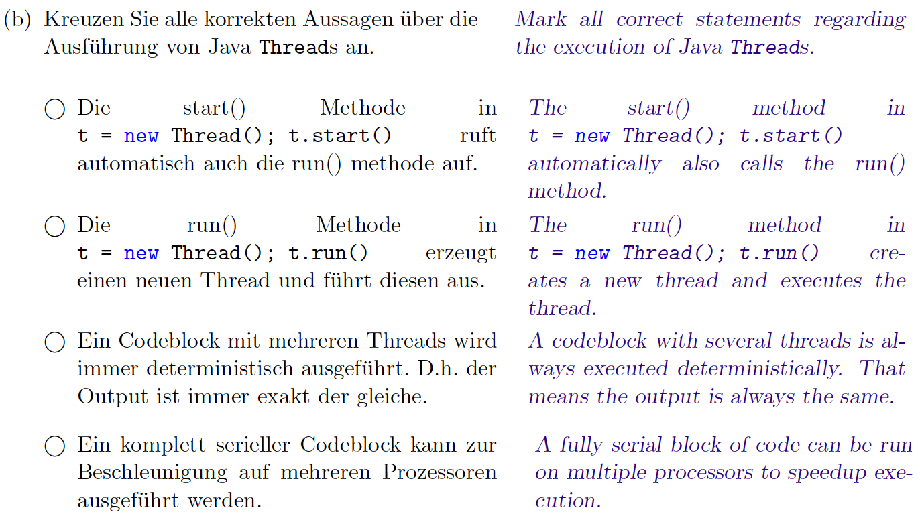
Past Exam Task
essentials
Rep. Exam, FS 2023

Slide 94
Past Exam Task
essentials
Rep. Exam, FS 2023

Slide 95
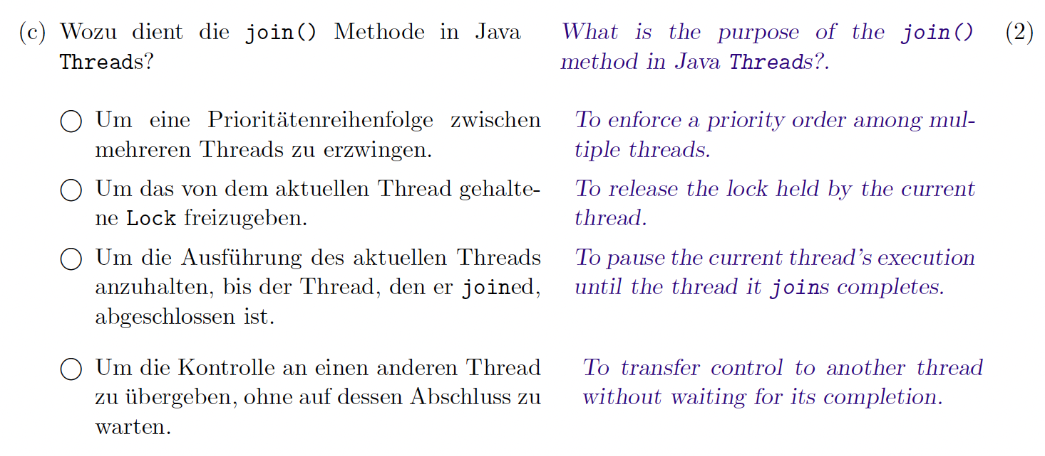
Past Exam Task
essentials
Rep. Exam, FS 2023

Slide 96
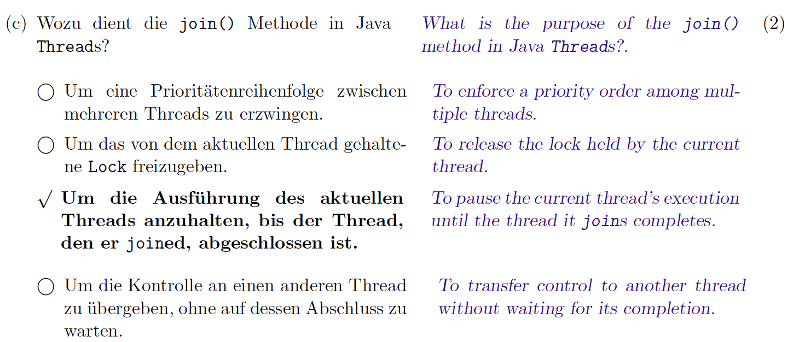
Past Exam Task
essentials
Rep. Exam, FS 2023

