Slide 1
Parallel Programming
Exercise Session 4
Spring 2024

Slide 2
Schedule
Post-Discussion Ex. 3
Recap
Break
Pre-Discussion Ex. 4
Quiz

Slide 3
Post-Discussion
Exercise 3

Slide 4
Counter
essentials
Let’s count number of times a given event occurs
// background threads
for (int i = 0; i < numIterations; i++) {
// perform some work
counter.increment();
}
// progress thread
while (isWorking) {
System.out.println(counter.value());
}
public interface Counter {
public void increment();
public int value();
}

Slide 5
essentials
10 iterations each
Thread 1
0
Counter
Thread 2
0
0
Thread 3
0
value of the
shared Counter
number of times increment() is called

Slide 6
essentials
Thread 1
0
Counter
Thread 2
0
0
Thread 3
0
value of the
shared Counter
number of times increment() is called

Slide 7
essentials
Thread 1
1
Counter
Thread 2
0
0
Thread 3
0
value of the
shared Counter
number of times increment() is called

Slide 8
essentials
Thread 1
1
increment()
Counter
Thread 2
1
0
Thread 3
0
value of the
shared Counter
number of times increment() is called

Slide 9
essentials
Thread 1
10
increment()
Counter
Thread 2
10
0
Thread 3
0
value of the
shared Counter
number of times increment() is called

Slide 10
essentials
Thread 1
10
Counter
Thread 2
15
0
increment()
Thread 3
5
value of the
shared Counter
number of times increment() is called

Slide 11
essentials
Thread 1
10
Counter
Thread 2
25
increment()
10
Thread 3
5
value of the
shared Counter
number of times increment() is called

Slide 12
essentials
Thread 1
10
Counter
Thread 2
30
10
increment()
Thread 3
10
value of the
shared Counter
number of times increment() is called

Slide 13
essentials
Thread 1
10
Counter
Thread 2
30
10
Main
Thread 3
value()
Print 30
10
read the
Counter value
value of the
shared Counter
number of times increment() is called

Slide 14
Task A: SequentialCounter
essentials
public class SequentialCounter implements Counter {
public void increment() {
??
}
public int value() {
??
}
}

Slide 15
Task A: SequentialCounter
essentials
public class SequentialCounter implements Counter {
private int c = 0;
public void increment() {
c++;
}
public int value() {
return c;
}
}

Slide 16
Task A: SequentialCounter
essentials
Thread 1
0
Counter
Thread 2
0
0
public void increment() {
c++;
}
Thread 3
0

Slide 17
Task A: SequentialCounter
essentials
Thread 1
1
Counter
Thread 2
1
conflicting
access!
1
How is this possible?
public void increment() {
c++;
}
Thread 3
0

Slide 18
Task A: SequentialCounter
essentials
Thread 1
1
Counter
Thread 2
1
conflicting
access!
1
How is this possible?
public void increment() {
c++;
}
Thread 3
0
public void increment() {
c = c + 1;
}

Slide 19
Task A: SequentialCounter
essentials
Thread 1
1
assume c is initialized to value 0
1. load c → 0
Counter
Thread 2
1
conflicting
access!
1
How is this possible?
public void increment() {
c++;
}
Thread 3
0
public void increment() {
c = c + 1;
}

Slide 20
Task A: SequentialCounter
essentials
Thread 1
1
assume c is initialized to value 0
1. load c → 0
Counter
Thread 2
1
2. load c → 0
conflicting
access!
1
How is this possible?
public void increment() {
c++;
}
Thread 3
0
public void increment() {
c = c + 1;
}

Slide 21
Task A: SequentialCounter
essentials
Thread 1
1
assume c is initialized to value 0
1. load c → 0
3. c + 1 → 1
4. store c ← 1
Counter
Thread 2
1
2. load c → 0
conflicting
access!
1
How is this possible?
public void increment() {
c++;
}
Thread 3
0
public void increment() {
c = c + 1;
}

Slide 22
Task A: SequentialCounter
essentials
Thread 1
1
assume c is initialized to value 0
1. load c → 0
3. c + 1 → 1
4. store c ← 1
Counter
Thread 2
1
2. load c → 0
5. c + 1 → 1
6. store c ← 1
conflicting
access!
1
How is this possible?
public void increment() {
c++;
}
Thread 3
0
public void increment() {
c = c + 1;
}

Slide 23
Task A: SequentialCounter
essentials
Thread 1
1
note that
increment is
not atomic!
assume c is initialized to value 0
1. load c → 0
3. c + 1 → 1
4. store c ← 1
Counter
Thread 2
1
2. load c → 0
5. c + 1 → 1
6. store c ← 1
conflicting
access!
1
How is this possible?
public void increment() {
c++;
}
Thread 3
0
public void increment() {
c = c + 1;
}

Slide 24
Task B: SynchronizedCounter
essentials
public class SynchronizedCounter implements Counter {
public void increment() {
??
}
public int value() {
??
}
}

Slide 25
Task B: SynchronizedCounter
essentials
public class SynchronizedCounter implements Counter {
private int c = 0;
public synchronized void increment() {
c++;
}
public synchronized int value() {
return c;
}
}
Notes:
Ask why this is not good: Sequential program + overhead

Slide 26
Task B: SynchronizedCounter
essentials
Thread 1
0
synchronized void increment() {
c++;
}
Counter
Thread 2
0
0
Thread 3
0

Slide 27

Task B: SynchronizedCounter
essentials
Thread 1
0
synchronized void increment() {
c++;
}
thread 1
Counter
Thread 2
0
0
synchronized void increment() {
c++;
}
Thread 3
Thread 2 tries to acquire lock on counter. As the lock is already acquired by thread 1 the thread 2 suspends its execution.
0

Slide 28
Task B: SynchronizedCounter
essentials
Thread 1
1
synchronized void increment() {
c++;
}
thread 1
Counter
Thread 2
1
0
synchronized void increment() {
c++;
}
Thread 3
Thread 2 tries to acquire lock on counter. As the lock is already acquired by thread 1 the thread 2 suspends its execution.
0

Slide 29
Task B: SynchronizedCounter
essentials
Thread 1
1
synchronized void increment() {
c++;
}
Counter
Thread 2
releases lock upon method exit
1
0
synchronized void increment() {
c++;
}
Thread 3
0

Slide 30
Task B: SynchronizedCounter
essentials
Thread 1
1
synchronized void increment() {
c++;
}
thread 2
Counter
Thread 2
1
0
synchronized void increment() {
c++;
}
Thread 3
0

Slide 31
Task D
essentials
Implement a FairThreadCounter that ensures that different threads increment the Counter in a round-robin fashion. That is, two threads with ids 1 and 2 would increment the value in the following order 1, 2, 1, 2, 1, 2, etc. You should implement the scheduling using the wait and notify methods.
(Optional) Extend your implementation to work with arbitrary number of threads (instead of only 2) that increment the counter in round-robin fashion.
Notes:
Discuss options

Slide 32
Wait and Notify Recap
essentials
Object (lock) provides wait and notify methods
(any object is a lock)
wait: Thread must own object’s lock to call wait
thread releases lock and is added to “waiting list” for that object
thread waits until notify is called on the object
notify: Thread must own object’s lock to call notify
notify: Wake one (arbitrary) thread from object’s “waiting list”
notifyAll: Wake all threads

Slide 33


Wait and Notify Recap
essentials
Spurious wake-ups and notifyAll()
→ wait has to be in a while loop

Slide 34
essentials
Thread 1 must increment first!
Thread 1
0
Counter
Thread 2
0
0
Thread 3
0

Slide 35
essentials
Thread 1
0
Counter
thread 2
lock
Thread 2
0
0
Thread 3
0

Slide 36
essentials
Thread 1
0
Counter
thread 2
Thread 2
0
0
Suspended:
Thread 3
lock failed
Thread 3
0

Slide 37
essentials
Thread 1
0
Counter
thread 2
lock
check
Thread 2
0
0
Blocked:
Thread 3
Thread 3
0

Slide 38
essentials
Thread 1
0
Counter
lock
check
wait
Waiting:
Thread 2
Thread 2
0
0
Blocked:
Thread 3
Thread 3
0

Slide 39
essentials
Thread 1
0
Counter
thread 3
Waiting:
Thread 2
Thread 2
0
0
lock
Thread 3
0

Slide 40
essentials
Thread 1
0
Counter
thread 3
Waiting:
Thread 2
Thread 2
0
0
lock
check
Thread 3
0

Slide 41
essentials
Thread 1
0
Counter
Waiting:
Thread 2
Thread 3
Thread 2
0
0
lock
check
wait
Thread 3
0

Slide 42
essentials
Thread 1
lock
0
Counter
thread 1
Waiting:
Thread 2
Thread 3
Thread 2
0
0
Thread 3
0

Slide 43
essentials
Thread 1
lock
check
0
Counter
thread 1
Waiting:
Thread 2
Thread 3
Thread 2
0
0
Thread 3
0

Slide 44
essentials
Thread 1
lock
check
increment
1
Counter
thread 1
Waiting:
Thread 2
Thread 3
Thread 2
1
0
Thread 3
0

Slide 45
essentials
Thread 1
lock
check
increment
notify or notifyAll?
1
Counter
thread 1
Waiting:
Thread 2
Thread 3
Thread 2
1
0
Thread 3
0

Slide 46
essentials
Thread 1
lock
check
increment
notifyAll
unlock
1
Counter
Waiting:
Thread 2
Thread 3
Thread 2
1
0
Thread 3
0

Slide 47
essentials
Thread 1
lock
check
increment
notifyAll
unlock
1
Counter
Waiting:
Thread 2
Thread 3
Thread 2
1
0
Thread 3
Which thread will be woken up and acquire the lock?
0
Which thread will be woken up if we use notify instead of notifyAll?

Slide 48
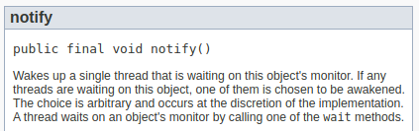
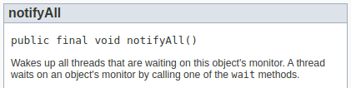
How to find the difference between notify vs notifyAll?
essentials
https://docs.oracle.com/en/java/javase/17/docs/api/java.base/java/lang/Object.html

Slide 49
Task E: AtomicCounter
essentials
public class AtomicCounter implements Counter {
public void increment() {
??
}
public int value() {
??
}
}

Slide 50
Task E: AtomicCounter
essentials
public class AtomicCounter implements Counter {
private AtomicInteger c = new AtomicInteger(0);
public void increment() {
c.incrementAndGet();
}
public int value() {
return c.get();
}
}

Slide 51
Task E: AtomicCounter
essentials
public class AtomicCounter implements Counter {
private AtomicInteger c = new AtomicInteger(0);
public void increment() {
c.incrementAndGet();
}
public int value() {
return c.get();
}
}
What is the difference?
int
c++;
AtomicInteger
c.incrementAndGet();

Slide 52
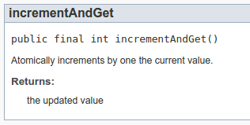
Task E: AtomicCounter
essentials
public class AtomicCounter implements Counter {
private AtomicInteger c = new AtomicInteger(0);
public void increment() {
c.incrementAndGet();
}
public int value() {
return c.get();
}
}
An operation is atomic if no other thread can see it partly executed. Atomic as in “appears indivisible”.
However, does not mean it’s implemented as single instruction.
What is the difference?
1. load c → 0
2. c + 1 → 1
3. store c ← 1
int
c++;
AtomicInteger
c.getAndIncrement();
not atomic
atomic

Slide 53
Post- vs Pre-Increment
details
Post-Increment
Pre-Increment
int i = 0;
AtomicInteger c = new AtomicInteger(0);
System.out.println(i++);
System.out.println(c.getAndIncrement());
int i = 0;
AtomicInteger c = new AtomicInteger(0);
System.out.println(++i);
System.out.println(c.incrementAndGet());

Slide 54
Theory Recap

Slide 55
Pipelining: Main Concepts Recap
essentials
Latency
Throughput
Balanced/Unbalanced Pipeline
Notes:
First ask: What is pipelining anyways and why is it useful?

Slide 56
Pipelining: Main Concepts Recap
essentials
Latency
time needed to perform a given computation
(e.g., process a customer)
Throughput
Balanced/Unbalanced Pipeline

Slide 57
Pipelining: Main Concepts Recap
essentials
Latency
time needed to perform a given computation
(e.g., process a customer)
Throughput
amount of work that can be done by a system in a given period of time
(e.g., how many customers can be processed in one minute)
Balanced/Unbalanced Pipeline

Slide 58
Pipelining: Main Concepts Recap
essentials
Latency
time needed to perform a given computation
(e.g., process a customer)
Throughput
amount of work that can be done by a system in a given period of time
(e.g., how many customers can be processed in one minute)
Balanced/Unbalanced Pipeline
a pipeline is balanced if each stage takes the same length of time

Slide 59
Library
essentials
At UZH the law students have been tasked with writing a legal essay about the philosophy of Swiss law. In order to write the essay, each student needs to read four different books on the subject, denoted as A, B, C and D (in this order).
This exercise is created by Lasse Meinen and is part of the unofficial VIS Prüfungsvorbereitungsworkshop Scripts available at:
https://vis.ethz.ch/de/services/pvw-scripts/
Every student takes the exact same amount of time to read a book, concretely:
1) Reading book A takes 80 minutes 3) Reading book C takes 120 minutes
2) Reading book B takes 40 minutes 4) Reading book D takes 40 minutes

Slide 60
Library
essentials
Over at UZH the law students have been tasked with writing a legal essay about the philosophy of Swiss law. In order to write the essay, each student needs to read four different books on the subject, denoted as A, B, C and D (in this order).
Question 1: Let’s assume all law students are a bit too competitive and don’t return any books before they’re done reading all of them. How long will it take for 4 students until all of them have started writing their essays?
Every student takes the exact same amount of time to read a book, concretely:
1) Reading book A takes 80 minutes 3) Reading book C takes 120 minutes
2) Reading book B takes 40 minutes 4) Reading book D takes 40 minutes

Slide 61
Library
essentials
Total: 4 * 280 min
Latency: 280 min
Throughput: 1 per 280 min
student 1
student 2
student 3
student 4
Question 1: Let’s assume all law students are a bit too competitive and don’t return any books before they’re done reading all of them. How long will it take for 4 students until all of them have started writing their essays?
Every student takes the exact same amount of time to read a book, concretely:
1) Reading book A takes 80 minutes 3) Reading book C takes 120 minutes
2) Reading book B takes 40 minutes 4) Reading book D takes 40 minutes

Slide 62
Library
essentials
Draw diagrams, as seen before
Question 2: The library introduces a ”one book at a time” policy, i.e., the students have to return a book before they can start on the next one. How long will it now take for 4 students until all of them have started writing their essays?
Every student takes the exact same amount of time to read a book, concretely:
1) Reading book A takes 80 minutes 3) Reading book C takes 120 minutes
2) Reading book B takes 40 minutes 4) Reading book D takes 40 minutes

Slide 63
Library
essentials
Latency?
student 1
student 2
student 3
student 4
Question 2: The library introduces a ”one book at a time” policy, i.e., the students have to return a book before they can start on the next one. How long will it now take for 4 students until all of them have started writing their essays?
Every student takes the exact same amount of time to read a book, concretely:
1) Reading book A takes 80 minutes 3) Reading book C takes 120 minutes
2) Reading book B takes 40 minutes 4) Reading book D takes 40 minutes

Slide 64
Library
essentials
Latency?
student 1
student 2
student 3
student 4
280 min
320 min
360 min
400 min
Question 2: The library introduces a ”one book at a time” policy, i.e., the students have to return a book before they can start on the next one. How long will it now take for 4 students until all of them have started writing their essays?
Every student takes the exact same amount of time to read a book, concretely:
1) Reading book A takes 80 minutes 3) Reading book C takes 120 minutes
2) Reading book B takes 40 minutes 4) Reading book D takes 40 minutes

Slide 65
Library
essentials
For this pipeline, latency makes sense only if asked for a particular student, not for the whole pipeline.
Latency?
student 1
student 2
student 3
student 4
280 min
320 min
360 min
400 min
Question 2: The library introduces a ”one book at a time” policy, i.e., the students have to return a book before they can start on the next one. How long will it now take for 4 students until all of them have started writing their essays?
Every student takes the exact same amount of time to read a book, concretely:
1) Reading book A takes 80 minutes 3) Reading book C takes 120 minutes
2) Reading book B takes 40 minutes 4) Reading book D takes 40 minutes

Slide 66
Library
essentials
Balanced?
Throughput?
Latency?
student 1
student 2
student 3
student 4
280 min
320 min
360 min
400 min
Question 2: The library introduces a ”one book at a time” policy, i.e., the students have to return a book before they can start on the next one. How long will it now take for 4 students until all of them have started writing their essays?
Every student takes the exact same amount of time to read a book, concretely:
1) Reading book A takes 80 minutes 3) Reading book C takes 120 minutes
2) Reading book B takes 40 minutes 4) Reading book D takes 40 minutes

Slide 67
Library
essentials
Balanced?
Throughput?
Latency?
student 1
student 2
student 3
student 4
1 student
per 160 minutes
280 min
320 min
360 min
400 min
With lead in
(fixed number of students)
Question 2: The library introduces a ”one book at a time” policy, i.e., the students have to return a book before they can start on the next one. How long will it now take for 4 students until all of them have started writing their essays?
Every student takes the exact same amount of time to read a book, concretely:
1) Reading book A takes 80 minutes 3) Reading book C takes 120 minutes
2) Reading book B takes 40 minutes 4) Reading book D takes 40 minutes

Slide 68
Library
essentials
Balanced?
Throughput?
Latency?
student 1
student 2
student 3
student 4
1 student
per 120 minutes
280 min
320 min
360 min
400 min
Without lead in
(indefinite number of students)
Question 2: The library introduces a ”one book at a time” policy, i.e., the students have to return a book before they can start on the next one. How long will it now take for 4 students until all of them have started writing their essays?
Every student takes the exact same amount of time to read a book, concretely:
1) Reading book A takes 80 minutes 3) Reading book C takes 120 minutes
2) Reading book B takes 40 minutes 4) Reading book D takes 40 minutes
Notes:
EXPLAIN LEAD IN/OUT

Slide 69
Library
essentials
Balanced?
Throughput?
Latency?
student 1
student 2
student 3
student 4
No
1 student
per 160 minutes
280 min
320 min
360 min
400 min
The pipeline is not balanced
since the stages have different length
Every student takes the exact same amount of time to read a book, concretely:
1) Reading book A takes 80 minutes 3) Reading book C takes 120 minutes
2) Reading book B takes 40 minutes 4) Reading book D takes 40 minutes

Slide 70
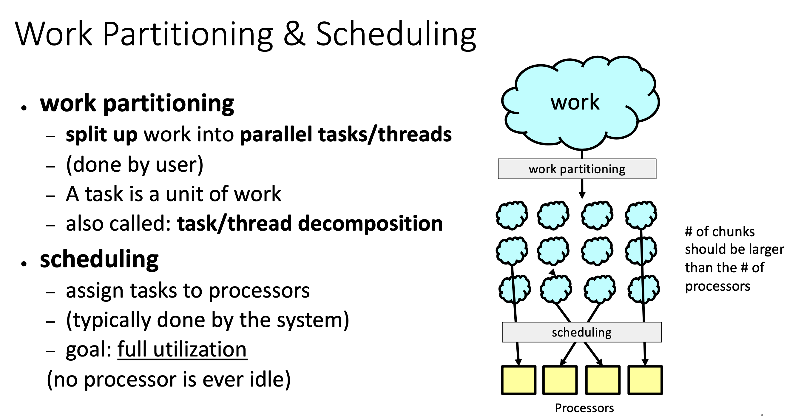
custom

Slide 71
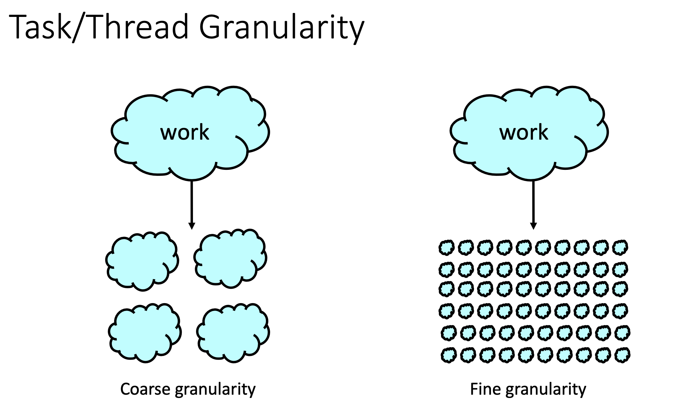
custom
Notes:
Advantages? When use what?

Slide 72
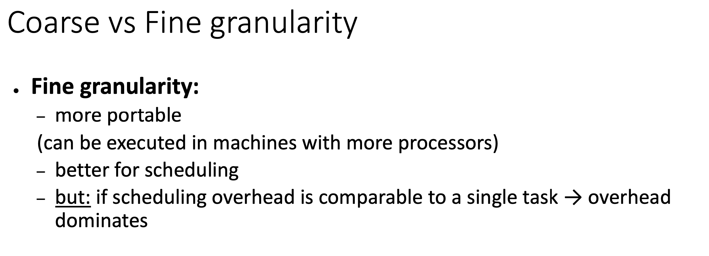
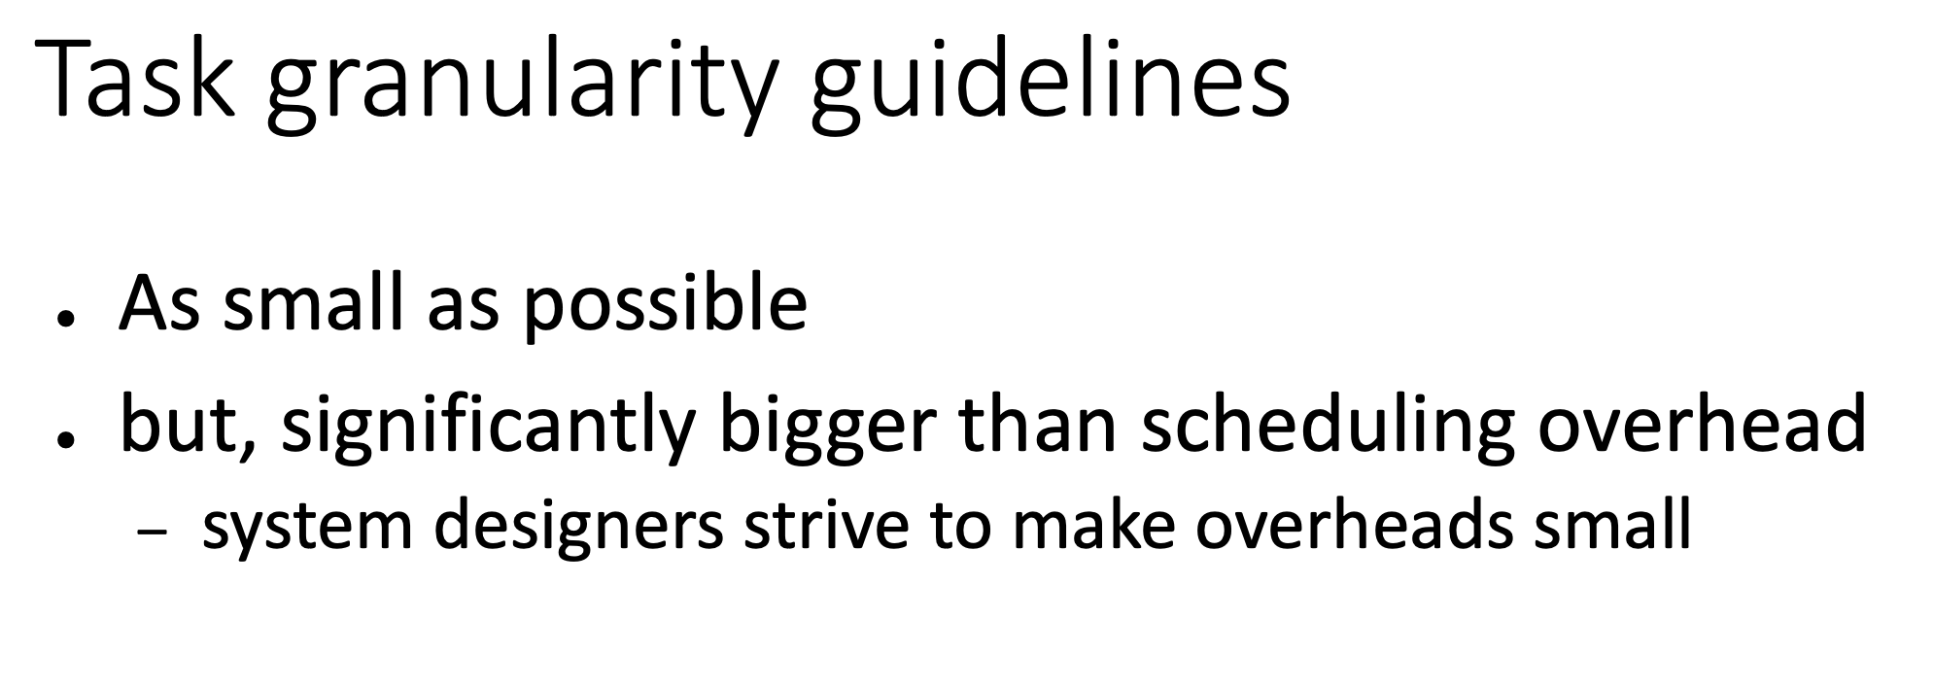
custom

Slide 73
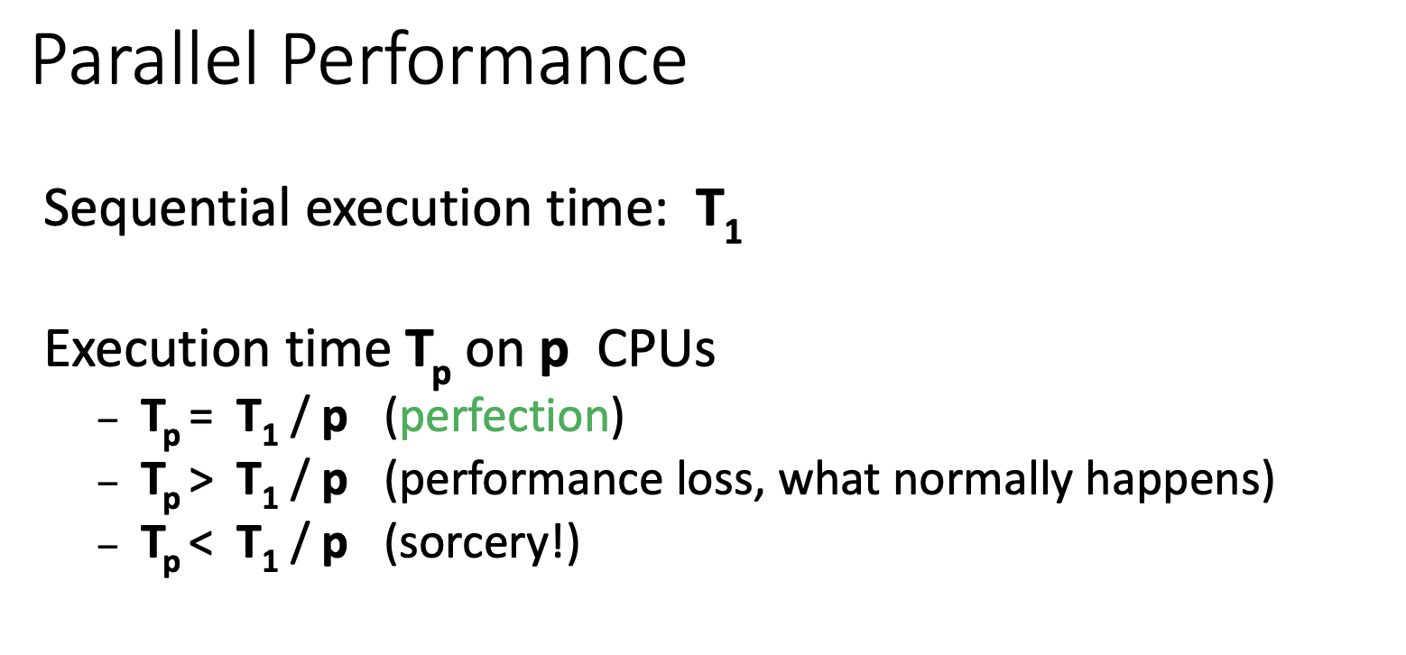
custom

Slide 74
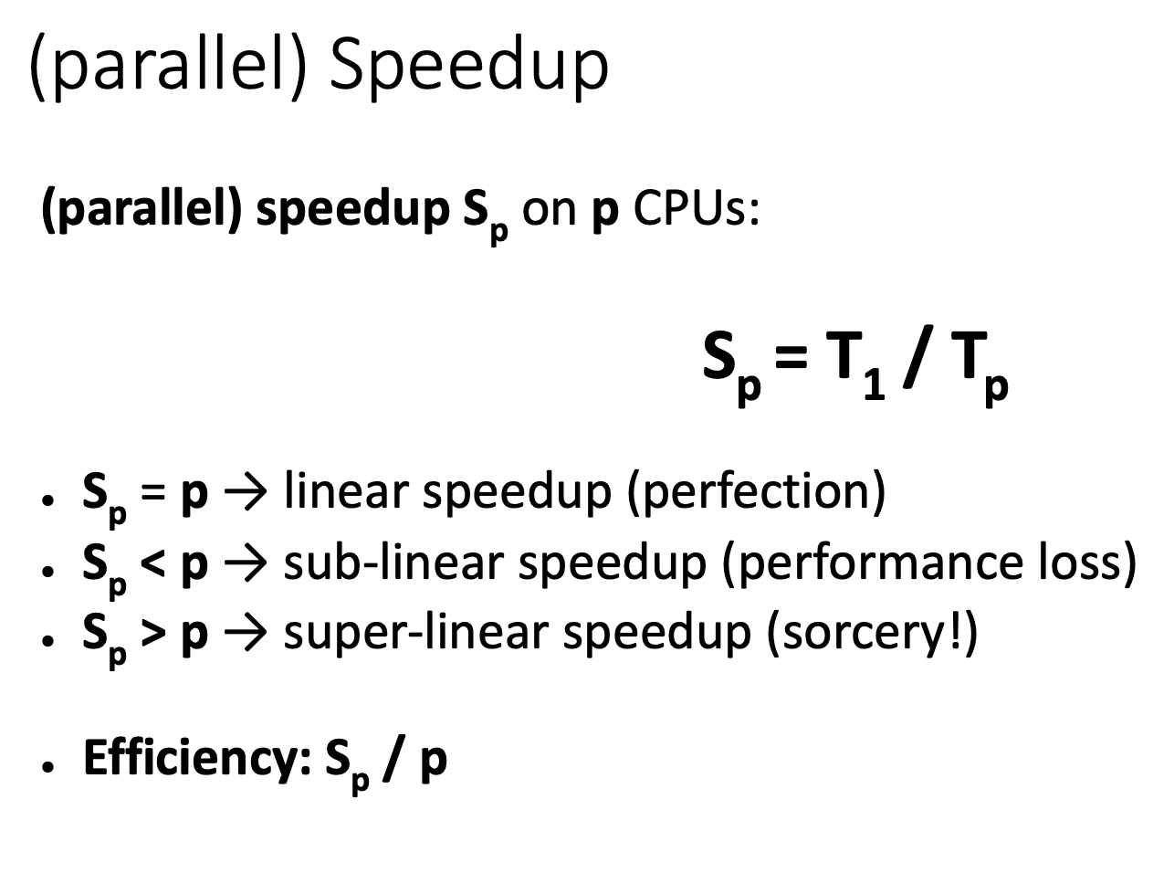
custom
Notes:
Ask what is the most common of these three and why

Slide 75
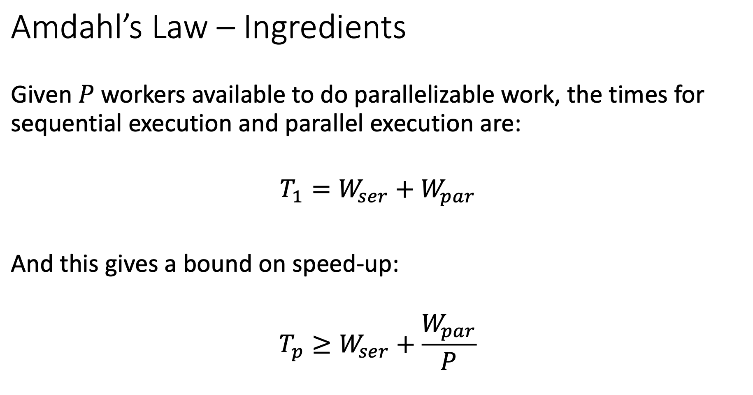
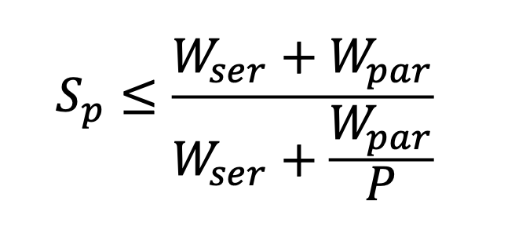
custom

Slide 76
custom

Slide 77
custom

Slide 78
custom

Slide 79
custom
Notes:
Remark: Amdahl is about how much time for fixed work load

Slide 80
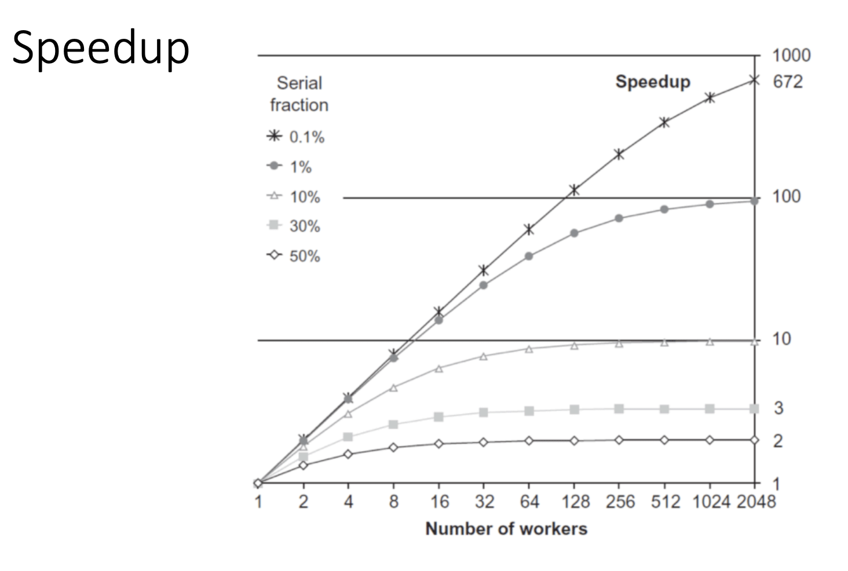
custom

Slide 81
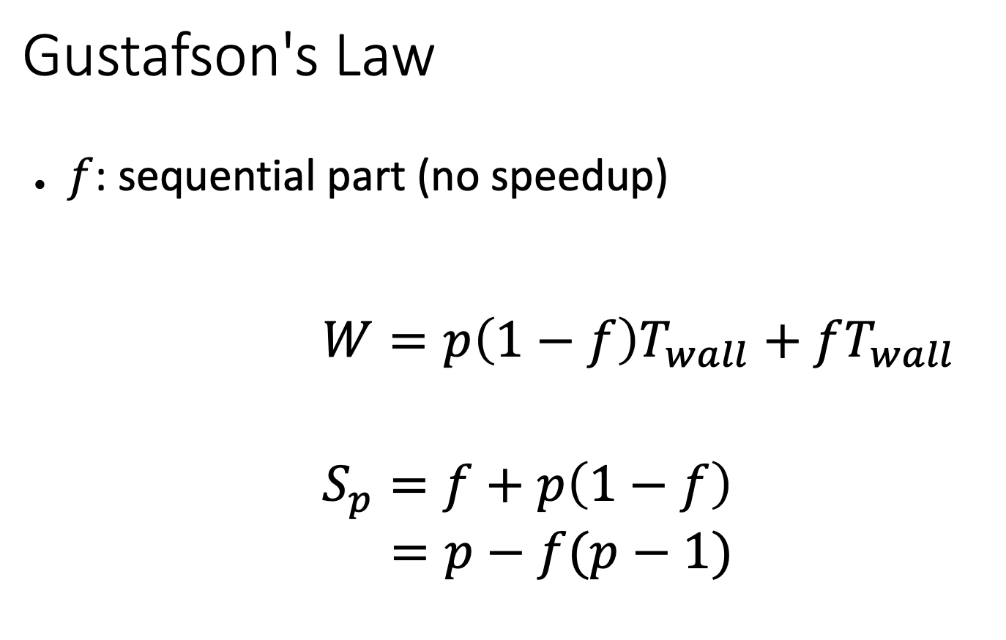
custom

Slide 82
custom

Slide 83
custom

Slide 84
custom

Slide 85
custom

Slide 86
Exercise 4
essentials

Slide 87
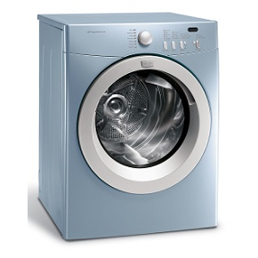
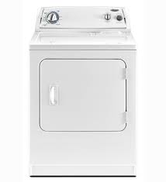

Task 1 - Pipelining
essentials
Bob, Mary, John and Alice
Laundry time using sequential order
Design a strategy with better laundry time
How would the laundry time improve if they bought a new dryer?
50 min
90 min
15 min

Slide 88
Task 2 - Pipelining II
essentials
Assume a processor that can each cycle issue either:
one multiplication instruction with latency 6 cycles
one addition instruction with latency 3 cycles
How many cycles are required to execute following loops?
for (int i = 0; i < data.length; i++) {
data[i] = data[i] * data[i];
}
for (int i = 0; i < data.length; i += 2) {
j = i + 1;
data[i] = data[i] * data[i];
data[j] = data[j] * data[j];
}
for (int i = 0; i < data.length; i += 4) {
j = i + 1;
k = i + 2;
l = i + 3;
data[i] = data[i] * data[i];
data[j] = data[j] * data[j];
data[k] = data[k] * data[k];
data[l] = data[l] * data[l];
}

Slide 89
Task 3 - Identify Potential Parallelization
essentials
Can we parallelize following two loops using parallel for construct?
for (int i=1; i<size; i++) { // for loop: i from 1 to (size-1)
if (data[i-1] > 0) // If the previous value is positive
data[i] = (-1)*data[i]; // change the sign of this value
} // end for loop
for (int i=0; i<size; i++) { // for loop: i from 0 to (size-1)
data[i] = Math.sin(data[i]); // calculate sin() of the value
} // end for loop

Slide 90
Example - Pipelining
essentials
You operate a factory where completing a product involves 4 tasks. The dependencies between these tasks and their respective completion times can be summarized as:
3’
2’
T0
T1
1’
product
T2
T3
5’
You plan to invest in enhancing ONE task to improve overall throughput. However, every saved minute incurs a cost.
  What is the current throughput?
  Which task do you choose, and by how much do you improve the time?
  What will be the new throughput?

Slide 91
Solution
essentials
Pipeline:
T0
T1
T2
T3 |  |  |  |  |  | P0 |  |  |  |  | P1 |  |  |  |  | P2
3’
2’
1’
You plan to invest in enhancing ONE task to improve overall throughput. However, every saved minute incurs a cost.
  What is the current throughput?
    1 product / 5’
  Which task do you choose, and by how much do you improve the time?
    T2, by 2’: T0 and T1 take 5’ together but can be pipelined. Reducing T2 by 2’min removes the bottleneck it currently induces.
  What will be the new throughput?
    1 product / 3’

Slide 92
Solution
essentials
Improved Pipeline:
1’
T0
T1
T2
T3 |  |  |  |  |  | P0 |  |  | P1 |  |  | P2 |  |  | P3

Slide 93

https://quizizz.com/admin/quiz/65eed2d6c44969557cb154fe?source=quiz_share

