Slide 1
Parallel Programming
Exercise Session 5
Spring 2024

Slide 2
Schedule
Post-Discussion Ex. 4
Theory Recap
Break
Old Exam Task
(Pre-Discussion Ex. 5)
Quiz
Additionally: Small wait/notify exercise

Slide 3
NEXT FRIDAY NO EXERCISE SESSION
Wednesday from 16:15-18:00 in LFW C 11

Slide 4
Post-Discussion
Exercise 4

Slide 5
Pipelining
Washing - 50 min, Dryer - 90 min, Iron - 15 min
Task a) total time if strictly sequential order?

Slide 6
Pipelining
Washing - 50 min, Dryer - 90 min, Iron - 15 min
Task a) total time if strictly sequential order?
50 + 90 + 15
155

Slide 7
Pipelining
Washing - 50 min, Dryer - 90 min, Iron - 15 min
Task a) total time if strictly sequential order?
155
+
155

Slide 8
Pipelining
Washing - 50 min, Dryer - 90 min, Iron - 15 min
Task a) total time if strictly sequential order?
155
+
155
+
155
+
155
=
620

Slide 9
Pipelining
Washing - 50 min, Dryer - 90 min, Iron - 15 min
Task b) what would be a better (faster) strategy?

Slide 10
Pipelining
Washing - 50 min, Dryer - 90 min, Iron - 15 min
Task b) what would be a better (faster) strategy?

Slide 11
Pipelining
Washing - 50 min, Dryer - 90 min, Iron - 15 min
Task b) what would be a better (faster) strategy?
Throughput?
With lead in & lead out
(fixed number of students)
1 person per 106.25 min (425 min / 4)

Slide 12
Pipelining
Washing - 50 min, Dryer - 90 min, Iron - 15 min
Task b) what would be a better (faster) strategy?
Throughput?
1 person per 90 min
Full utilization
(indefinite number of students)

Slide 13
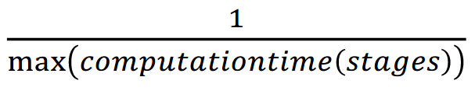
Pipelining
Washing - 50 min, Dryer - 90 min, Iron - 15 min
Task b) what would be a better (faster) strategy?
Throughput?
How to compute throughput fast for pipelines with no duplicated stages?
1 person per 90 min

Slide 14
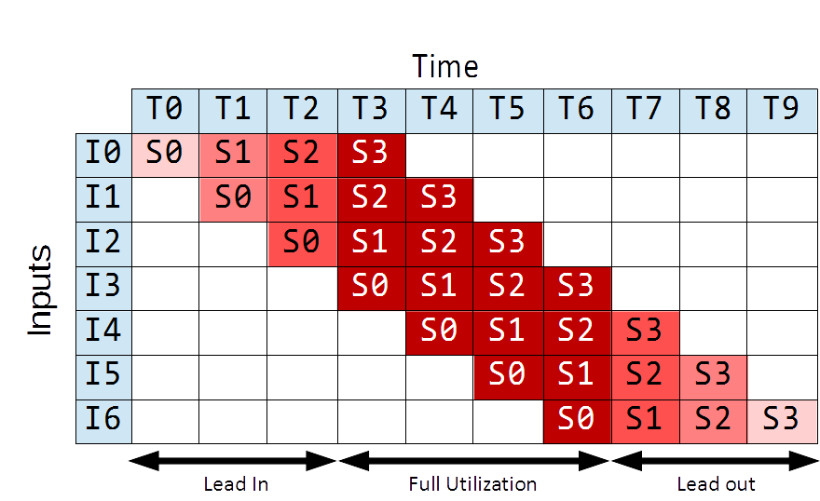
Pipelining

Slide 15
Pipelining
Washing - 50 min, Dryer - 90 min, Iron - 15 min
Task c) what if they bought another dryer?

Slide 16
Pipelining
Washing - 50 min, Dryer - 90 min, Iron - 15 min
Task c) what if they bought another dryer?

Slide 17
Pipelining
Washing - 50 min, Dryer - 90 min, Iron - 15 min
Task c) what if they bought another dryer?
Latency?
Throughput?
155 min
1 person per 50 min
(full utilization)
1 person per 76.25 min
(with lead in & lead out)
50 min
305 min

Slide 18
Pipelining
Washing - 50 min, Dryer - 90 min, Iron - 15 min
Task c) what if they bought another dryer?
Pipeline is not balanced as the stages do not take the same time.

Slide 19
Pipelining II
for (int i = 0; i < size; i++) {
data[i] = data[i] * data[i];
}
for (int i = 0; i < size; i += 2) {
j = i + 1;
data[i] = data[i] * data[i];
data[j] = data[j] * data[j];
}
for (int i = 0; i < size; i += 4) {
j = i + 1;
k = i + 2;
l = i + 3;
data[i] = data[i] * data[i];
data[j] = data[j] * data[j];
data[k] = data[k] * data[k];
data[l] = data[l] * data[l];
}

Slide 20
Pipelining II
for (int i = 0; i < size; i++) {
data[i] = data[i] * data[i];
}
Assumptions:
Only one instruction can be issued per cycle.
Loop body computation must be fully finished before next iteration starts
Consider only arithmetic expressions in loop body and ignore all other operations (i.e., loads, stores, loop counter increment, etc.)
Consider only execute step of an instruction (e.g., ignore fetch, decode, etc.)
How many cycles does the processor need to execute the following loops?
Addition takes 3 cycles to execute
Multiplication takes 6 cycles to execute
for (int i = 0; i < size; i += 2) {
j = i + 1;
data[i] = data[i] * data[i];
data[j] = data[j] * data[j];
}
for (int i = 0; i < size; i += 4) {
j = i + 1;
k = i + 2;
l = i + 3;
data[i] = data[i] * data[i];
data[j] = data[j] * data[j];
data[k] = data[k] * data[k];
data[l] = data[l] * data[l];
}

Slide 21
Pipelining II
essentials
for (int i = 0; i < size; i++) {
data[i] = data[i] * data[i];
}
i-1
loop
iteration
i+1
loop
iteration
1
2
3
4
5
6
for (int i = 0; i < size; i += 2) {
j = i + 1;
data[i] = data[i] * data[i];
data[j] = data[j] * data[j];
}
for (int i = 0; i < size; i += 4) {
j = i + 1;
k = i + 2;
l = i + 3;
data[i] = data[i] * data[i];
data[j] = data[j] * data[j];
data[k] = data[k] * data[k];
data[l] = data[l] * data[l];
}

Slide 22
Pipelining II
essentials
for (int i = 0; i < size; i++) {
data[i] = data[i] * data[i];
}
i-1
loop
iteration
i+1
loop
iteration
1
2
3
4
5
6
for (int i = 0; i < size; i += 2) {
j = i + 1;
data[i] = data[i] * data[i];
data[j] = data[j] * data[j];
}
1
2
3
4
5
6
7
8
9
i-2
loop
iteration
i+2
loop
iteration
for (int i = 0; i < size; i += 4) {
j = i + 1;
k = i + 2;
l = i + 3;
data[i] = data[i] * data[i];
data[j] = data[j] * data[j];
data[k] = data[k] * data[k];
data[l] = data[l] * data[l];
}

Slide 23
Pipelining II
essentials
for (int i = 0; i < size; i++) {
data[i] = data[i] * data[i];
}
i-1
loop
iteration
i+1
loop
iteration
1
2
3
4
5
6
for (int i = 0; i < size; i += 2) {
j = i + 1;
data[i] = data[i] * data[i];
data[j] = data[j] * data[j];
}
1
2
3
4
5
6
7
8
9
i-2
loop
iteration
i+2
loop
iteration
for (int i = 0; i < size; i += 4) {
j = i + 1;
k = i + 2;
l = i + 3;
data[i] = data[i] * data[i];
data[j] = data[j] * data[j];
data[k] = data[k] * data[k];
data[l] = data[l] * data[l];
}
1
2
3
4
5
6
7
8
9
10
11
12
i-4
loop
iteration
i+4
loop
iteration

Slide 24
Loop Parallelism
essentials
Can we parallelize the following loop?
for (int i=1; i<size; i++) { // for loop: i from 1 to (size-1)
if (data[i-1] > 0) // If the previous value is positive
data[i] = (-1)*data[i]; // change the sign of this value
} // end for loop

Slide 25
Loop Parallelism
essentials
Can we parallelize the following loop?
for (int i=1; i<size; i++) { // for loop: i from 1 to (size-1)
if (data[i-1] > 0) // If the previous value is positive
data[i] = (-1)*data[i]; // change the sign of this value
} // end for loop
for (int i = 0; i < size; i++) { // for loop: i from 0 to (size-1)
data[i] = Math.sin(data[i]); // calculate sin() of the value
} // end for loop

Slide 26
Loop Parallelism
essentials
Can we parallelize the following loop?
for (int i=1; i<size; i++) { // for loop: i from 1 to (size-1)
if (data[i-1] > 0) // If the previous value is positive
data[i] = (-1)*data[i]; // change the sign of this value
} // end for loop
for (int i = 0; i < size; i++) { // for loop: i from 0 to (size-1)
data[i] = Math.sin(data[i]); // calculate sin() of the value
} // end for loop
Notes:
We cannot parallelize the first loop, since the condition depends on the previous value at position i – 1.

Slide 27
Supplementary Exercise 4

Slide 28
SOLA Stafette
14 runners (numbered from 0 to 13)
each runner can start after the previous runner finished (except the first one).
public class RunnerThread extends Thread {
private AtomicInteger y;
private int id;
public RunnerThread(int id, AtomicInteger y) {
this.id = id;
this.y = y;
}
public void run(){
while (y.get() != this.id) {
// warten bis ich an der Reihe bin / wait until it is my turn
}
// laufen / do running
y.incrementAndGet();
}
}
Under which assumption
does the following code work?
Initial value of y?
0
Reference to object y?
needs to be the same object shared across all the threads

Slide 29
SOLA Stafette
14 runners (numbered from 0 to 13)
each runner can start after the previous runner finished (except the first one).
public class RunnerThread extends Thread {
private AtomicInteger y;
private int id;
public RunnerThread(int id, AtomicInteger y) {
this.id = id;
this.y = y;
}
public void run(){
while (y.get() != this.id) {
// warten bis ich an der Reihe bin / wait until it is my turn
}
// laufen / do running
y.incrementAndGet();
}
}
Under which assumption
does the following code work?
Initial value of y?
0
Reference to object y?
Ensures that y.get() returns the updated value after calling y.incrementAndGet();
needs to be the same object shared across all the threads

Slide 30
SOLA Stafette
Complete the implementation
using wait/notify
public class WaitNotifyRunnerThread extends Thread {
private .................. x;
private int id;
public WaitNotifyRunnerThread(int id, .................. x) {
this.id = id;
this.x = x;
}
public ................. void run(){
...................................................
...................................................
...................................................
...................................................
...................................................
...................................................
...................................................
...................................................
}
}

Slide 31
SOLA Stafette
essentials
Complete the implementation
using wait/notify
public class WaitNotifyRunnerThread extends Thread {
private .................. x;
private int id;
public WaitNotifyRunnerThread(int id, .................. x) {
this.id = id;
this.x = x;
}
public ................. void run(){
synchronized (?) {
...................................................
...................................................
...................................................
...................................................
...................................................
...................................................
...................................................
}
}
We’ll definitely need synchronization
What to synchronize on?

Slide 32
SOLA Stafette
essentials
Complete the implementation
using wait/notify
public class WaitNotifyRunnerThread extends Thread {
private .................. x;
private int id;
public WaitNotifyRunnerThread(int id, .................. x) {
this.id = id;
this.x = x;
}
public ................. void run(){
synchronized (?) {
while (condition) {
?.wait();
}
...................................................
...................................................
...................................................
...................................................
}
}
We’ll definitely need synchronization
What to synchronize on?
Check that it’s our turn, wait otherwise

Slide 33
SOLA Stafette
essentials
Complete the implementation
using wait/notify
public class WaitNotifyRunnerThread extends Thread {
private .................. x;
private int id;
public WaitNotifyRunnerThread(int id, .................. x) {
this.id = id;
this.x = x;
}
public ................. void run(){
synchronized (?) {
while (condition) {
?.wait();
}
// laufen / do running
...................................................
...................................................
...................................................
}
}
We’ll definitely need synchronization
What to synchronize on?
Check that it’s our turn, wait otherwise
Do work (run)

Slide 34
SOLA Stafette
essentials
Complete the implementation
using wait/notify
public class WaitNotifyRunnerThread extends Thread {
private .................. x;
private int id;
public WaitNotifyRunnerThread(int id, .................. x) {
this.id = id;
this.x = x;
}
public ................. void run(){
synchronized (?) {
while (condition) {
?.wait();
}
// laufen / do running
// update the condition
...................................................
...................................................
}
}
We’ll definitely need synchronization
What to synchronize on?
Check that it’s our turn, wait otherwise
Do work (run)
Update the condition

Slide 35
SOLA Stafette
essentials
Complete the implementation
using wait/notify
public class WaitNotifyRunnerThread extends Thread {
private .................. x;
private int id;
public WaitNotifyRunnerThread(int id, .................. x) {
this.id = id;
this.x = x;
}
public ................. void run(){
synchronized (?) {
while (condition) {
?.wait();
}
// laufen / do running
// update the condition
?.notify(); // or notifyAll()
}
}
}
We’ll definitely need synchronization
What to synchronize on?
Check that it’s our turn, wait otherwise
Do work (run)
Update the condition
Notify waiting threads
This is a basic pattern that you
will see in many tasks.
Now, let’s fill in the details.

Slide 36
SOLA Stafette
essentials
Complete the implementation
using wait/notify
public class WaitNotifyRunnerThread extends Thread {
private .................. x;
private int id;
public WaitNotifyRunnerThread(int id, .................. x) {
this.id = id;
this.x = x;
}
public ................. void run(){
synchronized (?) {
while (condition) {
?.wait();
}
// laufen / do running
// update the condition
?.notify(); // or notifyAll()
}
}
}
We’ll definitely need synchronization
What to synchronize on?
Check that it’s our turn, wait otherwise
Do work (run)
Update the condition
Notify waiting threads

Slide 37
SOLA Stafette
essentials
Complete the implementation
using wait/notify
public class WaitNotifyRunnerThread extends Thread {
private .................. x;
private int id;
public WaitNotifyRunnerThread(int id, .................. x) {
this.id = id;
this.x = x;
}
public ................. void run(){
synchronized (x) {
while (condition) {
x.wait();
}
// laufen / do running
// update the condition
x.notify(); // or notifyAll()
}
}
}
We’ll definitely need synchronization
What to synchronize on?
Check that it’s our turn, wait otherwise
Do work (run)
Update the condition
Notify waiting threads

Slide 38
SOLA Stafette
essentials
Complete the implementation
using wait/notify
public class WaitNotifyRunnerThread extends Thread {
private .................. x;
private int id;
public WaitNotifyRunnerThread(int id, .................. x) {
this.id = id;
this.x = x;
}
public ................. void run(){
synchronized (x) {
while (condition) {
x.wait();
}
// laufen / do running
// update the condition
x.notify(); // or notifyAll()
}
}
}
We’ll definitely need synchronization
What to synchronize on?
Check that it’s our turn, wait otherwise
Do work (run)
Update the condition
Notify waiting threads
while (y.get() != this.id) {
original condition
can we reuse it?
Yes!

Slide 39
SOLA Stafette
essentials
Complete the implementation
using wait/notify
public class WaitNotifyRunnerThread extends Thread {
private AtomicInteger x;
private int id;
public WaitNotifyRunnerThread(int id, AtomicInteger x) {
this.id = id;
this.x = x;
}
public ................. void run(){
synchronized (x) {
while (x.get() != this.id) {
x.wait();
}
// laufen / do running
// update the condition
x.notify(); // or notifyAll()
}
}
}
We’ll definitely need synchronization
What to synchronize on?
Check that it’s our turn, wait otherwise
Do work (run)
Update the condition
Notify waiting threads

Slide 40
SOLA Stafette
essentials
Complete the implementation
using wait/notify
public class WaitNotifyRunnerThread extends Thread {
private AtomicInteger x;
private int id;
public WaitNotifyRunnerThread(int id, AtomicInteger x) {
this.id = id;
this.x = x;
}
public ................. void run(){
synchronized (x) {
while (x.get() != this.id) {
x.wait();
}
// laufen / do running
x.incrementAndGet(); // update the condition
x.notify(); // or notifyAll()
}
}
}
We’ll definitely need synchronization
What to synchronize on?
Check that it’s our turn, wait otherwise
Do work (run)
Update the condition
Notify waiting threads

Slide 41
SOLA Stafette
essentials
Complete the implementation
using wait/notify
public class WaitNotifyRunnerThread extends Thread {
private AtomicInteger x;
private int id;
public WaitNotifyRunnerThread(int id, AtomicInteger x) {
this.id = id;
this.x = x;
}
public ................. void run(){
synchronized (x) {
while (x.get() != this.id) {
x.wait();
}
// laufen / do running
x.incrementAndGet(); // update the condition
x.notify(); // or notifyAll()
}
}
}
We’ll definitely need synchronization
What to synchronize on?
Check that it’s our turn, wait otherwise
Do work (run)
Update the condition
Notify waiting threads
Should we use notify or notifyAll?

Slide 42
SOLA Stafette
essentials
Complete the implementation
using wait/notify
public class WaitNotifyRunnerThread extends Thread {
private AtomicInteger x;
private int id;
public WaitNotifyRunnerThread(int id, AtomicInteger x) {
this.id = id;
this.x = x;
}
public ................. void run(){
synchronized (x) {
while (x.get() != this.id) {
x.wait();
}
// laufen / do running
x.incrementAndGet(); // update the condition
x.notifyAll();
}
}
}
We’ll definitely need synchronization
What to synchronize on?
Check that it’s our turn, wait otherwise
Do work (run)
Update the condition
Notify waiting threads
Should we use notify or notifyAll?
notifyAll because multiple
threads can be waiting

Slide 43
SOLA Stafette
essentials
Complete the implementation
using wait/notify
public class WaitNotifyRunnerThread extends Thread {
private AtomicInteger x;
private int id;
public WaitNotifyRunnerThread(int id, AtomicInteger x) {
this.id = id;
this.x = x;
}
public ................. void run(){
synchronized (x) {
while (x.get() != this.id) {
x.wait();
}
// laufen / do running
x.incrementAndGet(); // update the condition
x.notifyAll();
}
}
}
We’ll definitely need synchronization
What to synchronize on?
Check that it’s our turn, wait otherwise
Do work (run)
Update the condition
Notify waiting threads
Can we replace
synchronized (x)
with synchronizing
the method?
No

Slide 44
SOLA Stafette
essentials
Complete the implementation
using wait/notify
public class WaitNotifyRunnerThread extends Thread {
private AtomicInteger x;
private int id;
public WaitNotifyRunnerThread(int id, AtomicInteger x) {
this.id = id;
this.x = x;
}
public void run(){
synchronized (x) {
while (x.get() != this.id) {
x.wait();
}
// laufen / do running
x.incrementAndGet(); // update the condition
x.notifyAll();
}
}
}
We’ll definitely need synchronization
What to synchronize on?
Check that it’s our turn, wait otherwise
Do work (run)
Update the condition
Notify waiting threads
Can we replace
AtomicInteger x
With
Integer x
?

Slide 45
SOLA Stafette
essentials
Complete the implementation
using wait/notify
public class WaitNotifyRunnerThread extends Thread {
private Integer x;
private int id;
public WaitNotifyRunnerThread(int id, Integer x) {
this.id = id;
this.x = x;
}
public void run(){
synchronized (x) {
while (x.get() != this.id) {
x.wait();
}
// laufen / do running
x += 1; // update the condition
x.notifyAll();
}
}
}
We’ll definitely need synchronization
What to synchronize on?
Check that it’s our turn, wait otherwise
Do work (run)
Update the condition
Notify waiting threads
Can we replace
AtomicInteger x
With
Integer x
NO

Slide 46
SOLA Stafette
details
Complete the implementation
using wait/notify
public class WaitNotifyRunnerThread extends Thread {
private Integer x;
private int id;
public WaitNotifyRunnerThread(int id, Integer x) {
this.id = id;
this.x = x;
}
public void run(){
synchronized (x) {
while (x.get() != this.id) {
x.wait();
}
// laufen / do running
x += 1; // update the condition
x.notifyAll();
}
}
}
Do these assumptions still hold?
Initial value of x?
Can we replace
AtomicInteger x
With
Integer x
NO
0
Reference to object x?
needs to be the same object shared across all the threads
No, because x += 1 in Java creates a new Object!

Slide 47
Theory Recap

Slide 53
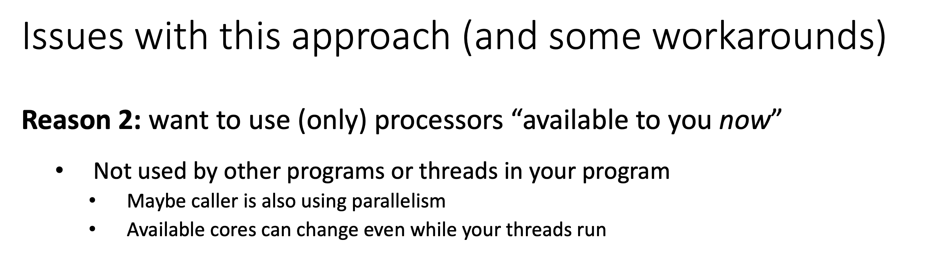


Slide 54
Divide and Conquer
essentials
Examples of divide-and-conquer algorithms are quicksort, mergesort, Strassen matrix multiplication, and many others.
Basic structure of a divide-and-conquer algorithm:
  If problem is small enough, solve it directly
  Otherwise
    Break problem into subproblems
    Solve subproblems recursively
    Assemble solutions of subproblems into overall solution

Slide 55
Adding Numbers from Vector: (Recursive Version)
essentials
public static int do_sum_rec(int[] xs, int l, int h) {
int size = h – l;
if (size == 1)
return xs[l];
int mid = size / 2;
int sum1 = do_sum_rec(xs, l, l + mid);
int sum2 = do_sum_rec(xs, l + mid, h);
return sum1 + sum2;
}

Slide 56
Parallel Version: Task Parallelism Model
essentials
Basic flow of operations
  Create parallel tasks
  Wait for parallel tasks to complete
Parallel versions of divide-and-conquer on the task model are trivial:
  Create a task for the first and second part
  Wait for tasks to complete
  Combine their results

Slide 57
Divide and Conquer
essentials
+
+
+
+
+
+
+
+
+
+
+
+
+
+
+

Slide 58
Divide and Conquer
essentials
+
+
+
+
+
+
+
+
+
+
+
+
+
+
+
base case
no further split

Slide 59
Divide and Conquer
essentials
Tasks at different levels of granularity
+
+
+
+
+
+
+
+
+
+
+
+
+
+
+

Slide 60
Divide and Conquer
essentials
Tasks at different levels of granularity
+
+
+
+
+
+
+
+
+
+
+
+
+
+
+
What determines a task?

Slide 61
Divide and Conquer
essentials
Tasks at different levels of granularity
+
+
+
+
+
+
+
+
+
+
+
+
+
+
+
What determines a task?
i) input array ii) start index iii) length/end index
These are fields we want to store in the task

Slide 62
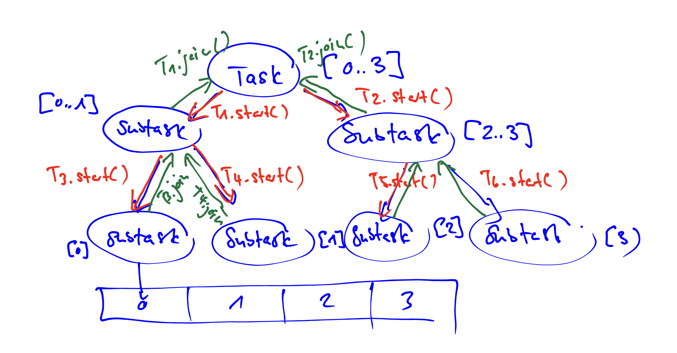

Slide 64
Notes:
Ask what isn’t good here: Too small cutoff -> Overhead and also OutOfMemory when creating Threads. MAPPING TO OS THREAD

Slide 65
Notes:
Remind them of JVM Thread -> OS Thread mapping

Slide 66
Notes:
But still requires manual optimization etc. because for large arrays it will still run out of memory

Slide 67
Notes:
Draw on board

Slide 68
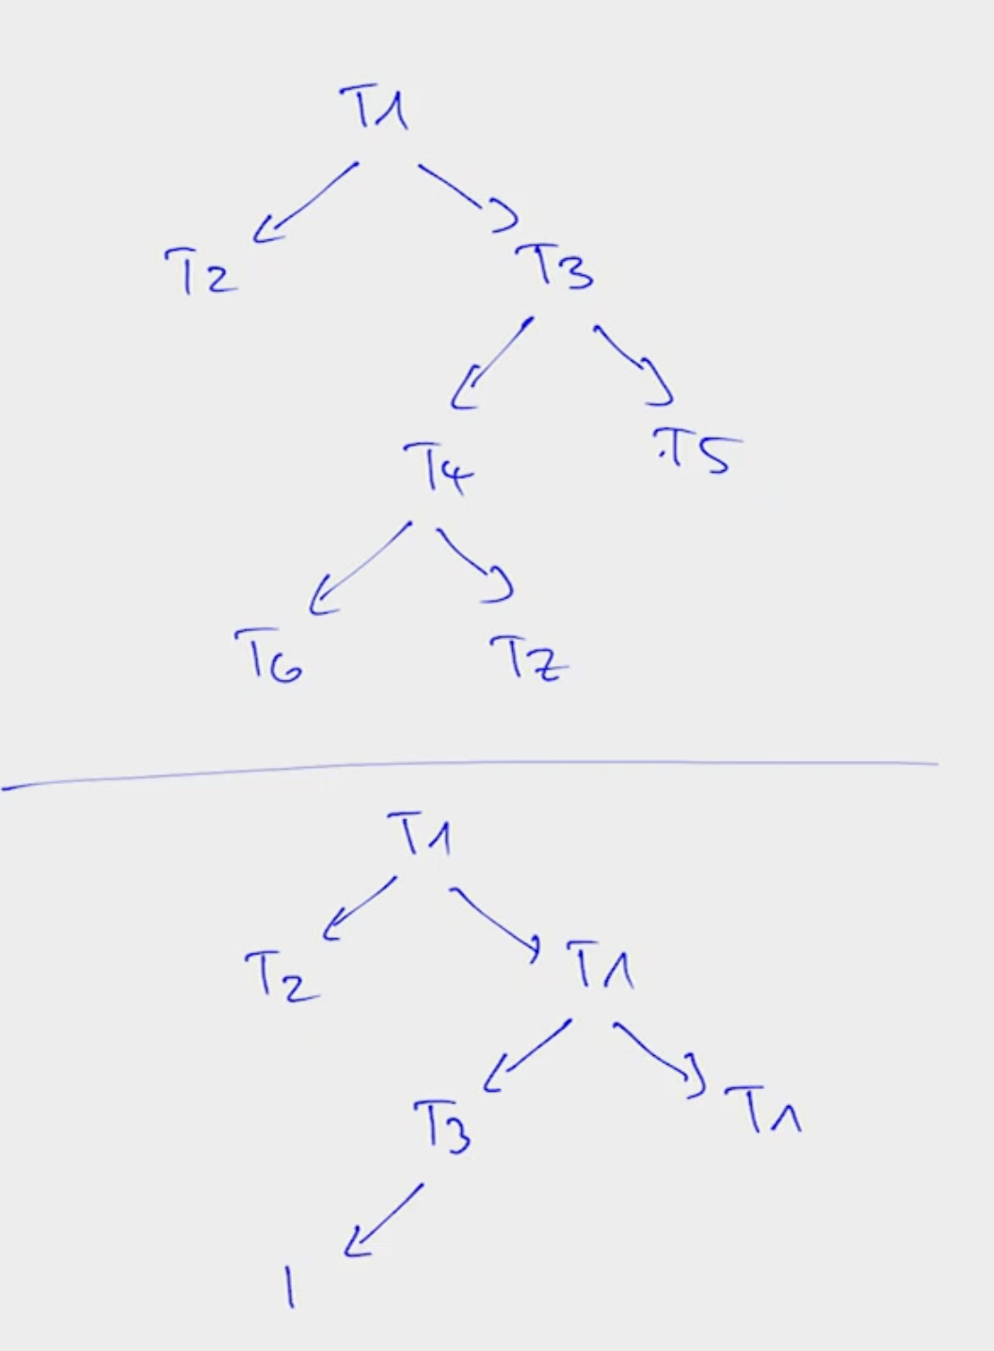

Slide 69
Java Threads are too heavyweight. What should we do?

Slide 70
ExecutorService!

Slide 72
Notes:
Draw blocking queue etc. on board: Say its cleaner and less threads, explain that previously every task was a thread (A HEAVYWEIGHT OS THREAD!)

Slide 73
Notes:
That’s why I recommended Runnable > Thread

Slide 74
Notes:
Ask students: Whats the problem here? Blocking/waiting in return statement. If less Threads than Tasks -> Deadlock
Draw on board
Problem with the divide and conquer approach is that tasks create other tasks and work partitioning (splitting up work) is part of the task.

Slide 76
Lesson:
ExecutorService is good for “flat” problems.
But for recursive problems (like divide-and-conquer) we need a more complex system: Work stealing
Notes:
Quickly mention Cilk

Slide 77
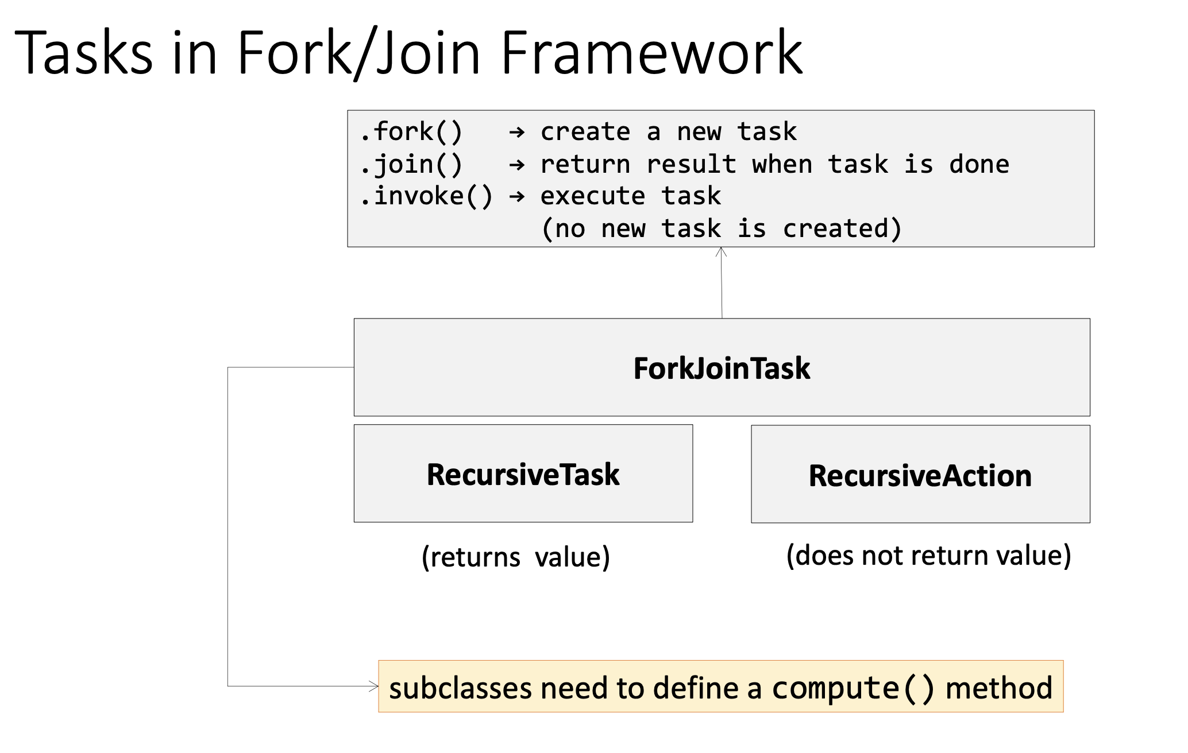

Slide 78
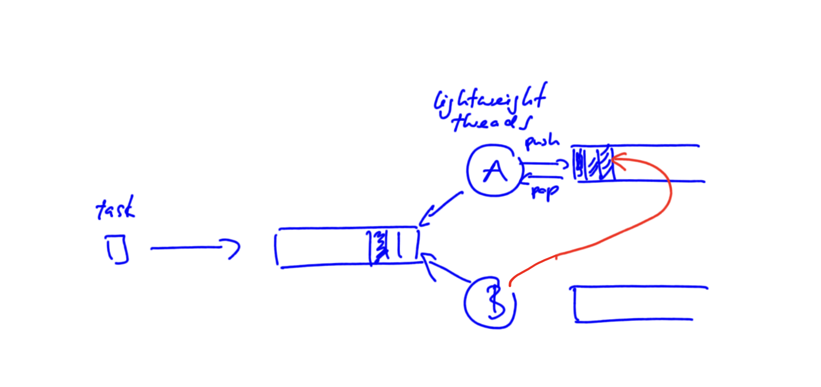

Slide 79
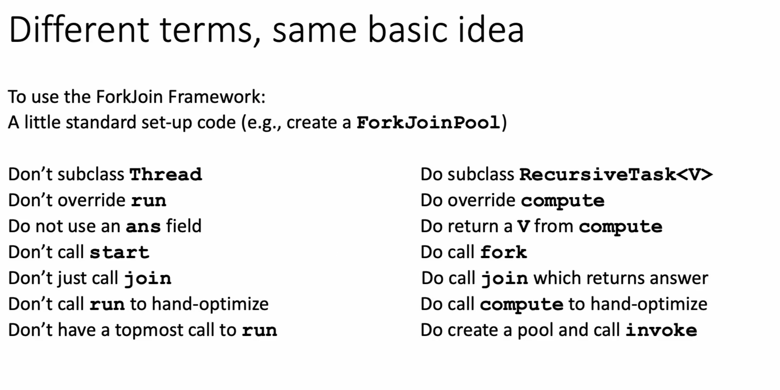

Slide 82
Pre-Discussion
Exercise 5

Slide 83
Assignment 5
Parallel Search and Count
Search an array of integers for a certain feature and count integers that have this feature.
    Light workload: count number of non-zero values.
    Heavy workload: count how many integers are prime numbers.
We will study single threaded and multi-threaded implementation of the problem.
Explanation of given code
Notes:
83

Slide 84
Assignment 5
Parallel Search and Count
Search an array of integers for a certain feature and count integers that have this feature.
    Light workload: count number of non-zero values.
    Heavy workload: count how many integers are prime numbers.
We will study single threaded and multi-threaded implementation of the problem.
Amdahl’s and Gustafson’s Law II
Amdahl’s and Gustafson’s Law
Task Graph
Notes:
84

Slide 85
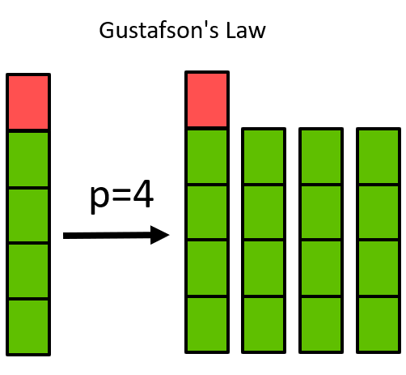
Amdal’s & Gustavson’s Law
Assuming a program consists of 50% non-parallelizable code.
a) Compute the speed-up when using 2 and 4 processors according to Amdahl’s law.
b) Now assume that the parallel
work per processor is fixed.
Compute the speed-up when
using 2 and 4 processors according
to Gustafson’s law.
Time is constant
→ More work overall

Slide 86
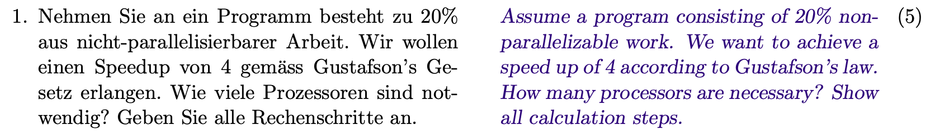


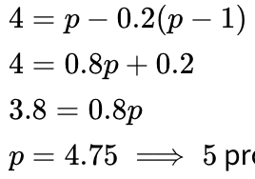
Old Exam Task (HS20 – Task 1)
Gustafson: From the text:
→ 5 processors are required!
⟺
⟺
⟺

Slide 87
Old Exam Task (HS20 – Task 1)
Gustafson:

Slide 88

https://quizizz.com/admin/quiz/65f7e8ede558fa3845d65bf3?source=quiz_share
Replace link with link to quiz

