Slide 1
Parallel Programming
Exercise Session 6
Spring 2024

Slide 2
Today
Post-Discussion Ex. 5 (+ some Theory)
Theory Recap (Locks and Race condition)
Break
Additional Recap (if there is interest)
Pre-Discussion Ex. 6
Quiz

Slide 3
Exam Preparation Session
Tuesday, April 9, 10:15 – 12:00
HG F 7
Hosted by Julianne Orel and Finn Heckman

Slide 4

Feedback zur Übungsstunde

Slide 5
Post-Discussion
Exercise 5

Slide 6
Recall: Amdahl's vs Gustafson's Law
The key goal is to:
Understand the main difference and implications
(i.e., when to use which formula)
Know how to derive formula based on the understanding,
Not because you memorized them for the exam

Slide 7
Recall: Amdahl's vs Gustafson's Law
The key goal is to:
Understand the main difference and implications
(i.e., when to use which formula)
Know how to derive formula based on the understanding,
Not because you memorized them for the exam

Slide 8
Recall: Amdahl's vs Gustafson's Law
essentials
Amdahl's Law
Gustafson's Law
p=4
p=1
p=1
p=4
p₁
p₂
p₃
p₄
p₁
p₁
p₁
p₂
p₃
p₄
Time
Less Time for the parallel part
More work in the same Time

Slide 9
Recall: Amdahl's vs Gustafson's Law
The key is goal to:
Understand the main difference and implications
(i.e., when to use which formula)
Know how to derive formula based on the understanding,
Not because you memorized them for the exam

Slide 10
Amdahl's Law Derivation
essentials
T₁ - sequential time
f - sequential fraction
T_{p} - parallel time on p processors
T_{p} = ?
Amdahl's Law
p=4
p=1
T₁f
T₁f
T₁(1-f)/p
T₁
Less Time for the parallel part

Slide 11

Amdahl's Law Derivation
essentials
T₁ - sequential time
f - sequential fraction
T_{p} - parallel time on p processors
T_{p} = $T_{1}f+\frac{T_{1}(1−f)}{p}$
Amdahl's Law
p=4
p=1
T₁f
T₁f
T₁(1-f)/p
T₁
Less Time for the parallel part

Slide 12
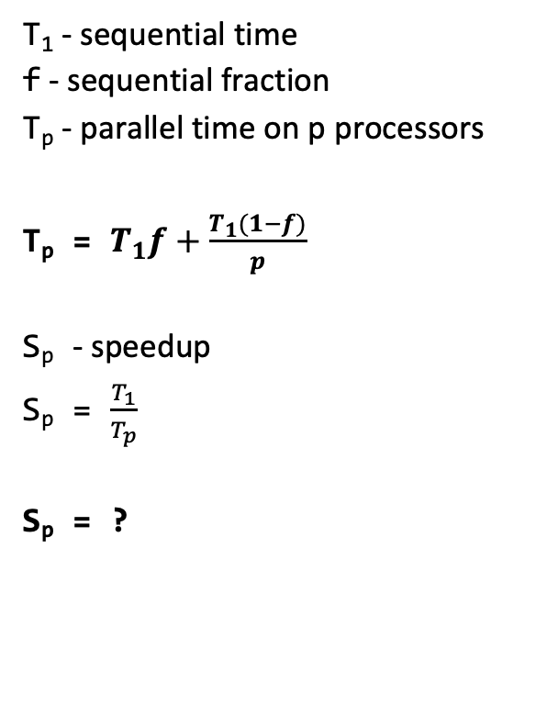
Amdahl's Law Derivation
essentials
T₁ - sequential time
f - sequential fraction
T_{p} - parallel time on p processors
T_{p} = $T_{1}f+\frac{T_{1}(1−f)}{p}$
S_{p} - speedup
S_{p} = $\frac{T_{1}}{T_{p}}$
S_{p} = ?
Amdahl's Law
p=4
p=1
T₁f
T₁f
T₁(1-f)/p
T₁
Less Time for the parallel part

Slide 13
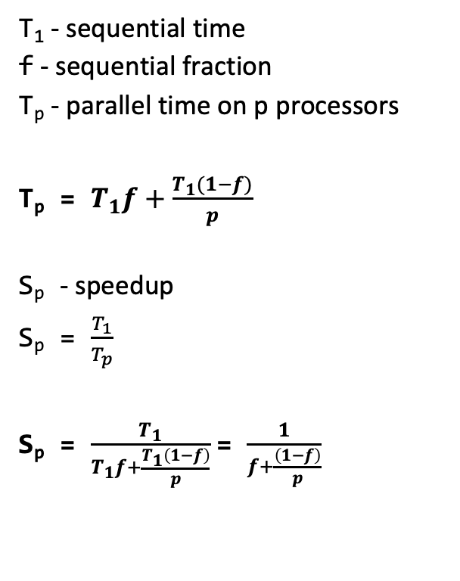
Amdahl's Law Derivation
essentials
T₁ - sequential time
f - sequential fraction
T_{p} - parallel time on p processors
T_{p} = $T_{1}f+\frac{T_{1}(1−f)}{p}$
S_{p} - speedup
S_{p} = $\frac{T_{1}}{T_{p}}$
S_{p} = $\frac{T_{1}}{T_{1}f+\frac{T_{1}\left(1−f\right)}{p}}$= $\frac{1}{f+\frac{\left(1−f\right)}{p}}$
Amdahl's Law
p=4
p=1
T₁f
T₁f
T₁(1-f)/p
T₁
Less Time for the parallel part

Slide 14
Gustafson's Law Derivation
essentials
Gustafson's Law
T - sequential time of original work
T₁ - sequential time with work*p
f - sequential fraction
T₁ = ?
p=4
More work in the same Time

Slide 15

Gustafson's Law Derivation
essentials
Gustafson's Law
T - sequential time of original work
T₁ - sequential time with work*p
f - sequential fraction
T₁ = $Tf+T\left(1−f\right)p$
p=4
More work in the same Time

Slide 16
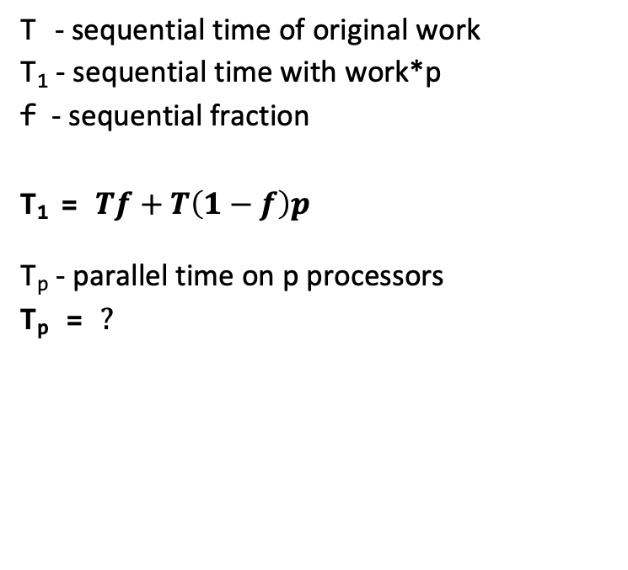
Gustafson's Law Derivation
essentials
Gustafson's Law
T - sequential time of original work
T₁ - sequential time with work*p
f - sequential fraction
T₁ = $Tf+T\left(1−f\right)p$
T_{p} - parallel time on p processors
T_{p} = $?$
p=4
More work in the same Time

Slide 17
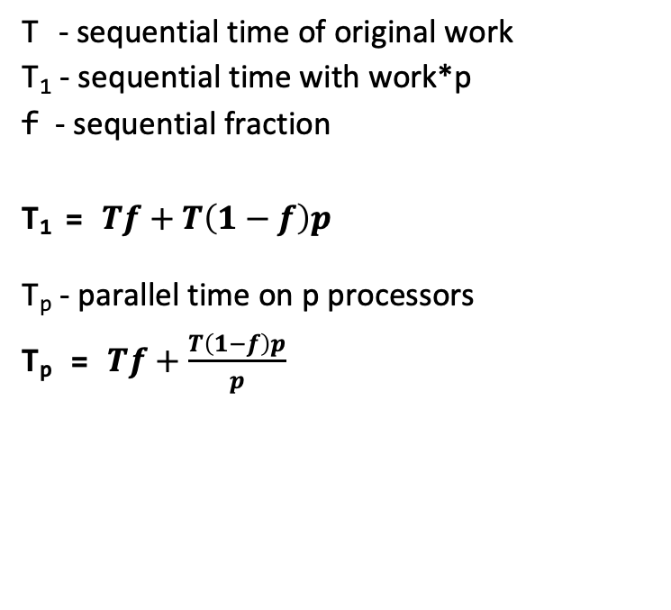
Gustafson's Law Derivation
essentials
Gustafson's Law
T - sequential time of original work
T₁ - sequential time with work*p
f - sequential fraction
T₁ = $Tf+T\left(1−f\right)p$
T_{p} - parallel time on p processors
T_{p} = $Tf+\frac{T\left(1−f\right)p}{p}$
p=4
More work in the same Time

Slide 18
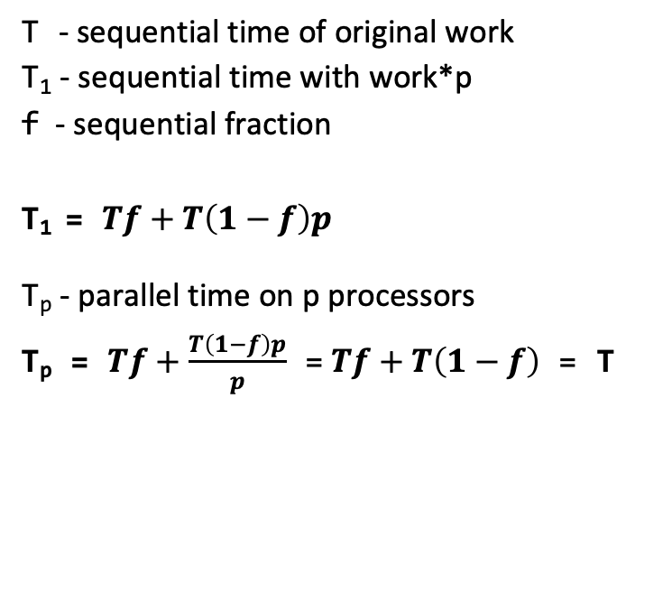
Gustafson's Law Derivation
essentials
Gustafson's Law
T - sequential time of original work
T₁ - sequential time with work*p
f - sequential fraction
T₁ = $Tf+T\left(1−f\right)p$
T_{p} - parallel time on p processors
T_{p} = $Tf+\frac{T\left(1−f\right)p}{p}$ =$Tf+T\left(1−f\right)$ = T
p=4
More work in the same Time
Notes:
Point out that this shows that time is constant in Gustafson lawa

Slide 19
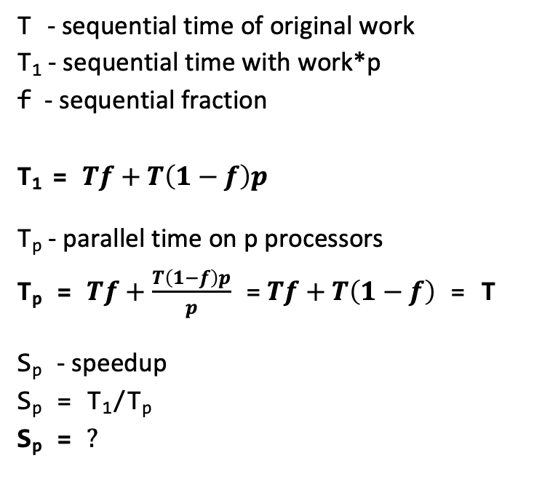
Gustafson's Law Derivation
essentials
Gustafson's Law
T - sequential time of original work
T₁ - sequential time with work*p
f - sequential fraction
T₁ = $Tf+T\left(1−f\right)p$
T_{p} - parallel time on p processors
T_{p} = $Tf+\frac{T\left(1−f\right)p}{p}$ =$Tf+T\left(1−f\right)$ = T
S_{p} - speedup
S_{p} = T₁/T_{p}
S_{p} = $?$
p=4
More work in the same Time

Slide 20
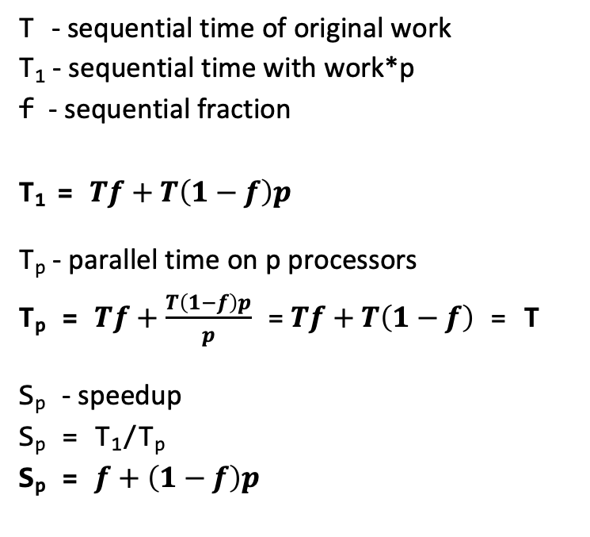
Gustafson's Law Derivation
essentials
Gustafson's Law
T - sequential time of original work
T₁ - sequential time with work*p
f - sequential fraction
T₁ = $Tf+T\left(1−f\right)p$
T_{p} - parallel time on p processors
T_{p} = $Tf+\frac{T\left(1−f\right)p}{p}$ =$Tf+T\left(1−f\right)$ = T
S_{p} - speedup
S_{p} = T₁/T_{p}
S_{p} = $f+\left(1−f\right)p$
p=4
More work in the same Time

Slide 21
fib(4) task graph
public class Fibonacci {
public static long fib(int n) {
if (n < 2) {
return n;
}
spawn task for fib(n-1);
spawn task for fib(n-2);
wait for tasks to complete
return addition of task results
}
}

Slide 22
fib(4) task graph
essentials
public class Fibonacci {
public static long fib(int n) {
if (n < 2) {
return n;
}
spawn task for fib(n-1);
spawn task for fib(n-2);
wait for tasks to complete
return addition of task results
}
}
fib(4)
fib(3)
fib(2)
What is a task?
fib(2)
fib(1)
fib(1)
fib(0)
base case
spawn
wait
What is an edge?
fib(1)
fib(0)
same procedure
spawn
wait

Slide 23
fib(4) task graph
essentials
public class Fibonacci {
public static long fib(int n) {
if (n < 2) {
return n;
}
spawn task for fib(n-1);
spawn task for fib(n-2);
wait for tasks to complete
return addition of task results
}
}
fib(4)
fib(3)
fib(2)
What is a task?
fib(2)
fib(1)
fib(1)
fib(0)
base case
spawn
wait
What is an edge?
fib(1)
fib(0)
critical path length is 8 tasks
same procedure
spawn
wait

Slide 24
fib(4) simplified task graph
essentials
public class Fibonacci {
public static long fib(int n) {
if (n < 2) {
return n;
}
spawn task for fib(n-1);
spawn task for fib(n-2);
wait for tasks to complete
return addition of task results
}
}
4
3
2
What is a task?
2
1
1
0
Call to Fibonacci
1
0
What is an edge?
Simpler at the expense of not modelling joins and inter-process dependencies
spawn
(no dependency within same procedure)

Slide 25
fib(4) simplified task graph
essentials
public class Fibonacci {
public static long fib(int n) {
if (n < 2) {
return n;
}
spawn task for fib(n-1);
spawn task for fib(n-2);
wait for tasks to complete
return addition of task results
}
}
4
3
2
What is a task?
2
1
1
0
Call to Fibonacci
1
0
Caching results can
speed-up computation
What is an edge?
Simpler at the expense of not modelling joins and inter-process dependencies
spawn
(no dependency within same procedure)

Slide 26
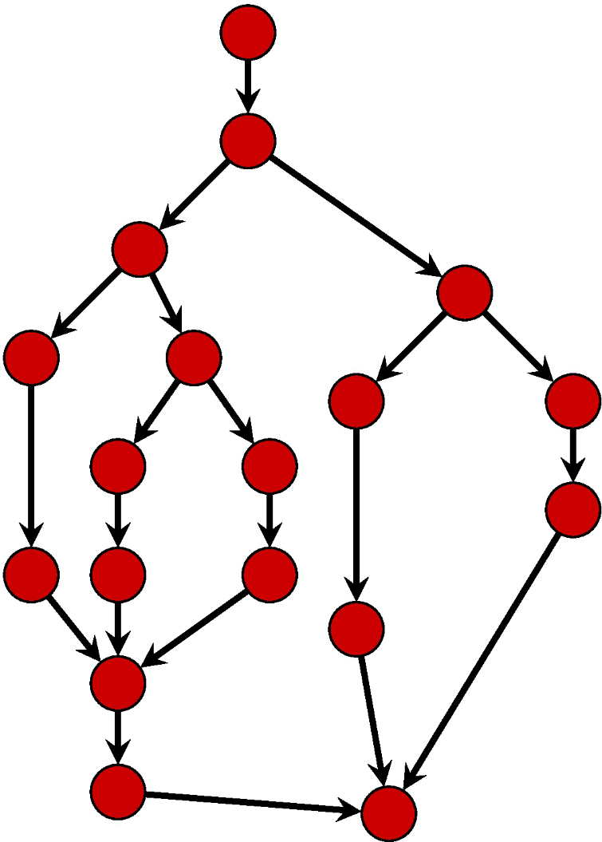
Task Graphs
essentials
Critical path: path from start to end that takes the longest (for some metric)
Example: #nodes

Slide 27
Task Graphs
essentials
Critical path: path from start to end that takes the longest (for some metric)
Example: #nodes

Slide 28
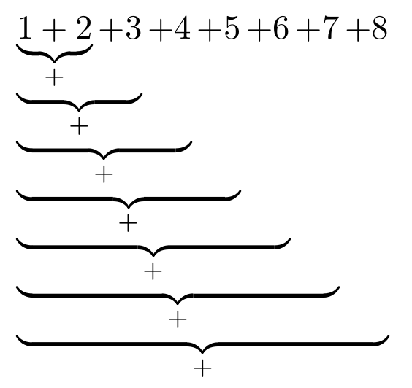
Task Graphs
Adding eight numbers:

Slide 29
Task Graphs
Adding eight numbers:
What is the corresponding task graph?

Slide 30
Task Graphs
What is the corresponding task graph?
Adding eight numbers:
+1
+2
+3
+4
+5
+6
+7
+8

Slide 31
Task Graphs
essentials
What is the corresponding task graph?
Adding eight numbers:
+1
+2
+3
+4
Critical path
n
+5
+6
+7
+8

Slide 32
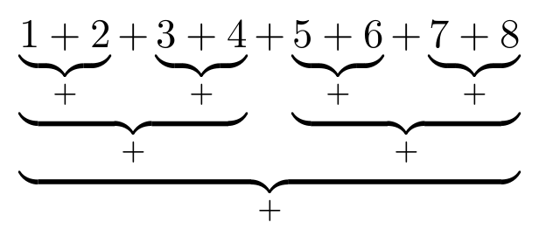
Task Graphs
Adding eight numbers:

Slide 33
Task Graphs
Adding eight numbers:
What is the corresponding task graph?

Slide 34
Task Graphs
Adding eight numbers:
What is the corresponding task graph?

Slide 35
Task Graphs
essentials
Adding eight numbers:
What is the corresponding task graph?
Critical path
log(n)

Slide 36
Search And Count
Search an array of integers for a certain feature and count integers that have this feature:
  Light workload: count number of non-zero values.
  Heavy workload: count how many integers are prime numbers.
We will study single threaded and multi-threaded implementation of the problem.
Notes:
36

Slide 37
Search And Count - Sequential
public class SearchAndCountSingle {
private int[] input;
private Workload.Type type;
private SearchAndCountSingle(int[] input, Workload.Type wt) {
this.input = input;
this.type = wt;
}
private int count() {
int count = 0;
for (int i = 0; i < input.length; i++) {
if (Workload.doWork(input[i], type)) count++;
}
return count;
}
}
Straightforward implementation. Simply iterate through the input array and count how many times given event occurs.

Slide 38
Divide and Conquer
essentials
Basic structure of a divide-and-conquer algorithm:
  If problem is small enough, solve it directly
  Otherwise
    Break problem into subproblems
    Solve subproblems recursively
    Assemble solutions of subproblems into overall solution
Notes:
Step 2.c is not necessary if algorithm is tail-recursive

Slide 39
Divide and Conquer
+
+
+
+
+
+
+
+
+
+
+
+
+
+
+

Slide 40
Divide and Conquer
essentials
+
+
+
+
+
+
+
+
+
+
+
+
+
+
+
base case
no further split

Slide 41
Divide and Conquer
essentials
Tasks at different levels of granularity
+
+
+
+
+
+
+
+
+
+
+
+
+
+
+

Slide 42
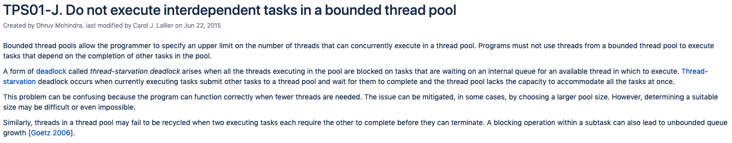
ExecutorService

Slide 43
Divide and Conquer Parallelization
essentials
thread 1
thread 2
thread 3
thread 4
thread 5
thread 6
thread 7
thread 8
...
+
+
+
+
+
+
+
+
+
+
+
+
+
+
+

Slide 44
Divide and Conquer Parallelization
essentials
Performance optimization
Same thread is reused instead of creating a new one
thread 1
thread 2
thread 3
thread 4
thread 5
thread 6
thread 7
thread 8
...
+
+
+
+
+
+
+
+
+
+
+
+
+
+
+

Slide 45
Divide and Conquer Parallelization
essentials
Performance optimization
Same thread is reused instead of creating a new one
thread 1
thread 2
thread 3
thread 4
thread 5
thread 6
thread 7
thread 8
...
+
+
+
+
+
+
+
+
+
+
+
+
+
+
+
Task B:
Extend your implementation such that it creates only a fixed number of threads. Make sure that your solution is properly synchronized when checking whether to create a new thread
How to achieve this?

Slide 46
Divide and Conquer Parallelization
essentials
+
+
+
+
+
+
+
+
+
+
+
+
+
+
+
Option 1:
Shared counter with synchronized/atomic access

Slide 47
Divide and Conquer Parallelization
essentials
0
1
2
3
4
5
6
+
+
+
+
+
+
+
+
+
+
+
+
+
+
+
Option 1:
Shared counter with synchronized/atomic access
Option 2:
Assign unique sequential id to each task. Spawn threads for first N tasks.

Slide 48
Divide and Conquer Parallelization
essentials
n
0
2n + 1
2n + 2
1
2
3
4
5
6
+
+
+
+
+
+
+
+
+
+
+
+
+
+
+
Option 1:
Shared counter with synchronized/atomic access
Option 2:
Assign unique sequential id to each task. Spawn threads for first N tasks.

Slide 49
Divide and Conquer Parallelization
essentials
n
0
2n + 1
2n + 2
1
2
3
4
5
6
+
+
+
+
+
+
+
+
+
+
+
+
+
+
+
Option 1:
Shared counter with synchronized/atomic access
Option 2:
Assign unique sequential id to each task. Spawn threads for first N tasks.
+ no synchronization required
- imbalanced amount of work

Slide 50
Divide and Conquer vs Fork/Join
essentials
Divide And Conquer
Fundamental design pattern based on recursively breaking down a problem into smaller problems that can be combined to give a solution to the original problem
Fork/Join
A framework that supports Divide and Conquer style parallelism

Slide 51
Divide and Conquer vs Fork/Join
essentials
Divide And Conquer
thread 1
+
+
+
+
+
+
+
+
+
+
+
+
+
+
+
+
recursively breaking down a problem into smaller problems
problems are solved sequentially

Slide 52
Divide and Conquer vs Fork/Join
essentials
Fork/Join
thread 1
thread 2
thread 3
thread 4
thread 5
thread 6
thread 7
...
+
+
+
+
+
+
+
+
+
+
+
+
+
+
+
a framework that supports Divide and Conquer style parallelism
problems are solved in parallel

Slide 53
Divide and Conquer vs Fork/Join
essentials
Performance optimization
Same thread is reused instead of creating a new one
Fork/Join
thread 1
thread 2
thread 3
thread 4
thread 5
thread 6
thread 7
...
+
+
+
+
+
+
+
+
+
+
+
+
+
+
+
a framework that supports Divide and Conquer style parallelism
problems are solved in parallel

Slide 54
Search And Count - Task Parallel
essentials
Define the task structure:
public class SearchAndCountMultiple extends RecursiveTask<Integer> {
private int[] input;
private int start;
private int length;
private int cutOff;
private Workload.Type workloadType;
}

Slide 55
Search And Count
essentials
protected Integer compute() {
}
Recall the template for divide and conquer task parallelism

Slide 56
Search And Count
essentials
protected Integer compute() {
if (// work is small) {
// do the work directly
else {
// split work into pieces
// invoke the pieces and
wait for the results
// combine the results
}
}
Recall the template for divide and conquer task parallelism

Slide 57
Search And Count
essentials
protected Integer compute() {
if (// work is small) {
// do the work directly
else {
// split work into pieces
// invoke the pieces and
wait for the results
// combine the results
}
}
Recall the template for divide and conquer task parallelism
Let’s fill in the template for the search and count task

Slide 58
Search And Count
essentials
public class SearchAndCountMultiple
extends RecursiveTask<Integer> {
private int[] input;
private int start;
private int length;
private int cutOff;
private Workload.Type type;
}
protected Integer compute() {
if (// work is small) {
// do the work directly
else {
// split work into pieces
// invoke the pieces and
wait for the results
// combine the results
}
}
protected Integer compute() {
if (// work is small) {
// do the work directly
else {
// split work into pieces
// invoke the pieces and
wait for the results
// combine the results
}
}

Slide 59
Search And Count
essentials
public class SearchAndCountMultiple
extends RecursiveTask<Integer> {
private int[] input;
private int start;
private int length;
private int cutOff;
private Workload.Type type;
}
protected Integer compute() {
if (// work is small)
// do the work directly
else {
// split work into pieces
// invoke the pieces and
wait for the results
// combine the results
}
}
protected Integer compute() {
if (length <= cutOff) {
// do the work directly
else {
// split work into pieces
// invoke the pieces and
wait for the results
// combine the results
}
}

Slide 60
Search And Count
essentials
public class SearchAndCountMultiple
extends RecursiveTask<Integer> {
private int[] input;
private int start;
private int length;
private int cutOff;
private Workload.Type type;
}
protected Integer compute() {
if (// work is small)
// do the work directly
else {
// split work into pieces
// invoke the pieces and
wait for the results
// combine the results
}
}
protected Integer compute() {
if (length <= cutOff) {
// do the work directly
else {
// split work into pieces
// invoke the pieces and
wait for the results
// combine the results
}
}

Slide 61
Search And Count
essentials
public class SearchAndCountMultiple
extends RecursiveTask<Integer> {
private int[] input;
private int start;
private int length;
private int cutOff;
private Workload.Type type;
}
protected Integer compute() {
if (// work is small)
// do the work directly
else {
// split work into pieces
// invoke the pieces and
wait for the results
// combine the results
}
}
protected Integer compute() {
if (length <= cutOff) {
int count = 0;
for (int i = start; i < start + length; i++) {
if (Workload.doWork(input[i], type)) count++;
}
return count;
else {
// split work into pieces
// invoke the pieces and
wait for the results
// combine the results
}
}
Same as sequential implementation

Slide 62
Search And Count
essentials
public class SearchAndCountMultiple
extends RecursiveTask<Integer> {
private int[] input;
private int start;
private int length;
private int cutOff;
private Workload.Type type;
}
protected Integer compute() {
if (// work is small)
// do the work directly
else {
// split work into pieces
// invoke the pieces and
wait for the results
// combine the results
}
}
protected Integer compute() {
if (length <= cutOff) {
int count = 0;
for (int i = start; i < start + length; i++) {
if (Workload.doWork(input[i], type)) count++;
}
return count;
else {
// split work into pieces
// invoke the pieces and
wait for the results
// combine the results
}
}

Slide 63
Search And Count
essentials
public class SearchAndCountMultiple
extends RecursiveTask<Integer> {
private int[] input;
private int start;
private int length;
private int cutOff;
private Workload.Type type;
}
protected Integer compute() {
if (// work is small)
// do the work directly
else {
// split work into pieces
// invoke the pieces and
wait for the results
// combine the results
}
}
protected Integer compute() {
if (length <= cutOff) {
int count = 0;
for (int i = start; i < start + length; i++) {
if (Workload.doWork(input[i], type)) count++;
}
return count;
else {
int half = (length) / 2;
SearchAndCountMultiple sc1 =
new SearchAndCountMultiple(input, start, half, cutOff, type);
SearchAndCountMultiple sc2 =
new SearchAndCountMultiple(input, start + half, length - half, cutOff, type);
// invoke the pieces and
wait for the results
// combine the results
}
}

Slide 64
Search And Count
essentials
public class SearchAndCountMultiple
extends RecursiveTask<Integer> {
private int[] input;
private int start;
private int length;
private int cutOff;
private Workload.Type type;
}
protected Integer compute() {
if (// work is small)
// do the work directly
else {
// split work into pieces
// invoke the pieces and
wait for the results
// combine the results
}
}
protected Integer compute() {
if (length <= cutOff) {
int count = 0;
for (int i = start; i < start + length; i++) {
if (Workload.doWork(input[i], type)) count++;
}
return count;
else {
int half = (length) / 2;
SearchAndCountMultiple sc1 =
new SearchAndCountMultiple(input, start, half, cutOff, type);
SearchAndCountMultiple sc2 =
new SearchAndCountMultiple(input, start + half, length - half, cutOff, type);
// invoke the pieces and
wait for the results
// combine the results
}
}

Slide 65
Search And Count
essentials
public class SearchAndCountMultiple
extends RecursiveTask<Integer> {
private int[] input;
private int start;
private int length;
private int cutOff;
private Workload.Type type;
}
protected Integer compute() {
if (// work is small)
// do the work directly
else {
// split work into pieces
// invoke the pieces and
wait for the results
// combine the results
}
}
protected Integer compute() {
if (length <= cutOff) {
int count = 0;
for (int i = start; i < start + length; i++) {
if (Workload.doWork(input[i], type)) count++;
}
return count;
else {
int half = (length) / 2;
SearchAndCountMultiple sc1 =
new SearchAndCountMultiple(input, start, half, cutOff, type);
SearchAndCountMultiple sc2 =
new SearchAndCountMultiple(input, start + half, length - half, cutOff, type);
sc1.fork();
sc2.fork();
int count1 = sc1.join();
int count2 = sc2.join();
// combine the results
}
}

Slide 66
Search And Count
essentials
public class SearchAndCountMultiple
extends RecursiveTask<Integer> {
private int[] input;
private int start;
private int length;
private int cutOff;
private Workload.Type type;
}
protected Integer compute() {
if (// work is small)
// do the work directly
else {
// split work into pieces
// invoke the pieces and
wait for the results
// combine the results
}
}
protected Integer compute() {
if (length <= cutOff) {
int count = 0;
for (int i = start; i < start + length; i++) {
if (Workload.doWork(input[i], type)) count++;
}
return count;
else {
int half = (length) / 2;
SearchAndCountMultiple sc1 =
new SearchAndCountMultiple(input, start, half, cutOff, type);
SearchAndCountMultiple sc2 =
new SearchAndCountMultiple(input, start + half, length - half, cutOff, type);
sc1.fork();
sc2.fork();
int count1 = sc1.join();
int count2 = sc2.join();
// combine the results
}
}

Slide 67
Search And Count
essentials
public class SearchAndCountMultiple
extends RecursiveTask<Integer> {
private int[] input;
private int start;
private int length;
private int cutOff;
private Workload.Type type;
}
protected Integer compute() {
if (// work is small)
// do the work directly
else {
// split work into pieces
// invoke the pieces and
wait for the results
// combine the results
}
}
protected Integer compute() {
if (length <= cutOff) {
int count = 0;
for (int i = start; i < start + length; i++) {
if (Workload.doWork(input[i], type)) count++;
}
return count;
else {
int half = (length) / 2;
SearchAndCountMultiple sc1 =
new SearchAndCountMultiple(input, start, half, cutOff, type);
SearchAndCountMultiple sc2 =
new SearchAndCountMultiple(input, start + half, length - half, cutOff, type);
sc1.fork();
sc2.fork();
int count1 = sc1.join();
int count2 = sc2.join();
return count1 + count2;
}
}

Slide 68
Search And Count
essentials
public class SearchAndCountMultiple
extends RecursiveTask<Integer> {
private int[] input;
private int start;
private int length;
private int cutOff;
private Workload.Type type;
}
protected Integer compute() {
if (// work is small)
// do the work directly
else {
// split work into pieces
// invoke the pieces and
wait for the results
// combine the results
}
}
protected Integer compute() {
if (length <= cutOff) {
int count = 0;
for (int i = start; i < start + length; i++) {
if (Workload.doWork(input[i], type)) count++;
}
return count;
else {
int half = (length) / 2;
SearchAndCountMultiple sc1 =
new SearchAndCountMultiple(input, start, half, cutOff, type);
SearchAndCountMultiple sc2 =
new SearchAndCountMultiple(input, start + half, length - half, cutOff, type);
sc1.fork();
sc2.fork();
int count1 = sc1.join();
int count2 = sc2.join();
return count1 + count2;
}
}

Slide 69
Theory Recap
Locks

Slide 74
Lock won’t be released
if exception is thrown!

Slide 75
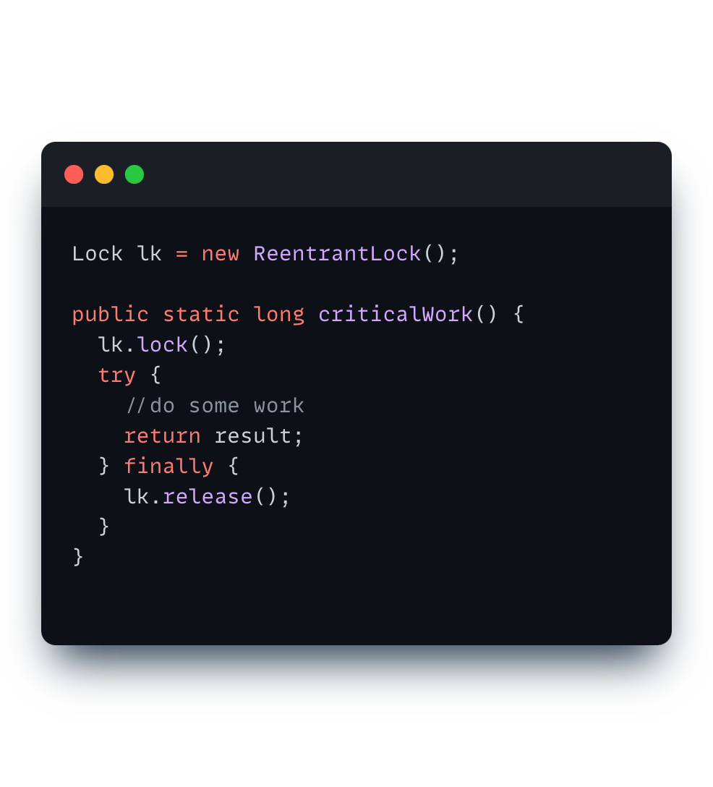
Solution: Use try/finally block!
Always gets executed
(even after exception or return)

Slide 77
Notes:
LAST PARAGRAPH IMPORTANT!!!!

Slide 78
Notes:
Explain count

Slide 81
Anything else?

Slide 82
Pre-Discussion
Exercise 6

Slide 83
Assignment 6
Task Parallelism:
Merge Sort
Longest Sequence
Notes:
83

Slide 84
Merge sort algorithm
essentials
In this exercise you will implement the merge sort algorithm using task parallelism.
The merge sort algorithm partitions the array into smaller arrays, sorts each one separately and then merges the sorted arrays.
  By default, the partitioning of the array continues recursively until the array size is 1 or 2, which then is sorted trivially.
  Try larger cutoff values (e.g partition arrays down to minimum size 4 instead of 2) and see how this affects the algorithm performance.
  Discuss the asymptotic running time of the algorithm and the obtained speedup.

Slide 85
Longest Sequence
Given a sequence of numbers:
[1, 9, 4, 3, 3, 8, 7, 7, 7, 0]
find the longest sequence of the same consecutive number
Notes:
85

Slide 86
Longest Sequence
Given a sequence of numbers:
[1, 9, 4, 3, 3, 8, 7, 7, 7, 0]
find the longest sequence of the same consecutive number
Notes:
86

Slide 87
Longest Sequence
Given a sequence of numbers:
[1, 9, 4, 3, 3, 8, 7, 7, 7, 0]
find the longest sequence of the same consecutive number.
If multiple sequences have the same length, return the first one (the one with lowest starting index)
[0, 1, 2, 3, 4, 5, 6, 7, 8, 9] [1, 1, 0, 0]
Notes:
87

Slide 88
Longest Sequence
essentials
Task:
Implement task parallel version that finds the longest sequence of the same consecutive number.
Challenge:
The input array cannot be divided arbitrarily. For example:
[1, 2, 3, 3, 4, 1]
[1, 2, 3] [3, 4, 1]
Notes:
88

Slide 89
Longest Sequence
essentials
Task:
Implement task parallel version that finds the longest sequence of the same consecutive number.
Challenge:
The input array cannot be divided arbitrarily. For example:
[1, 2, 3, 3, 4, 1]
[1, 2, 3] [3, 4, 1]
Combining results of subtasks does not give the correct answer!
Notes:
89

Slide 90
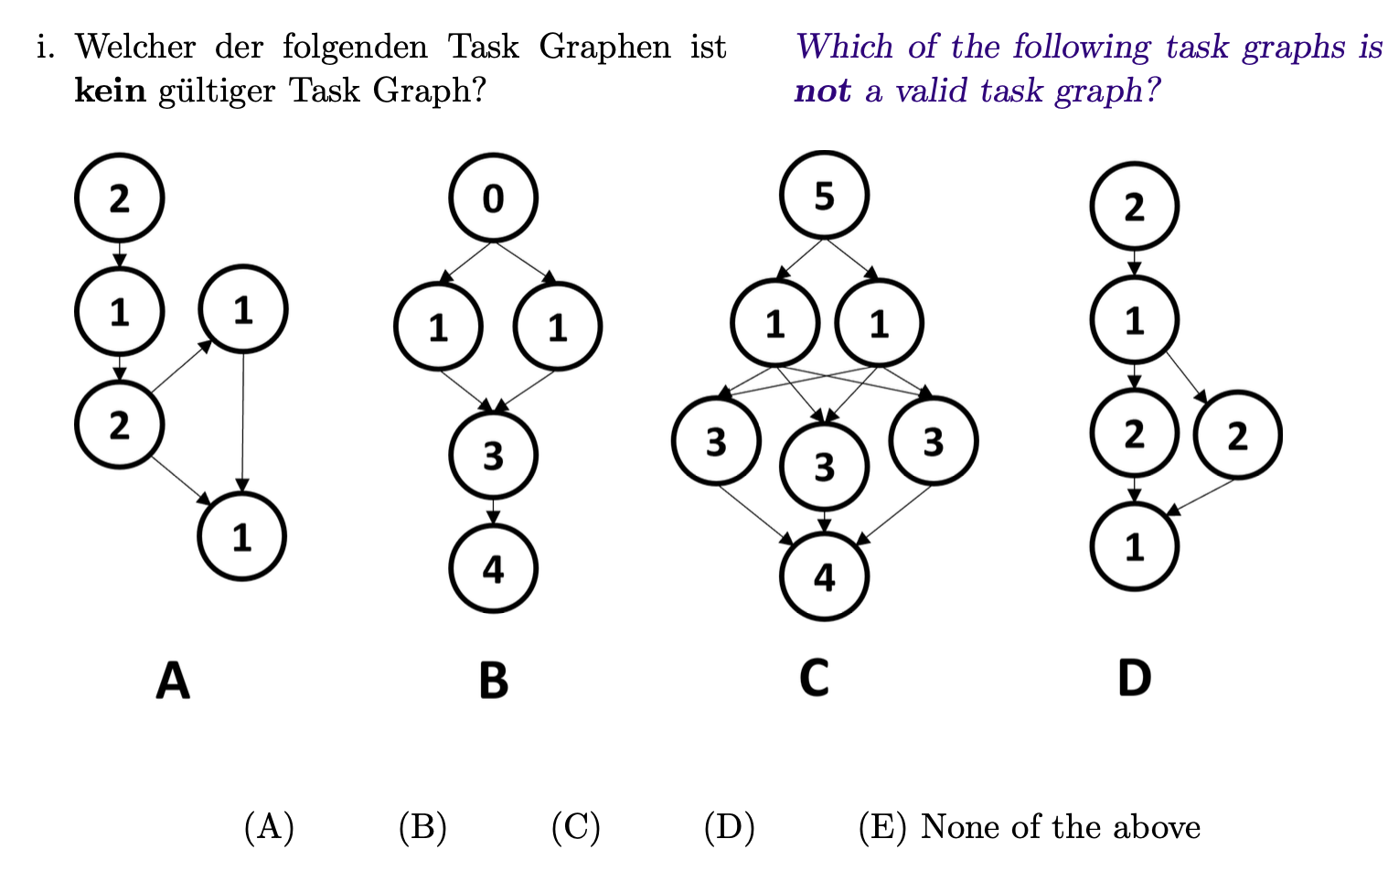
Old Exam Task (FS23)

Slide 91
Old Exam Task (FS23)

Slide 92


