Slide 1
Parallel Programming
Exercise Session 7
Spring 2024

Slide 2
Schedule
Post-Discussion Ex. 6
Part 1 Theory Recap
Break
Pre-Discussion Ex. 7
Quiz

Slide 3

Evaluation (G-18)
Please fill in the evaluation (~5min)
It is anonymous
(you don’t need to be logged in, no PII is stored)
It helps us improving the exercise sessions

Slide 4
Post-Discussion
Exercise 6

Slide 5
Longest Sequence
Given a sequence of numbers:
[1, 9, 4, 3, 3, 8, 7, 7, 7, 0]
find the longest sequence of the same consecutive number
Notes:
5

Slide 6
Longest Sequence
public class LongestSequenceMulti extends RecursiveTask<Sequence> {
protected Sequence compute() {
if (// work is small)
// do the work directly
else {
// split work into pieces
// invoke the pieces and wait for the results
// return the longest result
}
}
}
Outline almost as before, except:

Slide 7
Longest Sequence
public class LongestSequenceMulti extends RecursiveTask<Sequence> {
protected Sequence compute() {
if (// work is small)
// do the work directly
else {
// split work into pieces
// invoke the pieces and wait for the results
// check that result is not in between the pieces
// return the longest result
}
}
}
Outline almost as before, except:

Slide 8
Longest Sequence
public class LongestSequenceMulti extends RecursiveTask<Sequence> {
protected Sequence compute() {
if (// work is small)
// do the work directly
else {
// split work into pieces
// invoke the pieces and wait for the results
// check that result is not in between the pieces
// return the longest result
}
}
}
Outline almost as before, except:
[1, 2, 3, 3, 4, 1]
[1, 2, 3] [3, 4, 1]

Slide 9
Lecture Part 1 Recap

Slide 10
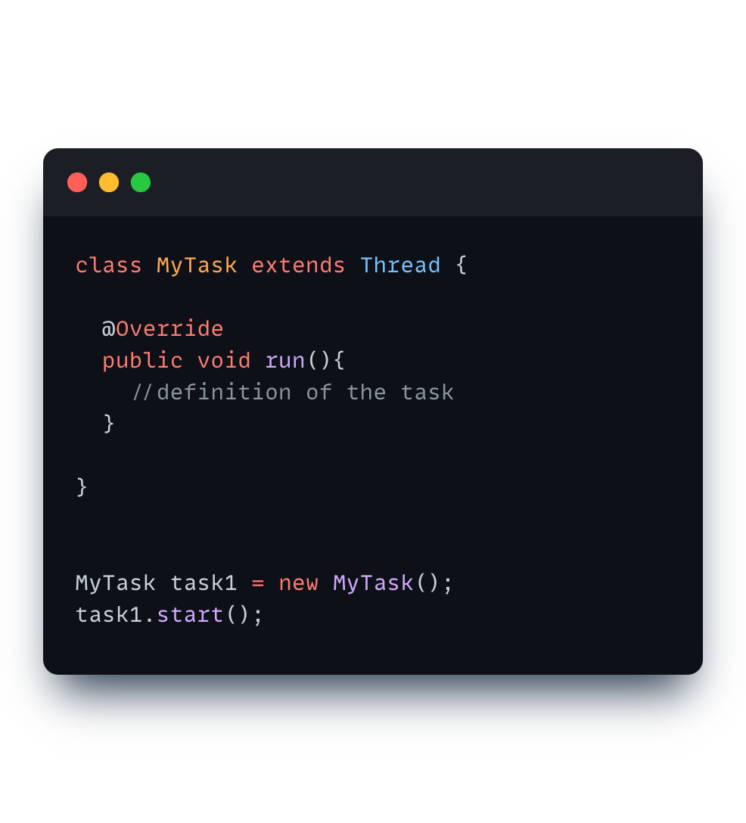
Creating Threads: extends Thread (old)

Slide 11
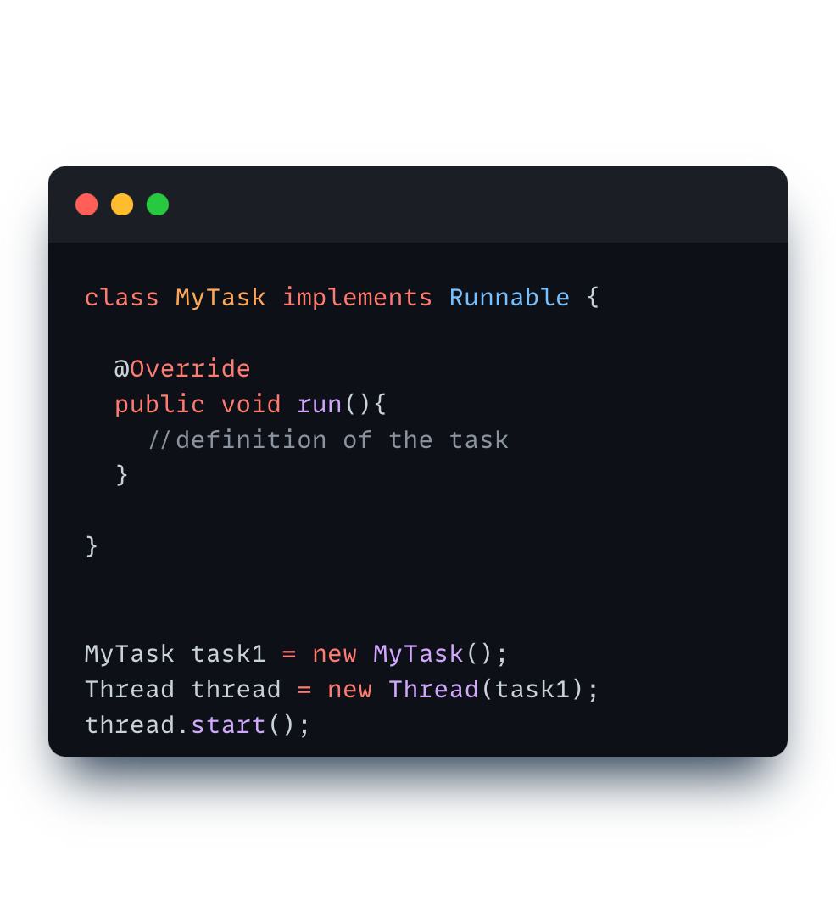
Creating Threads: impl Runnable (better)
Notes:
Mention why better

Slide 12
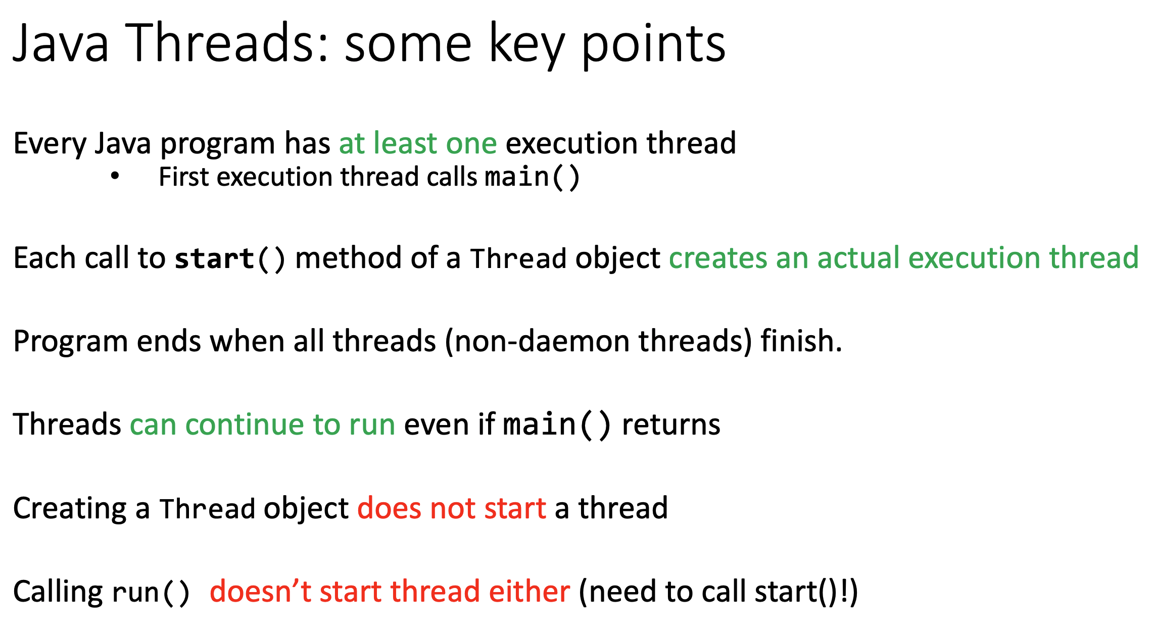
Notes:
Ask students what a daemon thread is (Background tasks as for example Garbage Collector)

Slide 13
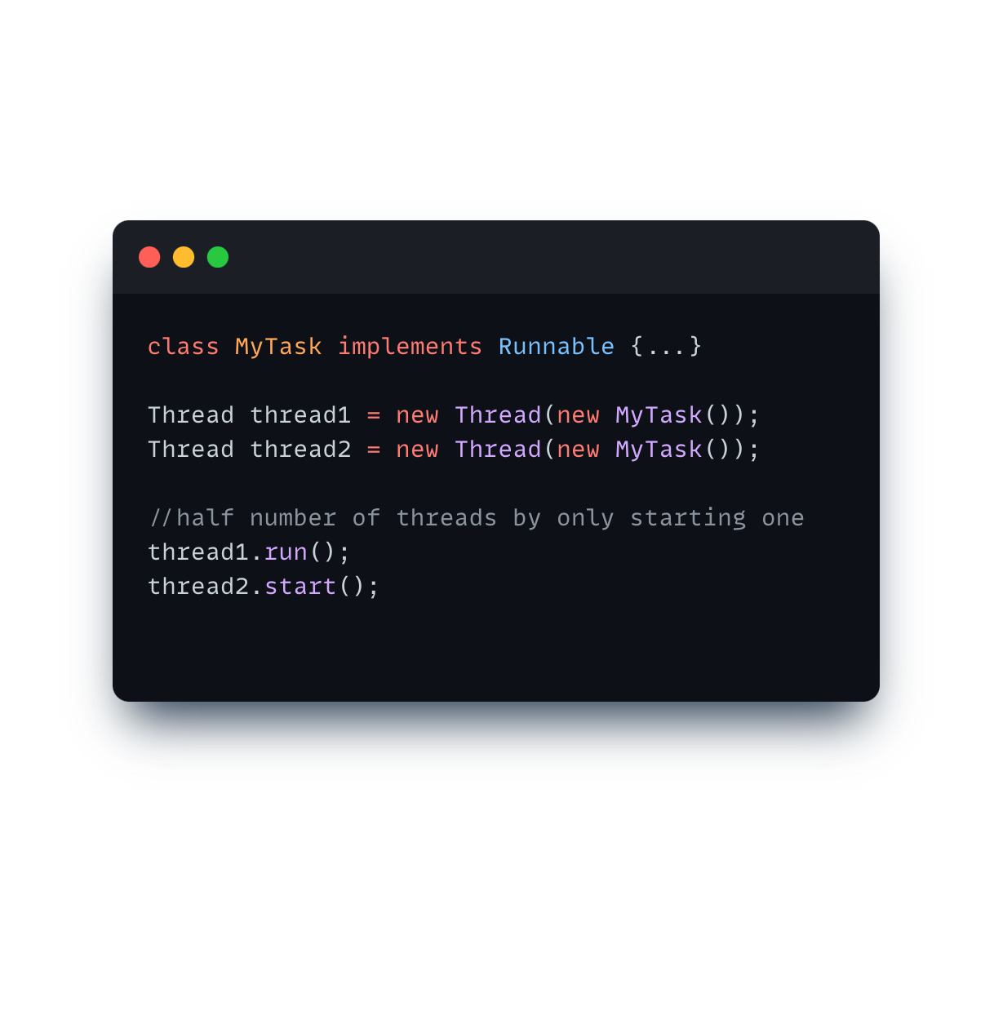
Thread Quiz: Spot the mistake
Wrong order!

Slide 14

Thread Quiz: Spot the mistake
✅

Slide 15
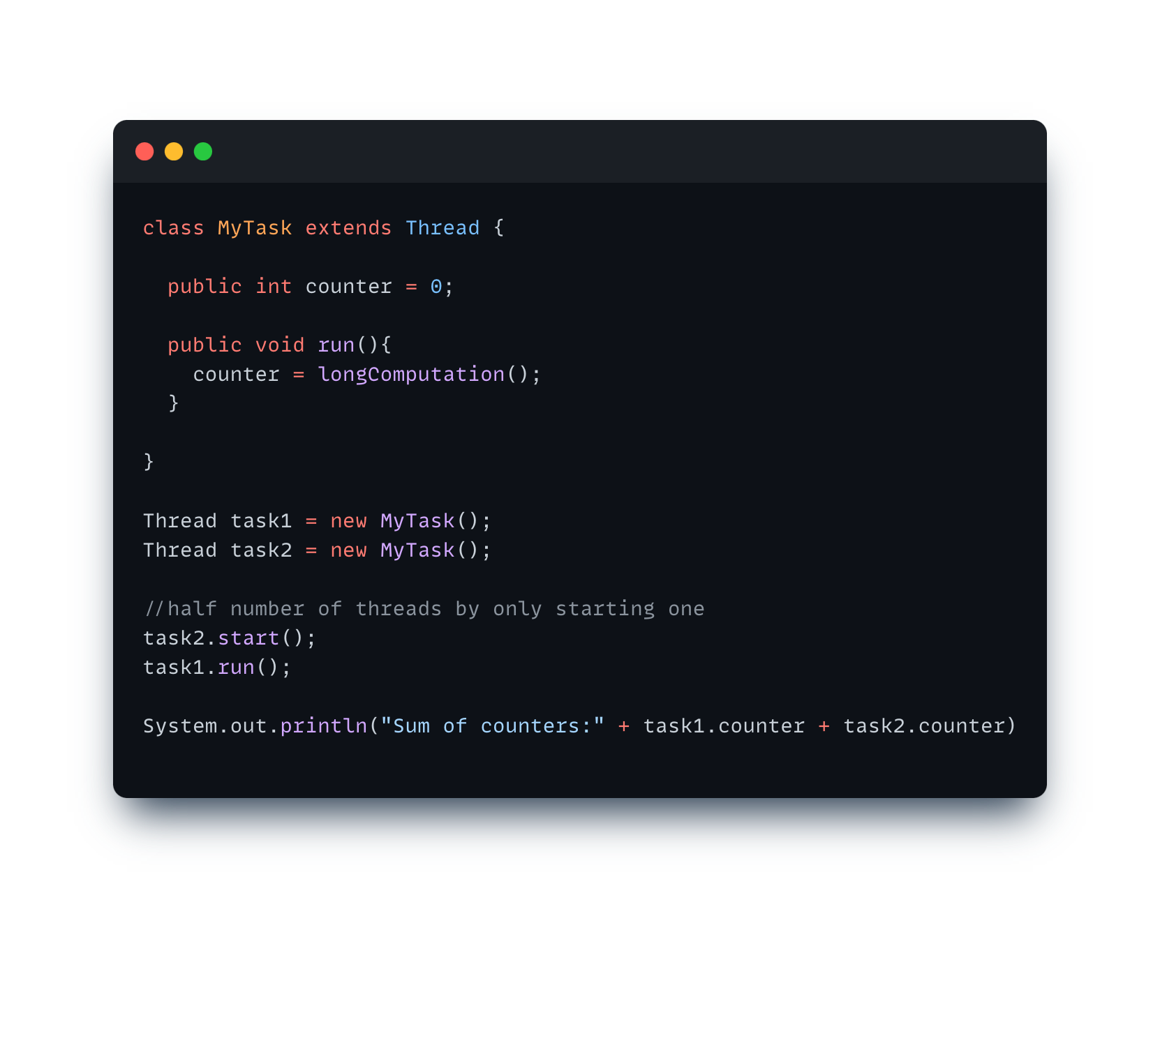
Thread Quiz: Spot the mistake
We need to join!
Notes:
ASK WHAT WE NEED TO JOIN

Slide 16
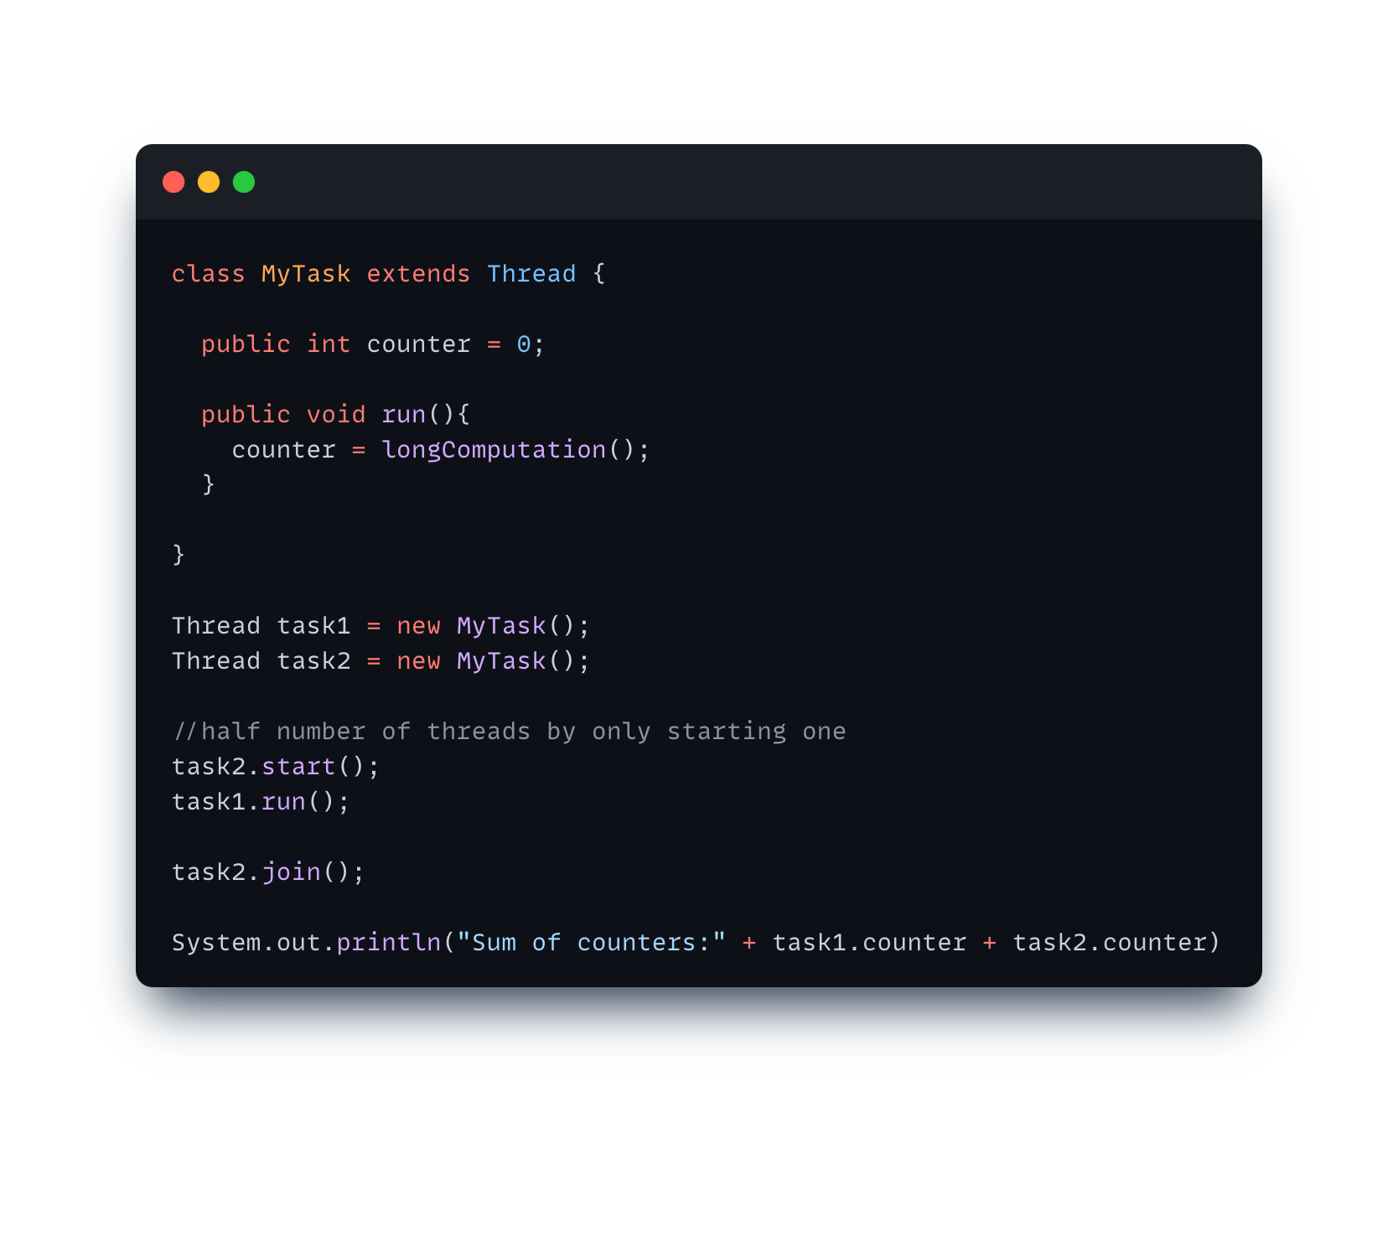
Thread Quiz: Spot the mistake
✅
Notes:
ASK WHAT WE NEED TO JOIN

Slide 17
Thread Safe Counter
public class Counter {
private int value;
// returns a unique value
public int getNext() {
return value++;
}
}
How to implement a thread safe Counter?

Slide 18
Thread Safe Counter
essentials
public class SyncCounter {
private int value;
public synchronized int getNext() {
return value++;
}
}
public class LockCounter {
private int value;
private Lock = new ReentrantLock();
public int getNext() {
lock.lock();
try {
return value++;
} finally {
lock.unlock()
}
}
}
public class AtomicCounter {
private AtomicInteger value;
public int getNext() {
return value.incrementAndGet();
}
}
How to implement a thread safe Counter?

Slide 19
Thread Safe Counter
essentials
public class SyncCounter {
private int value;
public synchronized int getNext() {
return value++;
}
}
public class LockCounter {
private int value;
private Lock = new ReentrantLock();
public int getNext() {
lock.lock();
try {
return value++;
} finally {
lock.unlock()
}
}
}
public class AtomicCounter {
private AtomicInteger value;
public int getNext() {
return value.incrementAndGet();
}
}
What is the difference between synchronized and a Lock?

Slide 20
Java: The synchronized keyword
essentials
Synchronization is built around an internal entity
known as the intrinsic lock or monitor lock
Every intrinsic lock has an object (or class) associated with it
A thread that needs exclusive access to an object’s field has to acquire
the object’s intrinsic lock before accessing them

Slide 21


What exactly is a lock/monitor?
custom
Thread 1
Counter C
Counter C = new Counter()
attributes
Thread 2
int count = 0;
methods
synchronized increment() {
count++;
}
Thread 3
Counter C

Slide 22
What exactly is a lock/monitor?
custom
Thread 1
Counter C
increment()
Counter C = new Counter()
attributes
Thread 2
int count = 0;
methods
synchronized increment() {
count++;
}
Thread 3
Counter C

Slide 23

What exactly is a lock/monitor?
custom
Thread 1
Counter C
count++
Counter C = new Counter()
attributes
Thread 2
int count = 0;
methods
synchronized increment() {
count++;
}
Thread 3
Counter C

Slide 24
What exactly is a lock/monitor?
custom
Thread 1
Counter C
count++
Counter C = new Counter()
attributes
Thread 2
int count = 0;
increment()
methods
synchronized increment() {
count++;
}
Thread 3
Counter C

Slide 25
What exactly is a lock/monitor?
custom
Thread 1
Counter C
count++
Counter C = new Counter()
attributes
Thread 2
int count = 0;
WAITING
methods
synchronized increment() {
count++;
}
Thread 3
Counter C

Slide 26
java.util.concurrent.Lock Interface
essentials
More low-level primitive than synchronized.
Clients need to implement:
lock(): Acquires the lock, blocks until it is acquired
trylock(): Acquire lock only if its lock is free when function is called
unlock(): Release the lock
Allows more flexible structuring than synchronized blocks
What does it mean to be more flexible?
Why is this useful?

Slide 27
What exactly is a lock/monitor?
custom
Thread 1
Counter C
Counter C = new Counter()
attributes
Thread 2
int count = 0;
methods
myLock
increment() {
myLock.lock()
count++;
myLock.unlock();
}
Thread 3
Counter C

Slide 28
What exactly is a lock/monitor?
custom
Thread 1
Counter C
increment()
Counter C = new Counter()
attributes
Thread 2
int count = 0;
methods
increment() {
myLock.lock()
count++;
myLock.unlock();
}
myLock
Thread 3
Counter C

Slide 29
What exactly is a lock/monitor?
custom
Thread 1
Counter C
increment()
Counter C = new Counter()
attributes
Thread 2
int count = 0;
methods
lock()
increment() {
myLock.lock()
count++;
myLock.unlock();
}
myLock
Thread 3
Counter C

Slide 30
What exactly is a lock/monitor?
custom
Thread 1
Counter C
count++
Counter C = new Counter()
attributes
Thread 2
int count = 0;
methods
increment() {
myLock.lock()
count++;
myLock.unlock();
}
myLock
Thread 3
Counter C

Slide 31
Lock Flexibility
essentials
Synchronized forces all lock acquisition and release
to occur in a block-structured way
The following lock order cannot
be expressed using synchronized blocks
synchronized (A) {
synchronized (B) {
}
}
A.lock();
B.lock();
B.unlock();
A.unlock();
A.lock();
B.lock();
A.unlock();
B.unlock();

Slide 32
Lock Flexibility
essentials
Synchronized forces all lock acquisition and release
to occur in a block-structured way
The following lock order cannot
be expressed using synchronized blocks
synchronized (A) {
synchronized (B) {
}
}
A.lock();
B.lock();
B.unlock();
A.unlock();
A.lock();
B.lock();
A.unlock();
B.unlock();
As we will see later in the course, such order is useful
for implementing concurred data structures and referred
to as “hand-over-hand” locking (or “chain-locking”)

Slide 33
Lock Flexibility
essentials
Consider a list of locks that you should acquire
public int getNext(List<Lock> locks) {
// acquire all locks
// critical section
// release all locks
}
Can this be achieved using synchronized?
Yes but its messy, any ideas how?

Slide 34
Lock Flexibility
essentials
Is the Lock acquired?
lock.isLocked()
Is the Lock acquired by current thread?
lock.isHeldByCurrentThread()
Try acquire the Lock without blocking
lock.tryLock()
https://docs.oracle.com/en/java/javase/17/docs/api/java.base/java/util/concurrent/locks/ReentrantLock.html

Slide 35
Implementing Classes of java.util.concurrent.Lock
details
ReentrantLock
ReentrantReadWriteLock.ReadLock
ReentrantReadWriteLock.WriteLock
Readers/Writers Lock will be covered
in detail in 3 weeks
https://docs.oracle.com/en/java/javase/17/docs/api/java.base/java/util/concurrent/locks/Lock.html
Notes:
Ask why reader/writer lock could be useful

Slide 36
Basic Synchronization Rule
essentials
Access to shared and mutable state needs to be always protected!

Slide 37
Synchronization Issues
Data Race: ??

Slide 38
Synchronization Issues
essentials
Data Race: A program has a data race if, during any possible execution, a memory location could be written from one thread, while concurrently being read or written from another thread.

Slide 39
Synchronization Issues
Data Race: A program has a data race if, during any possible execution, a memory location could be written from one thread, while concurrently being read or written from another thread.
Deadlock: ??

Slide 40
Synchronization Issues
essentials
Data Race: A program has a data race if, during any possible execution, a memory location could be written from one thread, while concurrently being read or written from another thread.
Deadlock: Circular waiting/blocking (no instructions are executed/CPU time is used) between threads, so that the system (union of all threads) cannot make any progress anymore.

Slide 41
Quiz: What is wrong with this code?
void exchangeSecret(Person a, Person b) {
a.getLock().lock();
b.getLock().lock();
Secret s = a.getSecret();
b.setSecret(s);
a.getLock().unlock();
b.getLock().unlock()
}
public class Person {
private ReentrantLock mLock = new ReentrantLock();
private String mName;
public ReentrantLock getLock() {
return mLock;
}
...
}

Slide 42
Quiz: What is wrong with this code?
essentials
void exchangeSecret(Person a, Person b) {
a.getLock().lock();
b.getLock().lock();
Secret s = a.getSecret();
b.setSecret(s);
a.getLock().unlock();
b.getLock().unlock()
}
public class Person {
private ReentrantLock mLock = new ReentrantLock();
private String mName;
public ReentrantLock getLock() {
return mLock;
}
...
}
Deadlock
Thread 2:
exchangeSecret(p2, p1)
Thread 1:
exchangeSecret(p1, p2)

Slide 43
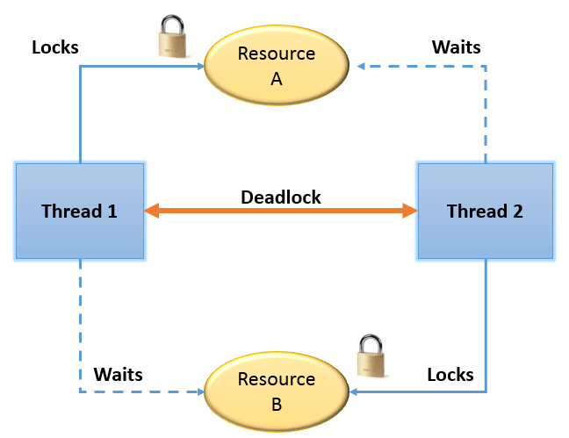

Slide 44
Any ideas on how to solve this?

Slide 45
Possible solution
essentials
void exchangeSecret(Person a, Person b) {
ReentrantLock first, second;
if (a.getName().compareTo(b.getName()) < 0) {
first = a.getLock(); second = b.getLock();
} else if (a.getName().compareTo(b.getName()) > 0) {
first = b.getLock(); second = a.getLock();
} else { throw new UnsupportedOperationException(); }
first.lock();
second.lock();
Secret s = a.getSecret();
b.setSecret(s);
first.unlock();
second.unlock();
}
Always acquire and release the Locks in the same order
Notes:
We need a total ordering

Slide 46
Deadlocks and Race conditions
details
Not easy to spot
Hard to debug
Might happen only very rarely
Testing usually not good enough
Reasoning about code is required
Lesson learned: Need to be careful when programming with locks

Slide 47
Wait and Notify Recap
Object (lock) provides wait and notify methods
(any object is a lock)
wait: Thread must own object’s lock to call wait
thread releases lock and is added to “waiting list” for that object
thread waits until notify is called on the object
notify: Thread must own object’s lock to call notify
notify: Wake one (arbitrary) thread from object’s “waiting list”
notifyAll: Wake all threads

Slide 48
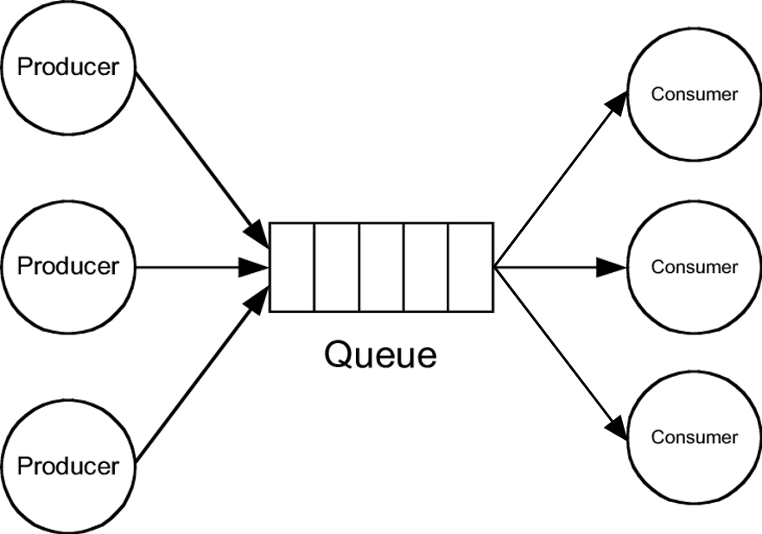
Producer-Consumer Problem
custom
Generating Data
Processing Data
Buffer
Notes:
Sneak Peek for next week

Slide 49
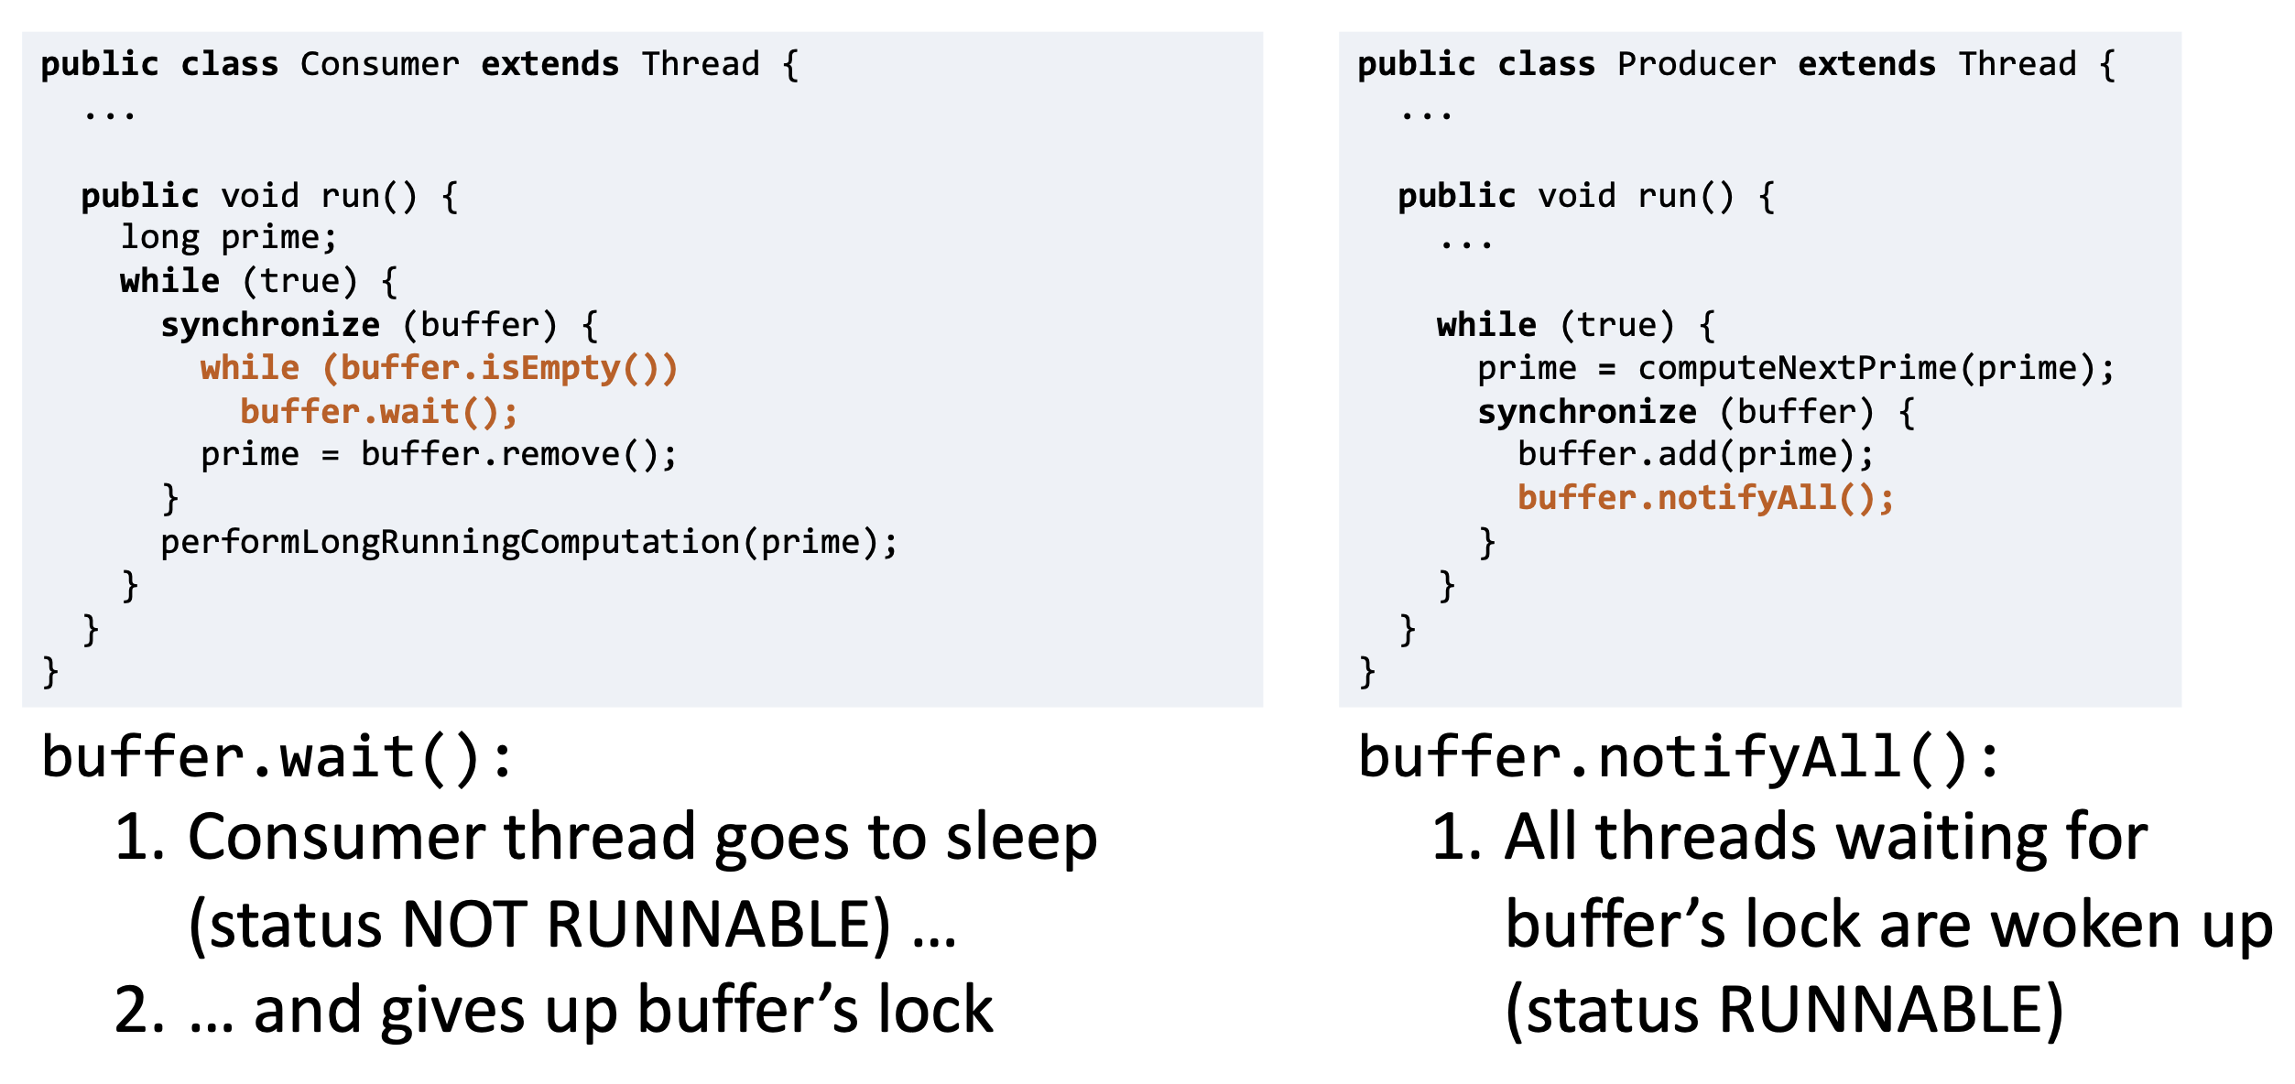
How to use wait/notify

Slide 50
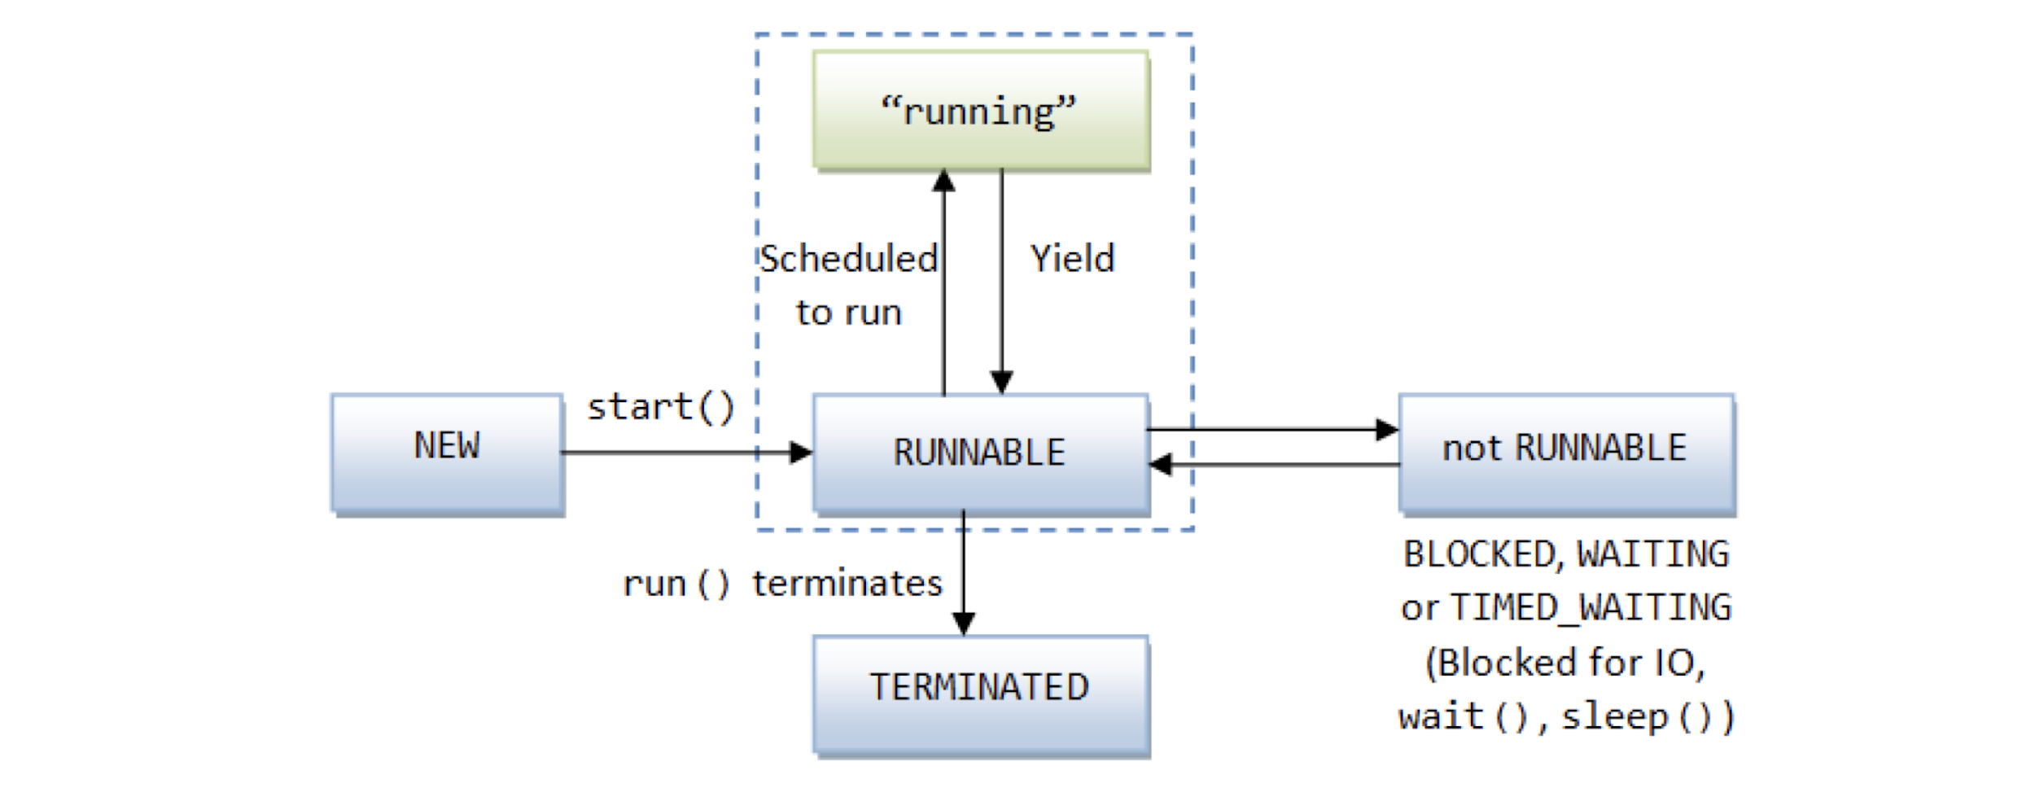
Remember? Thread State Model

Slide 51
Remember? Thread State Model

Slide 52


Wait and Notify Recap
What is the difference? Issues?

Slide 53
Wait and Notify Recap
Spurious wake-ups and notifyAll()
→ wait has to be in a while loop

Slide 54
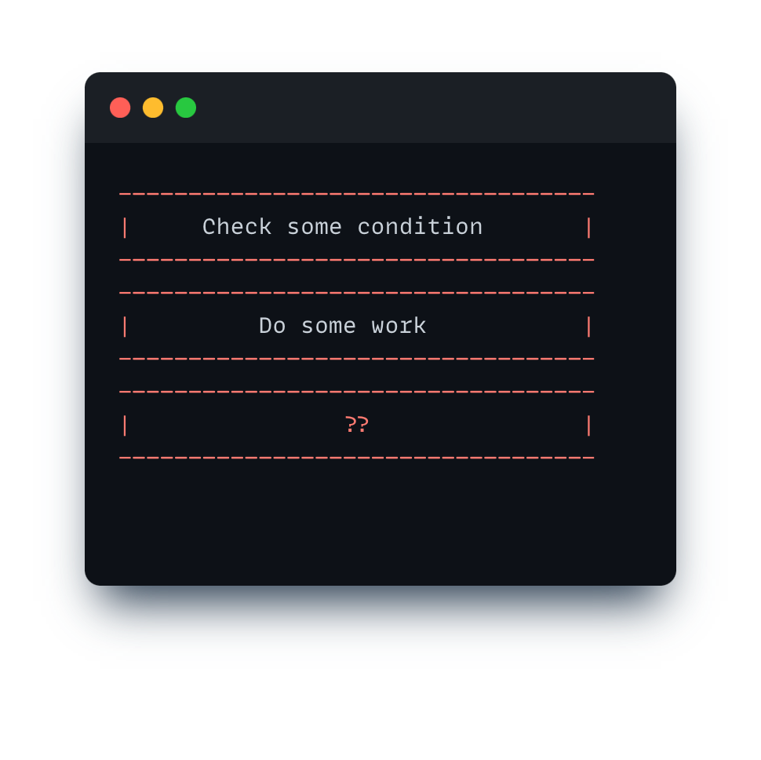
Wait/notify “Template”

Slide 55
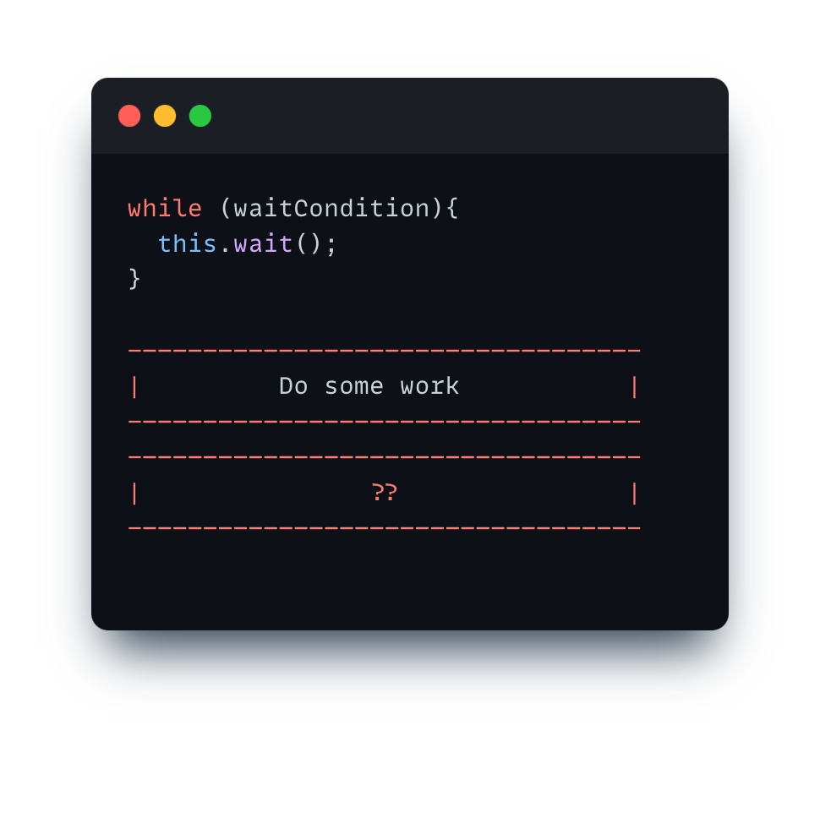
Wait/notify “Template”

Slide 56
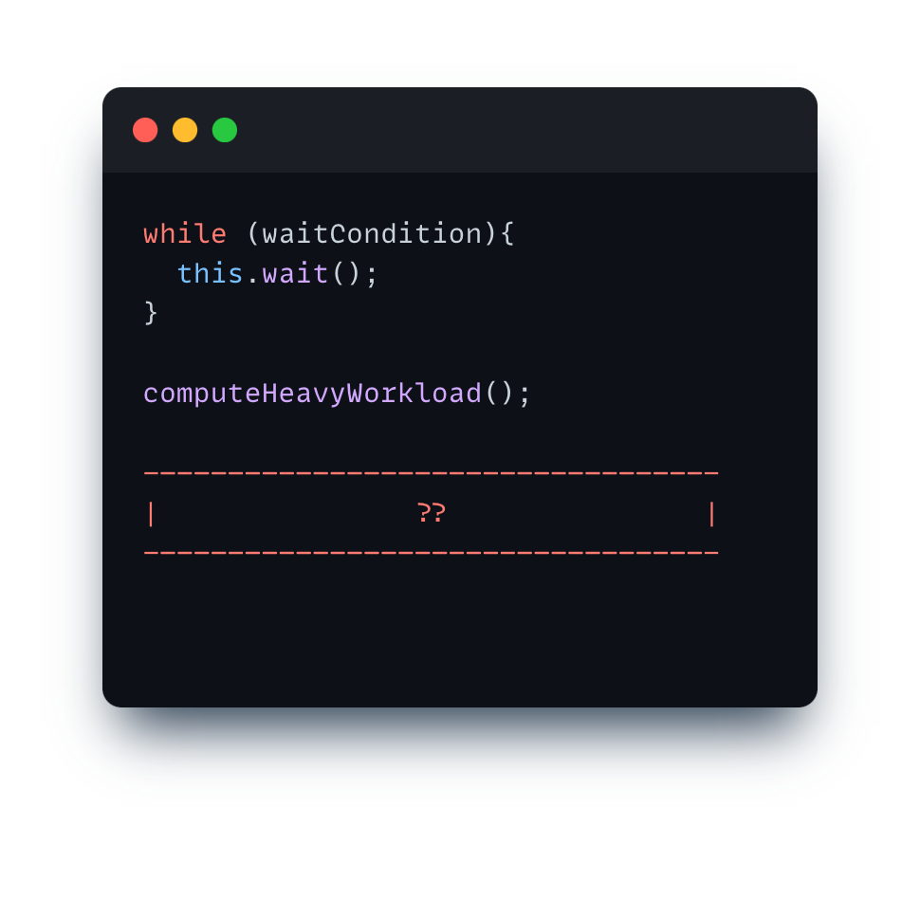
Wait/notify “Template”

Slide 57
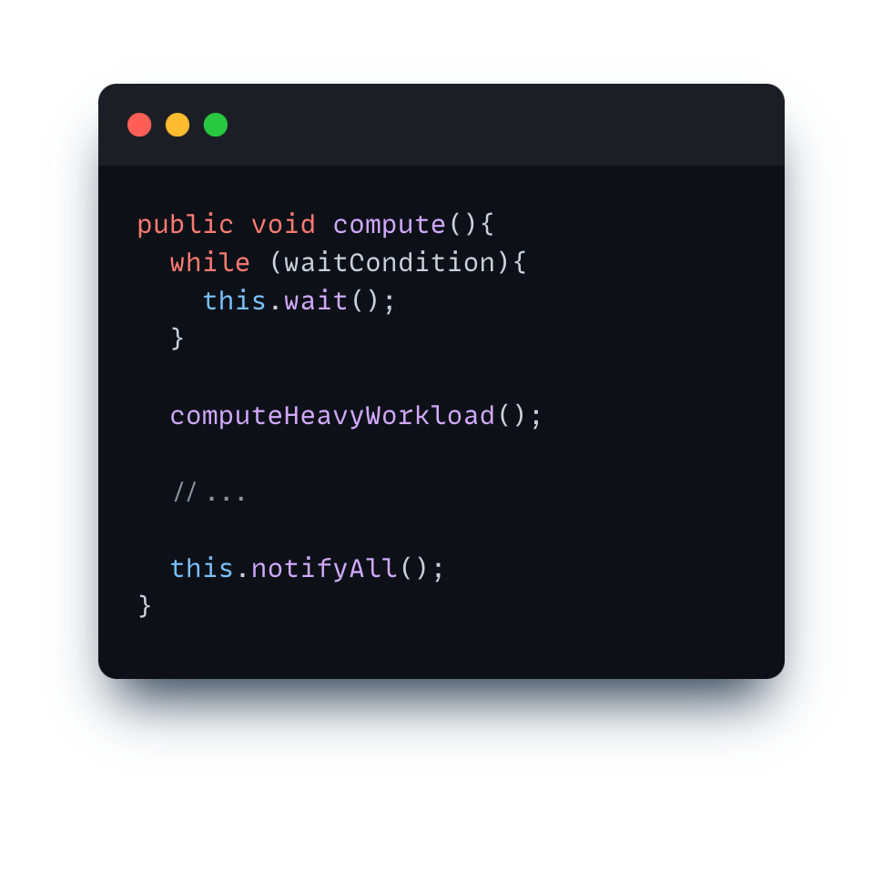
Is that all?

Slide 58
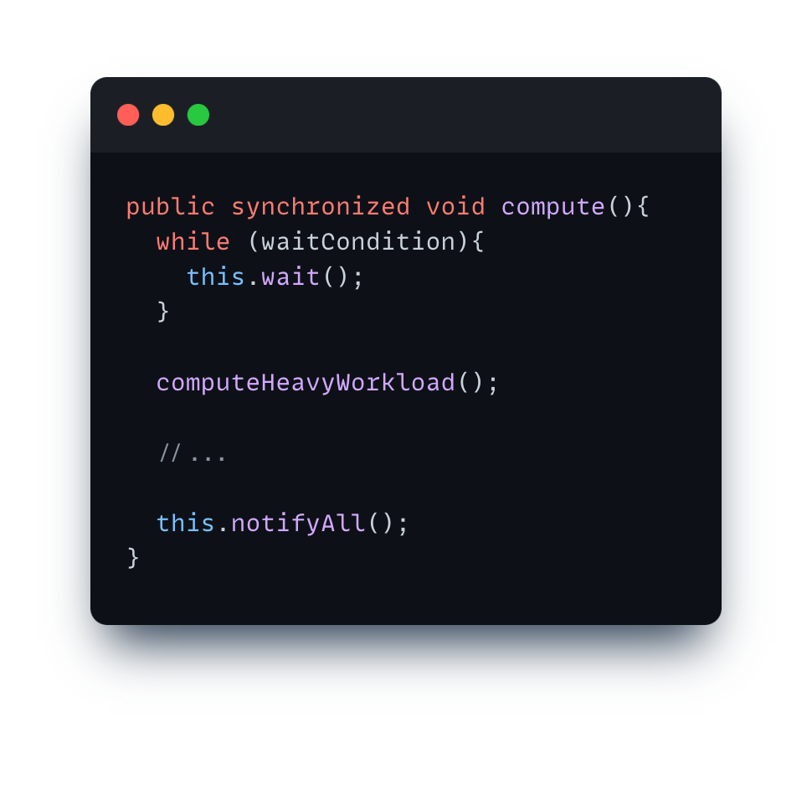
No, it must be inside a synchronized block!

Slide 59
Pipelining: Main Concepts Recap
essentials
Latency
Throughput
Balanced/Unbalanced Pipeline
Notes:
First ask: What is pipelining anyways and why is it useful?

Slide 60
Pipelining: Main Concepts Recap
essentials
Latency
time needed to perform a given computation
(e.g., process a customer)
Throughput
Balanced/Unbalanced Pipeline

Slide 61
Pipelining: Main Concepts Recap
essentials
Latency
time needed to perform a given computation
(e.g., process a customer)
Throughput
amount of work that can be done by a system in a given period of time
(e.g., how many customers can be processed in one minute)
Balanced/Unbalanced Pipeline

Slide 62
Pipelining: Main Concepts Recap
essentials
Latency
time needed to perform a given computation
(e.g., process a customer)
Throughput
amount of work that can be done by a system in a given period of time
(e.g., how many customers can be processed in one minute)
Balanced/Unbalanced Pipeline
a pipeline is balanced if each stage takes the same length of time
OR
the latency of each unit is equal in the pipeline

Slide 63
Divide and Conquer
essentials
+
+
+
+
+
+
+
+
+
+
+
+
+
+
+

Slide 64
Divide and Conquer
essentials
+
+
+
+
+
+
+
+
+
+
+
+
+
+
+
base case
no further split

Slide 65
Divide and Conquer
essentials
Tasks at different levels of granularity
+
+
+
+
+
+
+
+
+
+
+
+
+
+
+

Slide 66
Divide and Conquer
essentials
Tasks at different levels of granularity
+
+
+
+
+
+
+
+
+
+
+
+
+
+
+
What determines a task?

Slide 67
Divide and Conquer
essentials
Tasks at different levels of granularity
+
+
+
+
+
+
+
+
+
+
+
+
+
+
+
What determines a task?
i) input array ii) start index iii) length/end index
These are fields we want to store in the task

Slide 68
Will this work?
Notes:
Ask what isn’t good here: Too small cutoff -> Overhead and also OutOfMemory when creating Threads. MAPPING TO OS THREAD

Slide 69
Notes:
Remind them of JVM Thread -> OS Thread mapping

Slide 70
Notes:
But still requires manual optimization etc. because for large arrays it will still run out of memory

Slide 71
Notes:
Draw on board

Slide 72
Does this fix our issue?

Slide 73
No. Java Threads are too heavyweight. What should we do?

Slide 74
ExecutorService!

Slide 76
Notes:
Draw blocking queue etc. on board: Say its cleaner and less threads, explain that previously every task was a thread (A HEAVYWEIGHT OS THREAD!)

Slide 77
Notes:
That’s why I recommended Runnable > Thread
Ask if someone know how this works internally, draw on bord (me)

Slide 78
Notes:
Ask students: Whats the problem here? Blocking/waiting in return statement. If less Threads than Tasks -> Deadlock
Draw on board
Problem with the divide and conquer approach is that tasks create other tasks and work partitioning (splitting up work) is part of the task.

Slide 79
Does this fix our issue?

Slide 80
No. We have dependencies between tasks
Notes:
Ask what we can use instead

Slide 81
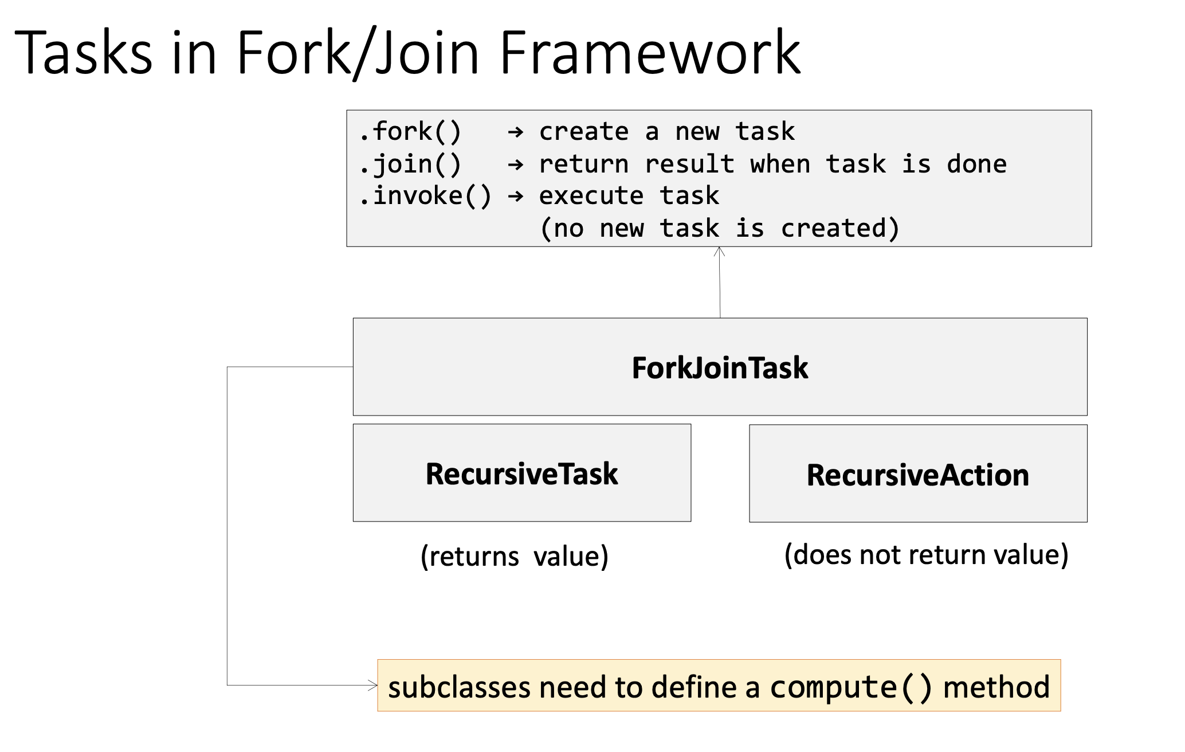

Slide 84
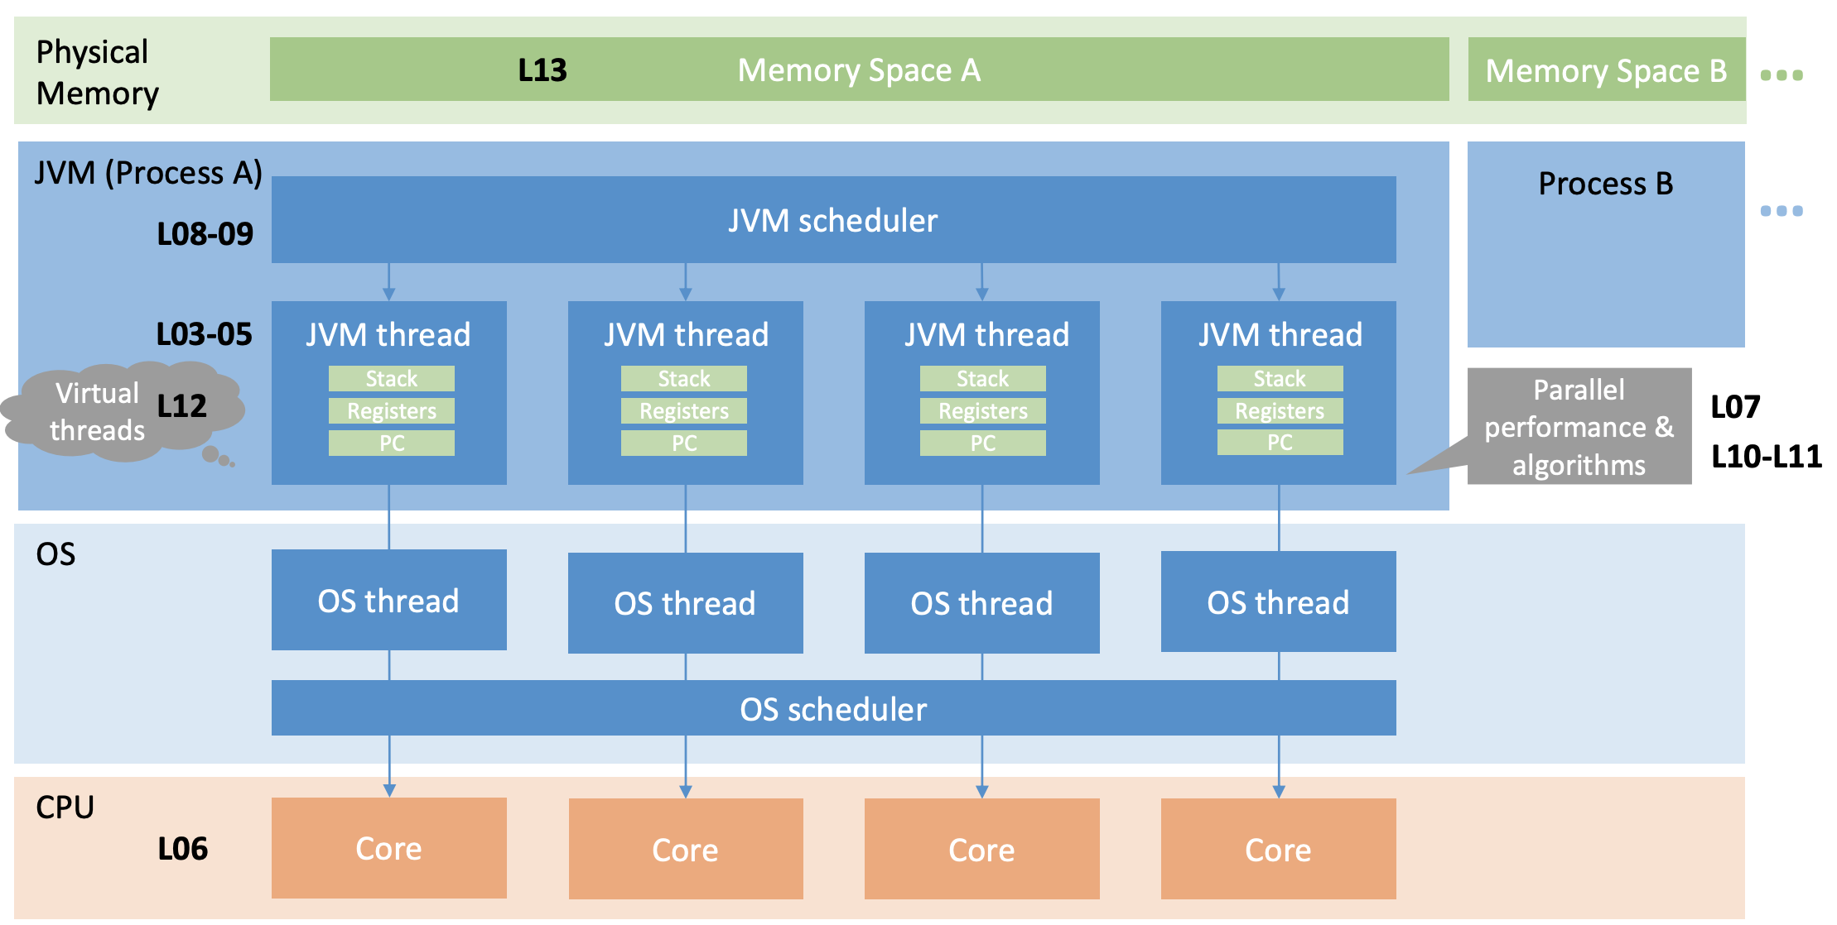
Big Picture
custom
Notes:
Mention Virtual Threads

Slide 85
Pre-Discussion
Exercise 7

Slide 86
Exercise 7
Banking System
  Multi-Threaded Implementation
  Coding exercise: Use synchronized and/or Locks
    Might have to make additions to existing classes
  Reason about Performance
  Reason about Deadlocks
  Run Tests

Slide 87
Multi-threaded Implementation
Task 1 – Problem Identification:
The methods of the classes Account and BankingSystem must be thread-safe.
You should understand why the current implementation does not work for more than one thread.

Slide 88
Thread-Safe – transferMoney()
essentials
Task 2 – Synchronized:
A simple solution to make the transferMoney() thread-safe is to use the synchronized keyword:
public synchronized boolean transferMoney(…)
Even though the code works as expected, the performance is poor.
The performance of the multi-threaded implementation is worse than the single-threaded. Why does this happen?

Slide 89
Performance of transferMoney()
essentials
Task 3 – Locking:
  Since the solution with the synchronized keyword does not perform well, you should find a better strategy to achieve the thread-safe implementation.
    Does your proposed solution work if a transaction happens from and to the same account?
    How do you know that your proposed solution does not suffer from deadlocks?

Slide 90
ThreadSafe - sumAccounts()
essentials
Task 4 – Summing Up
With a fine-grained synchronization on the transfer method, the method sumAccounts() may return incorrect results when a transaction takes place at the same time.
    Explain why the current implementation of the sumAccounts() method is not thread-safe any more.
    You should provide a thread-safe implementation.
    Is there any way to parallelize this method?

Slide 91
Testing
You should run the provided tests for your implementation.
If the test succeeds, your code is not necessarily correct.
It is hard to reproduce a bad interleaving.

Slide 92
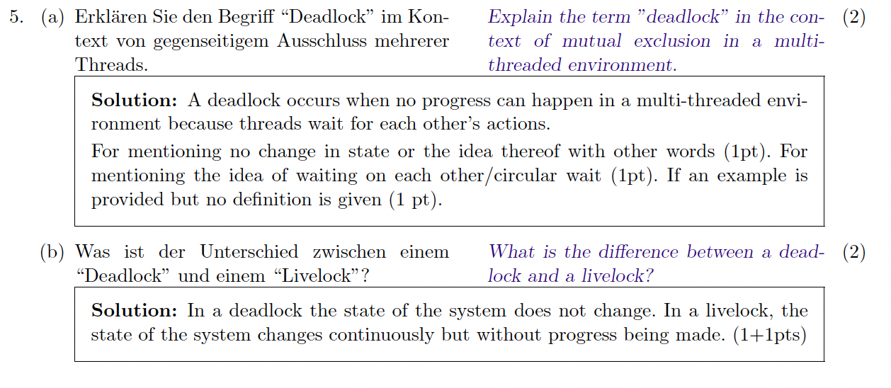
Old Exam Task (FS 2023)
essentials

Slide 93
Old Exam Task (FS 2023)
essentials

Slide 94


