Slide 1
Parallel Programming
Exercise Session 8
Week 8
Notes:
1

Slide 2
Feedback: Exercise 7
2
Notes:
2

Slide 3
Essential
Feedback for Assignment 7
What is wrong with the following code snippet?
public synchronized boolean transferMoney(Account from, Account to, int amount) {
…
…
return true;
}
3
Notes:
The synchronization is on the ‘this’ object, in this case the BankingSystem.
This means only a single money transfer can be executed “in parallel”. Can be imagined like a bank with just a single counter.

Slide 4
Essential
Feedback for Assignment 7
What we should have done for avoiding deadlocks
public class Account … {
…
private final Lock lock = new ReentrantLock();
…
}
4
Notes:
In case “from” == “to” the same lock would be taken twice by the same thread. To avoid deadlocks because the lock is already taken when it is locked the second time, we use a ReentrantLock. This lock allows to take the same lock multiple times from the same thread, using a counter to keep track when to lock must be freed.

Slide 5
Essential
Feedback for Assignment 7
What we should have done for avoiding deadlocks
public class BankingSystem {
…
public boolean transferMoney(Account from, Account to, aint amount) {
Account first, second;
// Introduce lock ordering:
if (to.getId() > from.getId()) {
first = from; second = to;
} else {
first = to; second = from;
}
…
}
5
Notes:
Criteria for deadlock - Coffman conditions
1) Mutual Exclusion
A section can only be entered by a single process
2) Hold and wait
A process holds one lock while waiting for another
3) No Preemption
The process is not allowed to give up a lock that has once been taken
4) Cycle between processes
There is a cycle between all processes, where each process holds a lock the next process needs.
To avoid a deadlock, it is sufficient to break any single of these conditions. We break condition 4)

Slide 6
Feedback for Assignment 7
Acquire locks, use finally to always release the locks
public class BankingSystem {
…
public boolean transferMoney(Account from, Account to, int amount) {
…
first.getLock().lock();
second.getLock().lock();
try {
…
} finally {
first.getLock().unlock();
second.getLock().unlock();
}
6

Slide 7
Feedback for Assignment 7
Summing up: How to do it safe
Lock each account before reading out its balance, but don’t release the lock until all accounts are summed up.
➔ Two-phase locking
In the first phase locks will be acquired without releasing,
in the second phase locks will be released.
➔ Deadlocks still a problem
➔ Ordered locking required
7
Notes:
Two-phase locking means to have a phase where locks are acquired followed by a phase where locks are released. We never acquire a lock after a lock has been released.
Two phase locking is sufficient to ensure serializability. This means with two phase locking we can find a serial ordering of the parallel phases of a program that has the same observable behavior. Brief: the program does what we expect it to do.
As discussed in slide 7, deadlocks are avoided by ensuring the absence of cycles between possibly interacting processes. We do this by always acquiring the locks in a specific global order.

Slide 8
Lecture Recap
Notes:
8

Slide 9
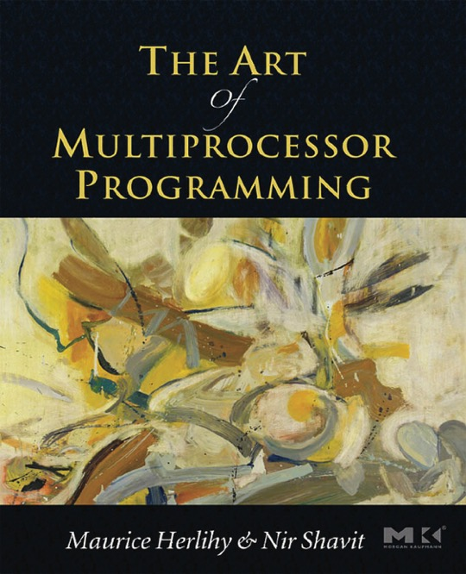
I recommend reading:
The Art of Multiprocessor Programming: An excellent book that covers almost everything from the lecture, especially for the second part of the course.
(WARNING: The 2008 version of the book has some small mistakes!)

Slide 15
But does this really work?

Slide 16
No
Optimizations by Compiler
Optimizations by Hardware
(basically the Memory Reordering)

Slide 17
Are these semantically equivalent?
Notes:
ASK: IS IT EQUIVALENT? Only in sequential

Slide 21
Notes:
We want as much as possible near the ALU, caches reorder read/write

Slide 29
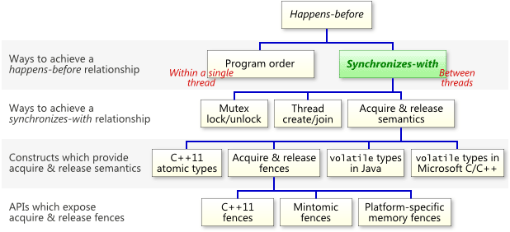

Slide 31
Notes:
DO on Board

Slide 35
Lecture recap: Program Order
We want to allow the compiler / hardware to optimize our code, i.e. remove useless code:
int a=0;
for (int i=0; i<10 i++) {a++;}
In sequential code we would expect this to be “rewritten” to a=10 since anyway nobody sees the intermediate values.
But what if a is shared?
35
Notes:
A specific computation (execution of a program) takes a particular path through the state space
35

Slide 36
Lecture recap: Synchronization Actions (SAs)
Java defines synchronization actions (read/write of volatile variable, lock/unlock, etc.)
SAs within thread obeys PO
All threads see SAs in the same order (synchronization order SO)
Reads are consistent in SO (see the last written value)
36
Notes:
A specific computation (execution of a program) takes a particular path through the state space
36

Slide 37
Lecture recap: Synchronizes With
SAs accross threads synchronize with each other, i.e., a volatile read sees the last value written by another thread
37
Notes:
A specific computation (execution of a program) takes a particular path through the state space
37

Slide 38
Lecture recap: Happens-before relationship
Two actions can be ordered by a happens-before relationship. If one action happens-before another, then the first is visible to and ordered before the second.
Transitive closure of PO and SW forms happens before order
All values we observe must obey this happens before order!
If x and y are actions of the same thread and x comes before y in program order, then hb(x, y).
If an action x synchronizes-with a following action y, then we also have hb(x, y).
If hb(x, y) and hb(y, z), then hb(x, z).
38
Notes:
A specific computation (execution of a program) takes a particular path through the state space
38

Slide 39
Beyond Locks Recap

Slide 44
Lecture recap: State Space Diagram
When dealing with mutual exclusion problems, we should focus on:
  the structure of the underlying state space, and
  the state transitions that occur
  Remember the state diagram captures the entire state space and all possible computations (execution paths a program may take)
A good solution will have a state space with no bad states
44
Notes:
A specific computation (execution of a program) takes a particular path through the state space
44

Slide 47
Notes:
Ask how starvation would look like

Slide 50
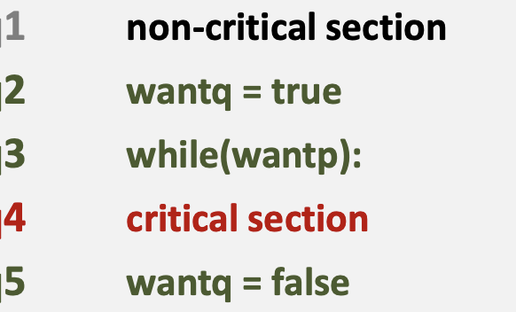

Slide 51
Notes:
Ask if deadloks, or if mutual exclusion is violated

Slide 52
Notes:
Threads “depend” on each other

Slide 53
Correctness of Mutual exclusion
“Statements from the critical sections of two or more processes must not be interleaved.”
  We can see that there is no state in which the program counters of both P and Q point to statements in their critical sections
53
Notes:
53

Slide 54
Freedom from deadlock
“If some processes are trying to enter their critical sections then one of them must eventually succeed.”
We don’t have a situation when the processes aren’t making any progress anymore
54
Notes:
54

Slide 55
Freedom from deadlock
Since the behaviour of processes P and Q is symmetrical, we only have to check what happens for one of the processes, say P.
Freedom from deadlock means that from any state where a process wishes to enter its CS (by awaiting its turn), there is always a path (sequence of transitions) leading to it entering its CS.
55
Notes:
55

Slide 56
Freedom from deadlock
Typically, a deadlocked state has no transitions leading from it, i.e. no statement is able to be executed.
  Sometimes a cycle of transitions may exist from a state for each process, from which no useful progress in the parallel program can be made. The program is still deadlocked but this situation is sometimes termed ‘livelock’. Every one is ‘busy doing nothing’.
56
Notes:
56

Slide 57
Freedom from individual starvation
“If any process tries to enter its critical section then that process must eventually succeed.”
If a process is wishing to enter its CS (awaiting its turn) and another process refuses to set the turn, the first process is said to be starved.
Possible starvation reveals itself as cycles in the state diagram.
Because the definition of the critical section problem allows for a process to not make progress from its Non-critical section, starvation is, in general, possible in this example
57
Notes:
57

Slide 58
So how do we fix our attempts?

Slide 70
Stop here if out of time or Atomics not covered yet!
→ Move to slide 32

Slide 71
Atomic operations
An atomic action is one that effectively happens at once i.e. this action cannot stop in the middle nor be interleaved
It either happens completely, or it doesn’t happen at all.
No side effects of an atomic action are visible until the action is complete
71
Notes:
71

Slide 72
Hardware support for atomic operations
Test-And-Set (TAS)
Compare-And-Swap (CAS)
Load Linked / Store Conditional
http://docs.oracle.com/javase/tutorial/essential/concurrency/atomic.html
72
Notes:
72

Slide 73
Hardware Semantics
boolean TAS(memref s)
if (mem[s] == 0) {
mem[s] = 1;
return true;
} else
return false;
int CAS (memref a, int old, int new)
oldval = mem[a];
if (old == oldval)
mem[a] = new;
return oldval;
atomic
atomic
73
Notes:
TODO: consensus numbers ? (TAS = 2, CAS = \infty)
73

Slide 74
java.util.concurrent.atomic.AtomicBoolean
boolean set();
boolean get();
boolean compareAndSet(boolean expect, boolean update);
boolean getAndSet(boolean newValue);
atomically set to value update iff current value is expect. Return true on success.
sets newValue and returns previous value.
74
Notes:
74

Slide 75
But why do these operations work without volatile?
The memory effects for accesses and updates of atomics generally follow the rules for volatiles, as stated in The Java Language Specification (17.4 Memory Model):
get has the memory effects of reading a volatile variable.
set has the memory effects of writing (assigning) a volatile variable.
Source: https://docs.oracle.com/javase/8/docs/api/java/util/concurrent/atomic/package-summary.html
75
Notes:
75

Slide 76
Exercise 8
Notes:
76

Slide 77
Assignment 8: Overview
Why do we need a memory model?
Why don’t we simply tell the compiler “execute everything exactly as I wrote it”?
How can we use Javas memory model to reason about executions?

