Slide 1
Parallel Programming
Exercise Session 9
Notes:
1

Slide 2
Today we will
((Java Memory Model ))
Lecture Recap
Break
Lecture Recap
Quiz (Kahoot)

Slide 3
Exercise Feedbacks

Slide 4
Lecture Recap

Slide 5
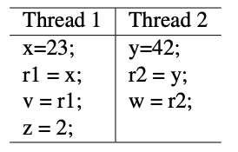
Race Conditions
Race condition occurs if multiple accesses can happen concurrently and at least one access is a write
Thread 1 accesses x, v, z
Thread 2 accesses y, w
No race condition, no bad interleaving possible

Slide 6
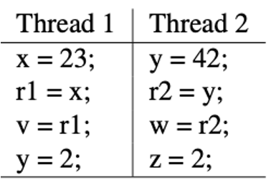
Race Conditions
Race condition occurs if multiple accesses can happen concurrently and at least one access is a write
Thread 1 accesses x, v, y
Thread 2 accesses y, w, z
Both write to y! Result depends on interleaving!

Slide 7
Lets take a step back
Threads perform actions, those actions are usually read/write to memory locations.
Compiler and Hardware can optimize read/writes by reordering memory accesses.

Slide 8
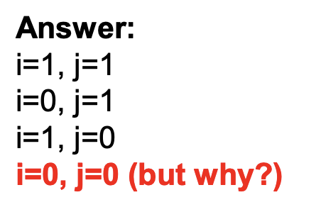
The big problem
Because of memory reordering we can suddenly get results that we did not expect!

Slide 9
Visibility not guaranteed
And even if an action has been executed, we do not have guarantees that other threads see them (in the correct order).
In other words, actions that were performed by one thread may not be visible to another thread!
We want to make sure that the actions become visible. And we want some guarantees on the ordering.
How? Java Memory Model!

Slide 10
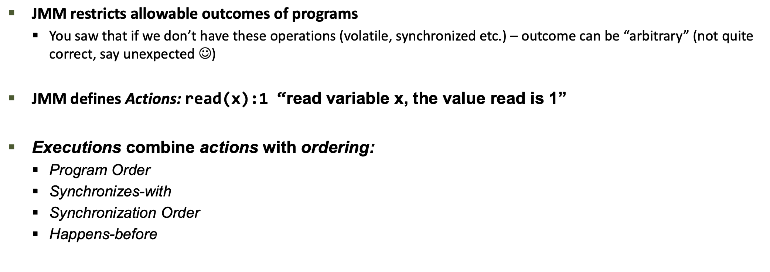
Java Memory Model

Slide 14
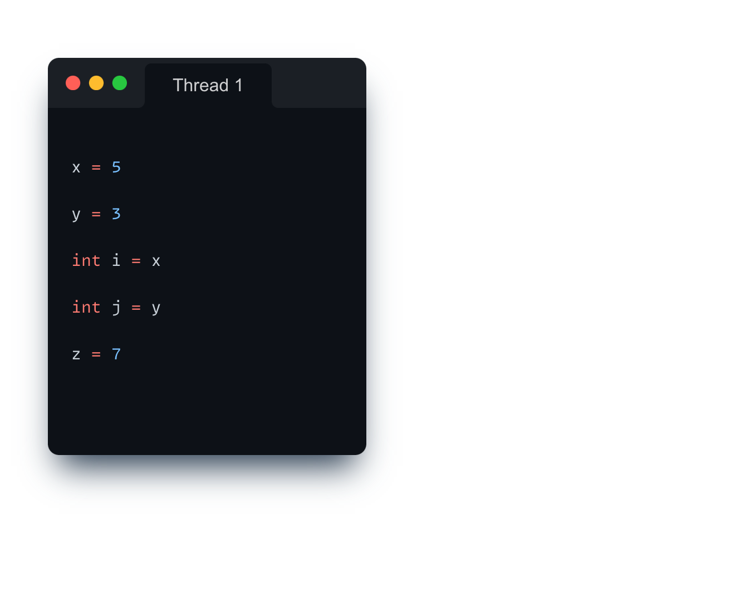
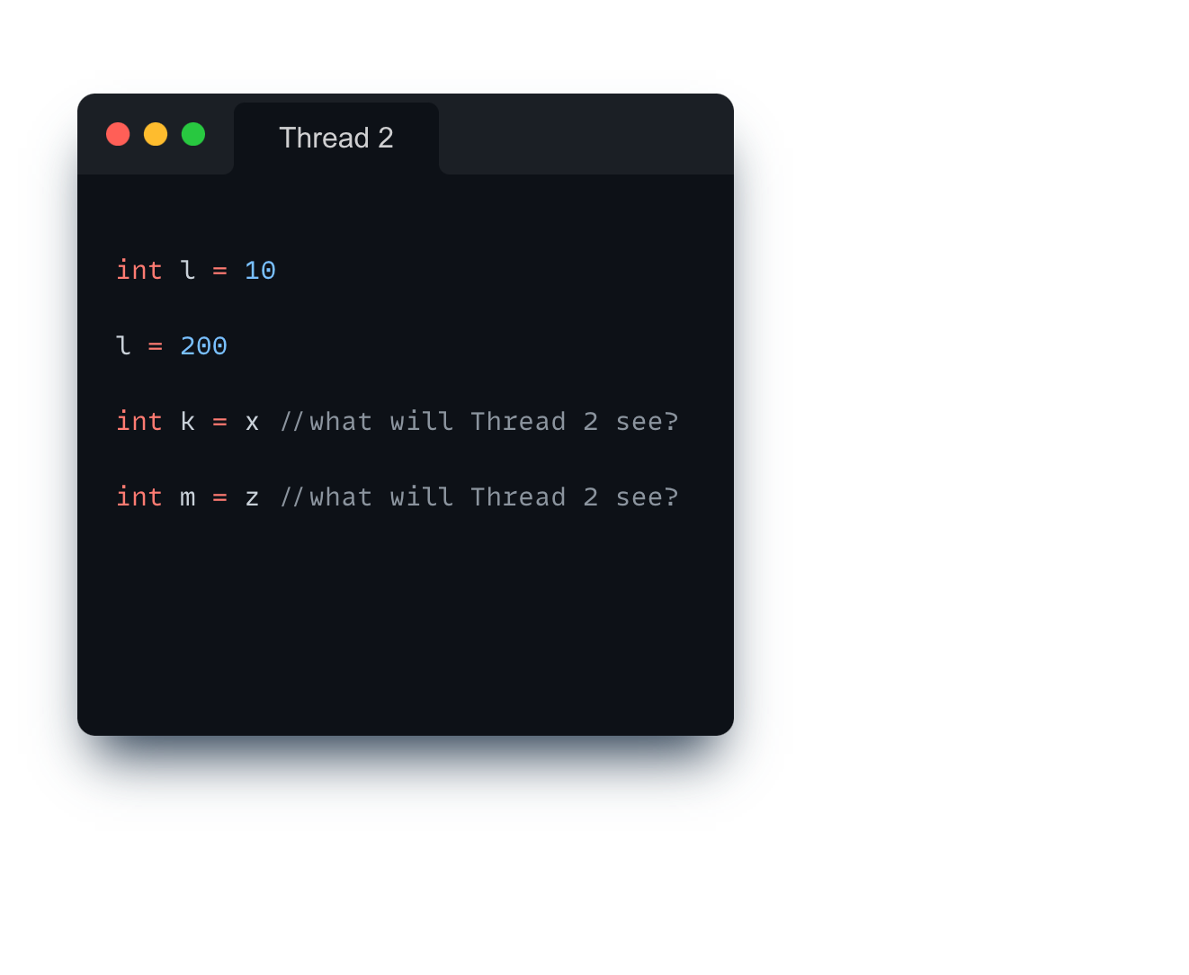
Program Order
int x,y = 0, volatile int z = 0

Slide 15
Program Order
int x,y = 0, volatile int z = 0

Slide 16
Synchronization Actions
int x,y = 0, volatile int z = 0

Slide 17
Synchronization Actions
int x,y = 0, volatile int z = 0

Slide 18
Synchronization Order?
int x,y = 0, volatile int z = 0

Slide 19
Assume Thread 1 runs first
int x,y = 0, volatile int z = 0 - SO: write(z, 7) --> m = read(z)

Slide 20
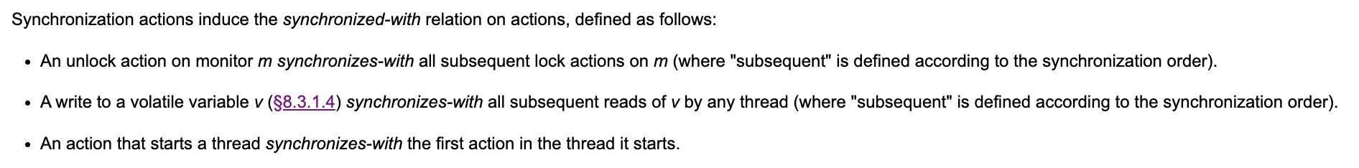

Slide 21
Now we can identify synchronizes-with
int x,y = 0, volatile int z = 0 - SO: write(z, 7) --> m = read(z)
SW

Slide 22
Happens-before relationship
Two actions can be ordered by a happens-before relationship. If one action happens-before another, then the first is visible to and ordered before the second.
Transitive closure of PO and SW forms happens before order
All values we observe must obey this happens before order!
If x and y are actions of the same thread and x comes before y in program order, then hb(x, y).
If an action x synchronizes-with a following action y, then we also have hb(x, y).
If hb(x, y) and hb(y, z), then hb(x, z).

Slide 23
SW + PO gives us Happens-Before relationship
int x,y = 0, volatile int z = 0 - SO: write(z, 7) --> m = read(z)
HB

Slide 24
So what does k = read(x) see?
int x,y = 0, volatile int z = 0 - SO: write(z, 7) --> m = read(z)
HB

Slide 25

How about now?
int x,y = 0, volatile int z = 0 - SO: write(z, 7) --> m = read(z)
HB

Slide 26
Notes:
DO on Board

Slide 30
Quick Recap of Locks

Slide 36

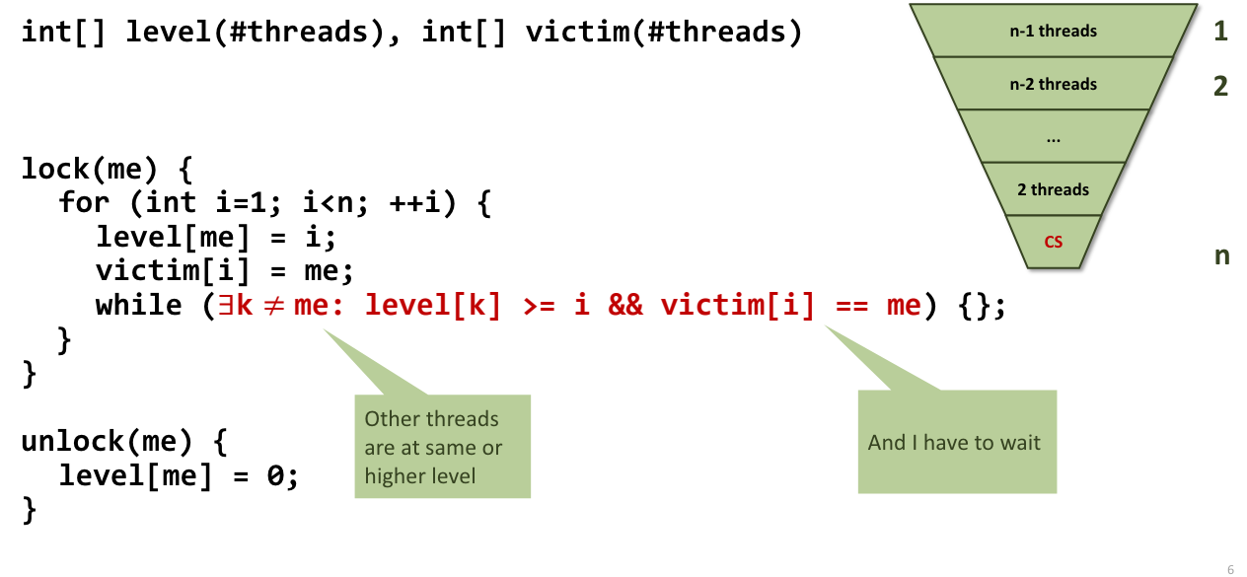
Filter Lock

Slide 37
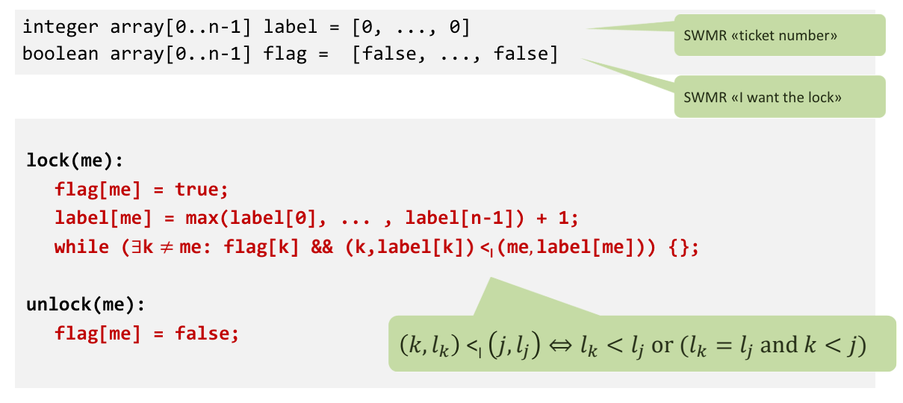
Bakery Lock
Notes:
Locks are remarkable because they do not rely on hardware RMW support, but they do take O(n) space

Slide 38
Atomic Registers and Operations

Slide 39
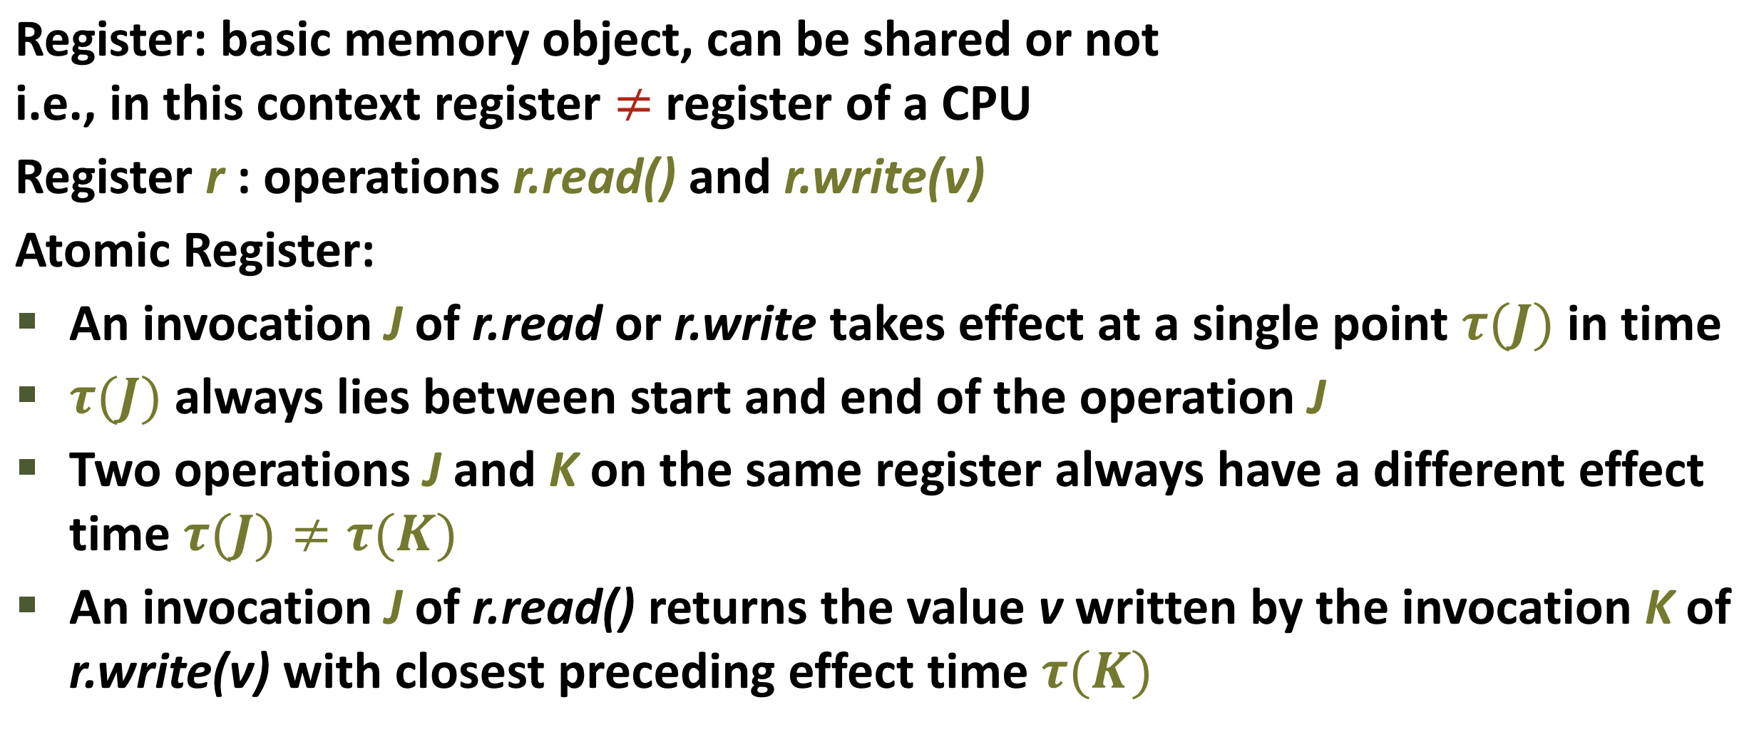
Atomic Registers

Slide 40
Atomic Registers

Slide 41
Atomic Registers

Slide 42
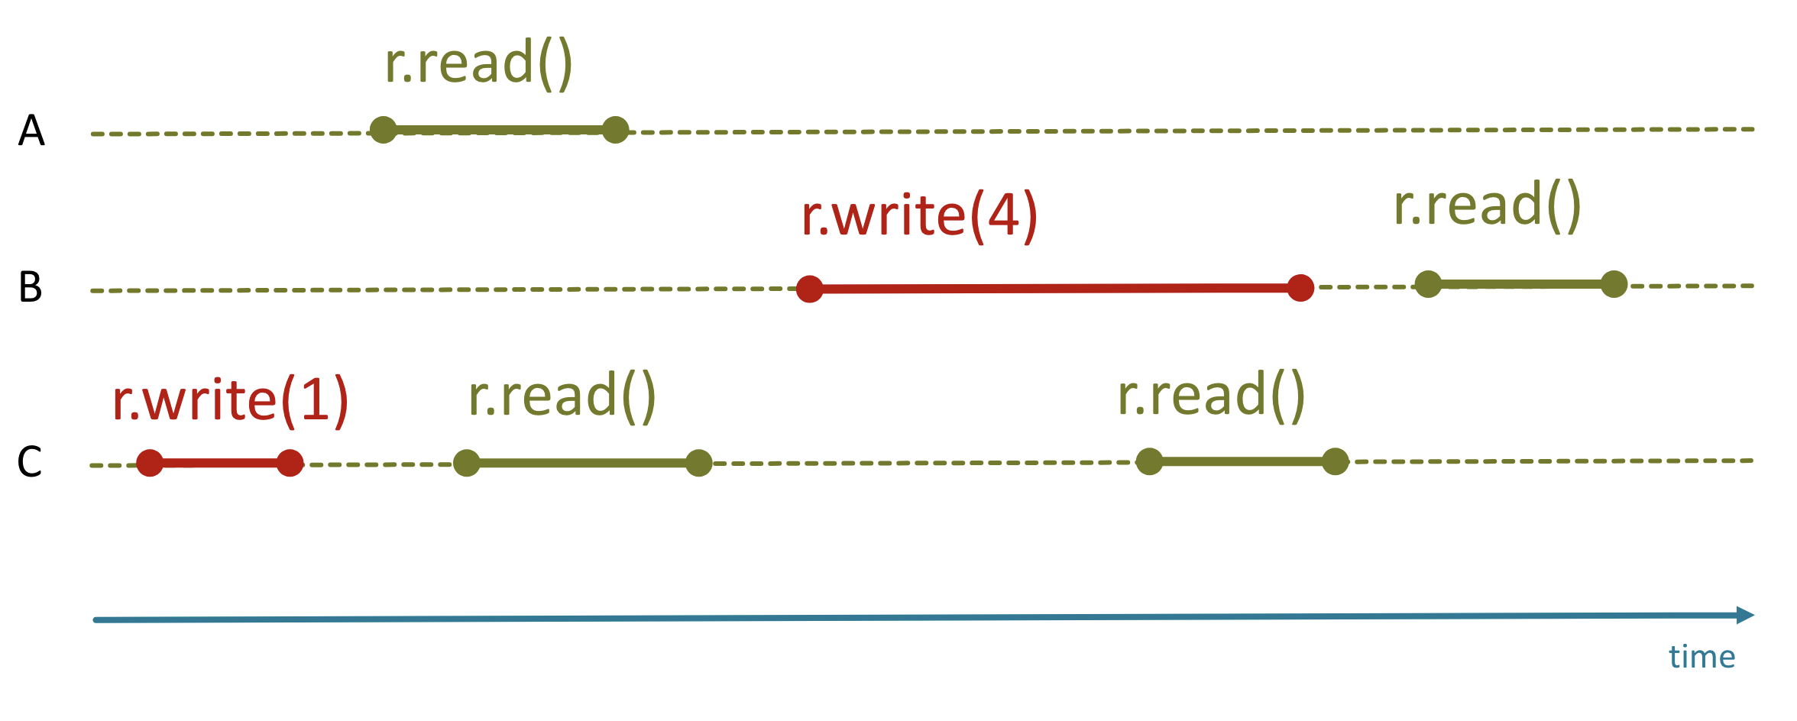
Atomic Registers

Slide 43
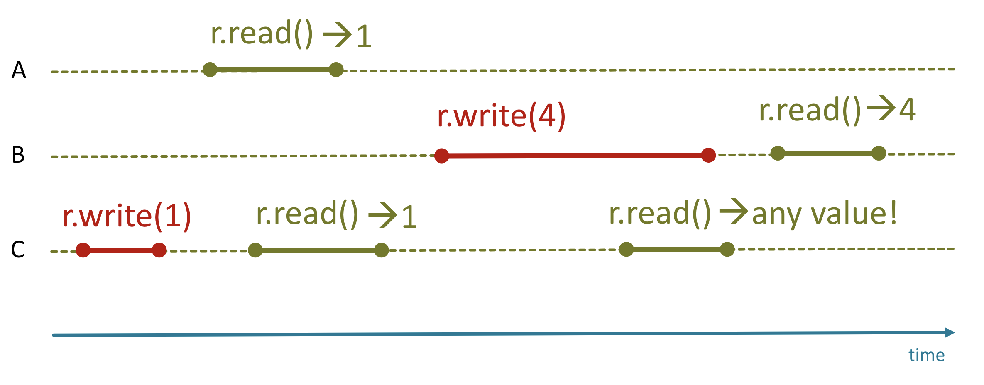
Atomic Registers

Slide 44
Atomic Operation
An atomic action is one that effectively happens at once i.e. this action cannot stop in the middle nor be interleaved
It either happens completely, or it doesn’t happen at all.
No side effects of an atomic action are visible until the action is complete
This essentially means that other Threads think that the change happened in an instant

Slide 45
Atomic Registers and Operations
An operation such as x++ (with x being an atomic register) is NOT atomic!
  Three steps: v = read(x), increment v, write(x, v)
Problem with atomic registers:
  We need O(n) space (registers) to synchronize n threads if we only have [atomic] read/write operations
  Fix: support more than read/write in an atomic operation

Slide 46
Hardware support for atomic operations
Different atomic operations have been proposed, unclear which is best
  Test-And-Set (TAS)
  Compare-And-Swap (CAS)
  Load Linked / Store Conditional
http://docs.oracle.com/javase/tutorial/essential/concurrency/atomic.html

Slide 47
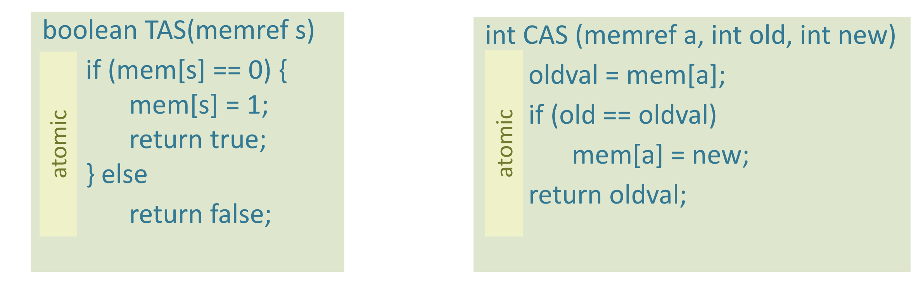
Hardware Semantics
We must have an expected current value (i.e. 5)
Then we tell the hardware: If the current value of that memoryref is 5, I want you to update it to X (i.e. 7). (Hardware does that atomically)
Hardware responds with either true/false (or oldval in case of CAS)
Notes:
O(1) space :)

Slide 48
Java atomic operations
boolean set();
boolean get();
boolean compareAndSet(boolean expect, boolean update);
boolean getAndSet(boolean newValue);
compareAndSet() - returns true if successful
getAndSet() - always return previous value

Slide 49
Now we know how getAndIncrement is implemented!

Slide 50
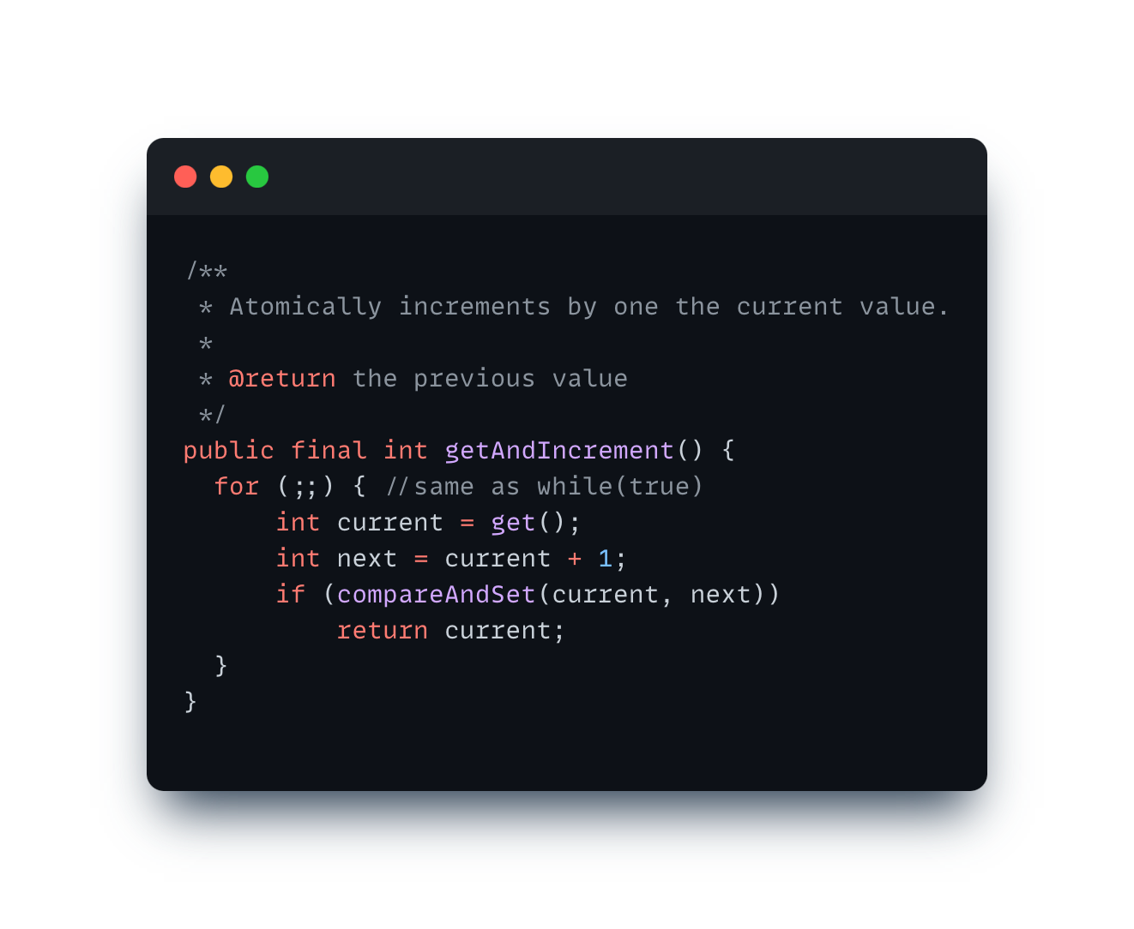
Now we know how getAndIncrement is implemented!
Source: https://github.com/openjdk-mirror/jdk7u-jdk/blob/master/src/share/classes/java/util/concurrent/atomic/AtomicInteger.java

Slide 51
Lets build a spinlock using RMW operations

Slide 52
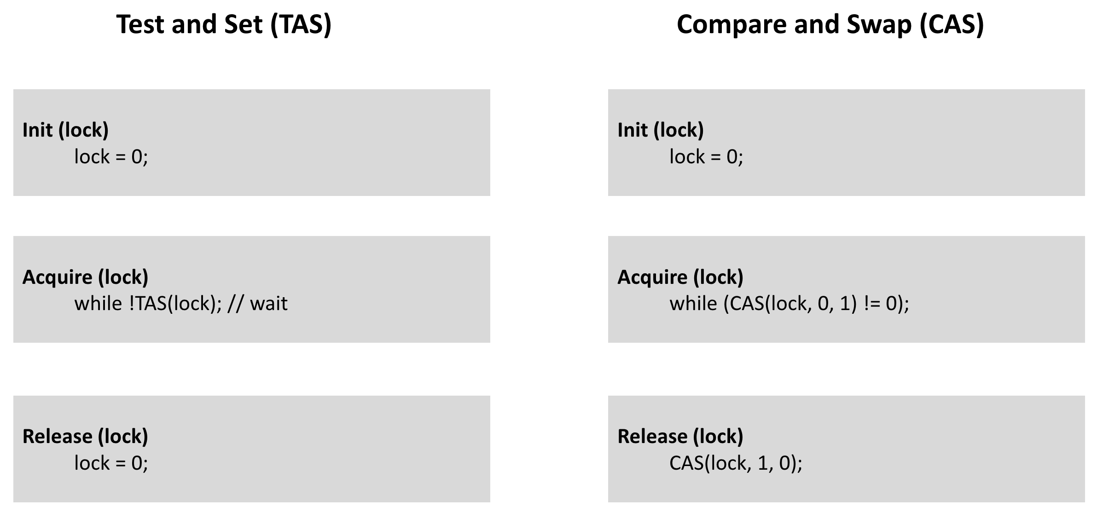
Lets build a spinlock using RMW operations

Slide 53
Lets build a spinlock using RMW operations

Slide 54
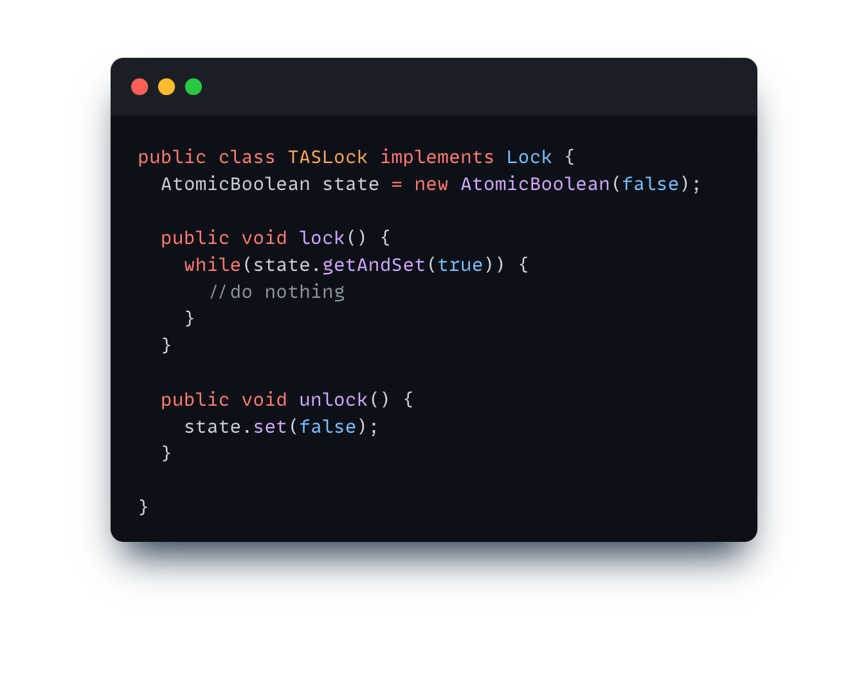
In Java…

Slide 55
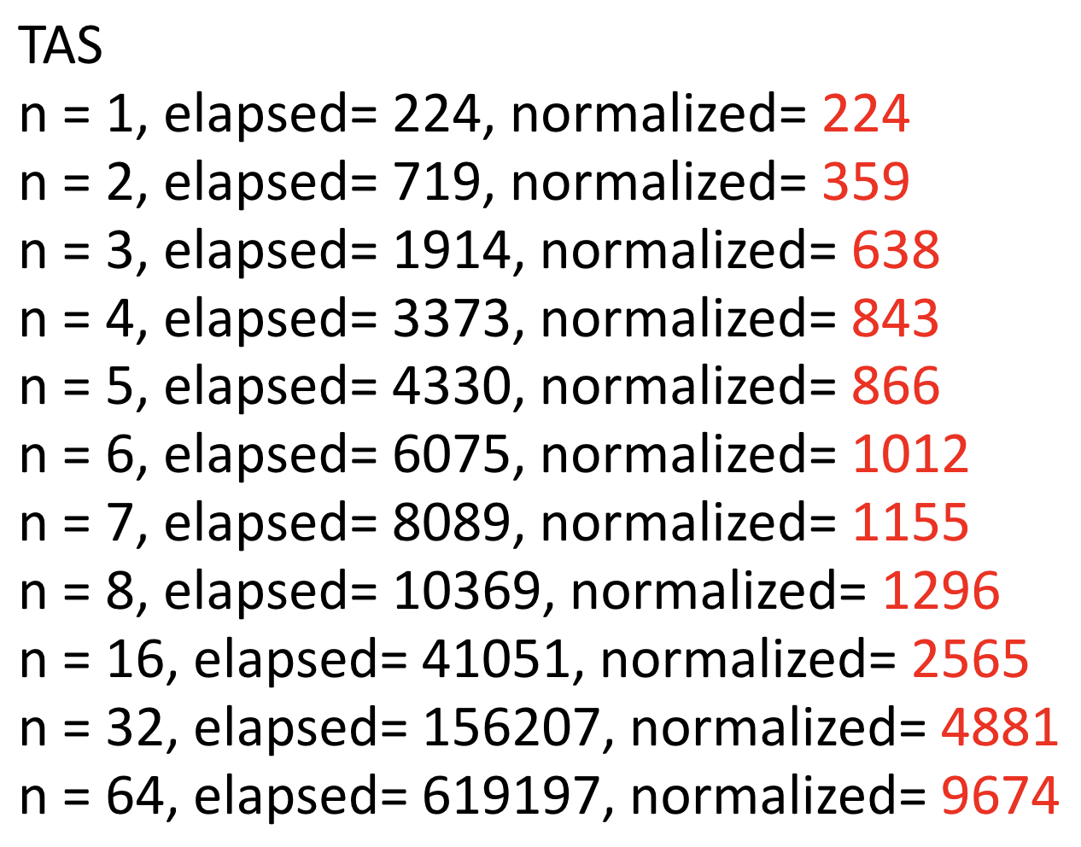
TAS Spinlock scales horribly, why?

Slide 56
Cache Coherency Protocol ☹
We have a sequential bottleneck!
Each call to getAndSet() invalidates cached copies! => Threads need to access memory via Bus => Bus Contention!
“[...] the getAndSet() call forces other processors to discard their own cached copies of the lock, so every spinning thread encounters a cache miss almost every time, and must use the bus to fetch the new, but unchanged value.” - The Art of Multiprocessor Programming

Slide 57
Lets visualize this
Main Memory / Shared Memory
lock = 1
BUS
Processor 1
Processor 2
Processor 3
Cache
Cache
Cache

Slide 58
Lets visualize this
Main Memory / Shared Memory
lock = 1
lock = 1
BUS
lock.getAndSet(1)
Processor 1
Processor 2
Processor 3
Cache
Cache
Cache

Slide 59
Lets visualize this
Main Memory / Shared Memory
lock = 1
lock = 1
BUS
lock.getAndSet(1)
Processor 1
Processor 2
Processor 3
Cache
Cache
Cache
lock = 1

Slide 60
Lets visualize this
Main Memory / Shared Memory
lock = 1
BUS
Processor 1
Processor 2
Processor 3
Cache
Cache
Cache
lock = 1

Slide 61
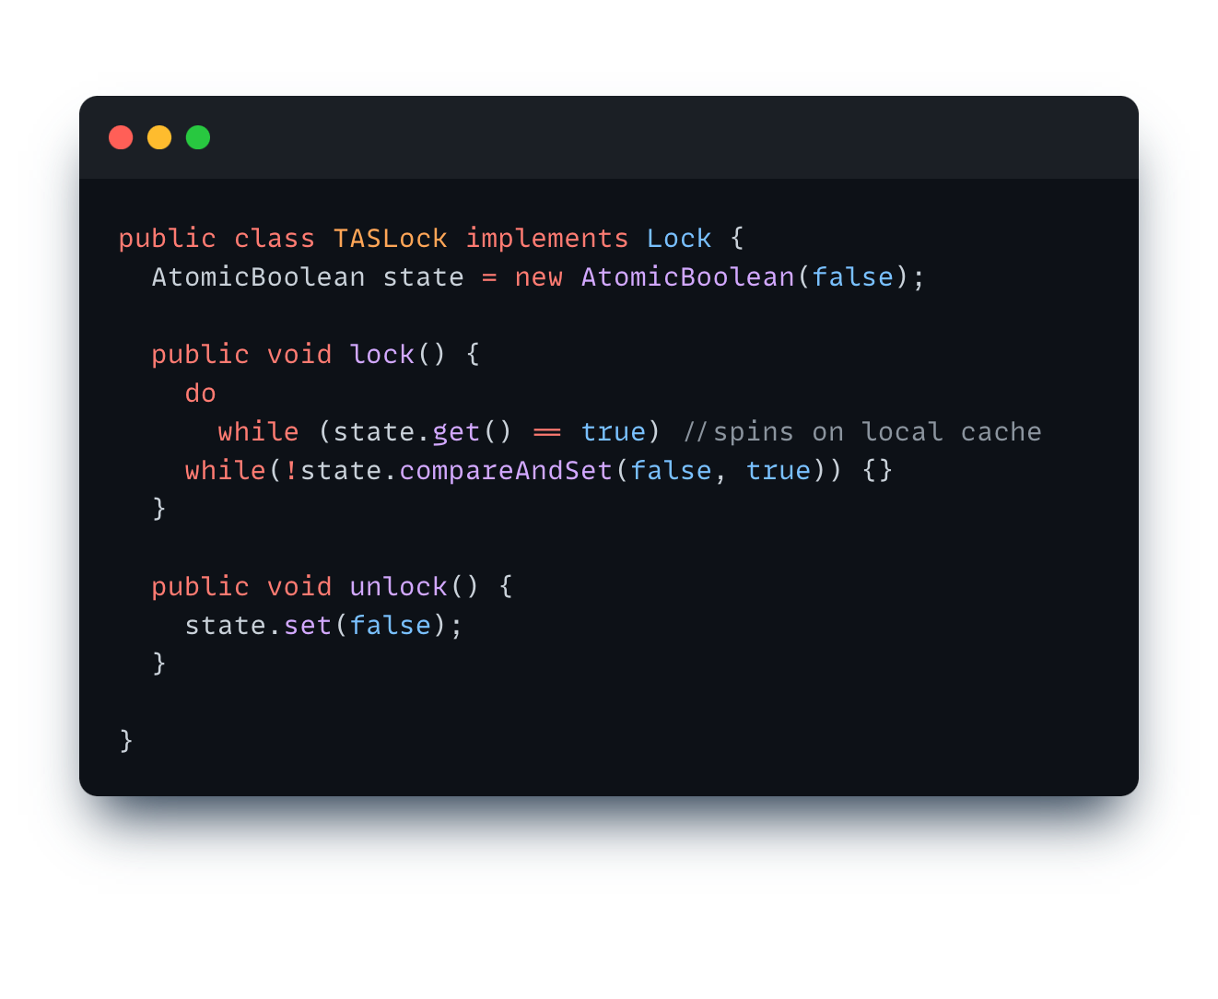
Lets try spinning on local cache

Slide 62
Lets visualize this
Main Memory / Shared Memory
lock = 1
BUS
Processor 1
Processor 2
Processor 3
Cache
Cache
Cache

Slide 63
Lets visualize this
Main Memory / Shared Memory
lock = 1
lock = 1
BUS
lock.get()
Processor 1
Processor 2
Processor 3
Cache
Cache
Cache

Slide 64
Lets visualize this
Main Memory / Shared Memory
lock = 1
lock = 1
BUS
lock.get()
Processor 1
Processor 2
Processor 3
Cache
Cache
Cache
lock = 1

Slide 65
Lets visualize this
Main Memory / Shared Memory
lock = 1
BUS
Processor 1
Processor 2
Processor 3
Cache
Cache
Cache
lock = 1
lock = 1

Slide 66
Lets visualize this
Main Memory / Shared Memory
lock = 1
BUS
lock.get()
Processor 1
Processor 2
Processor 3
Cache
Cache
Cache
lock = 1
lock = 1

Slide 67
Lets visualize this
Main Memory / Shared Memory
lock = 0
BUS
lock.set(0)
Processor 1
Processor 2
Processor 3
Cache
Cache
Cache
lock = 1
lock = 0
lock = 1

Slide 68
Now the whole problem repeats
Main Memory / Shared Memory
lock = 0
BUS
Processor 1
Processor 2
Processor 3
Cache
Cache
Cache
lock = 0
Notes:
Now all processors will “storm” the bus again => Contention

Slide 69
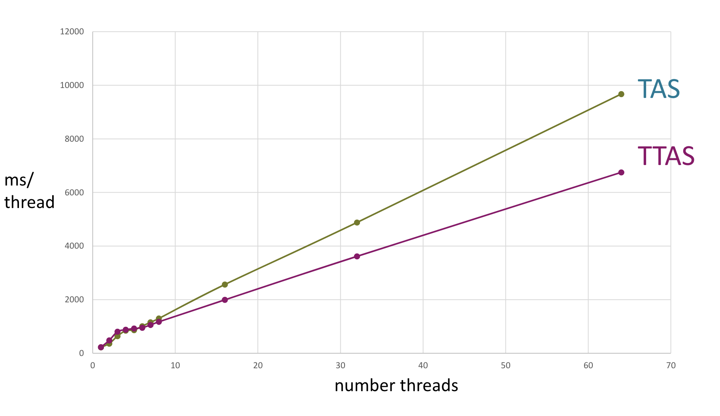
It only helped a little bit

Slide 70
What we learned
(too) many threads fight for access to the same resource
slows down progress globally and locally
CAS/TAS: Processor assumes we modify the value even if we fail!
Solution? Exponential Backoff
Idea: Each time TAS fails, wait longer until you re-try
  Backoff must be random!

Slide 71
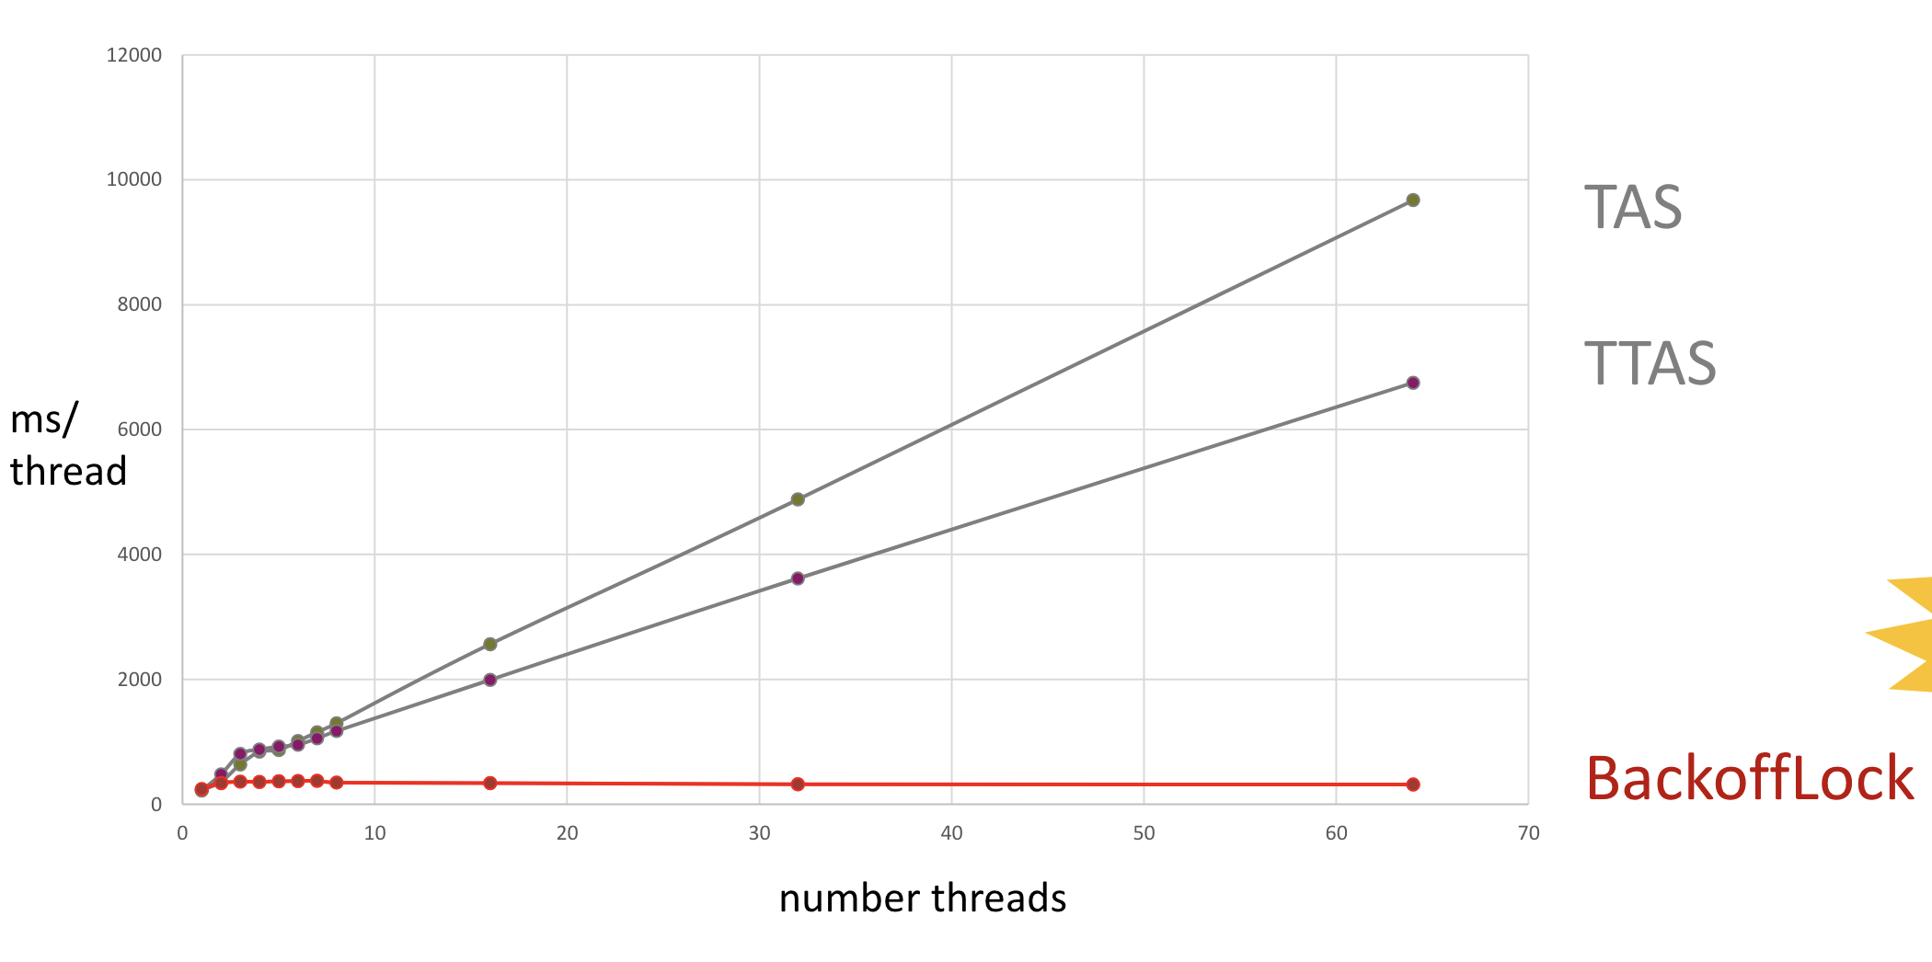
Nice!

Slide 72
Semaphores
and Barriers

Slide 73
Semaphores
Locks provide means to enforce atomicity via mutual exclusion
They lack the means for threads to communicate about changes
We need something stronger to coordinate threads (e.g. to implement rendezvous)

Slide 74
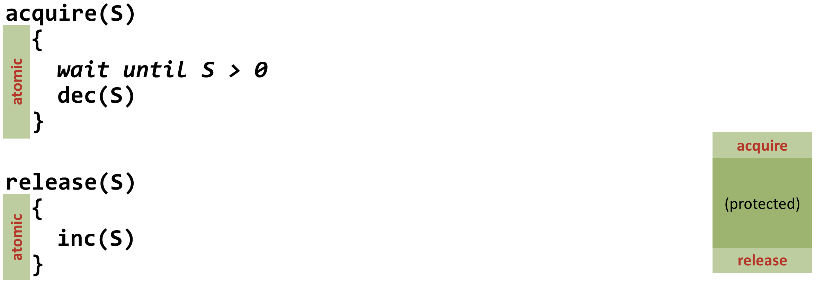
Semaphores
S = new Semaphore(n) - create a new semaphore with n permits

Slide 75
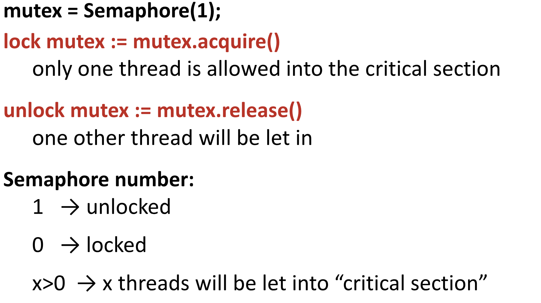
Building a lock with Semaphores

Slide 76
Semaphores aren’t Locks!
We can build Locks with Semaphores
Some key differences:
  More than one Thread can be in critical section!
  How many depends on the number of permits
  Threads can release() a Semaphore without accquiring before!
  The is no notion of “holding” a Semaphore as we have with ”holding” Locks

Slide 77
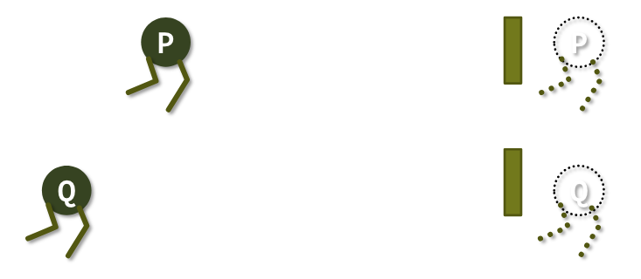
Rendezvous with Semaphores
Two processes P and Q execute code
Rendezvouz: locations in code, where P and Q wait for the other to arrive. Synchronize P and Q.

Slide 78
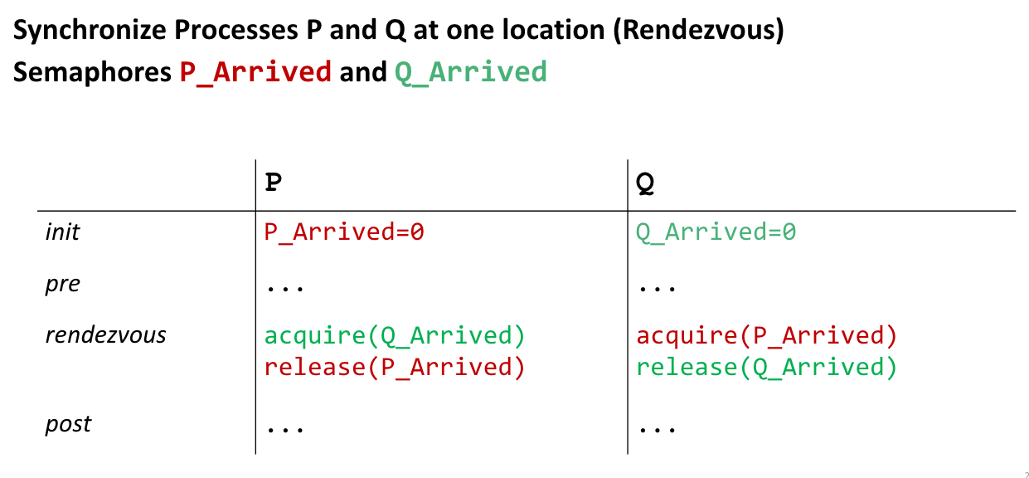
First attempt, whats wrong?

Slide 79
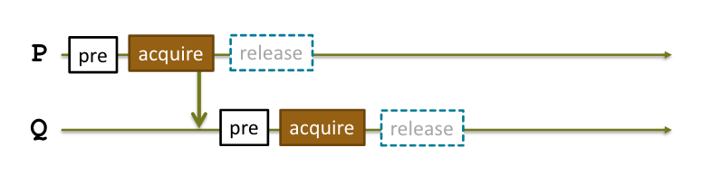
Deadlock :(
We are never able to release! Both P and Q wait endlessly for each other ☹

Slide 80
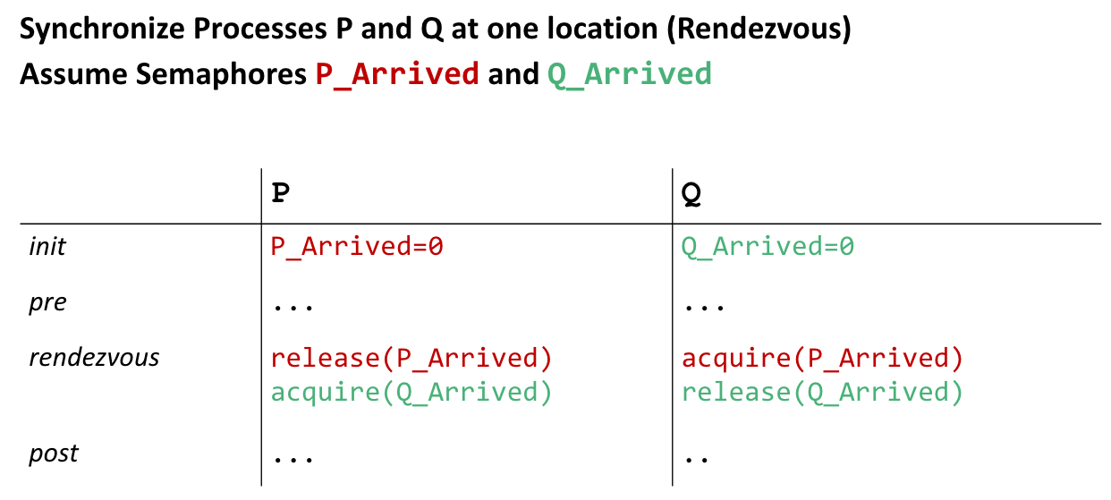
Attempt two, better?

Slide 81
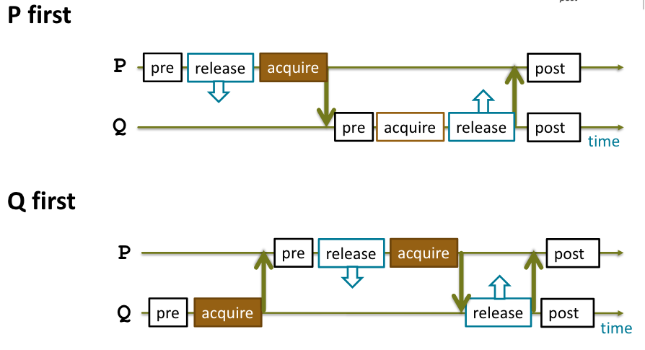
Yes, that works!

Slide 82
Yes, that works!
Many context switches

Slide 83
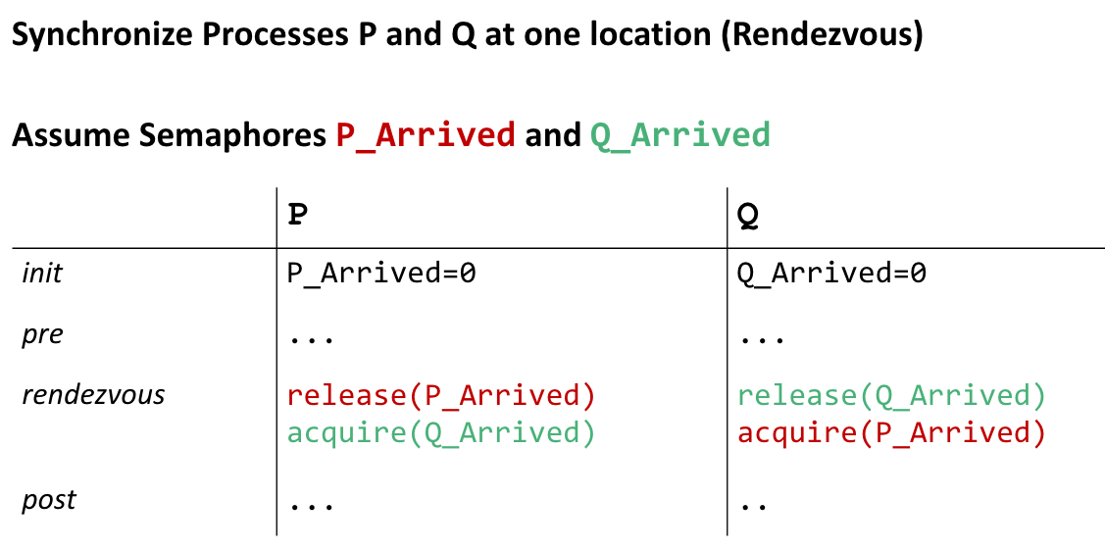
Lets do better!

Slide 84
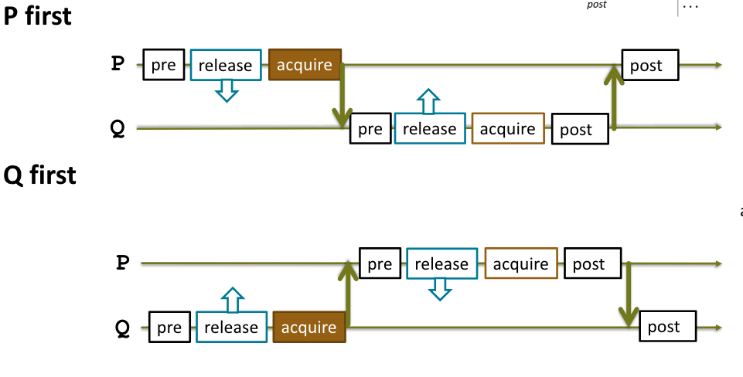
Order does no longer matter

Slide 85
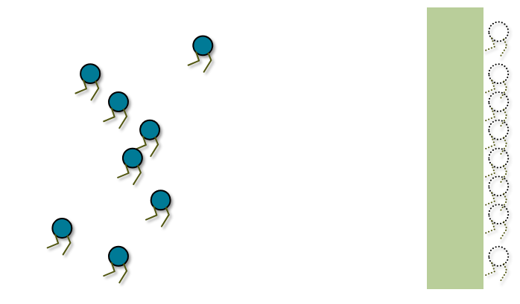
How about more than two threads? Barriers!

Slide 86
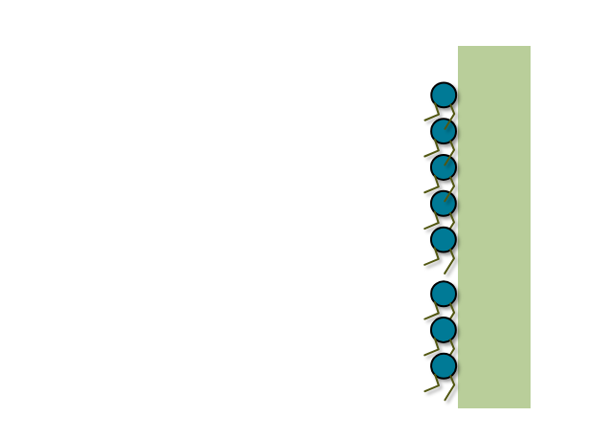
How about more than two threads? Barriers!

Slide 87
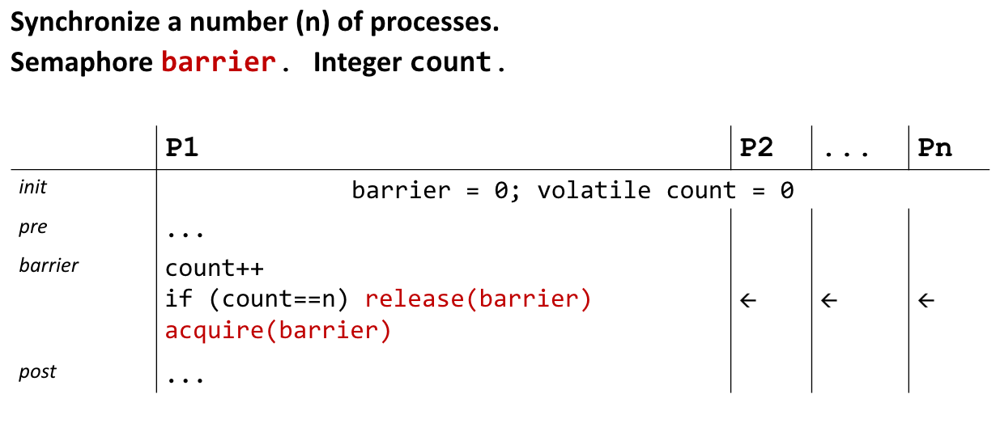
First attempt

Slide 88
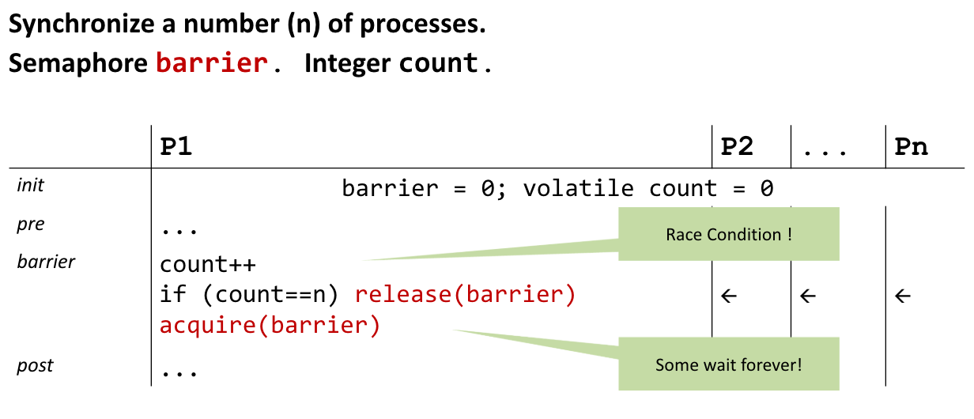
Wrong

Slide 89
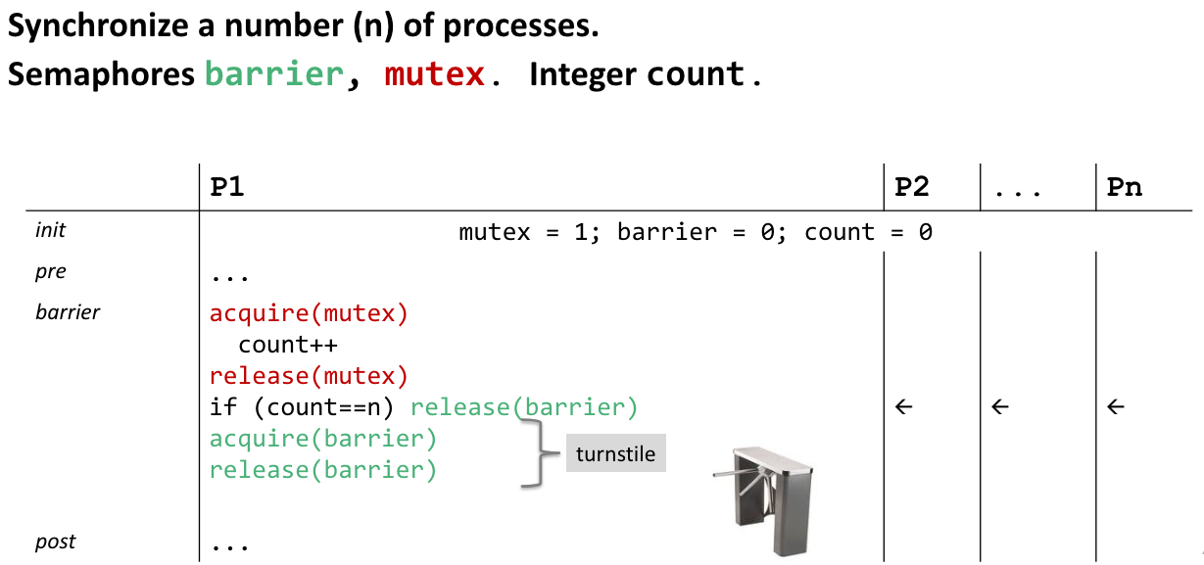
How about this?
Notes:
Works, but not resuable

Slide 90
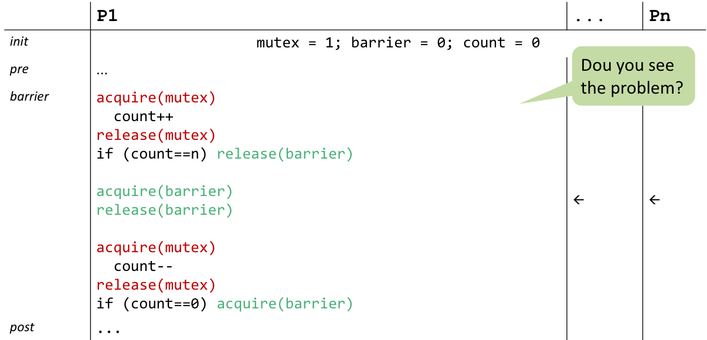
Reusable Barrier

Slide 91
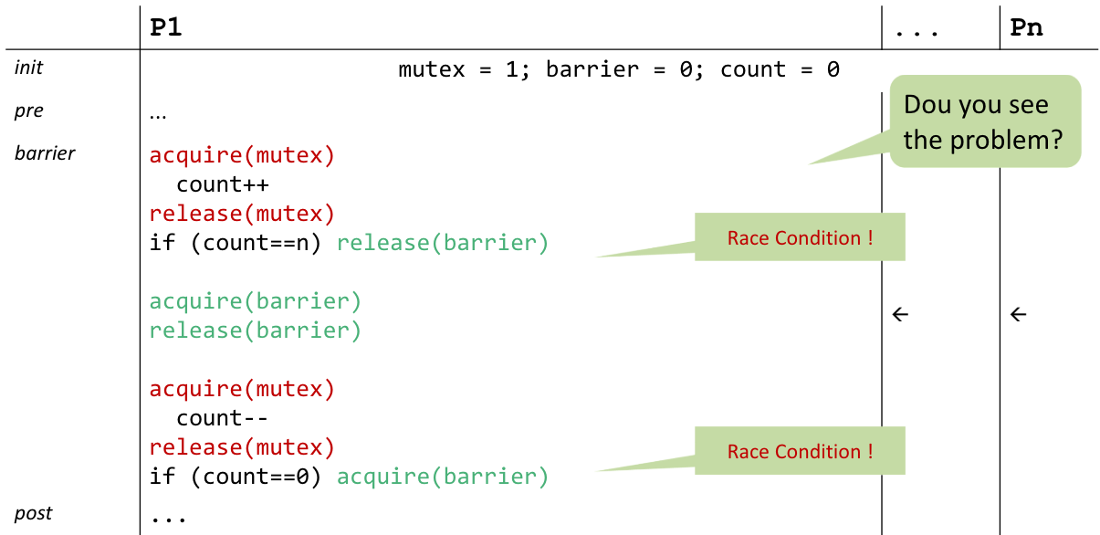
Reusable Barrier

Slide 92
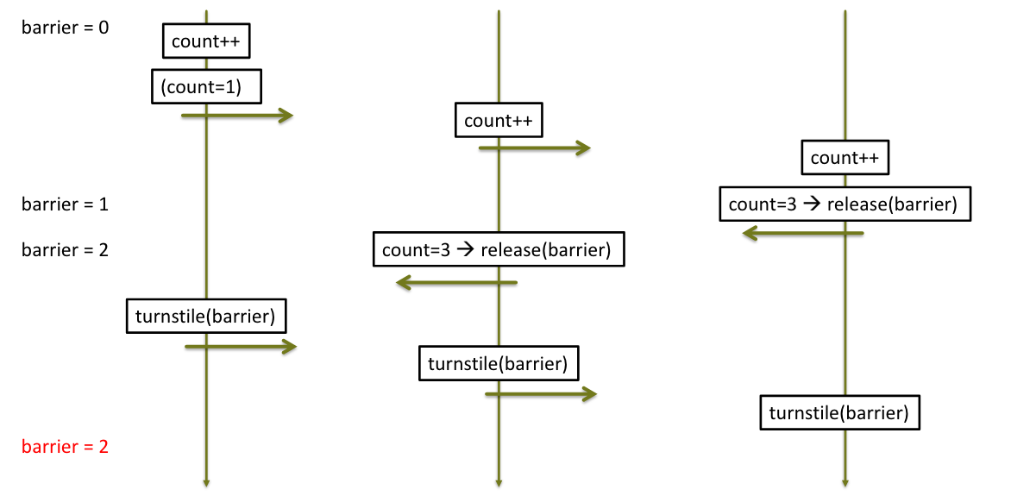
Scheduling Scenario

Slide 93
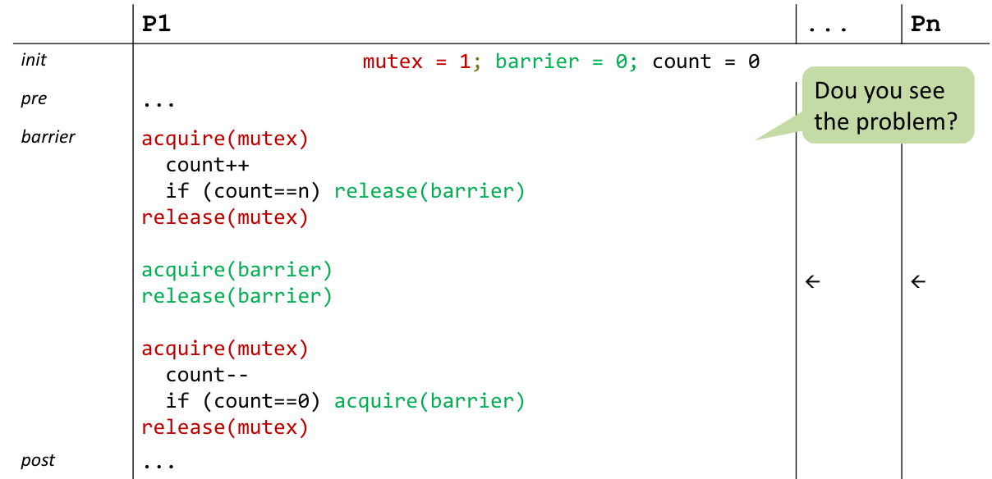
Reusable Barrier 2nd try

Slide 94
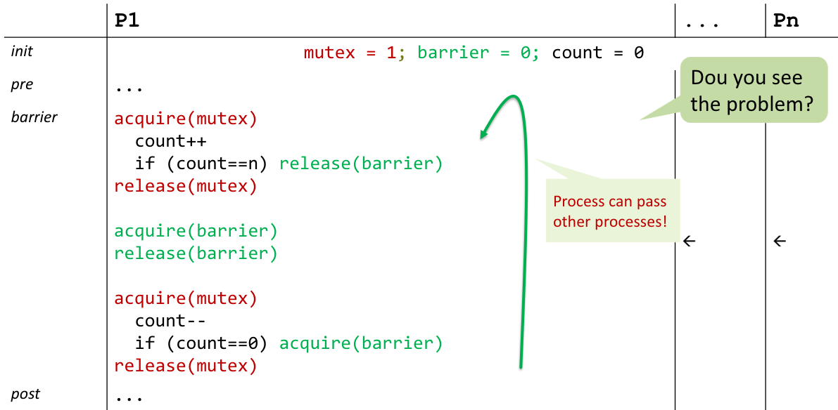
Doesn’t quite work yet

Slide 95
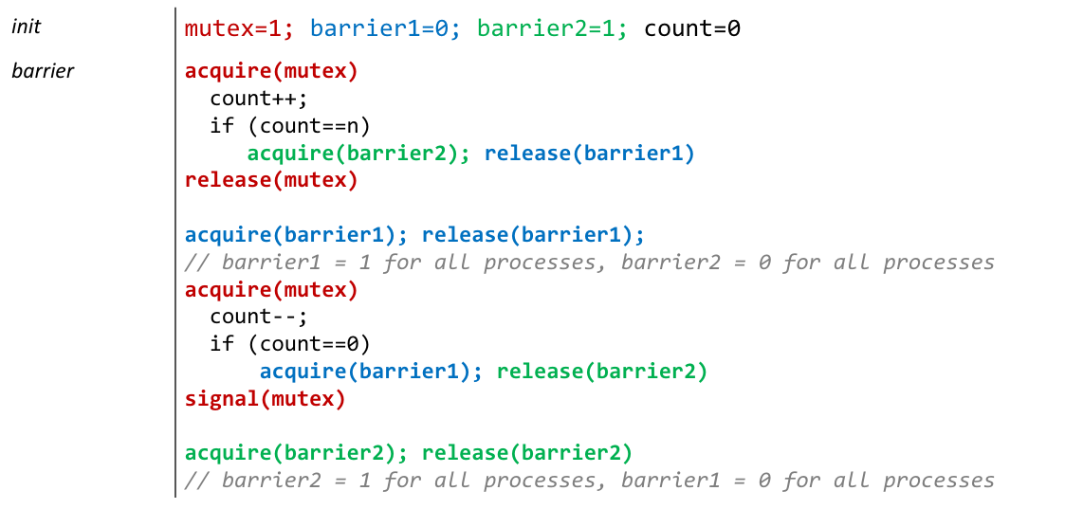
Solution: Two-Phase Barrier

